Slide 1
Repetition Statements
While, do-while and for loop

Slide 2
Repetition Statements
Repetition statements allow us to execute a statement multiple times
Often they are referred to as loops
Like conditional statements, they are controlled by boolean expressions
Java has three kinds of repetition statements:
the while loop
the do loop
the for loop

Slide 3
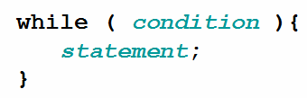
While statement
The while statement continually executes a block of statements while a particular condition is true. Its syntax can be expressed as:
The while statement evaluates expression, which must return a boolean value.
If the expression evaluates to true, the while statement executes the statement(s) in the while block.
The while statement continues testing the expression and executing its block until the expression evaluates to false

Slide 4
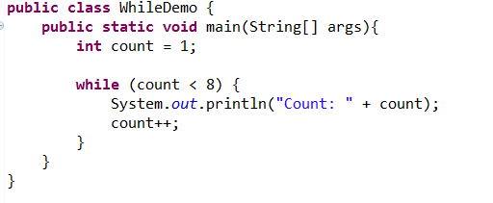
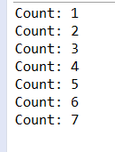
While statement example
Using the while statement to print the values from 1 through 7.
Note boolean test
Note count change to enable an end state to be reached

Slide 5
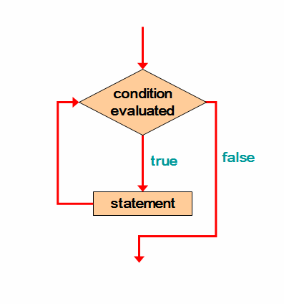
Logic of a while loop
For zero or more iterations, the condition evaluated will be true
A variable (sentinel value) that forms part of the condition is manipulated until the condition evaluates to false
A sentinel value is a special input value that represents the end of input

Slide 6

While loop – Points of note
If the condition of a while loop is false initially, the statement is never executed
Therefore, the body of a loop will execute zero or more times
You can do an infinite loop by doing the following:

Slide 7
Avoid infinite loops
The body of a while loop eventually must make the condition false
If not, it is called an infinite loop, which will execute until the user interrupts the program
This is a common logical (semantic) error
You should always double check the logic of a program to ensure that your loops will terminate normally

Slide 8
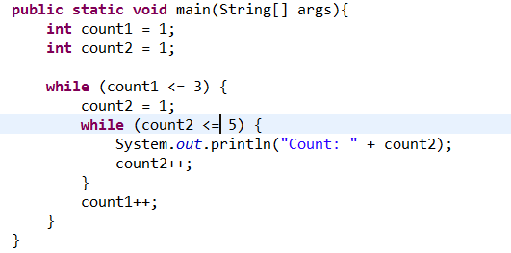
Nested Loops
Similar to nested if statements, loops can be nested as well
For each iteration of the outer loop, the inner loop iterates completely
How many times will this code execute?

Slide 9
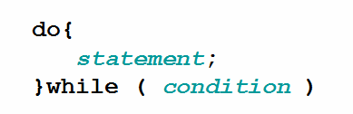
Do while statement
The difference between do-while and while is that do-while evaluates its expression at the bottom of the loop instead of the top.
The statement is executed once initially, and then the condition is evaluated
The statement is executed repeatedly until the condition becomes false

Slide 10
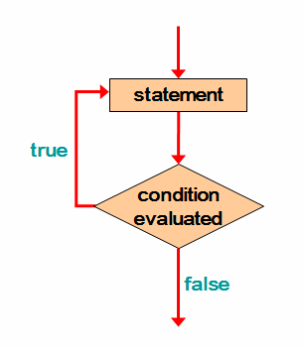
Do-while loop logic
Statement is always executed at least once
Condition is then evaluated just like a while loop
Sentinel value still exists here

Slide 11
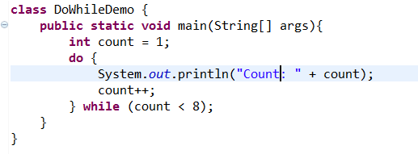
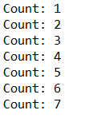
Do-while example
Note the use of count variable as the sentinel value

Slide 12
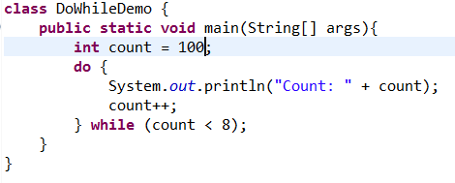

Do-while example – demoing single execution
Note single execution even though boolean statement never evaluates to true

Slide 13
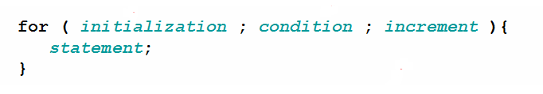
For statement
The for statement provides a compact way to iterate over a range of values. Programmers often refer to it as the "for loop" because of the way in which it repeatedly loops until a particular condition is satisfied.
The general form of the for statement can be expressed as follows:

Slide 14
For statement
The initialization expression initializes the loop; it's executed once, as the loop begins.
When the termination expression evaluates to false, the loop terminates.
The increment expression is invoked after each iteration through the loop; it is perfectly acceptable for this expression to increment or decrement a value.

Slide 15
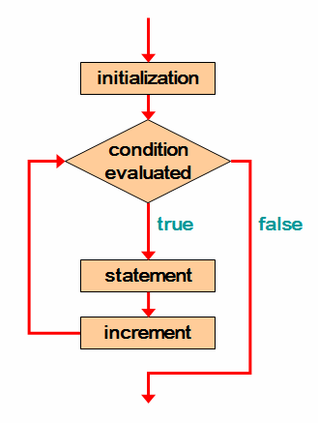
Logic of a for loop
Initialisation statement set at the start
e.g. int i = 1;
Condition is tested repeatedly until it evaluates to false
e.g. i<10;
Statement can be one or many lines of code that get executed if condition is true
Increment is executed at the end of each loop iteration
e.g. i++

Slide 16
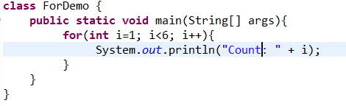
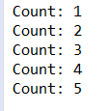
For loop example

Slide 17
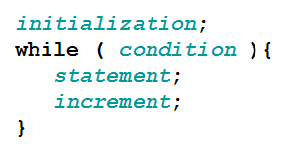
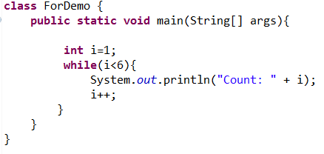
For loop can be built using while loop

Slide 18
For loop points of note
The initialization section can be used to declare a variable
Like a while loop, the condition of a for loop is tested prior to executing the loop body
Therefore, the body of a for loop will execute zero or more times
Increments\Decrements can be any calculation
e.g. i+=5, i-=100, i*=10

Slide 19
For statement expressions optional
Each expression in the header of a for loop is optional
If the initialization is left out, no initialization is performed
If the condition is left out, it is always considered to be true, and therefore creates an infinite loop
If the increment is left out, no increment operation is performed

Slide 20
For loop or while loop – which do you use?
A for loop is well suited for executing statements a specific number of times that can be calculated or determined in advance
A while loop is useful where you want iterate based on a test for an unspecified number of times

