Slide 1
IP - The Internet Protocol
Relates to Lab 2.
A module on the Internet Protocol.

Slide 2
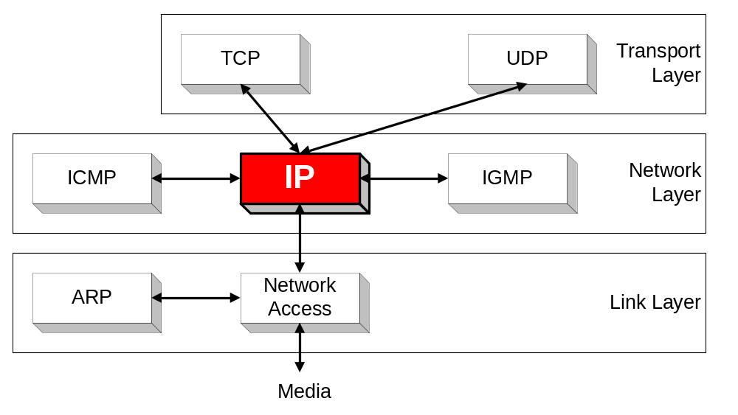
Orientation
IP (Internet Protocol) is a Network Layer Protocol.
IP’s current version is Version 4 (IPv4). It is specified in RFC 891.

Slide 3
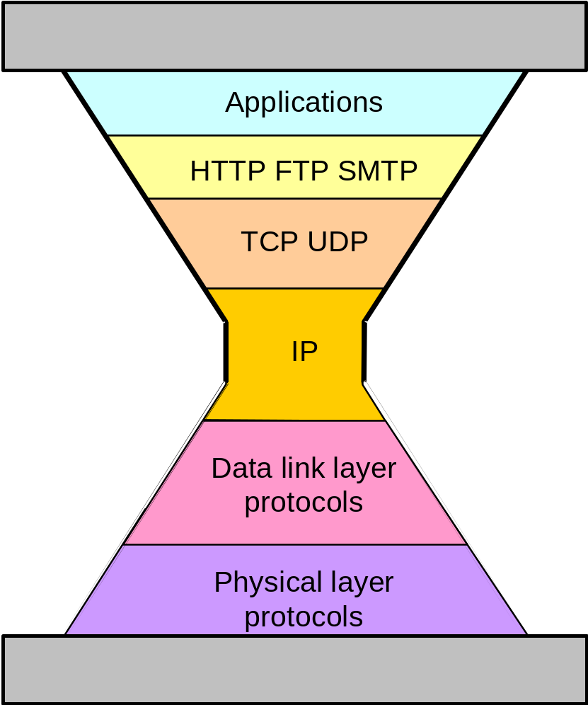
IP: The waist of the hourglass
IP is the waist of the hourglass of the Internet protocol architecture
Multiple higher-layer protocols
Multiple lower-layer protocols
Only one protocol at the network layer.

Slide 4
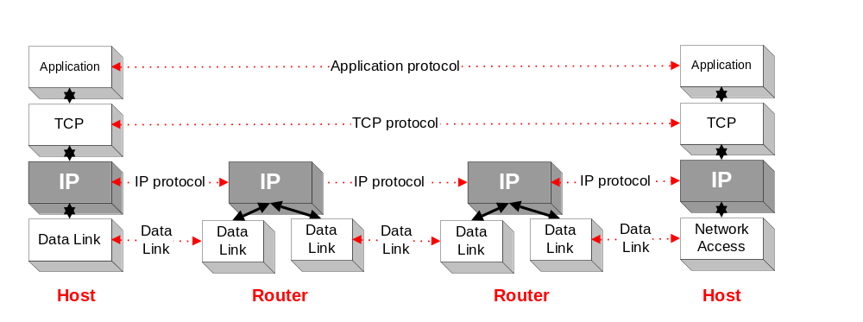
Application protocol
IP is the highest layer protocol which is implemented at both routers and hosts

Slide 5
IP Service
Delivery service of IP is minimal
IP provide provides an unreliable connectionless best effort service (also called: “datagram service”).
  Unreliable: IP does not make an attempt to recover lost packets
  Connectionless: Each packet (“datagram”) is handled independently. IP is not aware that packets between hosts may be sent in a logical sequence
  Best effort: IP does not make guarantees on the service (no throughput guarantee, no delay guarantee,…)
Consequences:
Higher layer protocols have to deal with losses or with duplicate packets
Packets may be delivered out-of-sequence

Slide 6
IP Service
IP supports the following services:
    one-to-one (unicast)
    one-to-all (broadcast)
    one-to-several (multicast)
IP multicast also supports a many-to-many service.
IP multicast requires support of other protocols (IGMP, multicast routing)
unicast
broadcast
multicast

Slide 7
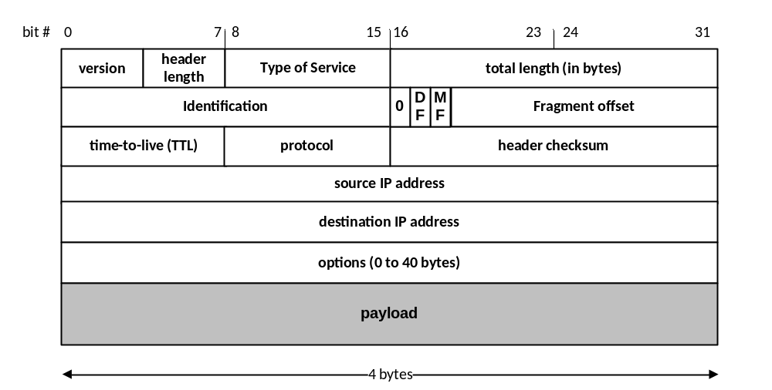
IP Datagram Format

Slide 8
Fields of the IP Header
Version (4 bits): current version is 4, next version will be 6.
Header length (4 bits): length of IP header, in multiples of 4 bytes
Type of Service field (1 byte)
  The first three bits of this field are known as precedence bits and are ignored as of today. The next 4 bits represent type of service and the last bit is left unused. The 4 bits that represent TOS are : minimize delay, maximize throughput, maximize reliability and minimize monetary cost.

Slide 9
Fields of the IP Header
Identification (16 bits): Unique identification of a datagram from a host. Incremented whenever a datagram is transmitted
Flags (3 bits):
  First bit always set to 0
  DF bit (Do not fragment)
  MF bit (More fragments)
  Will be explained later→ Fragmentation

Slide 10
Fields of the IP Header
Time To Live (TTL) (1 byte):
  Specifies longest paths before datagram is dropped
  Role of TTL field: Ensure that packet is eventually dropped when a routing loop occurs
  Used as follows:
  Sender sets the value (e.g., 64)
  Each router decrements the value by 1
  When the value reaches 0, the datagram is dropped

Slide 11
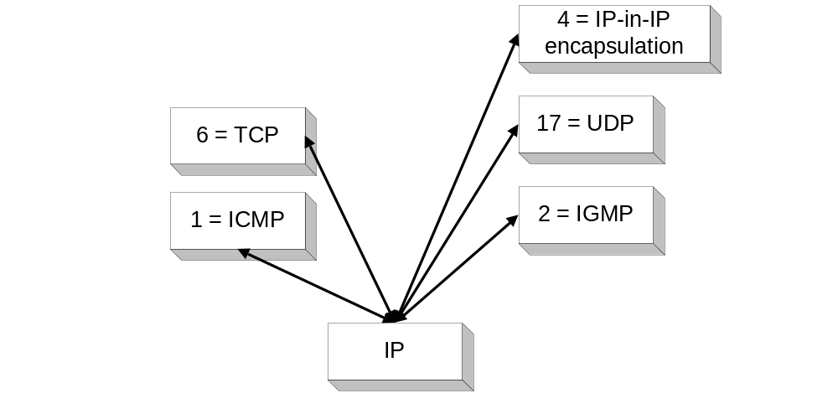
Fields of the IP Header
Protocol (1 byte):
    Specifies the higher-layer protocol.
    Used for demultiplexing to higher layers.
Header checksum (2 bytes): A simple 16-bit long checksum which is computed for the header of the datagram.

Slide 12
Fields of the IP Header
Options:
    Security restrictions
    Record Route: each router that processes the packet adds its IP address to the header.
    Timestamp: each router that processes the packet adds its IP address and time to the header.
    (loose) Source Routing: specifies a list of routers that must be traversed.
    (strict) Source Routing: specifies a list of the only routers that can be traversed.
Padding: Padding bytes are added to ensure that header ends on a 4-byte boundary

