Slide 1
TCP/UDP

Slide 2
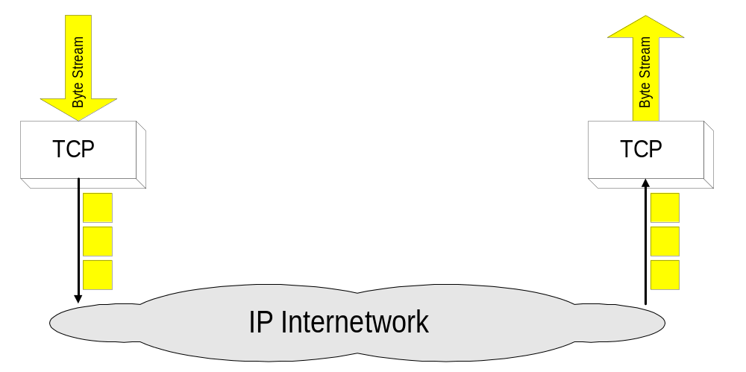
Overview
TCP = Transmission Control Protocol
Connection-oriented protocol
Provides a reliable unicast end-to-end byte stream over an unreliable internetwork.

Slide 3
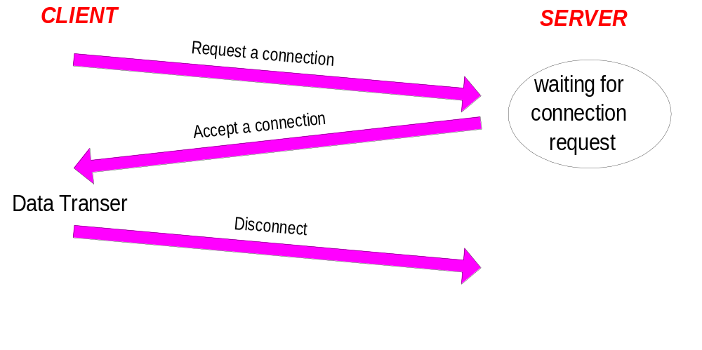
Connection-Oriented
Before any data transfer, TCP establishes a connection:
    One TCP entity is waiting for a connection (“server”)
    The other TCP entity (“client”) contacts the server
The actual procedure for setting up connections is more complex.
Each connection is
full duplex

Slide 4
Reliable
Byte stream is broken up into chunks which are called seg-ments
  Receiver sends acknowledgements (ACKs) for segments
  TCP maintains a timer. If an ACK is not received in time, the segment is retransmitted
Detecting errors:
  TCP has checksums for header and data. Segments with invalid checksums are discarded
  Each byte that is transmitted has a sequence number

Slide 5
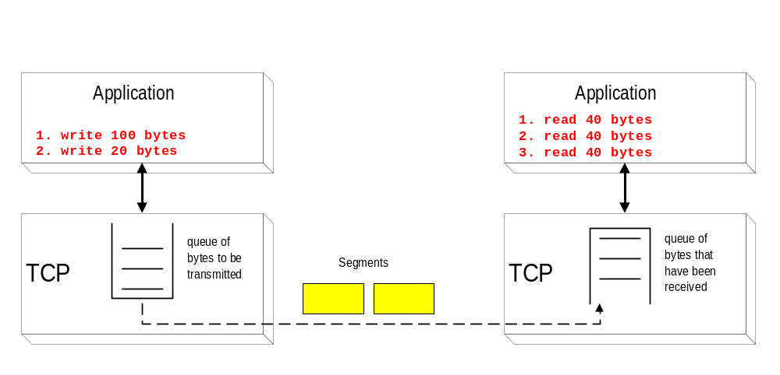
Byte Stream Service
To the lower layers, TCP handles data in blocks, the segments.
To the higher layers TCP handles data as a sequence of bytes and does not identify boundaries between bytes
So: Higher layers do not know about the beginning and end of segments !

Slide 6
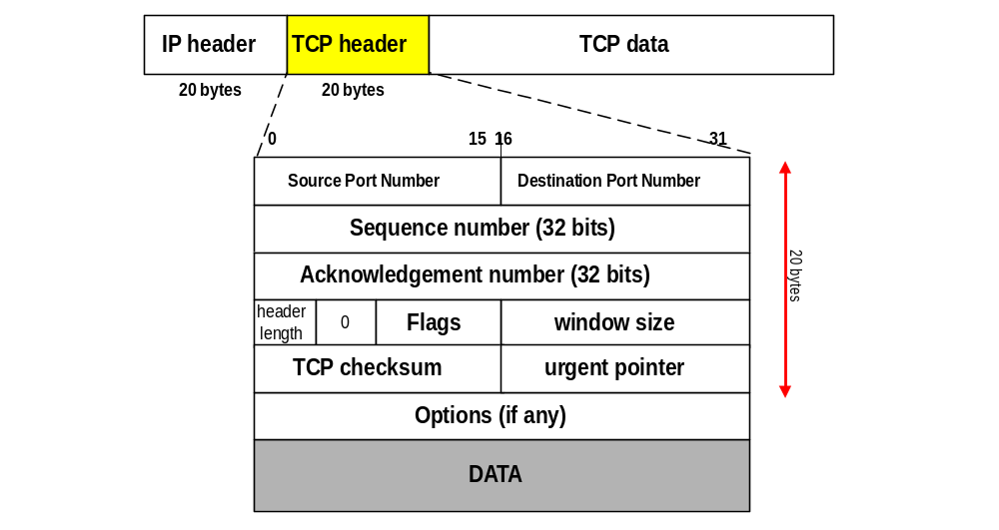
TCP Format
TCP segments have a 20 byte header with >= 0 bytes of data.

Slide 7
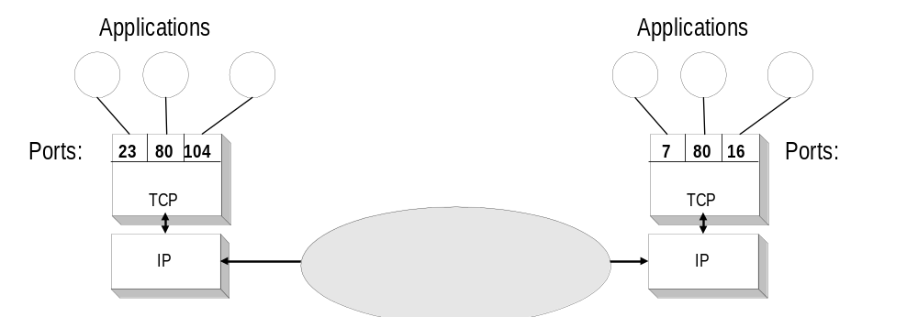
TCP header fields
Port Number:
    A port number identifies the endpoint of a connection.
    A pair <IP address, port number> identifies one endpoint of a connection.
    Two pairs <client IP address, server port number> and <server IP address, server port number> identify a TCP connection.

Slide 8
TCP header fields
Sequence Number (SeqNo):
  Sequence number is 32 bits long.
  So the range of SeqNo is
      0 <= SeqNo <= 2³² -1 ≈ 4.3 Gbyte
  Each sequence number identifies a byte in the byte stream
  Initial Sequence Number (ISN) of a connection is set during connection establishment

Slide 9
TCP header fields
Acknowledgement Number (AckNo):
  Acknowledgements are piggybacked, I.e
    a segment from A -> B can contain an acknowledgement for a data sent in the B -> A direction
  A hosts uses the AckNo field to send acknowledgements. (If a host sends an AckNo in a segment it sets the “ACK flag”)
  The AckNo contains the next SeqNo that a hosts wants to receive
  Example: The acknowledgement for a segment with sequence numbers 0-1500 is AckNo=1501

Slide 10
TCP header fields
Acknowledge Number (cont’d)
  TCP uses the sliding window flow protocol (see CS 457) to regulate the flow of traffic from sender to receiver
  TCP uses the following variation of sliding window:
      no NACKs (Negative ACKnowledgement)
      only cumulative ACKs
Example:
  Assume: Sender sends two segments with “1..1500” and “1501..3000”, but receiver only gets the second segment.
  In this case, the receiver cannot acknowledge the second packet. It can only send AckNo=1

Slide 11
TCP header fields
Header Length ( 4bits):
  Length of header in 32-bit words
  Note that TCP header has variable length (with minimum 20 bytes)

Slide 12
TCP header fields
Flag bits:
  URG: Urgent pointer is valid
      If the bit is set, the following bytes contain an urgent message in the range:
        SeqNo <= urgent message <= SeqNo+urgent pointer
  ACK: Acknowledgement Number is valid
  PSH: PUSH Flag
      Notification from sender to the receiver that the receiver should pass all data that it has to the application.
      Normally set by sender when the sender’s buffer is empty

Slide 13
TCP header fields
Flag bits:
  RST: Reset the connection
      The flag causes the receiver to reset the connection
      Receiver of a RST terminates the connection and indicates higher layer application about the reset
  SYN: Synchronize sequence numbers
      Sent in the first packet when initiating a connection
  FIN: Sender is finished with sending
      Used for closing a connection
      Both sides of a connection must send a FIN

Slide 14
TCP header fields
Window Size:
  Each side of the connection advertises the window size
  Window size is the maximum number of bytes that a receiver can accept.
  Maximum window size is 2¹⁶-1= 65535 bytes
TCP Checksum:
  TCP checksum covers over both TCP header and TCP data (also covers some parts of the IP header)
Urgent Pointer:
  Only valid if URG flag is set

Slide 15
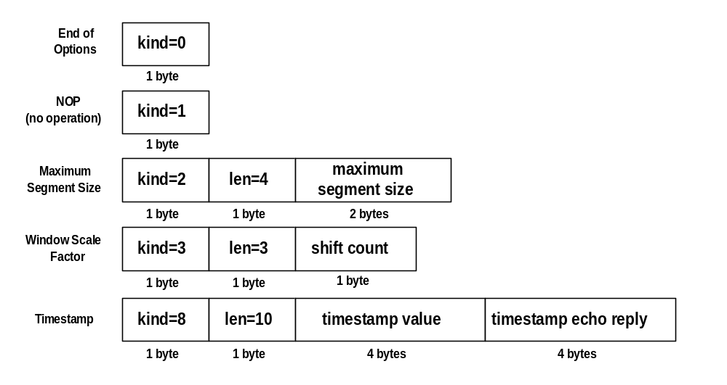
TCP header fields
Options:

Slide 16
TCP header fields
Options:
  NOP is used to pad TCP header to multiples of 4 bytes
  Maximum Segment Size
  Window Scale Options
        Increases the TCP window from 16 to 32 bits, I.e., the window size is interpreted differently
        Q: What is the different interpretation ?
        This option can only be used in the SYN segment (first segment) during connection establishment time
  Timestamp Option
        Can be used for roundtrip measurements

Slide 17
TCP Connection Establishment
TCP uses a three-way handshake to open a connection:
(1) ACTIVE OPEN: Client sends a segment with
      SYN bit set *
      port number of client
      initial sequence number (ISN) of client
(2) PASSIVE OPEN: Server responds with a segment with
      SYN bit set *
      initial sequence number of server
      ACK for ISN of client
  (3) Client acknowledges by sending a segment with:
      ACK ISN of server (* counts as one byte)

Slide 18
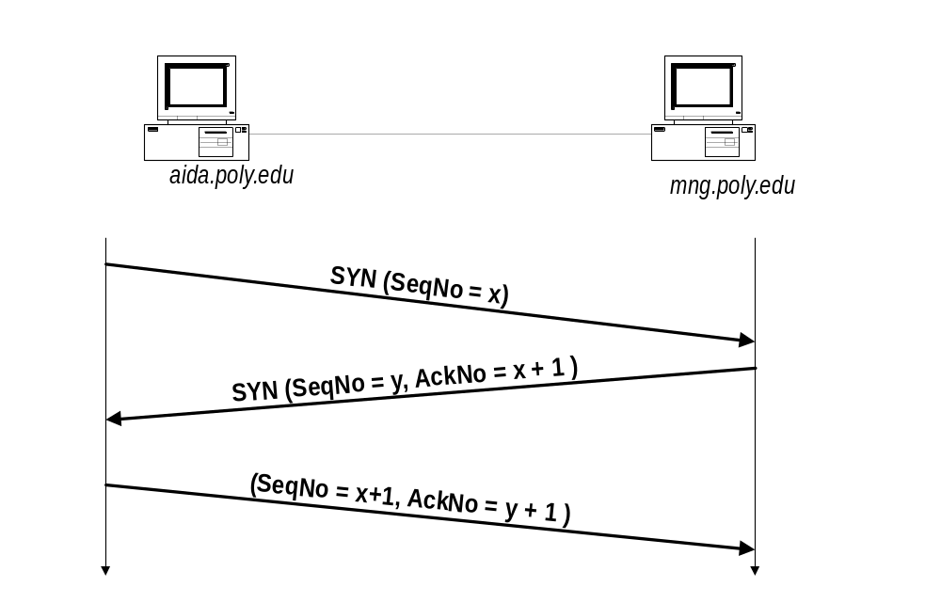
Three-Way Handshake

Slide 19
Transport Protocols in the Internet
The Internet supports 2 transport protocols
UDP - User Datagram Protocol
datagram oriented
unreliable, connectionless
simple
unicast and multicast
useful only for few applications, e.g., multimedia applications
used a lot for services
  network management (SNMP), routing (RIP), naming (DNS), etc.
TCP - Transmission Control Protocol
stream oriented
reliable, connection-oriented
complex
only unicast
used for most Internet applications:
  web (http), email (smtp), file transfer (ftp), terminal (telnet), etc.

Slide 20
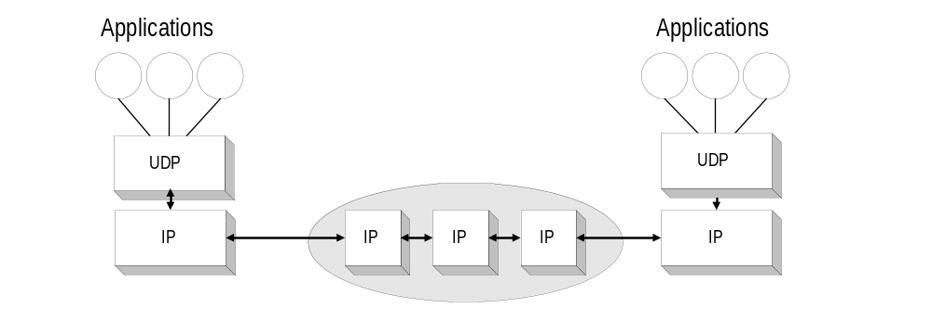
UDP - User Datagram Protocol
UDP is supports unreliable transmissions of datagrams
UDP merely extends the host-to-to-host delivery service of IP datagram to an application-to-application service
The only thing that UDP adds is multiplexing and demultiplexing

Slide 21
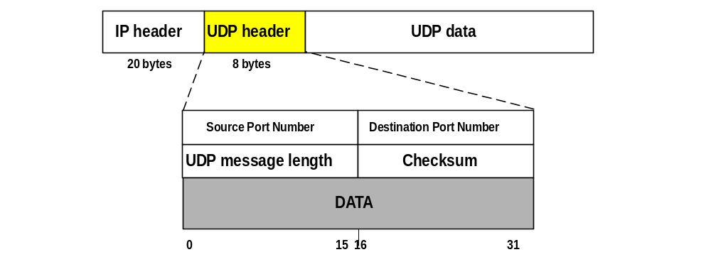
UDP Format
Port numbers identify sending and receiving applications (processes). Maximum port number is 2¹⁶-1= 65,535
Message Length is at least 8 bytes (I.e., Data field can be empty) and at most 65,535
Checksum is for header (of UDP and some of the IP header fields)

