Slide 1
Motherboards

Slide 2
Motherboard
Main circuit in a computer that connects different parts of a computer together
Analogous to the body's nervous system – allows the CPU to control and communicate with separate parts
Also bridges external components through motherboard ports
Houses CPU, memory and expansion cards

Slide 3
Main motherboard components
CPU
Chipset
Buses
Memory slots and chips
Expansion slots and cards
Ports and connectors

Slide 4
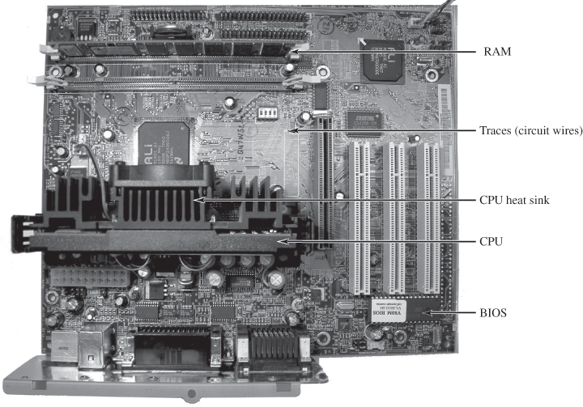
Typical motherboard

Slide 5
Different Types
AT
Obsolete, patterned after original IBM AT motherboard
Baby AT
Same design layout as AT, but using smaller area
ATX
Most common motherboard today
Micro ATX
Smaller form factor for smaller cases
NLX
Used in low-profile cases, usually clone PCs
BTX
BTX form factor designed for better air flow in case; uses ATX power supply

Slide 6
ATX Motherboard
12” X 9.6”
One-piece power supply connector
Built-in IO ports
Expansion slots parallel to narrow edge of board
Better placement of CPU, RAM, allow better cooling and more expansion slots
Soft-power switching

Slide 7
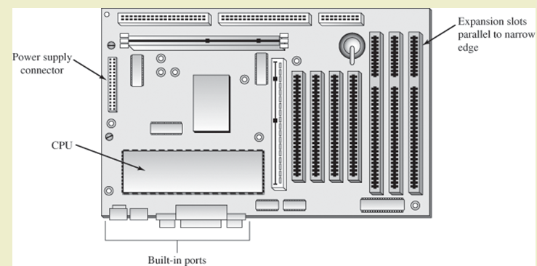
ATX Motherboard

Slide 8
Motherboard components
CPU
Typically has heat sink or fan attached
Attached through socket or slot
Motherboard buses
Network of fine wires on circuit board
Internal bus
External bus (expansion bus)

Slide 9
Motherboard components of note
BIOS Chip
Stands for Basic Input/Output System
Allows the hardware in the computer to communicate during startup
Uses non-volitile memory
PCI Slots
Used to add extension cards to a machine
Mainly graphic cards, network cards etc

Slide 10
Motherboard components of note
CMOS
Complementary Metal Oxide Semi-conductor
Little battery used to power CMOS powered memory to hold date time and system setup parameters
BIOS used to configure CMOS settings
Southbridge
An integrated circuit responsible for
Hard drive controller
I/O controller
Soundcard
USB
BIOS etc
Although it handles I/O devices, slower I/O devices such as keyboard, non-usb mouse handled by S I/O (Super I/O)

Slide 11
Motherboard components of note
NorthBridge
Responsible for communications between RAM and AGP with the CPU.
Also known as memory controller hub
Acts as a bridge to the SouthBridge
Usually closer to the CPU and memory and slightly larger than SouthBridge
With SouthBridge, known as chipset

Slide 12
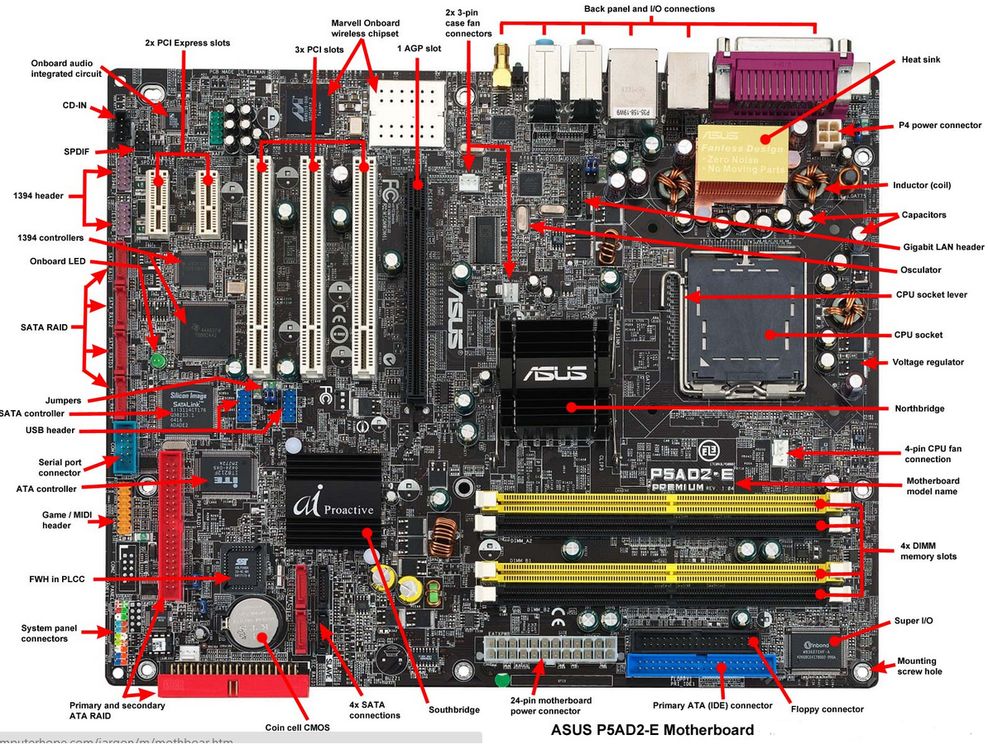
Motherboard diagram

Slide 13
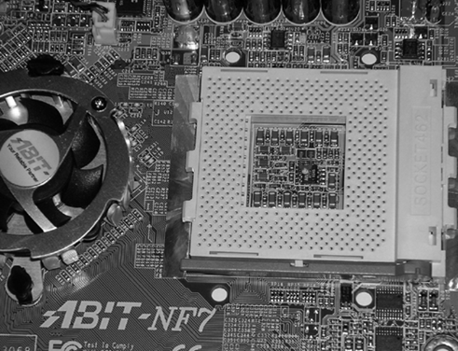
CPU Socket

Slide 14
Northbridge/Southbridge differences
Northbridge
CPU and memory
High-speed peripherals
Southbridge
Onboard video circuitry
Southbridge
Peripheral devices
Non-essential controllers
Secondary and legacy buses

Slide 15
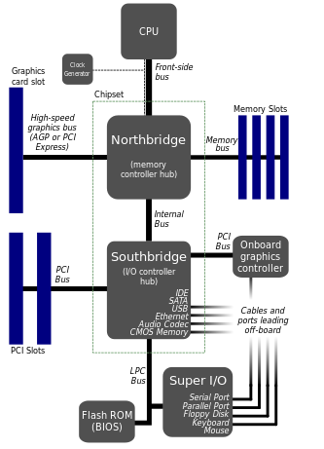
Motherboard bus architecture
The Northbridge chips handles IO duties between the CPU and RAM
The Southbridge chip handles IO duties with HDDs, BIOS, USB etc
CPU directly connected to the NorthBridge
NorthBridge acts as a “bridge” to the SouthBridge
Super I/O caters for the slow I/O technologies

Slide 16
Expansion slots
Used for adding additional circuitry
Network interfaces
Video graphics controllers
Types of expansion slots
ISA - older
PCI – short, white
PCI Express
AGP – Brown, shorter than PCI

Slide 17
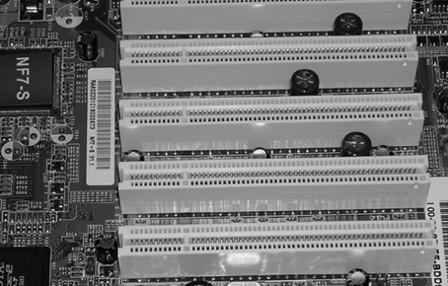
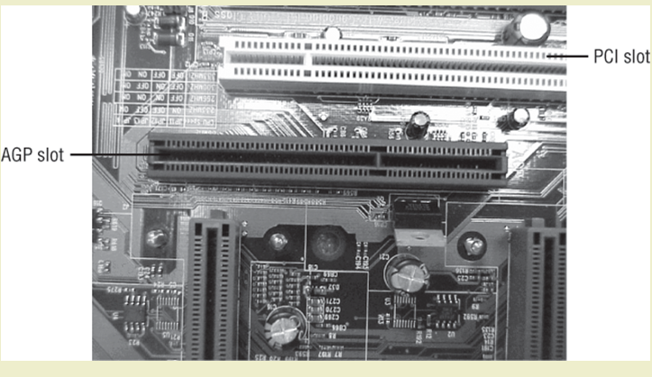
Expansion slots

Slide 18
Other motherboard features
Memory slots
Connectors
Power
Keyboard
USB And other peripheral devices

Slide 19
More on BIOS
Controls essential components
Keyboard
Display screen
Disk drives etc
Three main functions
Booting the PC
Verifies hardware
Provides and interface between hardware and software

Slide 20
Boot process steps
Power supply initializes
Primary part of BIOS loads to RAM
CPU access jump address for start of BIOS boot program
Type of boot confirmed
Cold boot: When PC’s power switched on
Warm boot: When PC restarted or reset, does not run POST
Power On Self Test (POST) begins
Error messages given as beep codes
Video adapter software loads

Slide 21
Boot process steps
Other device BIOS loads
BIOS startup screen loads
Error messages displayed as text
CMOS configuration tested
Test if devices listed in CMOS are present, functioning
Ports assigned and devices configured
Hardware configuration confirmed
BIOS displays summary screen
Operating system located and loaded
Boot failure:
When PC unable to complete process and load OS
Typically caused by loose or missing component

