Slide 1
Anatomy of a computer

Slide 2
Going to cover
RAM
CPU
Clock
Execution
CPU Cooler
Motherboard
Components of note
Bus architecture

Slide 3
RAM (Random Access Memory)
Data is stored in random locations
Data can be accessed directly regardless of location
In contrast to hard drives etc where they have to spin to the location of the data before being able to access it.
Essentially a set of memory chips soldered onto a stick of circuit board

Slide 4
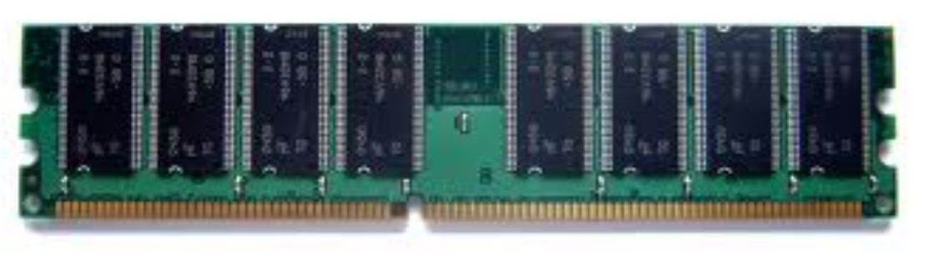
RAM
Blazing fast when compared to hard drives
RAM storage is volatile
Lost once computer is turned off
Like short term memory
Very important in software programs
Keep low memory footprint
OutOfMemoryException (beware)

Slide 5
CPU (Central Processing Unit)
Also known as the processor/microprocessor
Known as the “brains” of the computer
Housed in a single chip
Inserted directly into a CPU socket, pin side down on the motherboard
Modern CPUs are attached to a heat sink to dissipate heat

Slide 6
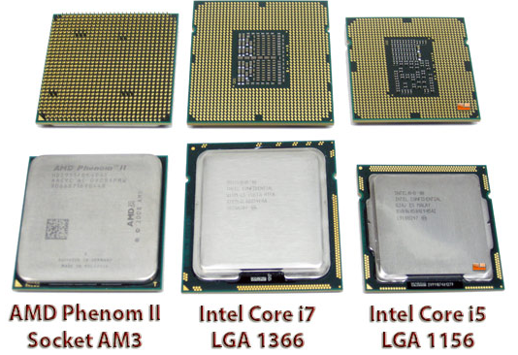
CPU (Central Processing Unit)
Anonymous processing
Uses a clock
Executes instructions
Uses a bus
Can have many cores

Slide 7
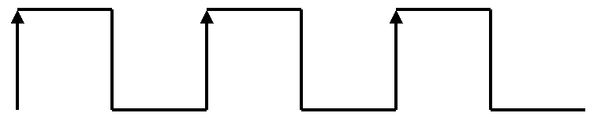
CPU Clock
Used to “sync” instructions in a computer
Typical clock signal, square signal changing from 0 to 1 at a fixed rate
3 full cycles shown (ticks)
Measured in Hertz, 100MHz = 100 million ticks per second

Slide 8
CPU Clock
Clock cycle for each instruction is stored in tables
Queues instructions based on “delay”
Two identical processors, better clock speed = better performance
CPUs have many execution units
Also has an external clock for transferring data to and from RAM

Slide 9
CPU External clock
Used when transferring data to and from RAM
When internal clock speeds got too fast, a slower external clock was needed

Slide 10
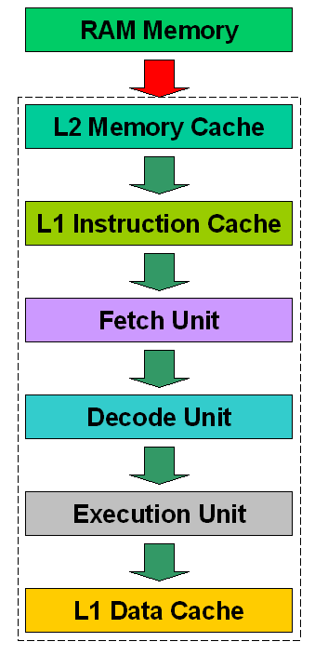
Block diagram of a CPU
Dotted line represents the CPU body
RAM outside CPU
Red arrow (external clock)
Other arrows (Internal clock)

Slide 11
Memory cache
High performance memory
Can work at same speed as the CPU clock
Static memory, consumes more power than dynamic memory but is much faster
Cache controller manages memory cache
Bigger the memory cache, less likely direct memory access is required
Hit = data in memory cache, Miss = data in RAM

Slide 12
Instruction/Data Cache
L1 Instruction cache works as an input cache, lining up instructions to be executed
Data cache simply an output cache
L1 Instruction cache particularly efficient for “looping behaviour” as required instructions are closer to the fetch unit

Slide 13
Fetch/Decode/Execute
Also known as an instruction cycle or FDX
Fetch
Gets data from RAM via an address bus and stores internally in CPU. Data received by CPU via data bus
Decode
CPU decodes the instruction just fetched and prepares various areas of chip for next step
Execute
Instruction is carried out on the data and output stored in data cache

Slide 14
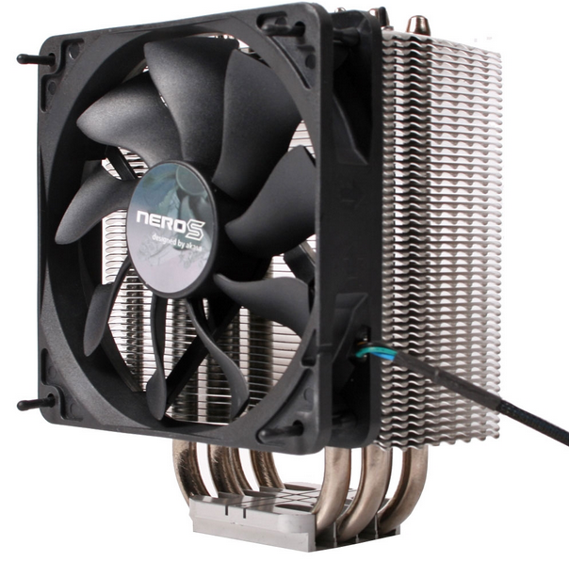
CPU Cooler
Also known as a heat sink or CPU fan
Often bundled with CPUs
Other heat sinks are used in a computer
Transfers thermal energy from a higher temperature device to a lower temperature fluid medium

Slide 15
Motherboard
Main circuit in a computer that connects different parts of a computer together
Analogous to the body's nervous system – allows the CPU to control and communicate with separate parts
Also bridges external components through motherboard ports
Houses CPU, memory and expansion cards

Slide 16
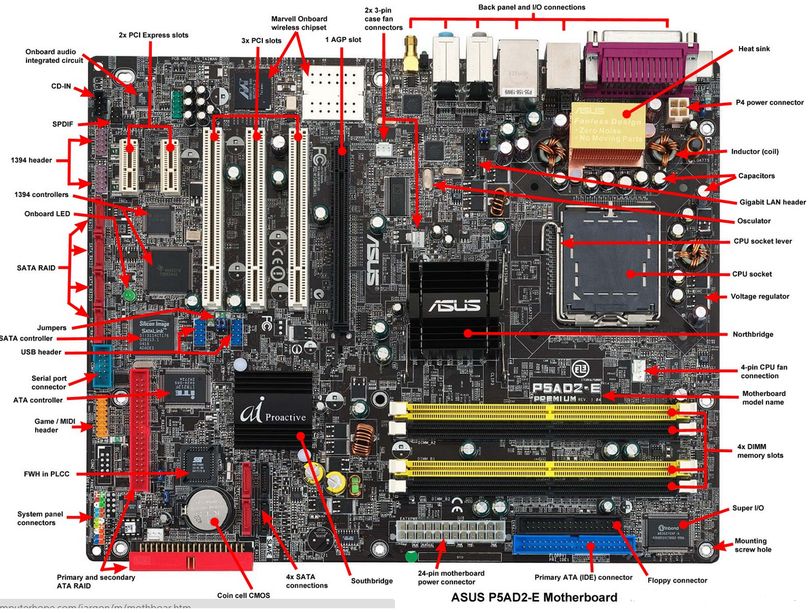
Motherboard diagram

Slide 17
Motherboard components of note
BIOS Chip
Stands for Basic Input/Output System
Allows the hardware in the computer to communicate during startup
Uses non-volitile memory
PCI Slots
Used to add extension cards to a machine
Mainly graphic cards, network cards etc

Slide 18
Motherboard components of note
CMOS
Complementary Metal Oxide Semi-conductor
Little battery used to power CMOS powered memory to hold date time and system setup parameters
Southbridge
An integrated circuit responsible for
Hard drive controller
I/O controller
Soundcard
USB
BIOS etc
Although it handles I/O devices, slower I/O devices such as keyboard, non-usb mouse handled by S I/O (Super I/O)

Slide 19
Motherboard components of note
NorthBridge
Responsible for communications between RAM and AGP with the CPU.
Also known as memory controller hub
Acts as a bridge to the SouthBridge
Usually closer to the CPU and memory and slightly larger than SouthBridge

Slide 20
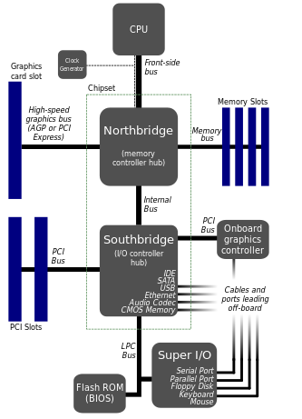
Motherboard bus architecture
The Northbridge chips handles IO duties between the CPU and RAM
The Southbridge chip handles IO duties with HDDs, BIOS, USB etc
CPU directly connected to the NorthBridge
NorthBridge acts as a “bridge” to the SouthBridge
Super I/O caters for the slow I/O technologies

Slide 21
What happens when you start a program?
Data transferred from hard disk to RAM
Program is a set of instructions for a CPU
CPU loads the program from RAM to in-memory CPU
The data (instructions) now inside the CPU gets executed (fetch-decode-execute)
What happens next depends on the program
Display on screen
Continue to load from RAM

