Slide 1
Miscellaneous

Slide 2
What we are going to cover
String class
Generating random numbers
Forcing exit
User validation
Arrays

Slide 3
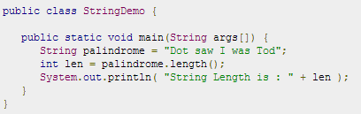
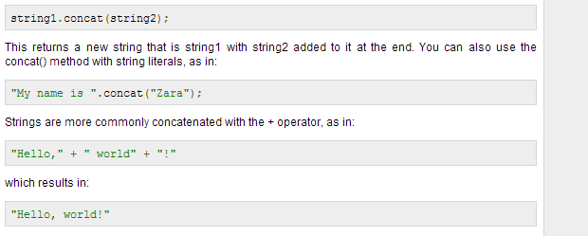
String class
To find the length of a String:
Concatenating Strings:

Slide 4
String class continued
Other useful methods of note – demonstrate:
CharAt
CompareTo(IgnoreCase)
EndsWith
Equals(IgnoreCase)
GetBytes
(Last)IndexOf
Matches
Replace(All|First)
Split
StartsWith
Substring
ToUpper/Lowercase
ValueOf

Slide 5
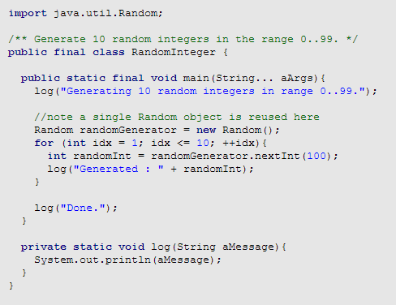
Generating random numbers
Using Random class in java.util (Can also use Math.random)

Slide 6
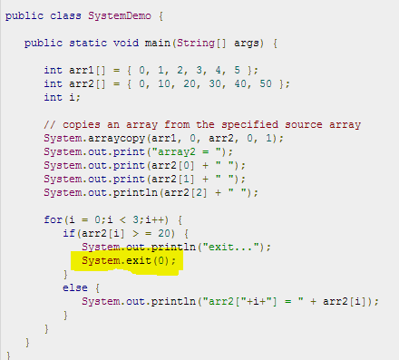
System.Exit(0)

Slide 7
Arrays\Validation
http://www.tutorialspoint.com/java/java_arrays.htm
Validation
Show issues
Show examples
Show loop validation

