Slide 1
HardDrive

Slide 2
Definition
A hard disk drive (HDD) is a data storage device used for storing and retrieving digital information using rapidly rotating disks (platters) coated with magnetic material.
A HDD retains its data even when powered off.
Data is read in a random-access manner, meaning individual blocks of data can be stored or retrieved in any order rather than sequentially.

Slide 3
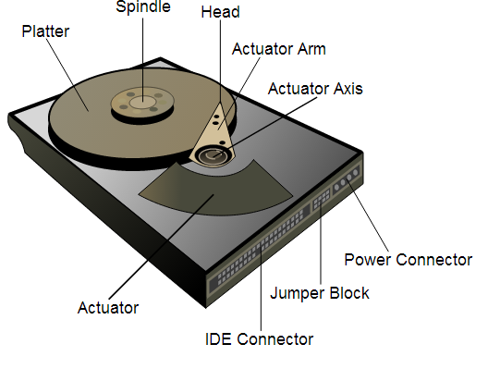
HDD Internals

Slide 4
Main components
Platters
Mounted and rotated on spindle in sealed enclosure
Has a thin film of ferro-magnetic material
Binary bits determined by change in direction of magnetisation
Spindle
Responsible for spinning the disks at a fast pace
Today on average sins between 5,400 to 7200 rpm
Actuator
Motor that positions read/write head assembly across the spinning platters

Slide 5
Main components
Actuator arm
Position controlled by the actuator, by being mounted on the actuator axis, supports read/write heads
Magnetic read/write heads
Used to detect and modify the magnetization of the material immediately under it
Actuator axis
Controls the angled position of the actuator arms via the actuator
Jumper pins
Used in ATA HDDs to configure master/slave
2 motors involved
Spindle
Actuator

Slide 6
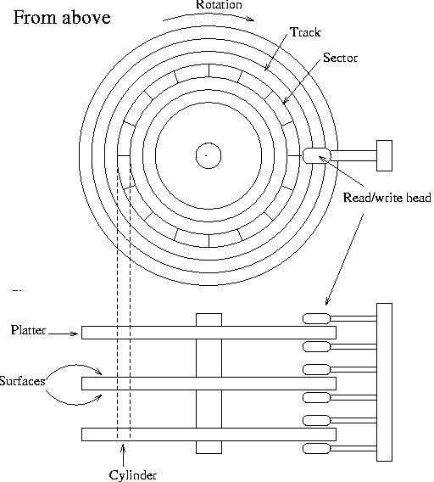
Drive geometry

Slide 7
Drive geometry
Heads
1 read/write head per platter
Tracks
Data written in concentric rings (16000+)
Cylinder
Collection of tracks at same actuator arm position on all platters
Sector
Smallest accessible portion of data on track
512 bytes, up to 63 per track

Slide 8
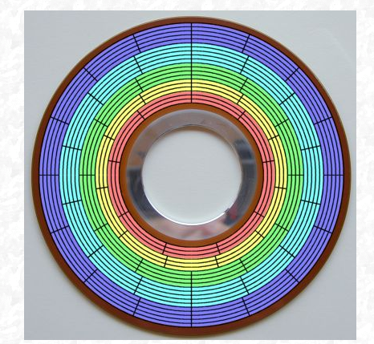
Zoned Bit Recording
Improves capacity
In example shown:
20 tracks
5 zones
Blue = 5*16 sectors
Cyan = 5*14 sectors
Red 3*9 sectors
Don’t want to limit outer to 9 sectors

Slide 9
HDD Characteristics
Capacity
Determined by the geometry of the drive
E.g 512bytes/sector*60 sectors/track *cylinders * heads etc.
Currently measured in GB (Ranges from 250 – 1TB)
Spin speed
Modern day drives usually 5,400 to 7,200 rpm
Performance differs based on speed
Some servers can have up to 15,000 rpm

Slide 10
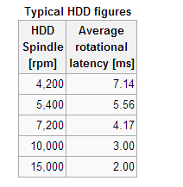
HDD Characteristics
Seek time
Measures the time it takes the head assembly on the actuator arm to travel to the track of the disk where the data will be read or written
Typically about 9ms
Rotational latency
Time for sector to travel to head after head in place
Measured in milliseconds
Usually seek time takes longer
Faster spin speed, faster rotational latency

Slide 11
HDD Characteristics
Average rotational latency
Time it takes disc to turn 180 degrees
Worst case is having to go a full revolution
Access time
Full amount of time to move head and access sector
Access time = (Seek time + Rotational Latency)

Slide 12
HDD Characteristics
Interface
Technology for connecting HDD (ATA, SATA etc)
Determine the rate of data transfer
Disk cache size
Typically 16-32 MB
Stores frequently accessed data
Minimises the number of physical seeks
Data transfer rate
Amount of data transferred in 1 second
External (RAM to disk cache)
Internal (Disk cache to platter)

Slide 13
PATA vs SATA
PATA
Also called ATA and IDE developed in 1980s
Modern motherboards don’t have PATA connectors
Slower (Max of 133 Gbps)
Connectors are flat ribbon cables of 40-80 wires
SATA
Introduced in 2003
Faster (up to 600 Gbps)
Spins at higher RPMs
Connectors are much smaller and thinner cables

Slide 14
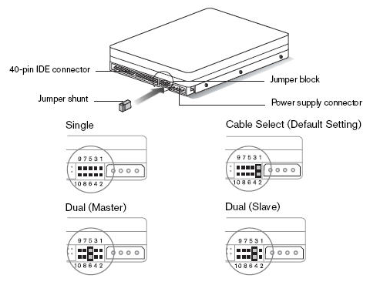
PATA Drive Master/Slave
Two PATA drives can share ribbon cable and controller, and can be configured using jumpers as master/slave

Slide 15
Preparing a drive for use
Must be “high-level” formatted
E.g. FAT32, NTFS
Low level formatting done by manufacturer
Prepares drive for managing files
Must be partitioned
Divided into sections with different drive letters
1 HDD can have as many as 4 partitions
Active partition = partition used to start the PC
System partition
Contains hardware files used by the OS
Usually = system partition

Slide 16
Managing hard drives
Back ups
Error checking (CHECKDISK)
Disk defragmentation (DISK DEFRAG UTILITY)
Fault tolerance
Troubleshooting
Faulty adapter
Faulty disk (defect, virus etc)
Adapter and disk not connected correctly

