Slide 1
Binary add, subtract, multiply, divide and 2s Complement

Slide 2
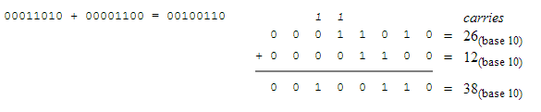
Binary add
Rules:
0 + 0 = 0
0 + 1 = 1
1 + 0 = 1
1 + 1 = 0 (and carry 1 to next significant bit)

Slide 3
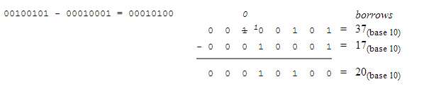
Binary subtract
Rules:
0 - 0 = 0
0 - 1 = 1 (and borrow 1 from next significant bit)
1 - 0 = 1
1 - 1 = 0

Slide 4
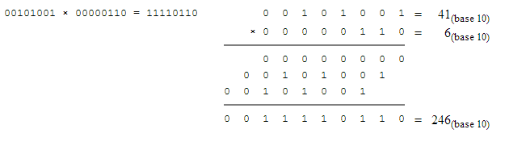
Binary multiply
Rules:
0 x 0 = 0
0 x 1 = 0
1 x 0 = 0
1 x 1 = 1

Slide 5
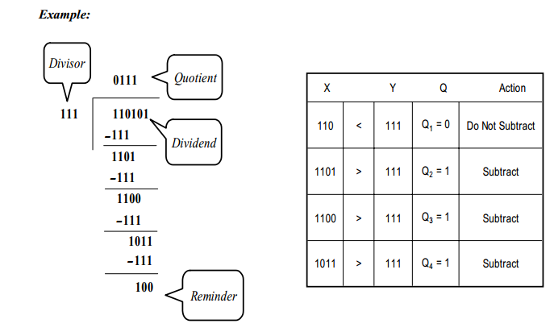
Binary divide
Just like standard math divide

Slide 6
Negative number representation in binary
How do we represent negative numbers in binary?
2s complement
Allows the use of binary arithmetic on signed integers
Positive 2s complement numbers represented as simple binary

Slide 7
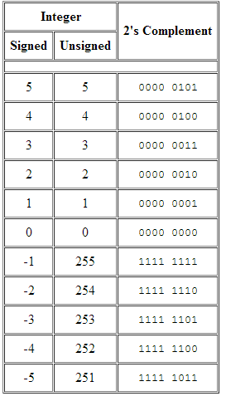
2s complement conversion
Leftmost bit known as the sign bit
To convert to 2s complement, invert the numbers and add 1
00010001_{(binary 17)}
11101110 (Invert)
+00000001 (add 1)
11101111_{(2s complement -17)}

Slide 8
2s complement addition
Same as binary addition
Eg. Add 5 and -3
00000101 (5)
11111101 (-3)
00000010 (2)

