Slide 1
Boolean algebra

Slide 2
Main logical operations
Algebraic variables combined with logical operators
OR (e.g. X + Y)
AND (e.g. XY)
NOT (e.g. X)

Slide 3
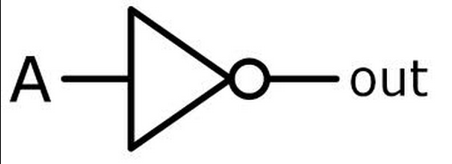
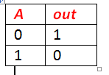
Simple Gates – NOT Gate
The NOT gate takes one bit as input and produces as output its opposite

Slide 4
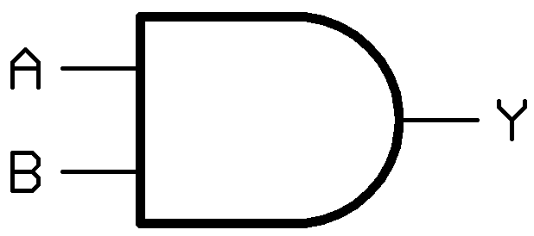
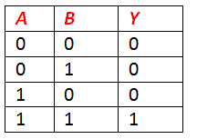
Simple Gates – AND Gate
The AND gate performs a logical and operation on two inputs

Slide 5
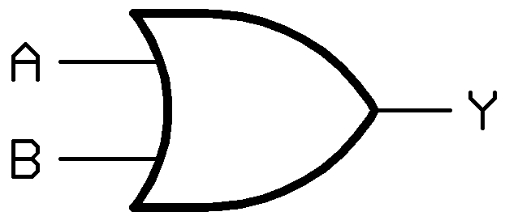
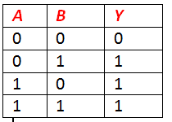
Simple Gates – OR Gate
If A is 1 or B is 1, then Y is 1

Slide 6

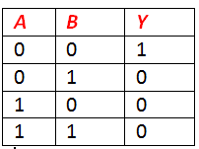
Simple Gates – NOR Gate
Combination of OR and NOT gate

Slide 7
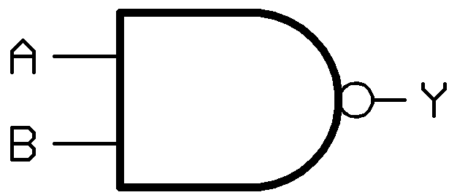
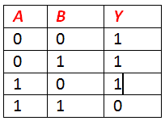
Simple Gates – NAND Gate
Combination of AND and NOT gate

Slide 8
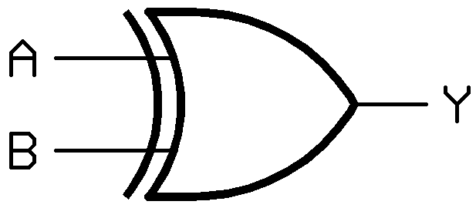
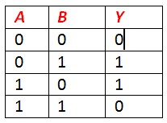
Simple Gates – XOR Gate
If A or B is 1, but not both, Y = 1

Slide 9
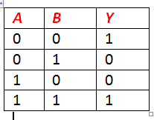
Simple Gates – XNOR Gate
If A or B are the same, Y = 1

Slide 10
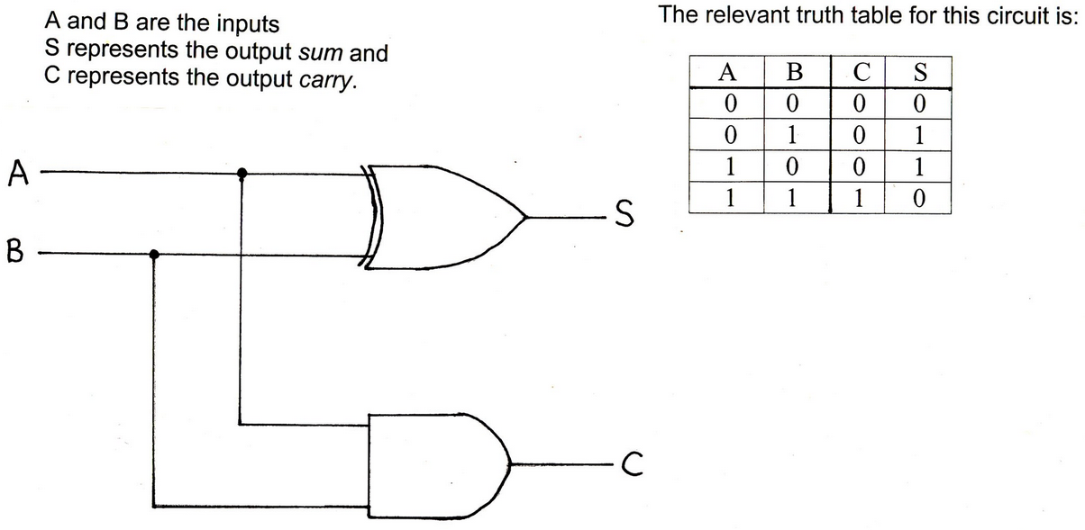
Half adder

Slide 11
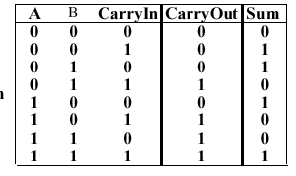
Full Adder
3 inputs
Effectively 2 half adders
Can be circuit modelled in many ways

Slide 12
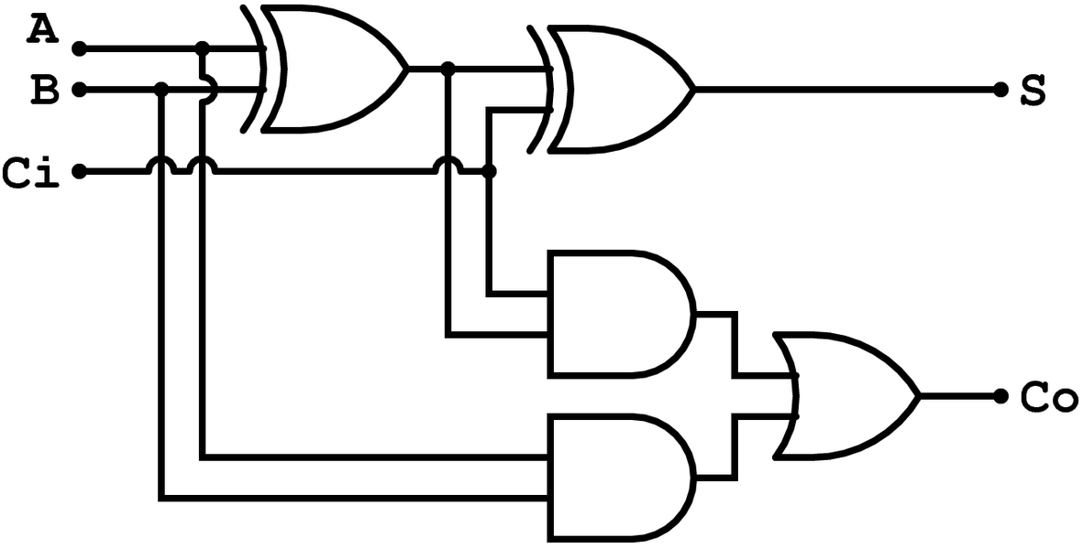
Full Adder

