Slide 1
Mobile app concepts
Wireless communication network introduction

Slide 2
Outline
Overview of a Communication System
Digital vs. Analog Communications
Examples of Wireless Communication Systems
Why Wireless is Different ?
Wireless System Architecture
Multiple Access Techniques
Evolution of Cellular Networks (1G - 3G)
Wireless Local Area Networks (WLANs), Bluetooth and
Personal Area Networks (PANs)
Ad hoc networks

Slide 3
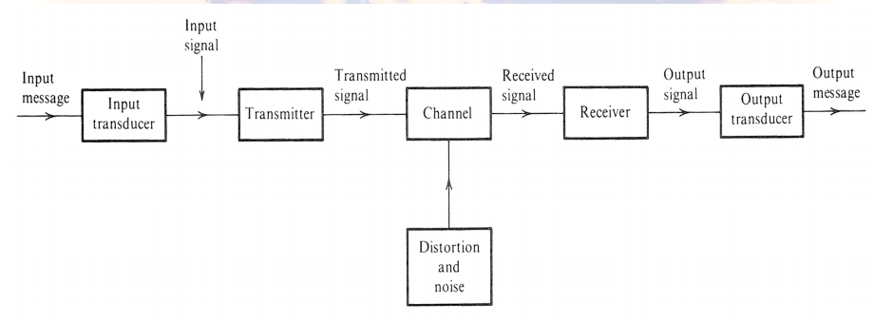
Communication system components

Slide 4
Communication system components (2)
The source originates a message, which could be a human voice, a television picture or data. The source is converted by an input transducer into an electrical waveform referred to as the baseband signal or message signal.
The transmitter modifies the baseband signal for efficient transmission. The transmitter generally consists of one or more of the following subsystems: a pre-emphasizer, a sampler, a quantizer, a coder and a modulator.
The channel is a medium through which the transmitter output is sent, which could be a wire, a coaxial cable, an optical fiber, or a radio link, etc.

Slide 5
Communication system components (3)
The receiver reprocessed the signal received from the channel by undoing the signal modifications made at the transmitter and the channel. The task of the receiver is to extract the message from the distorted and noisy signal at the channel output. The receiver may consist of a demodulator, a decoder, a filter, and a de-emphasizer.
The receiver output is fed to the output transducer, which converts the electrical signal to its original form.
Transmitters and receivers are carefully designed to overcome the distortion and noise. The Goal of Physical layer Communication System is to transmit information accurately and efficiently (power and spectrum).

Slide 6
Digital vs Analog comms
Messages are digital or analog.
Digital messages are constructed with a finite number of symbols. For example, a text file is a digital message constructed from 50 symbols, consists of 26 letters, 10 numbers, a space and several punctuation marks. Similarly, a Morse-coded telegraph is a binary message, implying only two symbols – mark and space.
Analog messages are characterized by data whose values vary over a continuous range. For example, a speech waveform has amplitudes that vary over a continuous range.

Slide 7
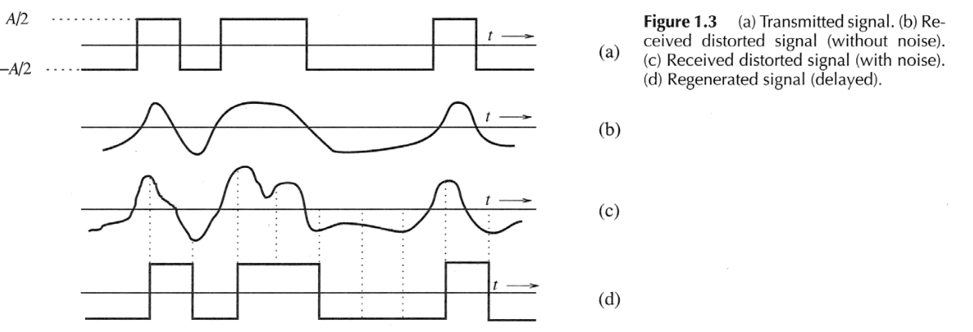
Noise immunity of digital signals

Slide 8
Digital vs Analog comms (2)
Digital data can be recovered without any error as long as the distortion and noise are within limits. On the other hand, for an analog message, even a slight distortion or interference in the waveform will cause an error in the received signal.
Regenerative repeaters – Based on this “noise immunity”, when transporting a bit stream over a long distance, regenerative repeaters or repeater stations are placed along the path of a digital system at distances short enough to ensure that noise and distortion remain within a limit. The viability of regenerative repeaters is the main reason for the superiority of digital systems over analog ones.
Every possible communication can be carried on with a minimum of two symbols, i.e., by using a proper binary sequence. In the last 20 years,digital communication gradually replace its analog competitors, and the revolution is now nearly complete

Slide 9
Examples of wireless communication systems
Codeless telephones ---use radio to connect a portable handset to a dedicated base station over a distance of a few tens of meters.
Paging systems --- Communication systems that broadcast a page from every base station in the network and send brief messages to a subscriber.
Cellular telephone systems -- provide a wireless connection to the PSTN (Public Switched Telephone Network) for any user location within the radio range of a system.
Garage car opener
Remote controllers for home entertainment equipment
Hand-held walkie-talkies
Wireless keyboard and mouse
Wireless Lan router and adapter

Slide 10
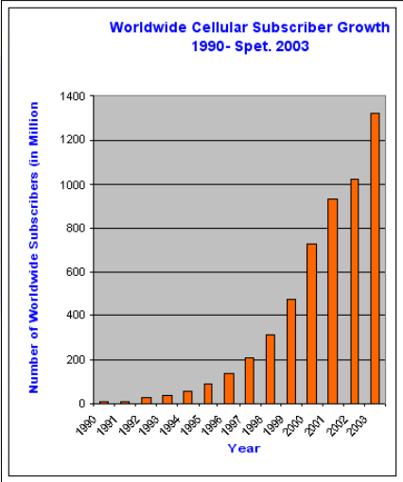
Wireless communication trends
Rapid growth in the last few decades, new and cheaper wireless services are emerging continuously
Convergence of wireless and Internet –Broadband communications

Slide 11
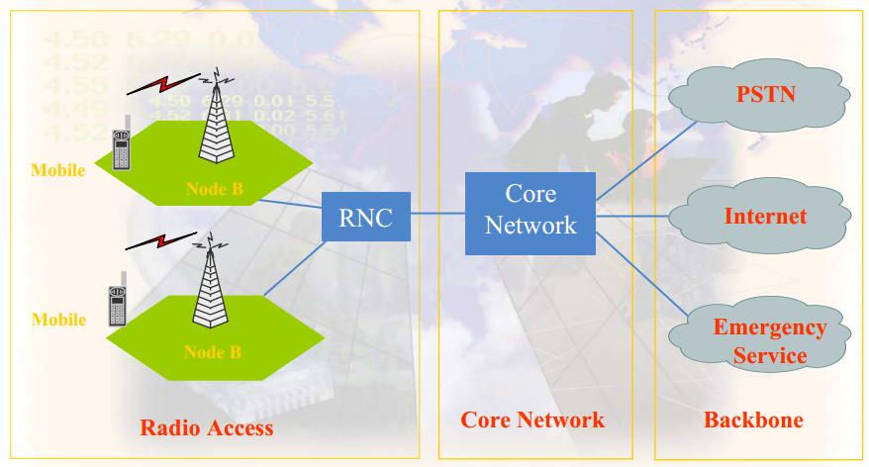
Cellular System Architecture

Slide 12
Cellular System Architecture
Radio Access: RF related signal processing and radio resource management. Mobile => base station => BSC or RNC => MSC.

Core Network: Main part is MSC (mobile switching center), performs user authentication, admission control, traffic control, roaming, billing, network support and maintenance etc.
Backbone networks: Providing voice services (PSTN, Public Switched Telephone Network), data services (through Internet), and emergency services. Wireless networks need to be connected to backbone networks to extend its service capabilities and geographic coverage

Slide 13
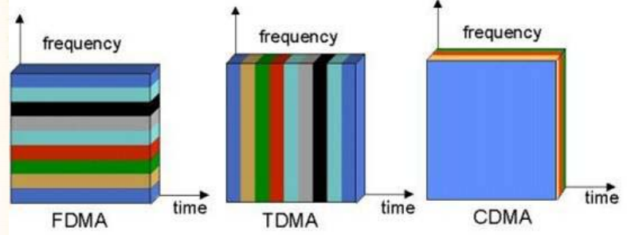
Multiple Access Techniques

Slide 14
Multiple Access Techniques
FDMA (Frequency Division Multiple Access) each user is allocated a unique frequency band or channel, no other user can share the same frequency band.
TDMA (Time Division Multiple Access) divides the radio spectrum into time slots, and in each slot, only one user is allowed to either transmit or receive.
CDMA (Code Division Multiple Access) each user is assigned a special code sequence (signature) to modulate its message signal, all users are allowed to transmit over the same channel simultaneously and asynchronously.
SDMA (Space Division Multiple Access) controls the radiated energy for each user in space. SDMA serves different users by using spot beam antennas

Slide 15
How a cellular telephone call is made
Turn on a cellular phone
The cellular phone scan the control channels to determine the one with the strongest signal, it then monitors the signal drops below a usable level. At his point, it starts to search of strongest base station again.
If a phone call is placed to a mobile user, the MSC dispatches the request to all the base stations in the system, the MIN (mobile identification number, i.e. the mobile’s phone number) is broadcast as a paging message through the forward control channel.
The mobile receives the signal through the base station it monitors and responds by identifying itself through the reverse control channel.
The base station informs the MSC of the handshake.
The MSC instructs the base station to move the call to an unused voice channel within the cell.
The base station signals the mobile to change frequencies to the unused unused forward and reverse voice channel pair.
The base station instructs the mobile phone to ring, thereby to instruct the user to answer the phone.

Slide 16
How a cellular telephone call is made (2)
Initiating a call
The mobile sends a call initiation request through the reverse control channel, with this the unit transmits its MIN, ESN (electronic serial number)and the phone number of the called party.
Base station receives the request and sends it to the MSC.
The MSC validates the request, making connection to the called party through PSTN.
The MSC instructs the base station and mobile user to move to an unused forward and reverse voice channel pair.
Roaming
All cellular systems provide a service called roaming. This allows subscribers to operate in service areas other than the one from which the service is subscribed.
The MSC issues a global command every several minutes, asking all unregistered mobiles to report their subscription information.
Mobiles report back upon receiving the request.
If the mobile has roaming authorization for billing purpose, the MSC registers the subscriber as a roamer.

