Slide 1
Mobile app concepts
Analog/digital

Slide 2
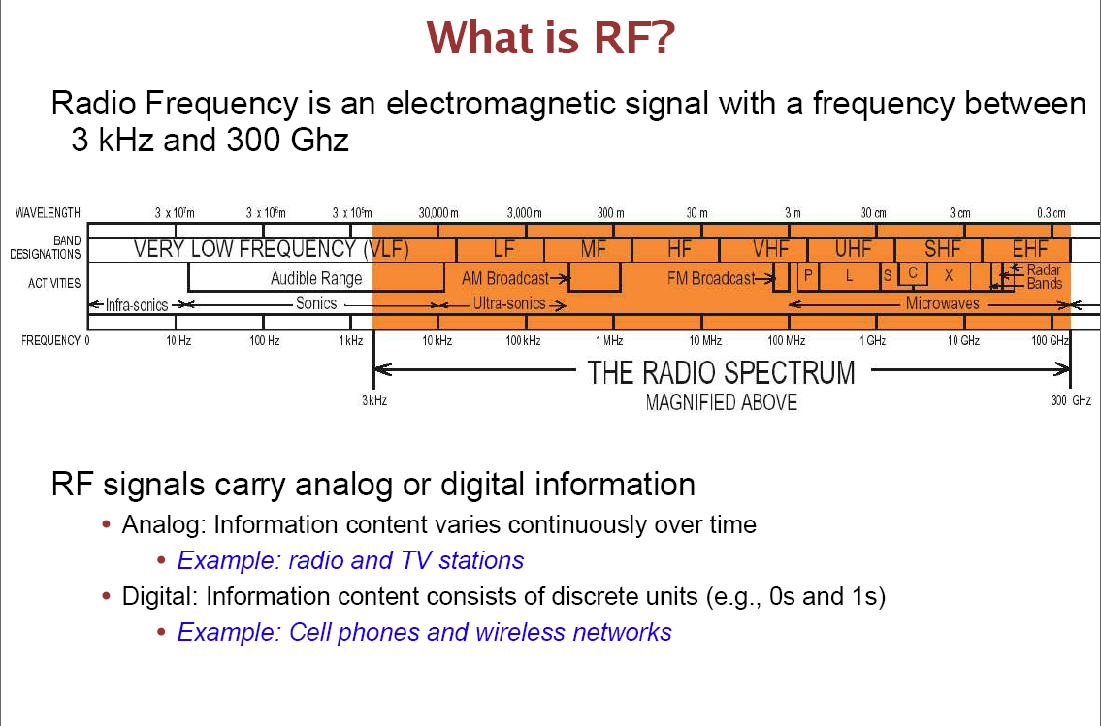

Slide 3
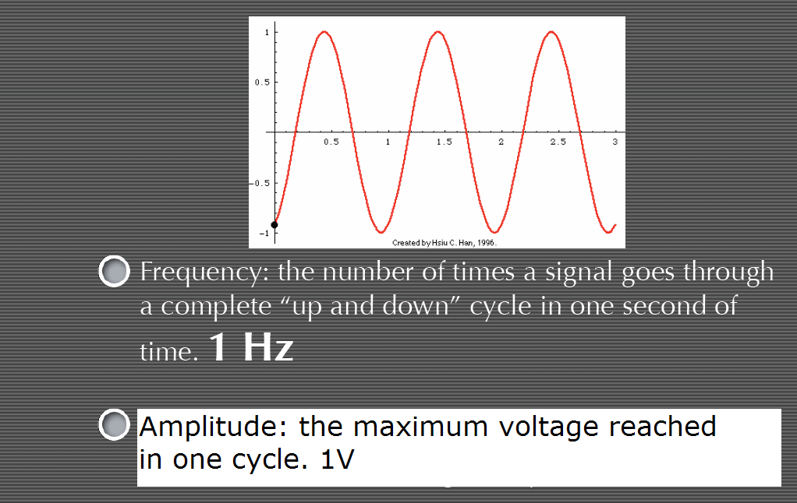

Slide 4
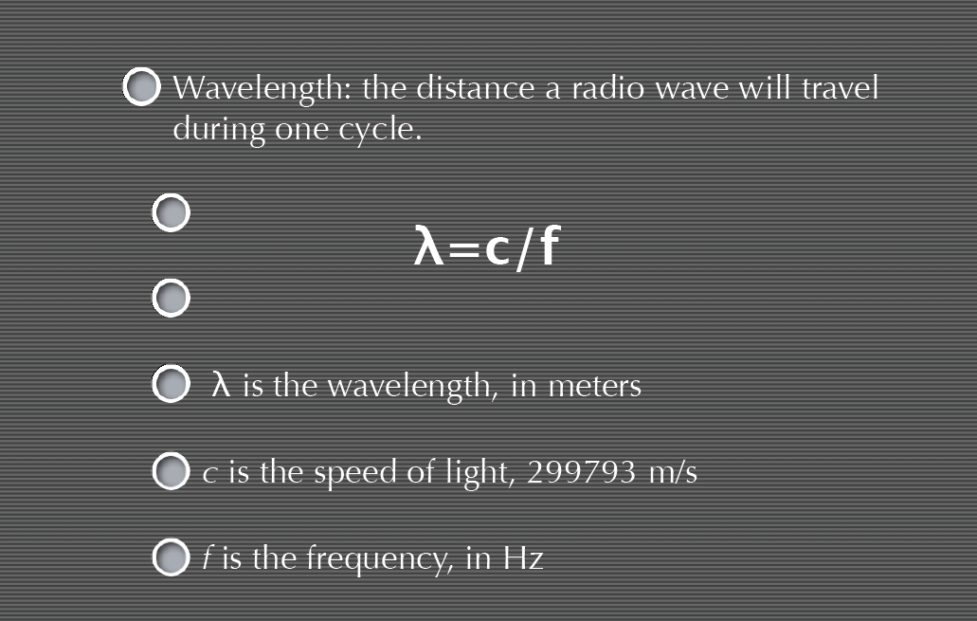

Slide 5
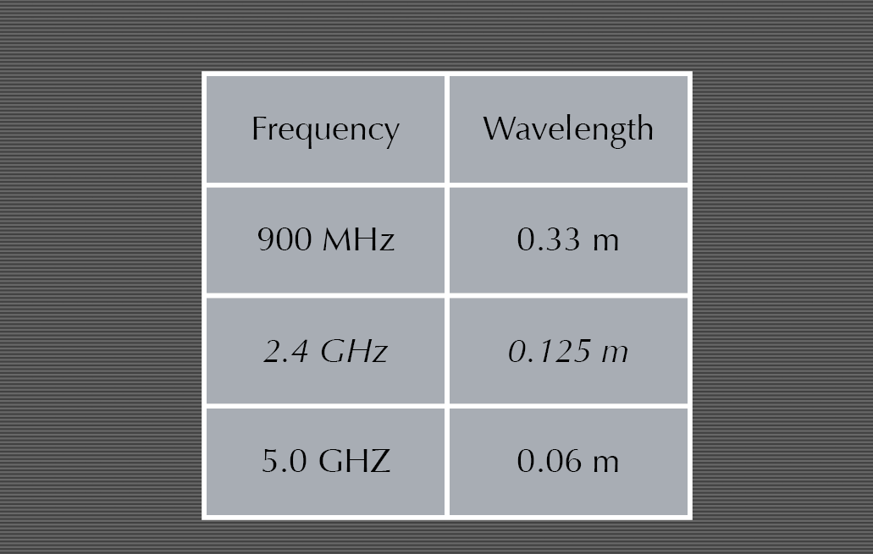

Slide 6
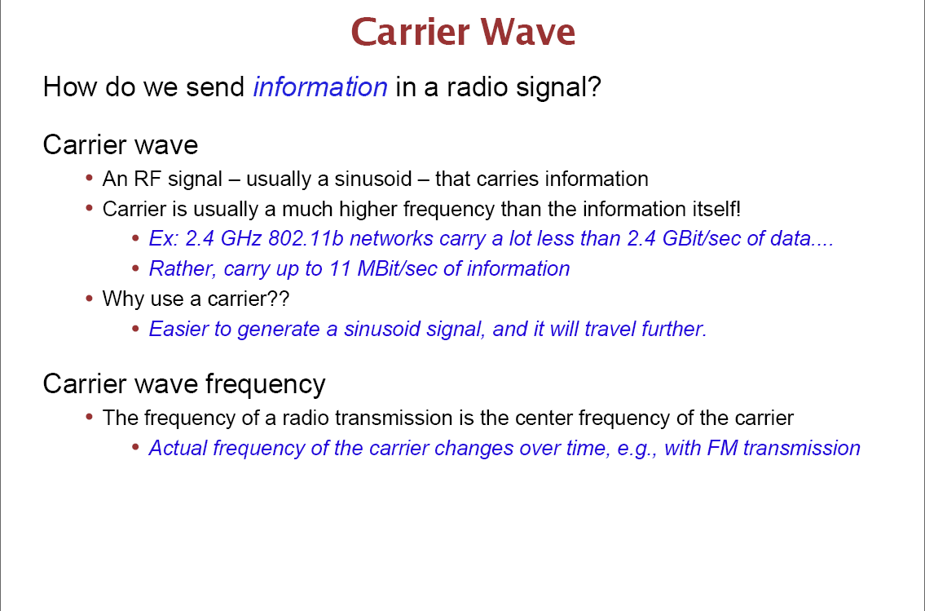

Slide 7
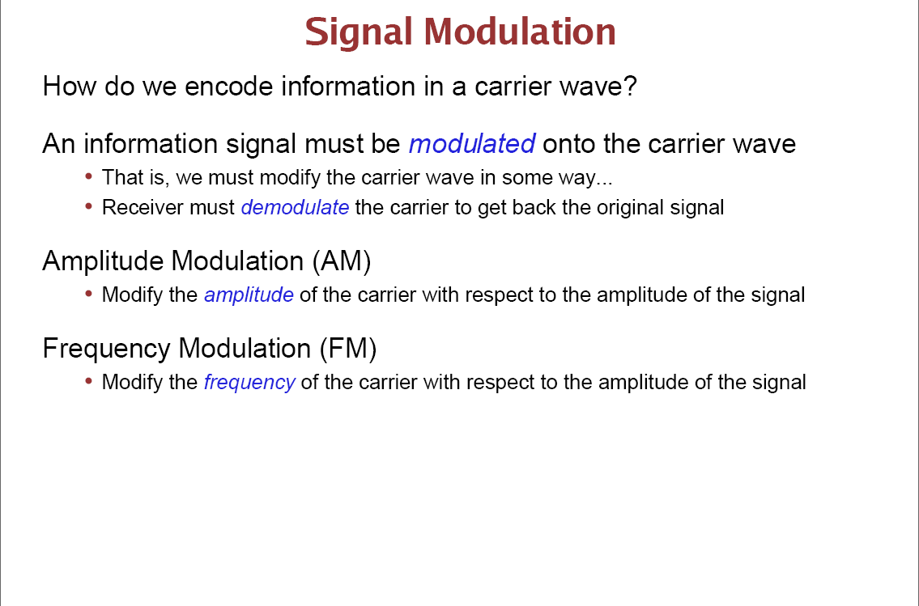

Slide 8
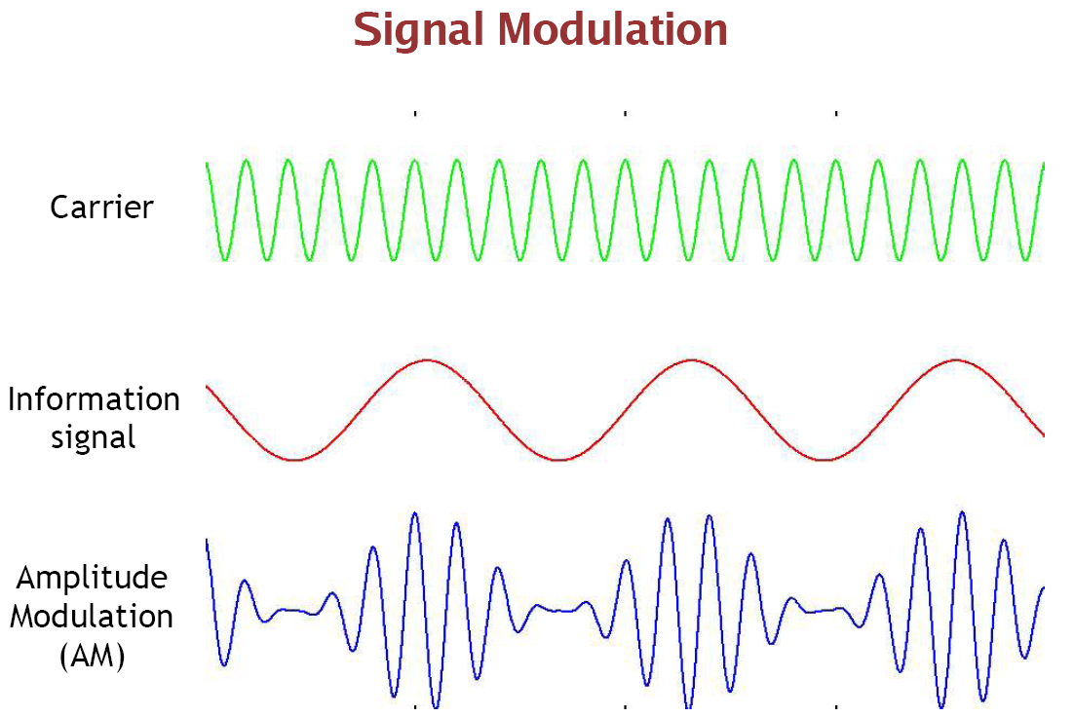

Slide 9
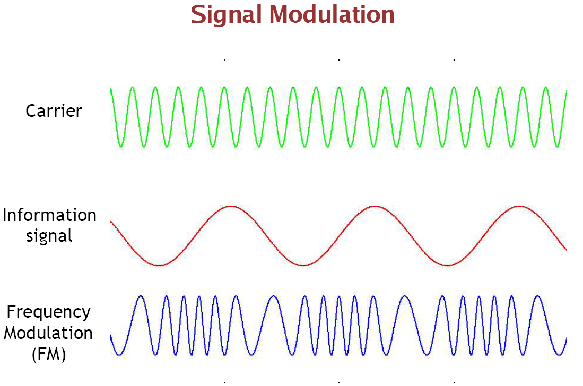

Slide 10
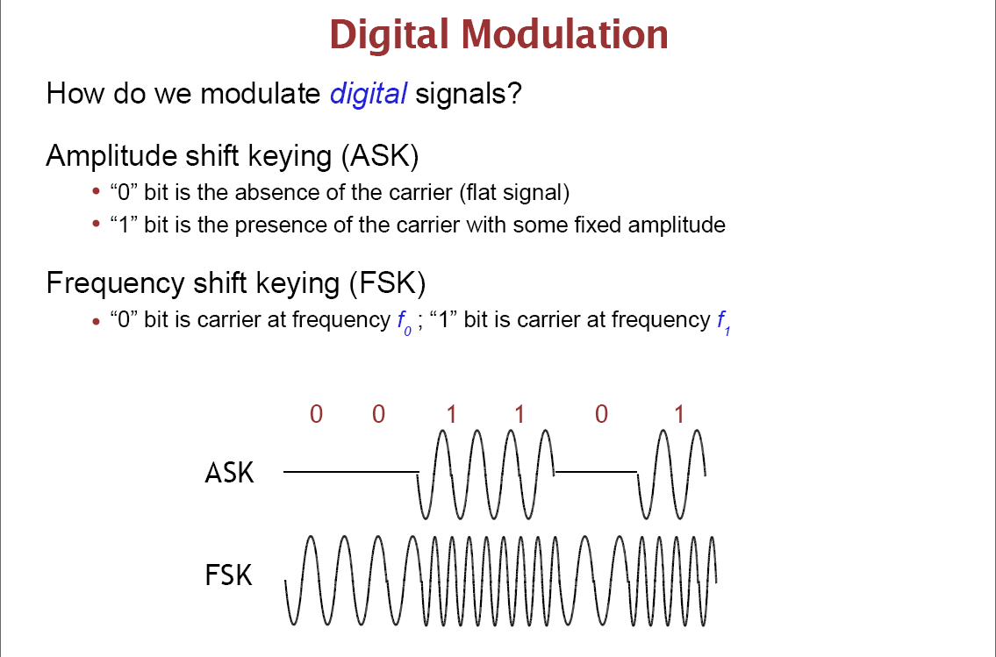

Slide 11
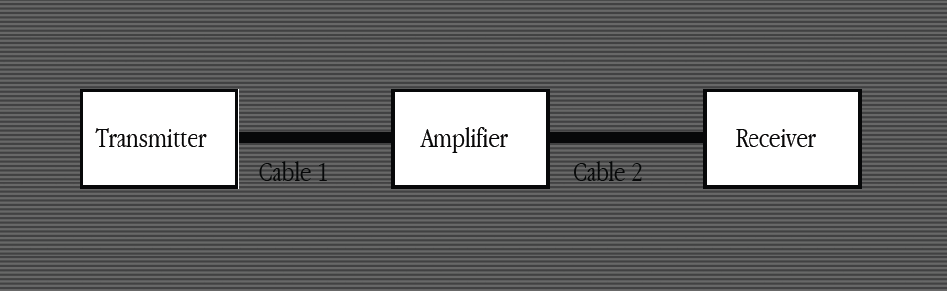
-A way to generate a carrier wave
-A way to "add" a signal wave to the carrier wave
-An antenna to radiate the combined waveform
-A "ground" connection to reference the antenna
-A voltage source to drive the transmission

Slide 12
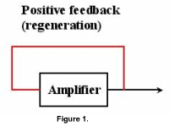
Generate a carrier wave
Requirements for an oscillator:
Amplification
A frequency determining device
Positive feedback

Slide 13
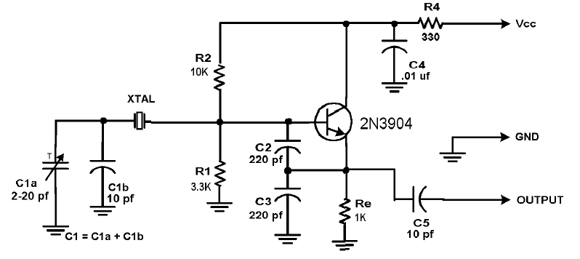
Colpitts Crystal Oscillator

Slide 14
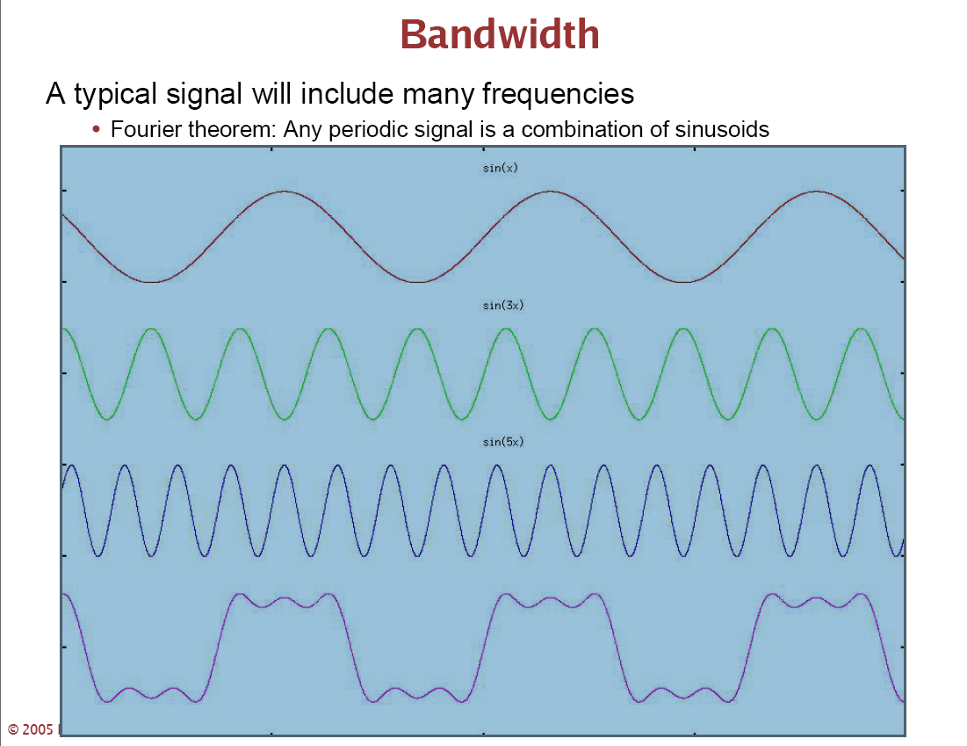

Slide 15
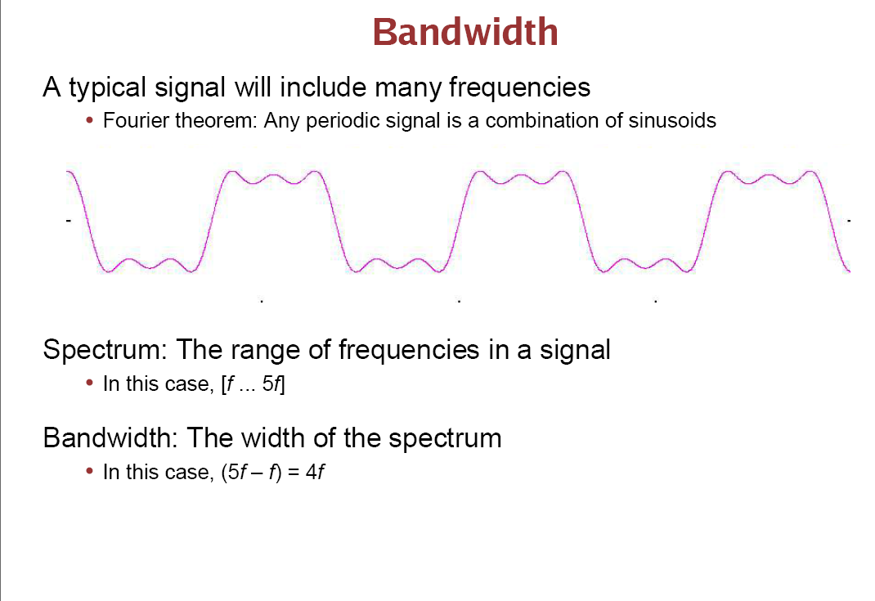

Slide 16
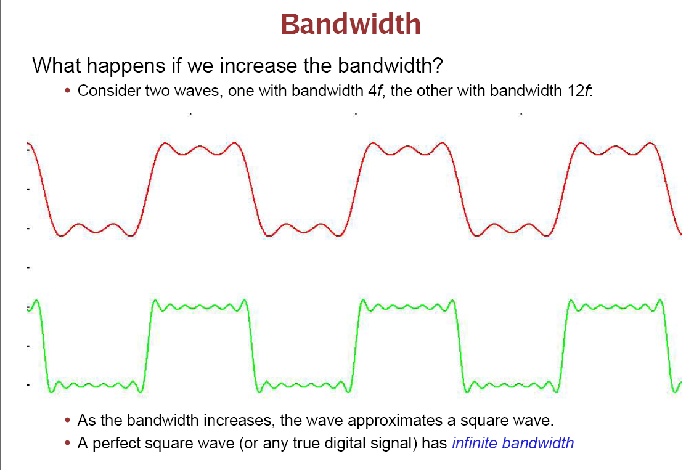

Slide 17
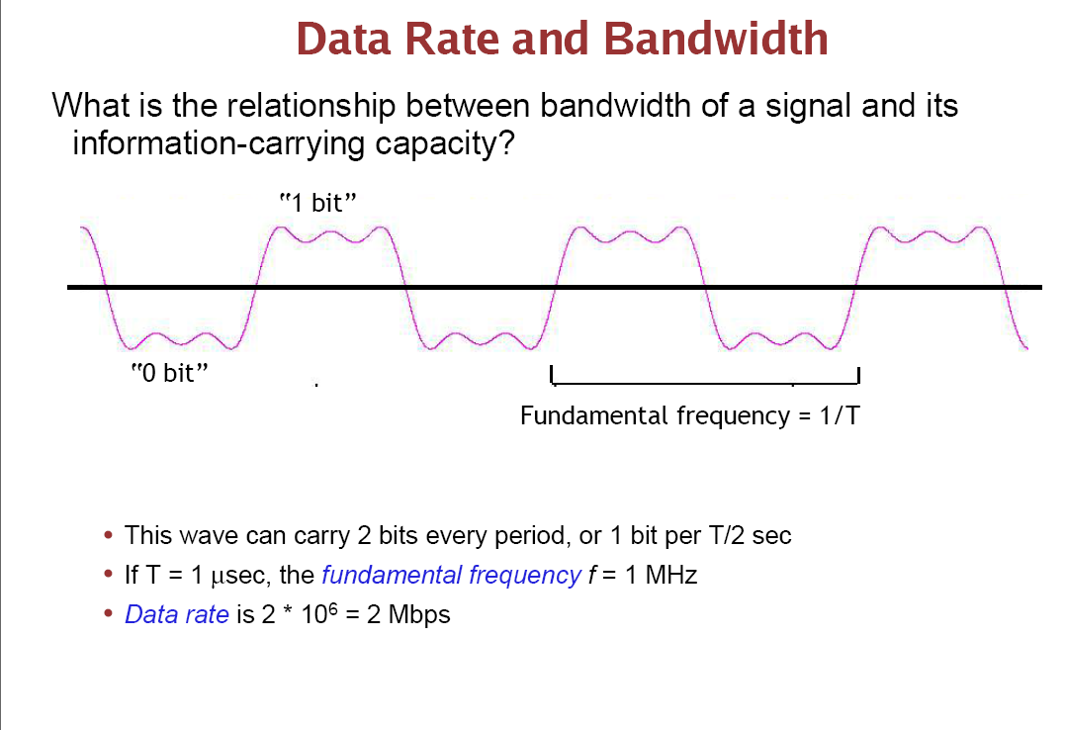

Slide 18
