Slide 1
Mobile app concepts
Mobile cellular network fundamentals and different generations

Slide 2
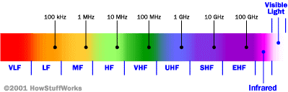
Cellular Network Basics
There are many types of cellular services; before delving into details, focus on basics (helps navigate the “acronym soup”)
Cellular network/telephony is a radio-based technology; radio waves are electromagnetic waves that antennas propagate
Most signals are in the 850 MHz, 900 MHz, 1800 MHz, and 1900 MHz frequency bands
Cell phones operate in this frequency range (note the logarithmic scale)

Slide 3
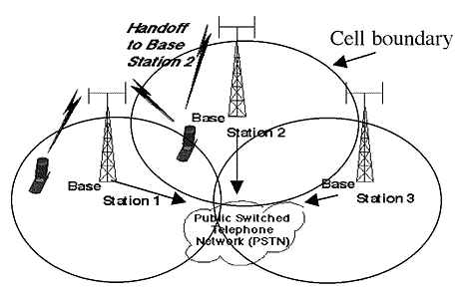
Cellular Network
Base stations transmit to and receive from mobiles at the assigned spectrum
Multiple base stations use the same spectrum (spectral reuse)
The service area of each base station is called a cell
Each mobile terminal is typically served by the ‘closest’ base stations
Handoff when terminals move

Slide 4
Cellular Network Generations
It is useful to think of cellular Network/telephony in terms of generations:
0G: Briefcase-size mobile radio telephones
1G: Analog cellular telephony
2G: Digital cellular telephony
3G: High-speed digital cellular telephony (including video telephony)
4G: IP-based “anytime, anywhere” voice, data, and multimedia telephony at faster data rates than 3G (to be deployed in 2012–2015)

Slide 5
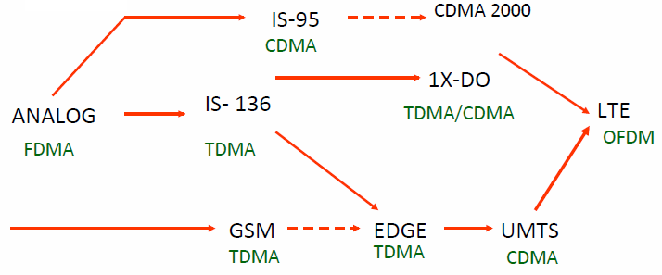
Evolution of Cellular Networks
1G
2G
2.5G
3G
4G

Slide 6
The Multiple Access Problem
The base stations need to serve many mobile terminals at the same time (both downlink and uplink)
All mobiles in the cell need to transmit to the base station
Interference among different senders and receivers
So we need multiple access scheme

Slide 7
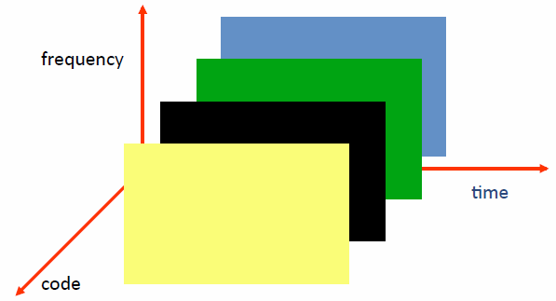
Multiple Access Schemes
3 orthogonal Schemes:
Frequency Division Multiple Access (FDMA)
Time Division Multiple Access (TDMA)
Code Division Multiple Access (CDMA)

Slide 8
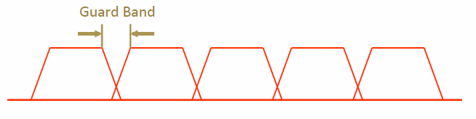
Frequency Division Multiple Access
frequency
Each mobile is assigned a separate frequency channel for the duration of the call
Sufficient guard band is required to prevent adjacent channel interference
Usually, mobile terminals will have one downlink frequency band and one uplink frequency band
Different cellular network protocols use different frequencies
Frequency is a precious and scare resource. We are running out of it!

Slide 9
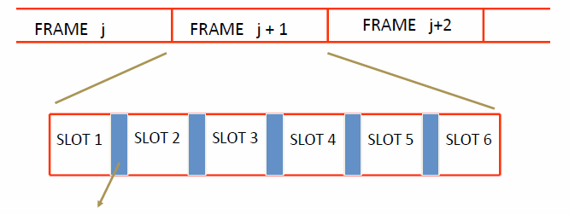
Time Division Multiple Access
Guard time – signal transmitted by mobile terminals at different locations do no arrive at the base station at the same time
Time is divided into slots and only one mobile terminal transmits during each slot
Like during the lecture, only one can talk, but others may take the floor in turn
Each user is given a specific slot. No competition in cellular network
Unlike Carrier Sensing Multiple Access (CSMA) in WiFi

Slide 10
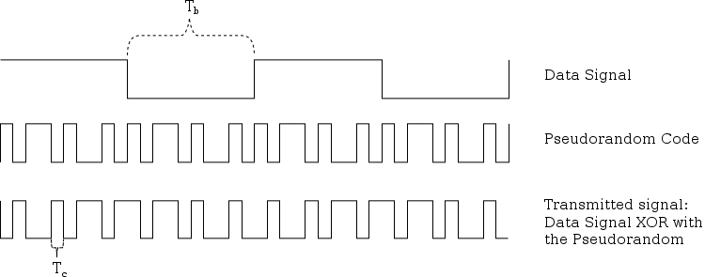
Code Division Multiple Access
Use of orthogonal codes to separate different transmissions
Each symbol of bit is transmitted as a larger number of bits using the user specific code – Spreading
Bandwidth occupied by the signal is much larger than the information transmission rate
But all users use the same frequency band together
Orthogonal among users

Slide 11
2G(GSM)

Slide 12
GSM
Abbreviation for Global System for Mobile Communications
Concurrent development in USA and Europe in the 1980’s
The European system was called GSM and deployed in the early 1990’s

Slide 13
GSM Services
Voice, 3.1 kHz
Short Message Service (SMS)
1985 GSM standard that allows messages of at most 160 chars. (incl. spaces) to be sent between handsets and other stations
Over 2.4 billion people use it; multi-billion $ industry
General Packet Radio Service (GPRS)
GSM upgrade that provides IP-based packet data transmission up to 114 kbps
Users can “simultaneously” make calls and send data
GPRS provides “always on” Internet access and the Multimedia Messaging Service (MMS) whereby users can send rich text, audio, video messages to each other
Performance degrades as number of users increase
GPRS is an example of 2.5G telephony – 2G service similar to 3G

Slide 14


GSM Channels
Downlink
Channels
Uplink
Physical Channel: Each timeslot on a carrier is referred to as a physical channel
Logical Channel: Variety of information is transmitted between the MS and BTS. Different types of logical channels:
Traffic channel
Control Channel

Slide 15
GSM Frequencies
Originally designed on 900MHz range, now also available on 800MHz, 1800MHz and 1900 MHz ranges.
Separate Uplink and Downlink frequencies
One example channel on the 1800 MHz frequency band, where RF carriers are space every 200 MHz
UPLINK FREQUENCIES
DOWNLINK FREQUENCIES
1710 MHz
1785 MHz
1805 MHz
1880 MHz
UPLINK AND DOWNLINK FREQUENCY SEPARATED BY 95MHZ

Slide 16
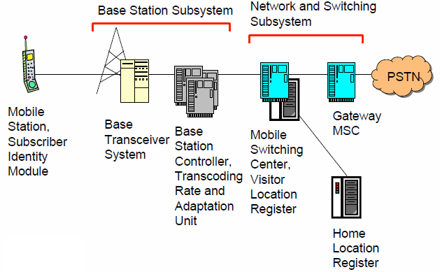
GSM Architecture

Slide 17
Mobile Station (MS)
MS is the user’s handset and has two parts
Mobile Equipment
Radio equipment
User interface
Processing capability and memory required for various tasks
Call signalling
Encryption
SMS
Equipment IMEI number
Subscriber Identity Module

Slide 18
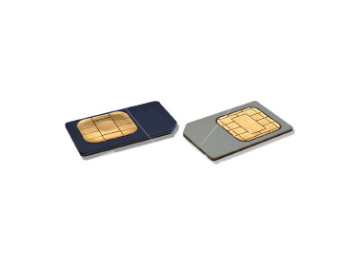
Subscriber Identity Module
A small smart card
Encryption codes needed to identify the subscriber
Subscriber IMSI number
Subscriber’s own information (telephone directory)
Third party applications (banking etc.)
Can also be used in other systems besides GSM, e.g., some WLAN access points accept SIM based user authentication

Slide 19
Location Updates
The cells overlap and usually a mobile station can ‘see’ several transceivers (BTSes)
The MS monitors the identifier for the BSC controlling the cells
When the mobile station reaches a new BSC’s area, it requests an location update
The update is forwarded to the MSC, entered into the VLR, the old BSC is notified and an acknowledgement is passed back

Slide 20
3G, 3.5G and 4G (LTE)

Slide 21
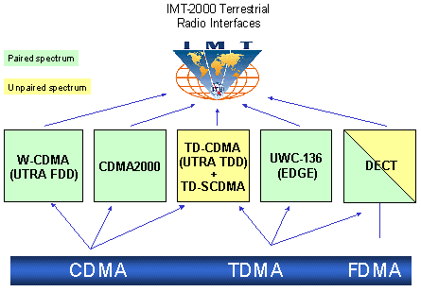
3G Overview
3G is created by ITU-T and is called IMT-2000

Slide 22
Evolution from 2G
2G
IS-95
GSM-
IS-136 & PDC
GPRS
2.5G
IS-95B
HSCSD
EDGE
Cdma2000-1xRTT
W-CDMA
3G
Cdma2000-1xEV,DV,DO
EDGE
TD-SCDMA
Cdma2000-3xRTT
3GPP2
3GPP

Slide 23
Service Roadmap
Improved performance, decreasing cost of delivery
3G-specific services take advantage of higher bandwidth and/or real-time QoS
Broadband
in wide area
Video sharing
Video telephony
Real-time IP
multimedia and games
Multicasting
A number of mobile services are bearer independent in nature
Multitasking
WEB browsing
Corporate data access
Streaming audio/video
MMS picture / video
xHTML browsing
Application downloading
E-mail
Voice & SMS
Presence/location
Push-to-talk
Typical average bit rates (peak rates higher)
GSM
9.6
kbps
GPRS
171
kbps
EGPRS
473
kbps
WCDMA
2
Mbps
HSDPA
1-10
Mbps
CDMA 2000 1x
CDMA 2000-EVDO
CDMA 2000-EVDV

Slide 24
GSM Evolution to 3G
High Speed Circuit Switched Data
Dedicate up to 4 timeslots for data connection ~ 50 kbps
Good for real-time applications c.w. GPRS
Inefficient -> ties up resources, even when nothing sent
Not as popular as GPRS (many skipping HSCSD)
Enhanced Data Rates for Global Evolution
Uses 8PSK modulation
3x improvement in data rate on short distances
Can fall back to GMSK for greater distances
Combine with GPRS (EGPRS) ~ 384 kbps
Can also be combined with HSCSD
GSM
9.6kbps (one timeslot)
GSM Data
Also called CSD
HSCSD
GSM
GPRS
WCDMA
General Packet Radio Services
Data rates up to ~ 115 kbps
Max: 8 timeslots used as any one time
Packet switched; resources not tied up all the time
Contention based. Efficient, but variable delays
GSM / GPRS core network re-used by WCDMA (3G)
EDGE

Slide 25
UMTS
Universal Mobile Telecommunications System (UMTS)
UMTS is an upgrade from GSM via GPRS or EDGE
The standardization work for UMTS is carried out by Third Generation Partnership Project (3GPP)
Data rates of UMTS are:
144 kbps for rural
384 kbps for urban outdoor
2048 kbps for indoor and low range outdoor
Virtual Home Environment (VHE)

Slide 26
3.5G (HSPA)
High Speed Packet Access (HSPA) is an amalgamation of two mobile telephony protocols, High Speed Downlink Packet Access (HSDPA) and High Speed Uplink Packet Access (HSUPA), that extends and improves the performance of existing WCDMA protocols
3.5G introduces many new features that will enhance the UMTS technology in future. 1xEV-DV already supports most of the features that will be provided in 3.5G. These include:
- Adaptive Modulation and Coding
- Fast Scheduling
- Backward compatibility with 3G
- Enhanced Air Interface

Slide 27
4G (LTE)
LTE stands for Long Term Evolution
Next Generation mobile broadband technology
Promises data transfer rates of 100 Mbps
Based on UMTS 3G technology
Optimized for All-IP traffic

Slide 28
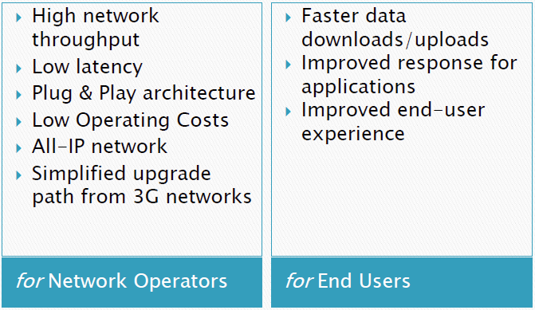
Advantages of LTE

Slide 29
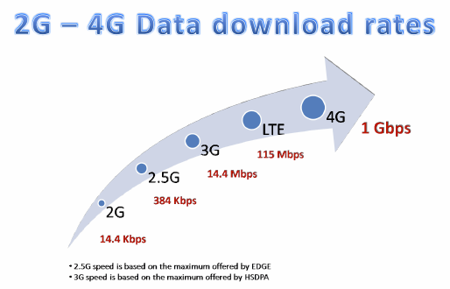
Comparison of LTE Speed

