Slide 1
Operation Systems
Introduction

Slide 2
OS Definition
What is an operation system?
An operation system is a collection of system programs that together control the operation of a computer system
So what is a computer system?
The operating system (OS) along with hardware, applications, other system software and users constitute a computer system
The one program running at all times on the computer” is the kernel. Everything else is either a system program (ships with the operating system) or an application program

Slide 3
OS Role/Goals
A program that acts as an intermediary between a user of a computer and the computer hardware.
Operating system goals:
Execute user programs and make solving user problems easier.
Make the computer system convenient to use.
Use the computer hardware in an efficient manner.

Slide 4
Computer system structure
Computer system can be divided into four parts
Hardware – provides basic computing resources
CPU, memory, I/O devices
Operating system
Controls and coordinates use of hardware among various applications and users
Application programs
Word processors, compilers, web browsers, database systems, video games
Users
People, machines, other computers

Slide 5
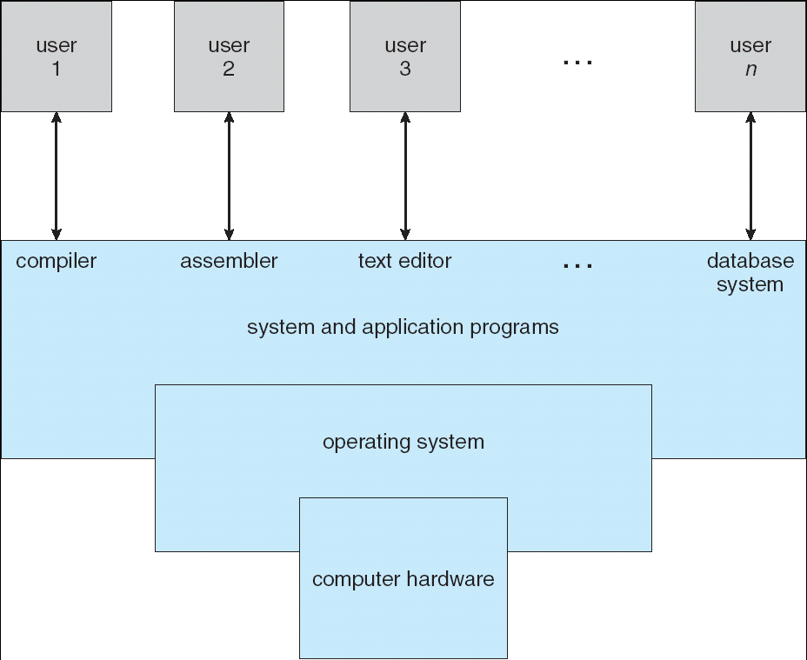
Computer system components

Slide 6
Starting an OS
Bootstrap loader locates the kernel and loads it into memory
Sometimes two-step process where boot block at fixed location loads bootstrap loader
When power initialized on system, execution starts at a fixed memory location

Slide 7
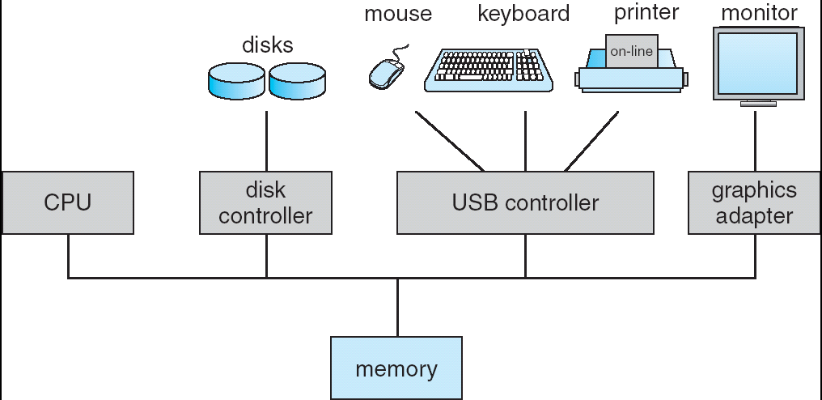
“Shared memory” bus
One or more CPUs, device controllers connect through common bus providing access to shared memory
Concurrent execution of CPUs and devices competing for memory cycles

Slide 8
Computer system operation
I/O devices and the CPU can execute concurrently.
Each device controller is in charge of a particular device type.
Each device controller has a local buffer.
CPU moves data from/to main memory to/from local buffers
I/O is from the device to local buffer of controller.

Slide 9
Interrupts
Device controller informs CPU that it has finished its operation by causing an interrupt.
Interrupt transfers control to the interrupt service routine generally, through the interrupt vector, which contains the addresses of all the service routines.
An operating system is interrupt driven.
The operating system preserves the state of the CPU by storing registers and the program counter.
Determines which type of interrupt has occurred:
Separate segments of code determine what action should be taken for each type of interrupt

Slide 10
Caching
Important concept, happens at many levels
Also an important concept in software development
Faster storage (cache) checked first to determine if information is there
If it is, information used directly from the cache (fast)
If not, data copied to cache and used there
Cache smaller than storage being cached
Cache management important design problem
Cache size and replacement policy

Slide 11
What is a register?
A register is one of a small set of data holding places that are part of a computer processor
A register may hold a computer instruction , a storage address, or any kind of data (such as a bit sequence or individual characters).
Some instructions specify registers as part of the instruction. For example, an instruction may specify that the contents of two defined registers be added together and then placed in a specified register.
A register must be large enough to hold an instruction - for example, in a 32-bit instruction computer, a register must be 32 bits in length

Slide 12
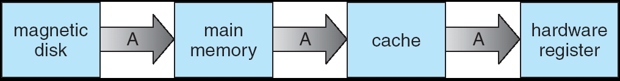
Migration of data from disk to register
Must be careful to use most recent value, no matter where it is stored in the storage hierarchy
E.g. an integer value = 10

Slide 13
Multiprogramming/Timesharing
Multiprogramming needed for efficiency
Single user cannot keep CPU and I/O devices busy at all times
Multiprogramming organizes jobs (code and data) so CPU always has one to execute
A subset of total jobs in system is kept in memory
One job selected and run via job scheduling
When it has to wait (for I/O for example), OS switches to another job
Timesharing (multitasking) is logical extension in which CPU switches jobs so frequently that users can interact with each job while it is running, creating interactive computing
Response time should be < 1 second
Each user has at least one program executing in memory process
If several jobs ready to run at the same time  CPU scheduling
If processes don’t fit in memory, swapping moves them in and out to run
Virtual memory allows execution of processes not completely in memory

Slide 14
Process Management
A process is a program in execution. It is a unit of work within the system.
Process needs resources to accomplish its task
CPU, memory, I/O, files
Initialization data
Process termination requires reclaim of any reusable resources
Single-threaded process has one program counter specifying location of next instruction to execute
Process executes instructions sequentially, one at a time, until completion
Multi-threaded process has one program counter per thread
Typically system has many processes, some user, some operating system running concurrently on one or more CPUs
Concurrency by multiplexing the CPUs among the processes / threads

Slide 15
Process Management
The operating system is responsible for the following activities in connection with process management:
Creating and deleting both user and system processes
Suspending and resuming processes
Providing mechanisms for process synchronization
Providing mechanisms for process communication
Providing mechanisms for deadlock handling

Slide 16
Memory Management
Memory management activities involve
Keeping track of which parts of memory are currently being used and by whom
Deciding which processes (or parts thereof) and data to move into and out of memory
Allocating and deallocating memory space as needed
Memory management determines what is in memory when
Optimizing CPU utilization and computer response to users

Slide 17
Storage management
OS provides uniform, logical view of information storage
Abstracts physical properties to logical storage unit - file
Each medium is controlled by device (i.e., disk drive, tape drive)
Varying properties include access speed, capacity, data-transfer rate, access method (sequential or random)
File-System management
Files usually organized into directories
Access control on most systems to determine who can access what
OS activities include
Creating and deleting files and directories
Primitives to manipulate files and dirs
Mapping files onto secondary storage
Backup files onto stable (non-volatile) storage media

Slide 18
I/O Subsystem
One purpose of OS is to hide peculiarities of hardware devices from the user
I/O subsystem responsible for
Memory management of I/O including buffering (storing data temporarily while it is being transferred), caching (storing parts of data in faster storage for performance), spooling (the overlapping of output of one job with input of other jobs)
General device-driver interface
Drivers for specific hardware devices

Slide 19
OS Services
OS provides the following services:
User interface CLI/GUI
Program Execution
I/O Operations
File system manipulation
Process communication (local or network)
Error detection
Resource allocation (multi users-multi jobs)
Accounting/auditing
Protection and security

Slide 20
GUI vs CLI
CLI allows direct command entry
Sometimes implemented in kernel, sometimes by systems program
Sometimes multiple flavors implemented – shells
GUI = User-friendly desktop metaphor interface
Usually mouse, keyboard, and monitor
Icons represent files, programs, actions, etc
Various mouse buttons over objects in the interface cause various actions (provide information, options, execute function, open directory (known as a folder)

Slide 21
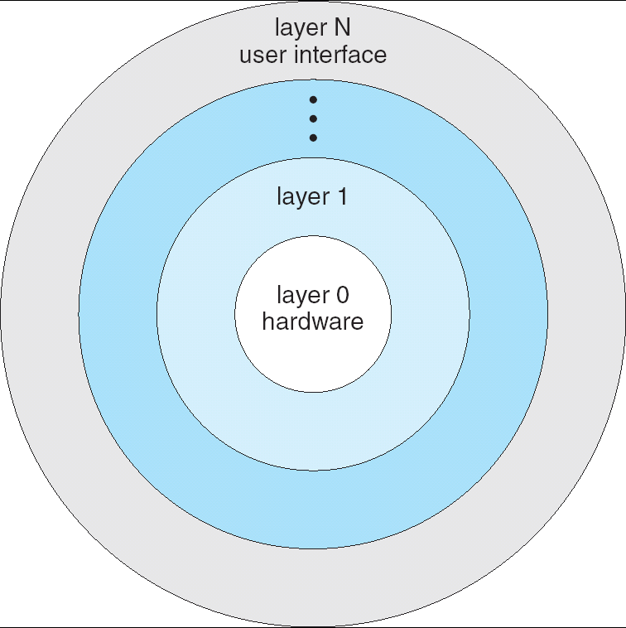
OS usually layered

Slide 22
Virtual machines
A virtual machine (VM) is a software implementation of a machine (i.e. a computer) that executes programs like a physical machine.
System virtual machine advantages:
multiple OS environments can co-exist on the same computer, in strong isolation from each other
the virtual machine can provide an instruction set architecture (ISA) that is somewhat different from that of the real machine
application provisioning, maintenance, high availability and disaster recovery^{[3]}
The main disadvantages of VMs are:
a virtual machine is less efficient than a real machine when it accesses the hardware indirectly
when multiple VMs are concurrently running on the same physical host, each VM may exhibit a varying and unstable performance (Speed of Execution, and not results), which highly depends on the workload imposed on the system by other VMs

Slide 23
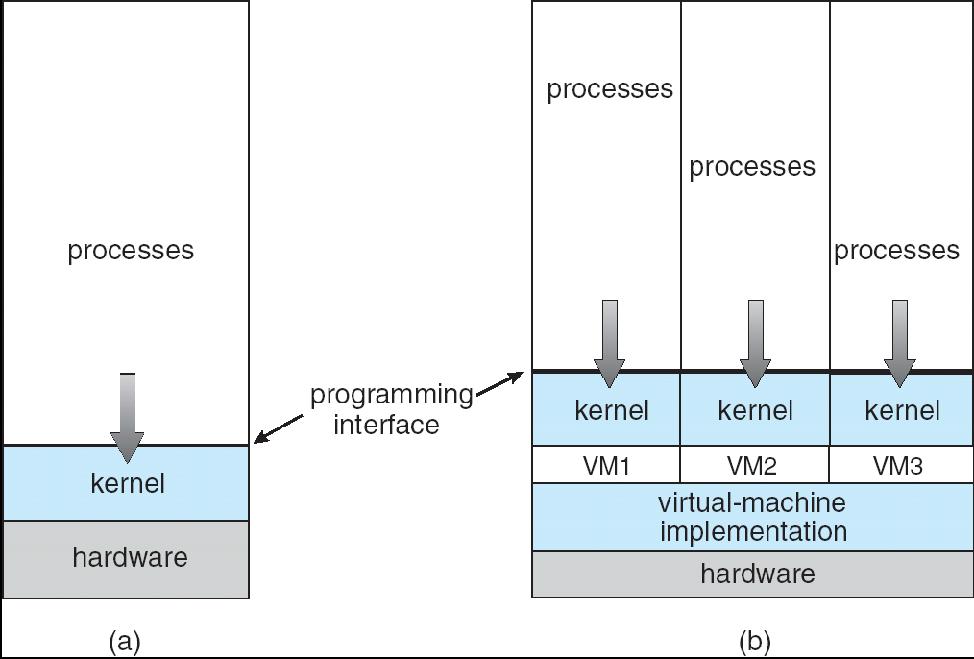
Non-VM (a) vs VM (b)

Slide 24
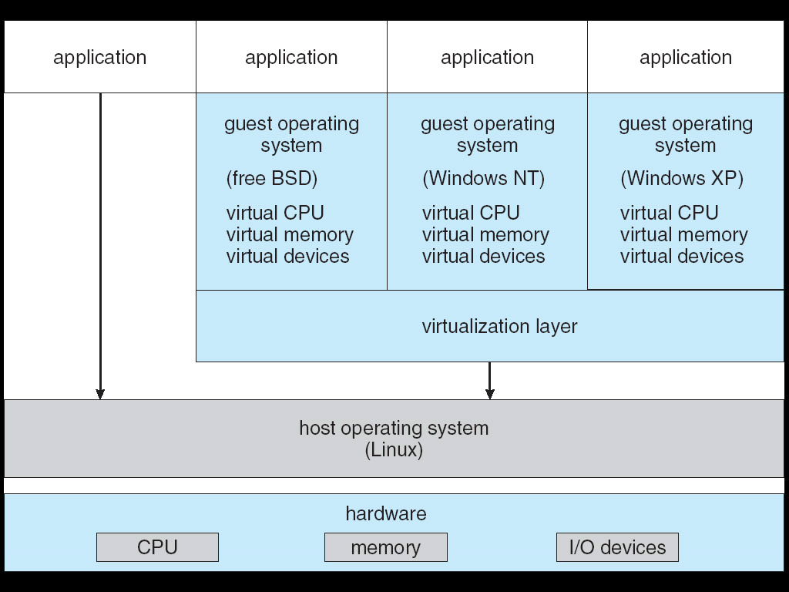
VMWare example

