Slide 1
Operation Systems
Process

Slide 2
Summary
We are going to cover:
What is a process
Process scheduling
Process operations

Slide 3
What is a process?
In computing, a process is an instance of a computer program that is being executed.
It contains the program code and its current activity. Depending on the operating system (OS), a process may be made up of multiple threads of execution that execute instructions concurrently.

Slide 4
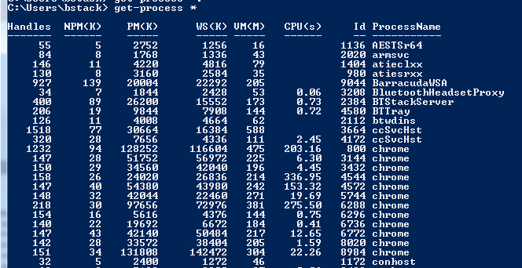
What is a process continued…
An OS executes a variety of programs
Each one of these is a process

Slide 5
Process states
A process can be in the following states:
New (Process being created)
Running (Instructions being executed)
Waiting (Waiting for some event to occur)
Ready (Waiting to be assigned to a processor)
Terminated (Process has finished execution)

Slide 6
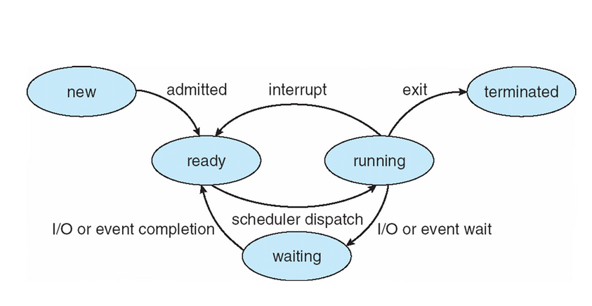
Process state diagram

Slide 7
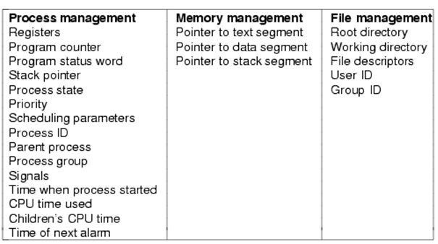
Process Control Block (PCB)
OS has a process table
1 entry per process
Entries sometimes called process control block - PCB

Slide 8
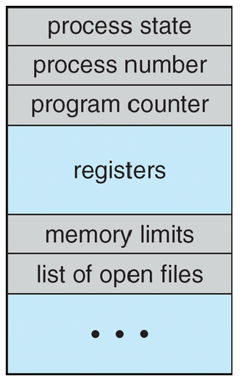
PCB Block
Actual entries are system dependent
Contains
Process state
Program counter
CPU registers
CPU scheduling info
Memory management info
Account info
I/O status info

Slide 9
Process scheduler
Objective of multiprogramming is to have some process running at all times to maximise CPU utilisation
The scheduler (part of OS) selects a process from those available for execution on the CPU
Will look at how scheduling algorithms can perform this later

Slide 10
Process context switching
When CPU switches to another process, the system must save the state of the old process and load the saved state for the new process via a context switch
Context of a process represented in the PCB
Context-switch time is overhead; the system does no useful work while switching
Time dependent on hardware support – typically a few milliseconds

Slide 11
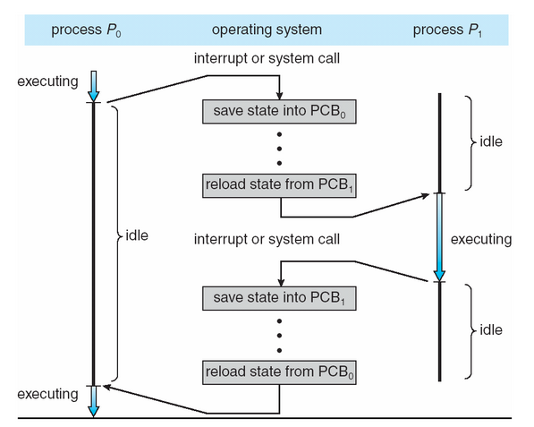
Process context switching

Slide 12
Process scheduling queues
Job queue
set of all processes in the system
Ready queue
set of all processes residing in main memory, ready and waiting to execute
Device queues
set of processes waiting for an I/O device
Processes move among the various queues

Slide 13
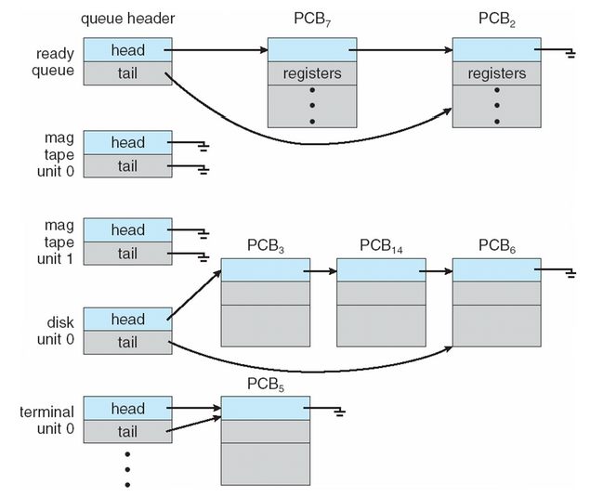
Ready Queue And Various I/O Device Queues

Slide 14
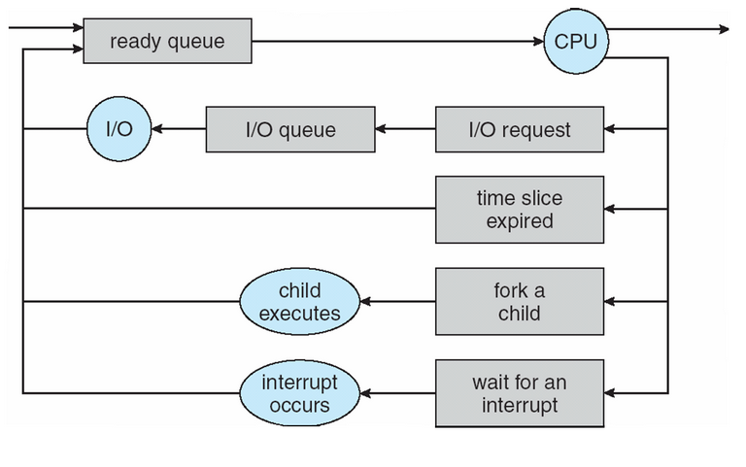
Process scheduling diagram

Slide 15
Process scheduler types
Long-term scheduler (or job scheduler)
selects which processes should be brought into the ready queue – usually in batch systems (main frames)
Short-term scheduler (or CPU scheduler)
selects which process should be executed next and allocates CPU

Slide 16
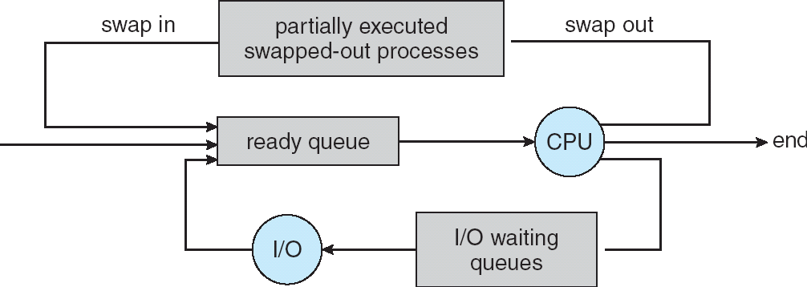
Addition of medium term scheduling

Slide 17
Schedulers continued…
Short-term scheduler is invoked very frequently (milliseconds) ⇒ (must be fast)
Long-term scheduler is invoked very infrequently (seconds, minutes) ⇒ (may be slow)
The long-term scheduler controls the degree of multiprogramming
Processes can be described as either:
I/O-bound process – spends more time doing I/O than computations, many short CPU bursts
CPU-bound process – spends more time doing computations; few very long CPU bursts

Slide 18
Process creation/termination
Creation
Parent process create children processes, which, in turn create other processes, forming a tree of processes
Address space
Child duplicate of parent
Child has a program loaded into it
UNIX examples
fork system call creates new process
exec system call used after a fork to replace the process’ memory space with a new program
Termination
Process executes last statement and asks the operating system to delete it (exit)
Output data from child to parent (via wait)
Process’ resources are deallocated by operating system
Parent may terminate execution of children processes (abort)

Slide 19
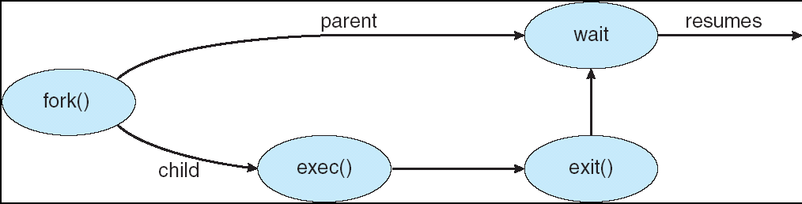
Process “Forking”
Process executes last statement and asks the operating system to delete it (exit)
Output data from child to parent (via wait)
Process’ resources are deallocated by operating system
Parent may terminate execution of children processes (abort)

