Slide 1
Anatomy of a computer

Slide 2
Going to cover
RAM
CPU
Clock
Execution
CPU Cooler
Motherboard
Components of note
Bus architecture

Slide 3
RAM (Random Access Memory)
Data is stored in random locations
Data can be accessed directly regardless of location
In contrast to hard drives etc where they have to spin to the location of the data before being able to access it.
Essentially a set of memory chips soldered onto a stick of circuit board

Slide 4
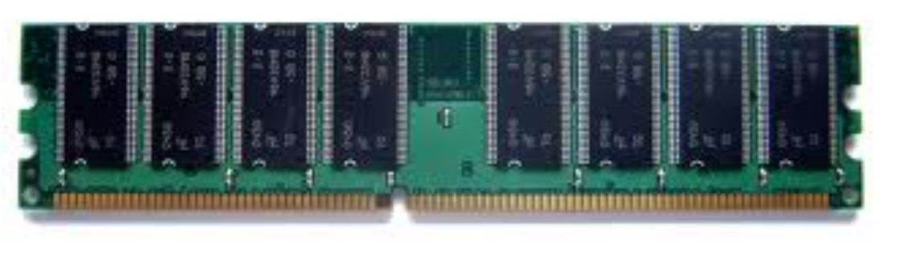
RAM
Blazing fast when compared to hard drives
RAM storage is volatile
Lost once computer is turned off
Like short term memory
Very important in software programs
Keep low memory footprint
OutOfMemoryException (beware)

Slide 5
CPU (Central Processing Unit)
Also known as the processor/microprocessor
Known as the “brains” of the computer
Housed in a single chip
Inserted directly into a CPU socket, pin side down on the motherboard
Modern CPUs are attached to a heat sink to dissipate heat

Slide 6
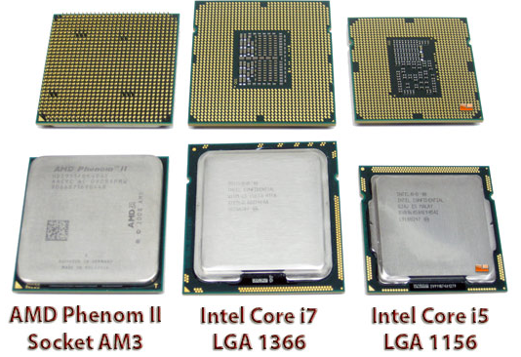
CPU (Central Processing Unit)
Anonymous processing
Uses a clock
Executes instructions
Uses a bus
Can have many cores

Slide 7
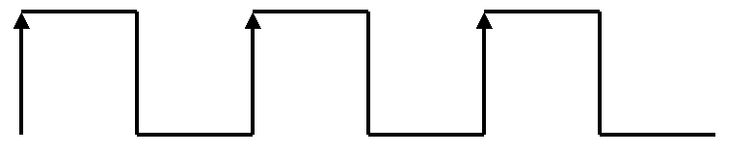
CPU Clock
Used to “sync” instructions in a computer
Typical clock signal, square signal changing from 0 to 1 at a fixed rate
3 full cycles shown (ticks)
Measured in Hertz, 100MHz = 100 million ticks per second

Slide 8
CPU Clock
Clock cycle for each instruction is stored in tables
Queues instructions based on “delay”
Two identical processors, better clock speed = better performance
CPUs have many execution units
Also has an external clock for transferring data to and from RAM

Slide 9
CPU External clock
Used when transferring data to and from RAM
When internal clock speeds got too fast, a slower external clock was needed

Slide 10
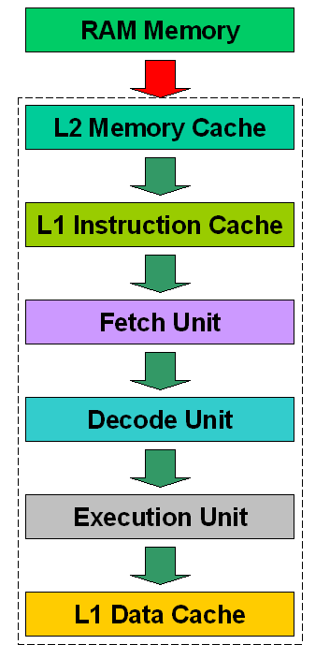
Block diagram of a CPU
Dotted line represents the CPU body
RAM outside CPU
Red arrow (external clock)
Other arrows (Internal clock)

Slide 11
Memory cache
High performance memory
Can work at same speed as the CPU clock
Static memory, consumes more power than dynamic memory but is much faster
Cache controller manages memory cache
Bigger the memory cache, less likely direct memory access is required
Hit = data in memory cache, Miss = data in RAM

Slide 12
Instruction/Data Cache
L1 Instruction cache works as an input cache, lining up instructions to be executed
Data cache simply an output cache
L1 Instruction cache particularly efficient for “looping behaviour” as required instructions are closer to the fetch unit

Slide 13
Fetch/Decode/Execute
Also known as an instruction cycle or FDX
Fetch
Gets data from RAM via an address bus and stores internally in CPU. Data received by CPU via data bus
Decode
CPU decodes the instruction just fetched and prepares various areas of chip for next step
Execute
Instruction is carried out on the data and output stored in data cache

Slide 14
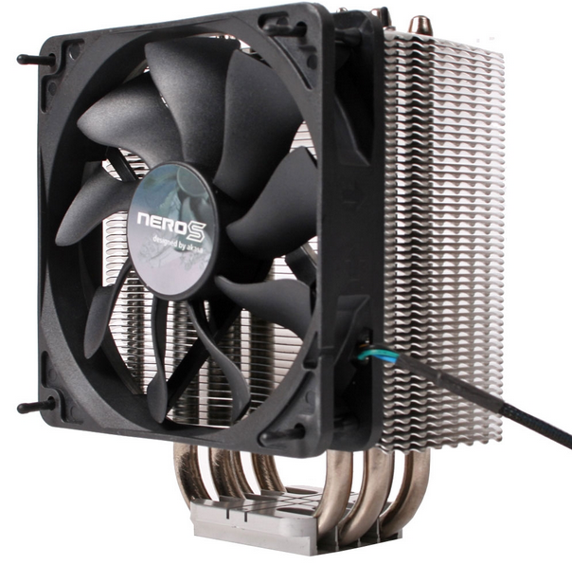
CPU Cooler
Also known as a heat sink or CPU fan
Often bundled with CPUs
Other heat sinks are used in a computer
Transfers thermal energy from a higher temperature device to a lower temperature fluid medium

