Slide 1
File Systems

Slide 2
Definition
A file system is the a system that your computer uses for managing files on the hard drive.
File system characteristics:
Efficiently utilises HDD space
Catalogs all files for fast/efficient retrieval
Provides basic operations (Delete, rename, copy, move etc)
Provides a data structure to allow computer boot off file system
Other features (compression, encryption etc)

Slide 3
FAT
File Allocation Table
Invented in 1977 by Bill Gates
FAT is still compatible with various devices
FAT16, FAT32, exFAT
Ideal if working with SD cards or external drives as well supported

Slide 4
FAT - variants
There are three basic variants of the FAT file system, which differ mainly in the construction of the actual file allocation table.
Floppy disks and small hard disks usually use the 12-bit version, which was superseded by the 16-bit version as hard disks became bigger.
This in turn was superseded by the 32-bitversion as disks became bigger still. We shall concentrate on the 16-bit version, since the 12-bit version can be tricky for beginners, and the 32-bit version is more complex than needed for this course

Slide 5
FAT16 – allocation units
All blocks (sectors) are the same size, 512 bytes, on practically all FAT file systems. Howewer, large disks can have too many blocks for comfort, so blocks are sometimes grouped together. Each such grouping is called an allocation unit.
The FAT file system actually works in allocation units, not blocks, but for simplicity we shall assume that each allocation unit contains exactly one block

Slide 6

FAT16 file system volume
Consists of:
Boot block
File allocation table
Disk root directory
File data area

Slide 7
FAT16 - Boot block
Occupies the first block of the disk
Holds a special program for loading the o/s into memory (bootstrapping porogram)
Contains critical file system information also:
Number of File Allocation tables
Number of bytes per block
Number of blocks per allocation unit
And a lot more settings

Slide 8
FAT16 – File Allocation Table
Comes immediately after the boot block
An option second FAT may exist also, which comes directly after the first on a new block. Most hard drives only have 1 FAT
For FAT16, each entry in FAT table is 2 bytes in length
One entry for every block on the disk

Slide 9
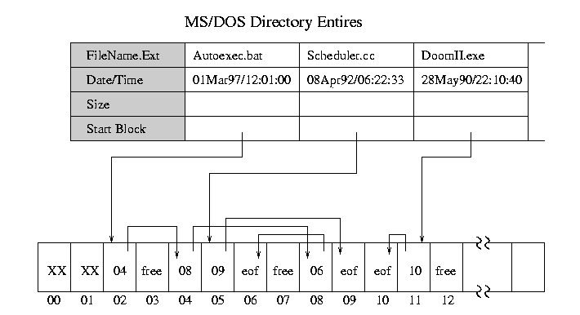
FAT16 – File Allocation Table
Cluster number usually contains:
Successor cluster number
Marker of being the last cluster in the file
Indication that the cluster is free

Slide 10
FAT16 – Root directory
Contains an entry for each for each file whose name appears at the root
Can contain subdirectories
Space for the root directory is allocated statically
Only a finite number of files can appear in the root directory

Slide 11
NTFS
New Technology File System
Introduced in 1993
Can handle:
Very large file sizes
Very large disk sizes
Security
Provides a combination of performance, reliability, and compatibility not found in the FAT file system
Designed to quickly perform standard file operations such as read, write, search and even advanced operations such as file-system recovery on very large hard disks

Slide 12

NTFS Volume
The following figure illustrates the layout of an NTFS volume when formatting has finished:
Partition boot sector generally serves similar purposes to boot sector in FAT16
Big difference is in the Master File Table

Slide 13
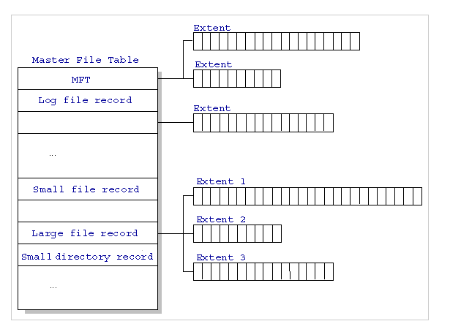
NTFS – Master File Table
Allocates space for each record
Small files (512 bytes or smaller) can be contained entirely within MFT
Small directory records reside entirely within the MFT structure.
Design makes this access very fast
Large directories and files are organized into B-trees, having records with pointers to external clusters containing directory entries that could not be contained within the MFT structure

Slide 14
NTFS – More efficient than FAT
Consider, the FAT file system, which uses a file allocation table to list the names and addresses of each file. FAT directory entries contain an index into the file allocation table.
When you want to view a file, FAT first reads the file allocation table and assures that it exists. Then FAT retrieves the file by searching the chain of allocation units assigned to the file.
With NTFS, as soon as you look up the file, it's there for you to use

Slide 15
NTFS vs FAT16
NTFS more efficient
NTFS can work on larger HDDs, FAT16 can only work on small HDDs - outdated
NTFS has better security because you can use permissions and encryption to restrict access to specific files to approved users
The capability to recover from some disk-related errors automatically, which FAT16 cannot

