Slide 1
Variables

Slide 2

Variable Declaration\Assignment
Variable data type
Variable name
Variable assignment
Variable value

Slide 3
Variable naming
Case sensitive
An unlimited sequence of unicode letters and digits
Must start with a letter, underscore or character – convention usually is letter
Use full words instead of abbreviations
Name cannot be a reserved word
Use camelCasing
Constants in uppercase

Slide 4
Primitive data types
byte – 8-bit integer (-128 to 127)
short – 16 bit integer (-32768 - 32767)
int – 32 bit (-2,147,483,648 - -2,147,483,647)
long – 64 bit
float – 32 bit floating point number
double – 64 bit floating point number
boolean – True/false
char – a single 16 bit unicode character

Slide 5

Character strings
Represented by the java.lang.String class
Immutable – cannot change
Not a primitive type but due to special support, is often thought as such

Slide 6
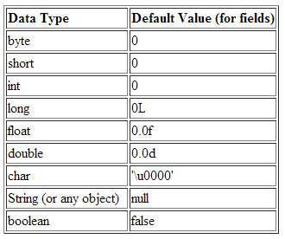

Default values
Variables declared but not set have a default value:
Eg x above will by default have a value of 0

Slide 7
Variable scope
Class scope
The variable is accessible throughout the whole class
Method scope
The variable is accessible in the method only
Block scope
The variable is accessible in the block of code only

Slide 8
Variable declaration exercises
Declare a variable to store your age
Declare a variable to store any value between 0 and 100
Declare a variable to store the value 20000
Declare a variable to store the name “Joe Bloggs”

