Slide 1
Keyboard Input and Screen Output

Slide 2
The Scanner class
Enables you to read in data from the console
Is located in java.util library
Simple text scanner that can parse primitive types and strings using regular expressions
Breaks input into tokens using a delimiter pattern which defaults to whitespace

Slide 3
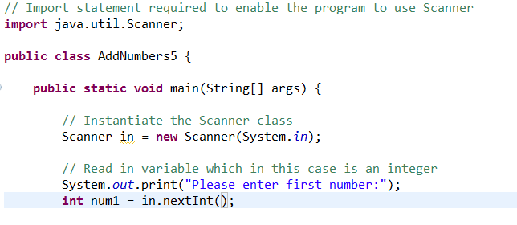
How to use the Scanner class - Console
Import
Instantiate
Scan in input

Slide 4
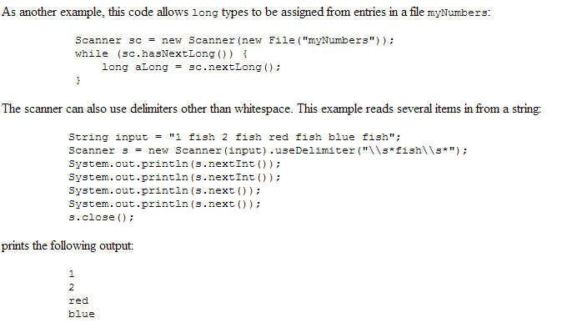
Other uses of Scanner
Scan from file
Scan from straight text
Using other delimiters

Slide 5
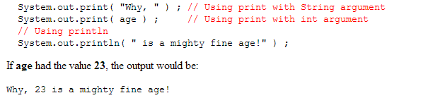
Screen output
System.out.println
Prints text
Prints variables
Prints variables + text
System.out.print

Slide 6
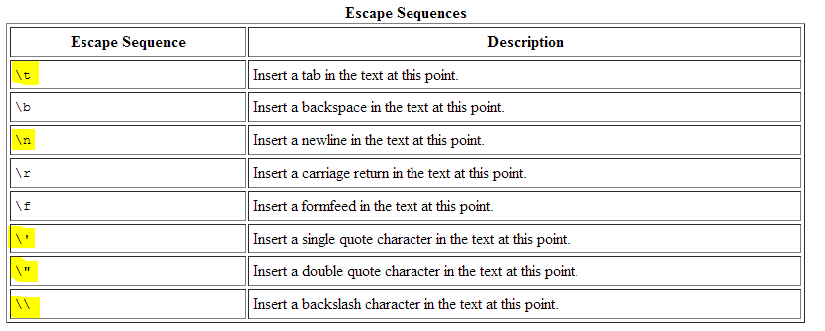
String concatenation/ escape sequences
Use + for concatenation

Slide 7
Formatting numbers - DecimalFormat
Enables you to format numbers
Is located in java.text library
Can format by specifying a pattern
Pattern we will be using is “#.00”
Try #.000
Try 000.00
Try #.#

Slide 8
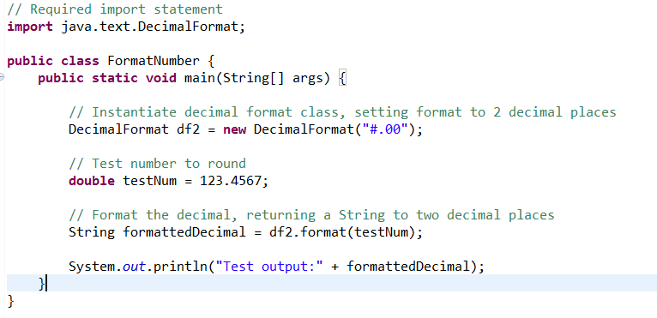
Formatting numbers - DecimalFormat

Slide 9
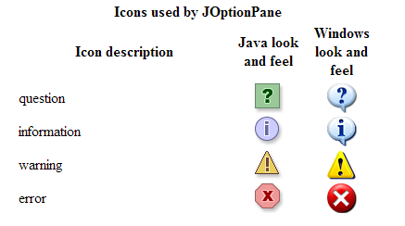
JOptionPane
Enables you to create and customize several kinds of dialogs
Provide icons
Specify the dialog title and text
Customize the button text

Slide 10
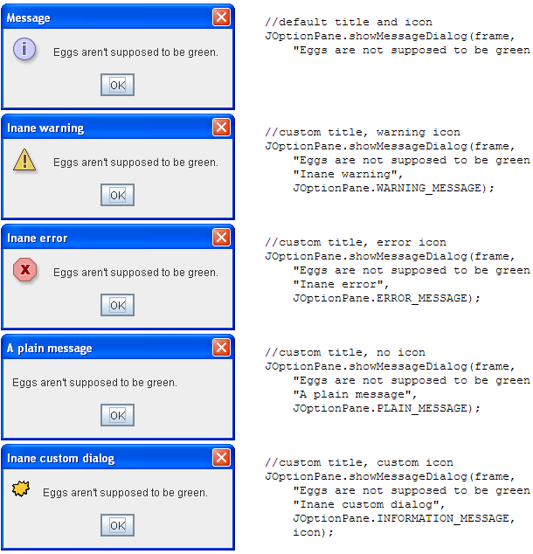
JOptionPane – show message dialog

Slide 11
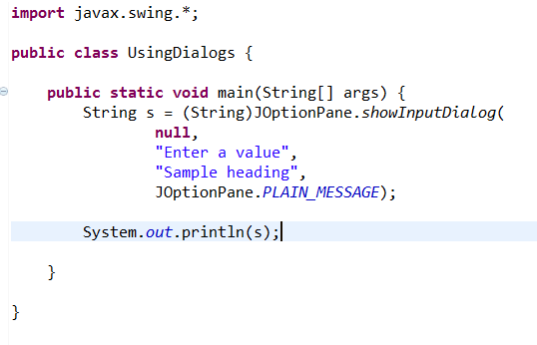
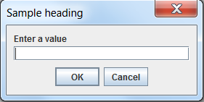
JOptionPane - showInputDialog

Slide 12
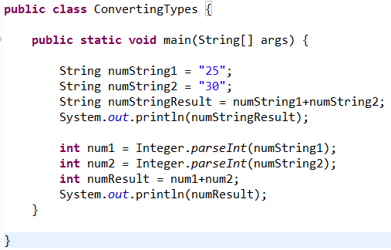
Converting from one type to another
Double.parseDouble
Byte.parseByte

