Slide 1
Control Statements

Slide 2
Flow of control
So far, the order of statement execution has been linear: one statement after another in sequence
However some programming statements allow us to:
decide whether or not to execute a particular statement
If statement
execute a statement over and over, repetitively
For loop
These decisions are based on boolean conditions that evaluate to true or false
The order of statement execution is called the flow of control

Slide 3
Conditional statements
In Java we have the following:
If statement
If-else statement
Switch statement

Slide 4
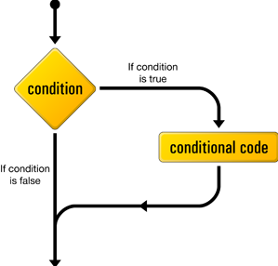
If statement syntax
Condition is boolean true or false
Conditional code only gets executed if condition is true

Slide 5
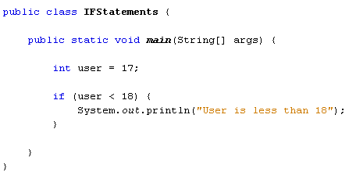
If statement example
Lets show an example of user = 18 and 19
Print out boolean expression demonstrating true/false
Note braces – also demo one line braces omitted
Note use of boolean operator we have done in previous lab
Note Indentation

Slide 6
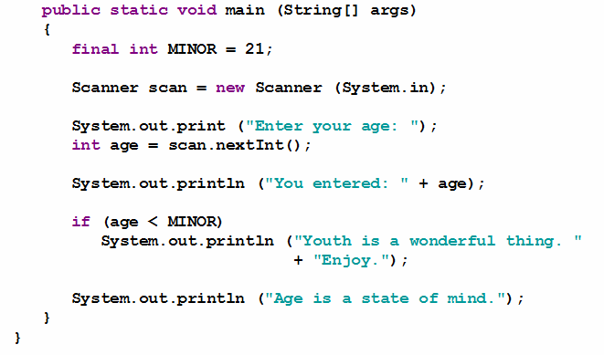
Code after if gets executed regardless
Demo this code

Slide 7
Code indentation/Neatness
Remember to write code as if you are writing for someone else
Indentation very important
Spacing important
Variable naming (if variable involved)

Slide 8
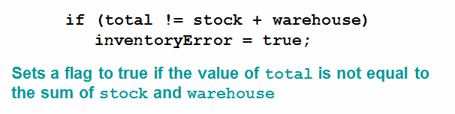
Precedence
The precedence of arithmetic operators is higher than equality and relational operators

Slide 9
Boolean logical operators in if statements
Remember the following boolean operators:
! Logical NOT
|| Logical OR
&& Logical AND
Show examples
if(age > 12 && age <18)
if(age > 65 || age <18)
if(!processedAlready)

Slide 10

Logical AND/OR Short Circuited
If the left operand is sufficient to evaluate the result, the right operand is not evaluated
Demo examples
Note that we cant have a situation where we divide by zero

Slide 11
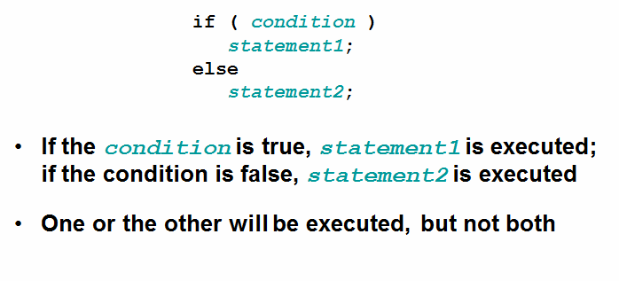
If-else statement
An else statement can be added to an if statement to make it and if-else statement
Show example

Slide 12
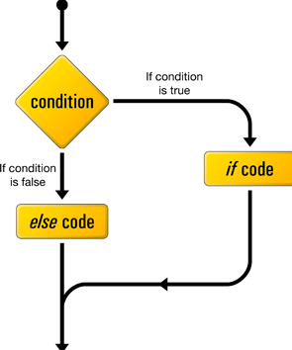
If-else syntax
Condition is boolean true or false
If code only gets executed if condition is true
Else code only gets executed if condition is true

Slide 13
Nested Ifs
You can have if statements within another if statement
You can have if/else statements within another if/else statement
Can be complicated to read –KISS!
Think of the person who has to read the code 6 months later

Slide 14
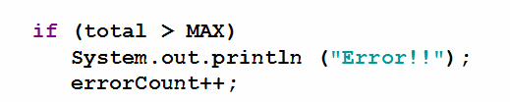
Indentation not always as seems
Compiler ignores indentation
For human readbility
Regardless of result, increment will always occur!

Slide 15
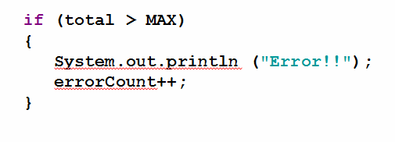
Block statements
Several statements can be grouped together into a block statement delimited by braces
A block statement can be used wherever a statement is called for in the Java syntax rules
Same applies for if/else statements

Slide 16
Switch statement
The switch statement provides another way to decide which statement to execute next
The switch statement evaluates an expression, then attempts to match the result to one of several possible cases
Each case contains a value and a list of statements
The flow of control transfers to statement associated with the first case value that matches
Switch must be on an int of a char, not boolean like if and if/else statements

Slide 17
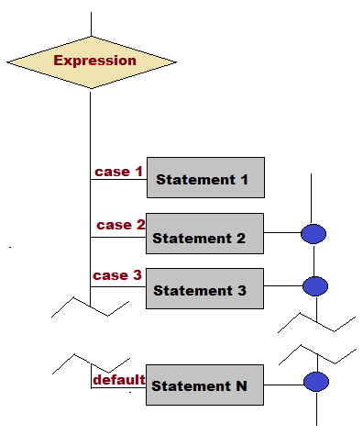
Switch statement syntax

Slide 18
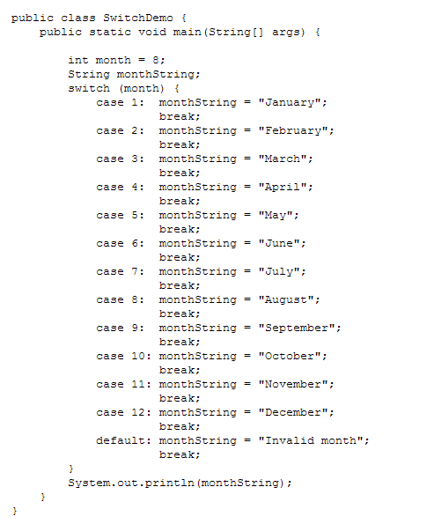
Switch statement example

Slide 19
Switch “break” statement
Often a break statement is used as the last statement in each case's statement list
A break statement causes control to transfer to the end of the switch statement
If a break statement is not used, the flow of control will continue into the next case
Sometimes this may be appropriate, but often we want to execute only the statements associated with one case

Slide 20
Switch “default” case
A switch statement can have an optional default case
The default case has no associated value and simply uses the reserved word default
If the default case is present, control will transfer to it if no other case value matches
If there is no default case, and no other value matches, control falls through to the statement after the switch

