Slide 1
Introduction Chapter 1
Revised: August 2011
Notes:
Gray units can be optionally omitted without causing later gaps

Slide 2
Network Hardware
Networks can be classified by their scale:
Scale | Type
Vicinity | PAN (Personal Area Network) »
Building | LAN (Local Area Network) »
City | MAN (Metropolitan Area Network) »
Country | WAN (Wide Area Network) »
Planet | The Internet (network of all networks)
Notes:
An “internetwork” is any larger network made up of smaller component networks. The “Internet” (with a capital I) is the set of all connected networks.

Slide 3
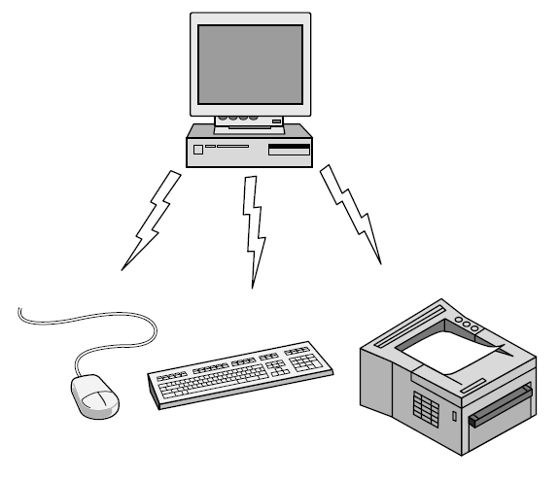
Personal Area Network
Connect devices over the range of a person
Example of a Bluetooth (wireless) PAN:

Slide 4
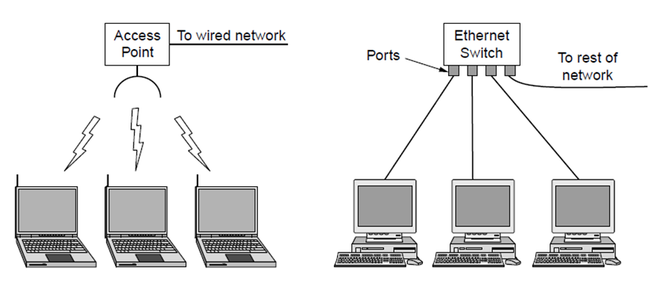
Local Area Networks
Connect devices in a home or office building
Called enterprise network in a company
Wireless LAN
with 802.11
Wired LAN with
switched Ethernet

Slide 5
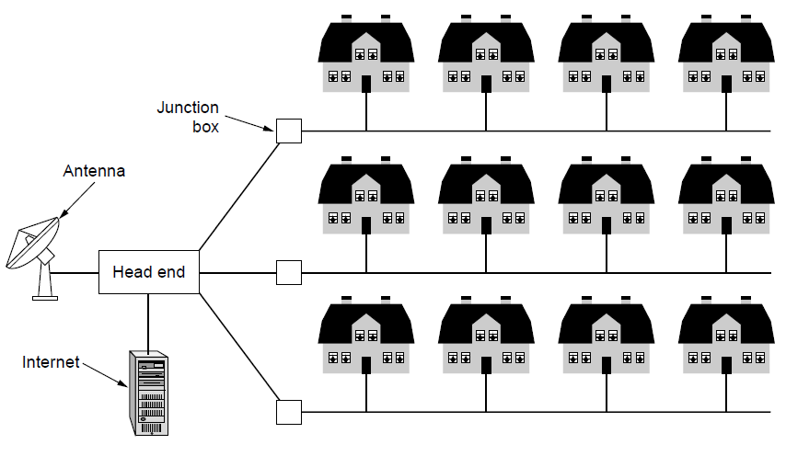
Metropolitan Area Networks
Connect devices over a metropolitan area
Example MAN based on cable TV:
Notes:
This is a common way in which home subscribers obtain access to the Internet in the US.

Slide 6
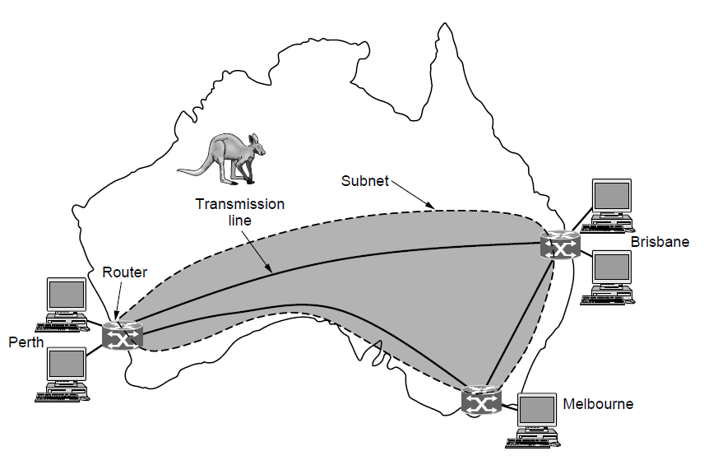
Wide Area Networks (1)
Connect devices over a country
Example WAN connecting three branch offices:
Notes:
The company probably leases the transmission lines (since most companies do not have their own lines).

Slide 7
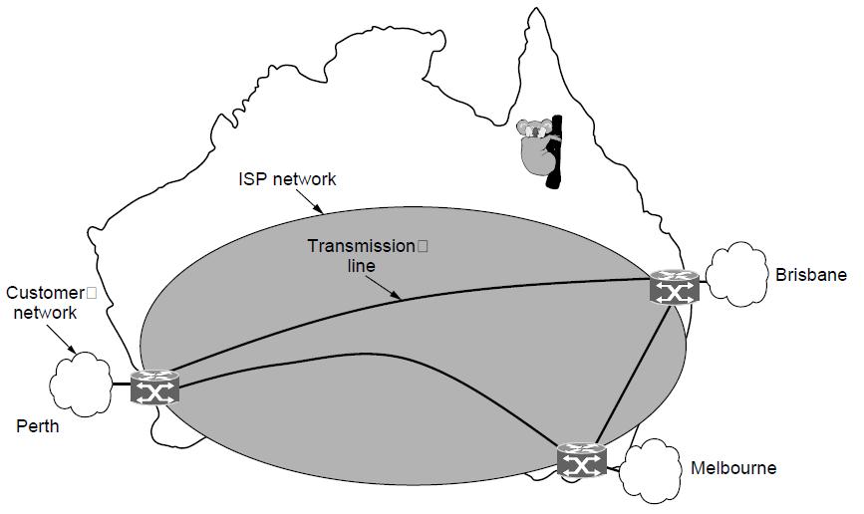
Wide Area Networks (2)
An ISP (Internet Service Provider) network is also a WAN.
Customers buy connectivity from the ISP to use it.
Notes:
Now the company/customer buys service from an ISP who uses its own lines to deliver packets.

Slide 8
Network Software
Protocol layers »
Design issues for the layers »
Connection-oriented vs. connectionless service »
Service primitives »
Relationship of services to protocols »

Slide 9
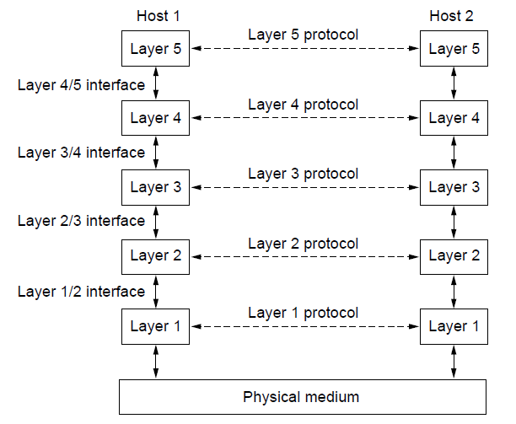
Protocol Layers (1)
Protocol layering is the main structuring method used to divide up network functionality.
Each protocol instance talks virtually to its peer
Each layer communicates only by using the one below
Lower layer services are accessed by an interface
At bottom, messages are carried by the medium

Slide 10
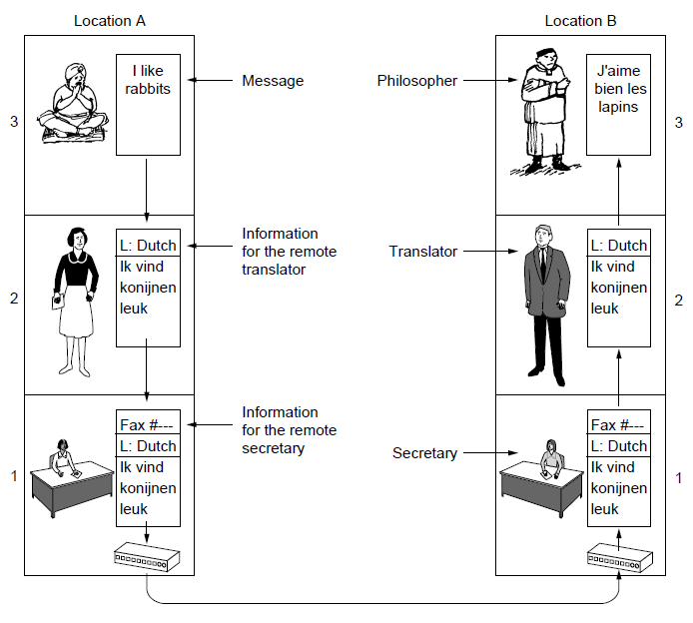
Protocol Layers (2)
Example: the philosopher-translator-secretary architecture
Each protocol at different layers serves a different purpose

Slide 11
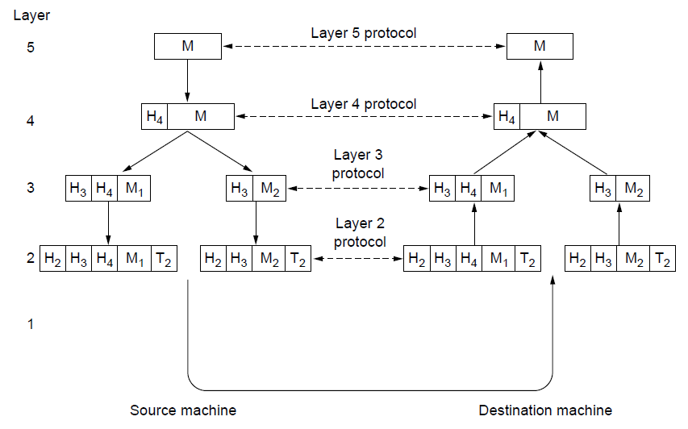
Protocol Layers (3)
Each lower layer adds its own header (with control inform-ation) to the message to transmit and removes it on receive
Layers may also split and join messages, etc.

Slide 12
Connection-Oriented vs. Connectionless
Service provided by a layer may be kinds of either:
Connection-oriented, must be set up for ongoing use (and torn down after use), e.g., phone call
Connectionless, messages are handled separately, e.g., postal delivery
Notes:
TCP provides a reliable bytestream service at the Transport layer, IP provides unreliable datagram service at the Network layer.
More examples: RTP (used to carry VoIP data) provides unreliable connection service; 802.11 (WiFi) provides acknowledged datagram service; Ethernet provides unreliable datagram service.

Slide 13
Reference Models
Reference models describe the layers in a network architecture
OSI reference model »
TCP/IP reference model »
Critique of OSI and TCP/IP »

Slide 14
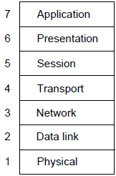
OSI Reference Model
A principled, international standard, seven layer model to connect different systems
– Provides functions needed by users (e.g http, ftp)
– Converts different representations
– Manages task dialogs
– Provides end-to-end delivery (e.g. TCP)
– Sends packets over multiple links (e.g. IP)
– Sends frames of information
– Sends bits as signals

Slide 15
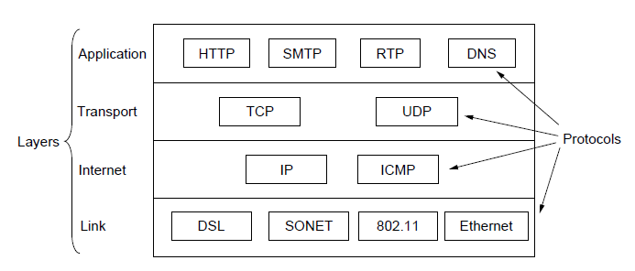
TCP/IP Reference Model
A four layer model derived from experimentation; omits some OSI layers and uses the IP as the network layer.
IP is the “narrow waist” of the Internet
Protocols are shown in their respective layers
Notes:
The comment about the narrow waist refers to the fact that the network layer of the Internet is IP (Internet Protocol) such that the network layer is called the “Internet” layer. The significance is that all Internet devices speak IP, which provides a point of interoperability that enables innovation both above (new applications and transports) and below (new link technologies).

Slide 16
Critique of OSI & TCP/IP
OSI:
Very influential model with clear concepts
Models, protocols and adoption all bogged down by politics and complexity
TCP/IP:
Very successful protocols that worked well and thrived
Weak model derived after the fact from protocols

Slide 17
Example Networks
The Internet »
3G mobile phone networks »
Wireless LANs »
RFID and sensor networks »

Slide 18
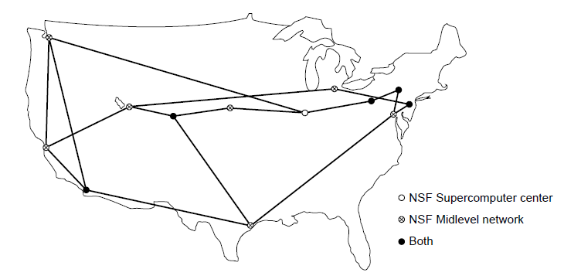
Internet (2)
The early Internet used NSFNET (1985-1995) as its backbone; universities connected to get on the Internet
T1 links (1.5 Mbps)
NSFNET topology in 1988
Notes:
NSFNET was an academic research network growing out of CSNET that was created so that universities without DoD contracts could participate. It was initially connected to the ARPANET by gateways, and later took over the central role as the “backbone of the Internet”, i.e., the network through which packets passed on their way between parties connected to different parts of the Internet.

Slide 19
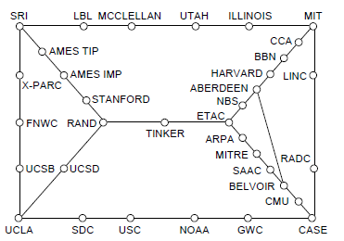
Internet (1)
Before the Internet was the ARPANET.
Nodes are IMPs, or early routers, linked to hosts
56 kbps links
ARPANET topology in Sept 1972.
Notes:
Decentralized or fully distributed is a contrast to the hierarchical telephone network that came beforehand. Unlike the telephone network, blowing up a single important node will not break the network or large portions of it.

Slide 20
Internet (3)
The modern Internet is more complex:
ISP networks serve as the Internet backbone
ISPs connect to exchange traffic at IXPs
Within each network routers switch packets
Customers connect at the edge by many means
Cable, DSL, Fiber-to-the-Home, 3G/4G wireless, dialup
Data centers concentrate many servers (“the cloud”)
Most traffic is content from data centers (esp. video)
The architecture continues to evolve
Notes:
ISP = Internet Service Provicer, IXP = Internet eXchange Point

Slide 21
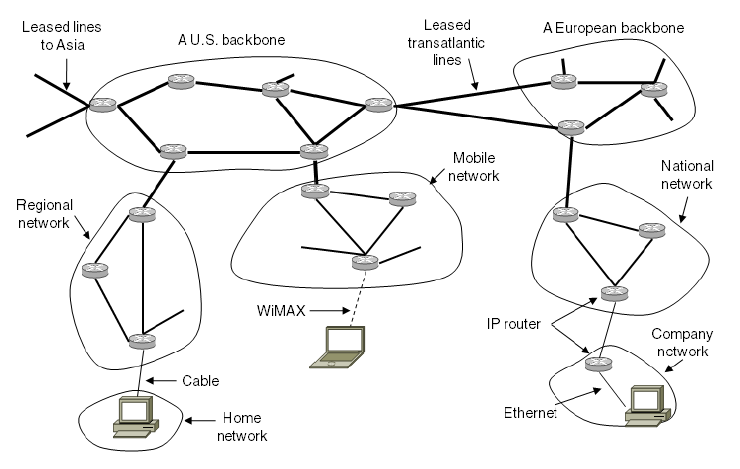
Internet (4)
Architecture of the Internet

Slide 22
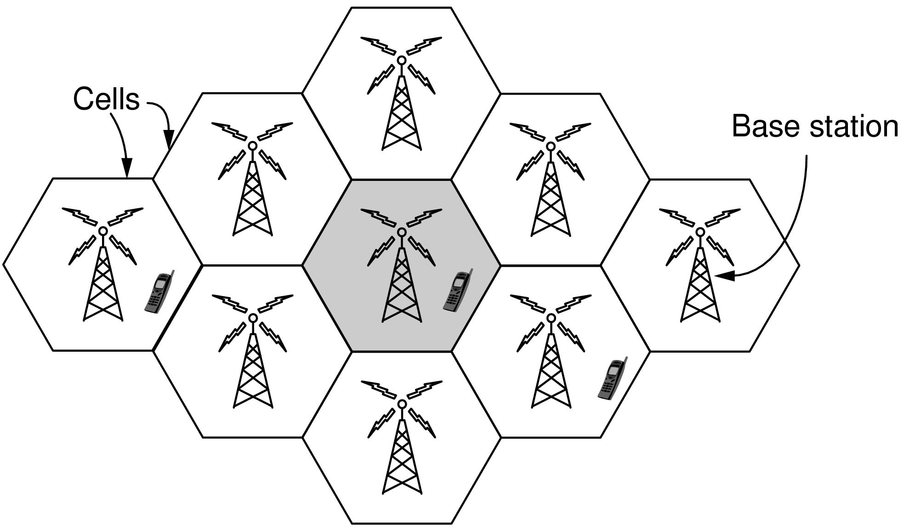
3G Mobile Phone Networks (1)
3G network is based on spatial cells; each cell provides wireless service to mobiles within it via a base station

Slide 23
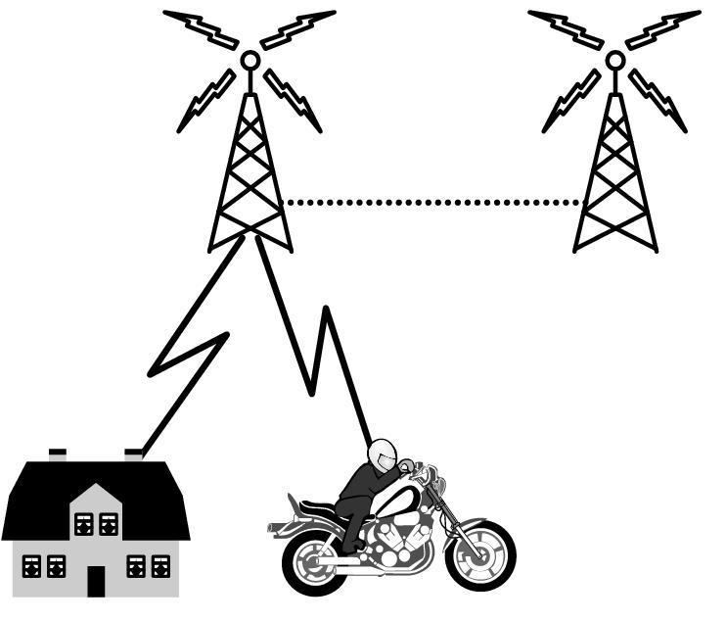
3G Mobile Phone Networks (3)
As mobiles move, base stations hand them off from one cell to the next, and the network tracks their location
Handover

Slide 24
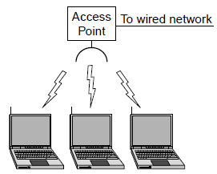
Wireless LANs (1)
In 802.11, clients communicate via an AP (Access Point) that is wired to the rest of the network.

Slide 25
Network Standardization
Standards define what is needed for interoperability
Some of the many standards bodies:
Body | Area | Examples
ITU | Telecommunications | G.992, ADSL H.264, MPEG4
IEEE | Communications | 802.3, Ethernet 802.11, WiFi
IETF | Internet | RFC 2616, HTTP/1.1 RFC 1034/1035, DNS
W3C | Web | HTML5 standard CSS standard

