Slide 1
OSI model vs. TCP/IP MODEL
TOPIC

Slide 2
OSI Model
Introduction
The Open Systems Interconnection (OSI) model is a reference tool for understanding data communications between any two networked systems.
There are also some benefits of OSI Model.

Slide 3
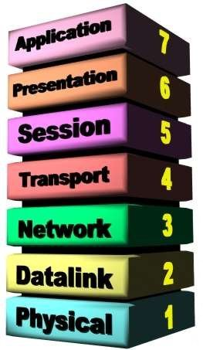
Seven Layers

Slide 4
The Physical Layer
Physical Layer is responsible for transmitting row bit stream over the physical cable.
Functions:
Data encoding
Transmission technique
Physical medium transmission

Slide 5
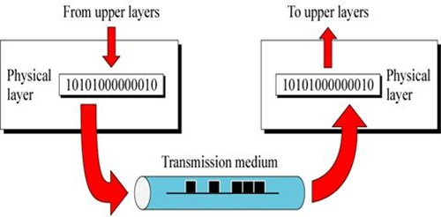

Slide 6
Data link Layer
Data link layer is responsible for controlling the error between adjacent nodes and transfer the frames to other computer via physical layer.
Functions:
Link establishment and termination
Frame traffic control
Frame acknowledgment

Slide 7
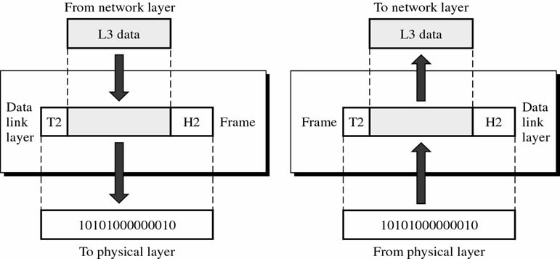

Slide 8
The Network Layer
This layer is responsible for translating the logical network address and names into their physical address.
Functions :
Subnet traffic control
Logical-physical address mapping
Frame fragmentation

Slide 9
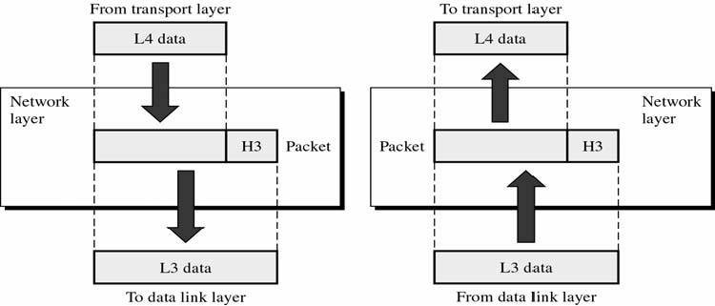

Slide 10
The Transport Layer
This layer is responsible for end-to-end delivers of messages between the networked hosts
Functions:
Message segmentation
Message acknowledgment
Session multiplexing

Slide 11
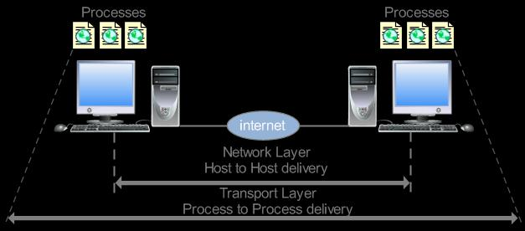

Slide 12
The Session Layer
This layer is responsible for establishing the process-to-process communication between the hosts in the network.
Functions:
Session establishment, maintenance and termination
Session support

Slide 13
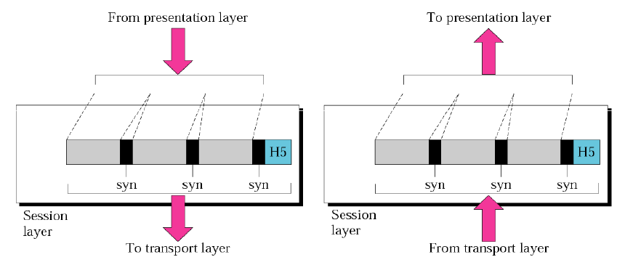

Slide 14
The Presentation Layer
The Presentation layer is responsible for protocol conversion, date encryption/decryption, Expanding graphics command and the date compression.
Functions:
Character code translation
Data conversion
Data compression

Slide 15
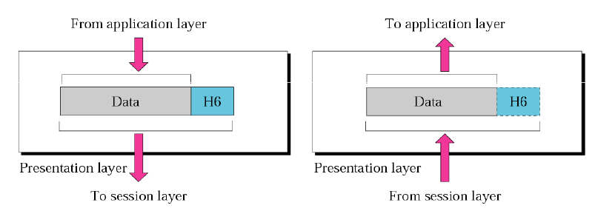

Slide 16
The Application Layer
The application layer provider different services to the application.
Functions:
Remote file access
Electronic messaging
Directory services
Network management

Slide 17
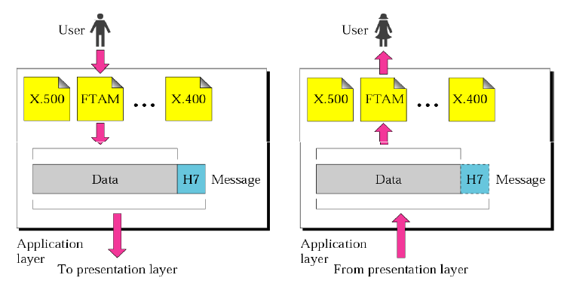

Slide 18
TCP/IP Model
TCP/IP are two protocols of this model. TCP stands for Transmission Control Protocol and IP stands for Internet Protocol.
There are 4 Layers in TCP/IP Model.

Slide 19
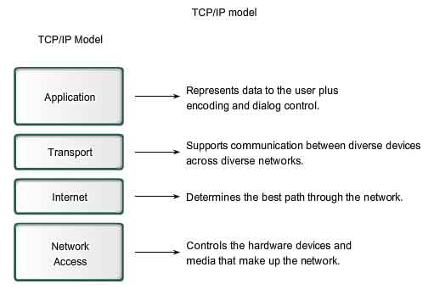

Slide 20
Application Layer
The Application Layer in TCP/IP groups the functions of OSI Application, Presentation Layer and Session Layer.
Functions:
Refers to standard network services
Also defines compatible representation of all data

Slide 21
Transport Layer
In TCP/IP architecture, there are two Transport Layer protocols. The Transmission Control Protocol (TCP) guarantees information transmission
Functions:
Manages the transfer of data
Manages the connections between networked applications

Slide 22
Internet Layer
The Internet Protocol (IP) is the primary protocol in the TCP/IP Network Layer.
Functions:
Manages addressing of packets and delivery of packets between networks
Fragments packets so that they can be dealt with by lower level layer

Slide 23
Network Layer
In the TCP/IP architecture, the Data Link Layer and Physical Layer are normally grouped together to become the Network Access layer
Functions:
Delivers data via physical link
Provides error detection and packet framing

Slide 24
OSI Model vs.TCP/IP Model
The OSI model consists of 7 architectural layers whereas the TCP/IP only has 4 layers.
OSI is a reference model and TCP/IP is an implementation of OSI model.
The OSI model however is a "generic, protocol-independent standard.

Slide 25
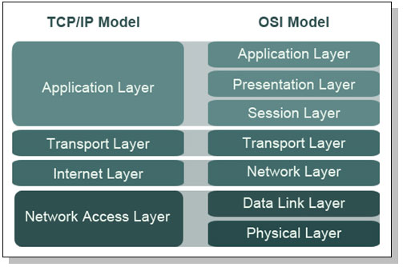

Slide 26
Sr. No. | TCP/IP Reference Model | OSI Reference Model
1 | Defined after the advent of Internet. | Defined before advent of internet.
2 | Service interface and protocols were not clearly distinguished before | Service interface and protocols are clearly distinguished
3 | TCP/IP supports Internet working | Internet working not supported
4 | Loosely layered | Strict layering
5 | Protocol Dependant standard | Protocol independent standard
6 | More Credible | Less Credible
7 | TCP reliably delivers packets, IP does not reliably deliver packets | All packets are reliably delivered

