Slide 1

Functional programming concepts – via F#
Billy Stack
24 February 2015

Slide 2
Intro
My background
Contact details
@bstack
http://ie.linkedin.com/pub/billy-stack/17/575/81
https://github.com/bstack
Why am I interested in functional stuff?
Aim of talk

Slide 3
About F#
Functional first language
Strongly typed
Started in 2002 as a research project – foundation for generics
First stable version released in 2010 (F# 2.0)
Based on OCaml but draws from Haskell, Clojure and others
Flexible, is more OO than other functional languages
Can interoperate with other CLR languages
Highly active open source community

Slide 4
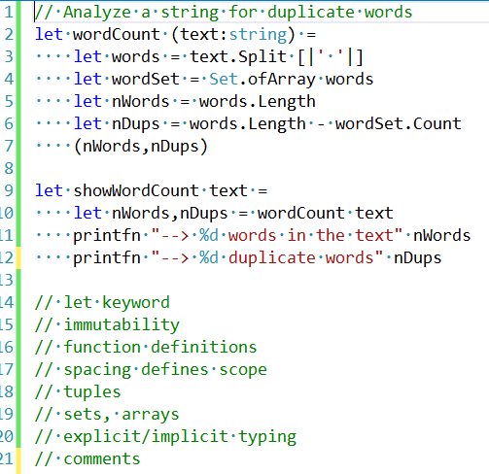
First F# program

Slide 5

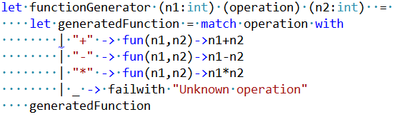
Functional first
Already seen functions can be declared as values
Functions can be passed as parameters to other functions
You can also return a function from a function
Using object methods as first class functions

Slide 6
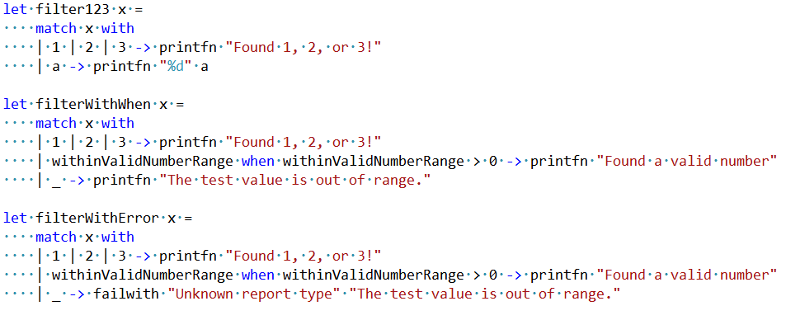
Pattern matching
Eliminates requiring arrowheads in code e.g. if-else statements etc
One of the main proposals for C# 7

Slide 7
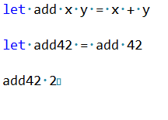
Function patterns
Pipelining
Composition
Partial application

Slide 8
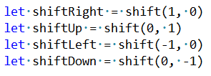
More partial application
Define function
Create partially applied functions
Apply shift function to a list by executing map

Slide 9
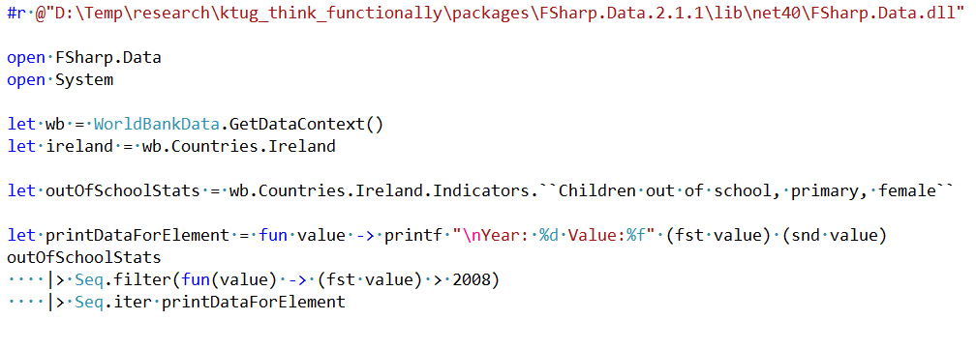

Type providers
F# type provider is a component that provides types, properties, and methods for use in your program. Eliminates barriers to working with diverse information sources

Slide 10
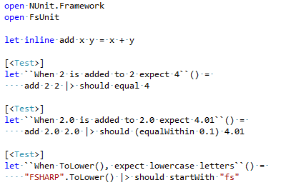
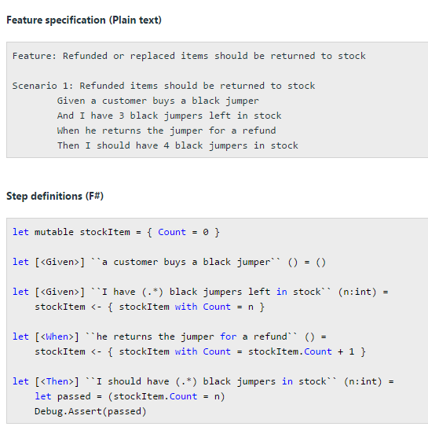
Testing
FsUnit
TickSpec

Slide 11
Stuff I cannot cover but will mention briefly
Vast imperative programming support
For/if/
Use of .NET mutable collections
Mutable keyword
Easy to operate with other .NET languages
Can invoke classes/methods written in other CLR languages
Collections
Covered some briefly
Seq/Array/Set etc with different operations

Slide 12
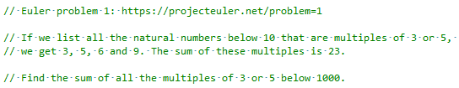
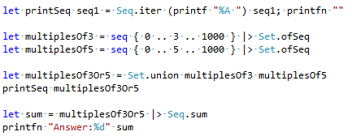
Euler problem 1

Slide 13
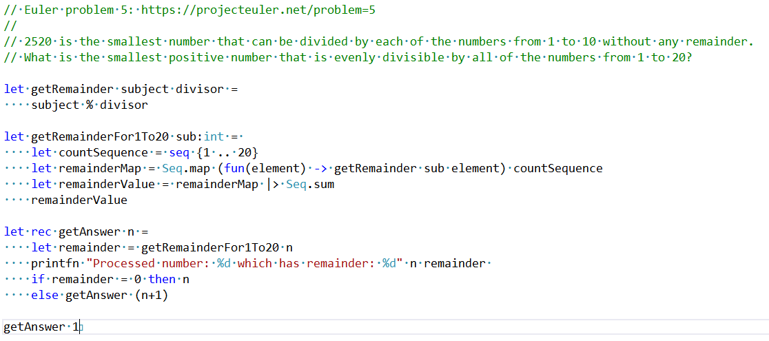
Euler problem 2

Slide 14
F# and AI - Digit Resolver
Write f# program that resolves what a digit is represented by a 16*16 grayscale image
There are two data samples
digitDataSample (5000), contains the answer, array of 256 numbers (grayscale)
digitValidationSample (500), contains the answer, array of 256 numbers (grayscale)
We read in both samples two arrays of records
We then spool through validation sample.
Using distance between two squares algorithm, we calculate the digit (from digitDataSample) that is closest match – this is best known as classification
We then check how many of the validation sample digits that we classified correctly

Slide 15
Where to learn more
http://fsharp.org/about/learning.html
http://fsharpforfunandprofit.com/
https://msdn.microsoft.com/en-us/library/dd233154.aspx
Twitter hashtag #fsharp
Stackoverflow
Books
Expert f# 3.0 (Don Syme)
F# deep dives (Tomas Petricek and Phillip Trelford)
Functional user groups (http://www.meetup.com/FunctionalKats/)
Functional programming workshops and conferences

