Slide 1

Who am I?

Slide 2
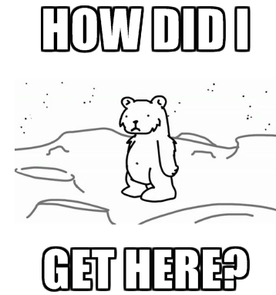

Slide 3


Slide 4


Slide 5
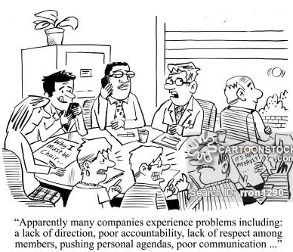

Slide 6


Slide 7
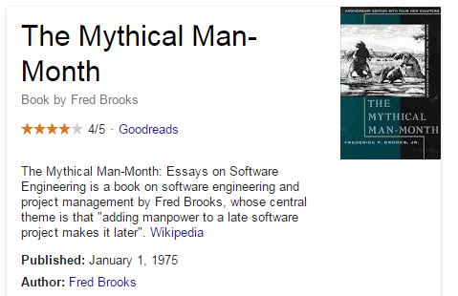

Slide 8
My contact details
Twitter: @bstack
Github: www.github.com/bstack
LinkedIn: http://ie.linkedin.com/pub/billy-stack/17/575/81
Email: bs.stack@gmail.com

