Slide 1

Functional Language Concepts
Billy Stack/Marta Doberschuetz O’Shaughnessy

Slide 2
What we are going to talk about
Functional background
Small bit of lambda calculus
Functional vs OOP
Some core functional concepts
Pure functional behaviour
Higher Order Functions
Immutability
Lazy evaluation
Declarative Code (vs Imperative code)
Other stuff

Slide 3
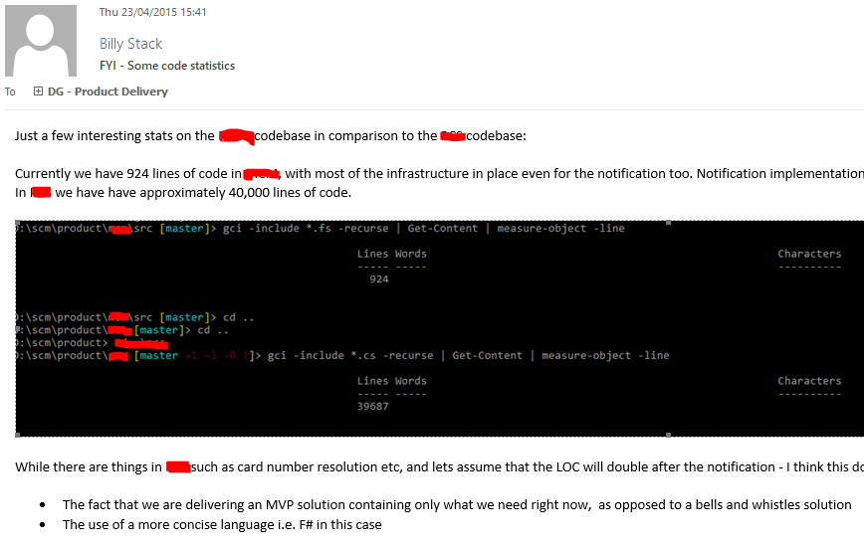
Why look at FP? - Sample email

Slide 4
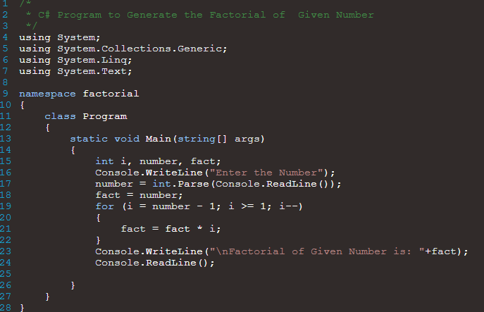
Declarative vs imperative code

Slide 5


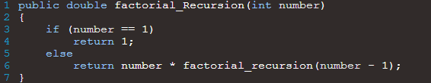
Declarative vs imperative code - 2

Slide 6
Functional background
Is a programming paradigm
Treats computation as the evaluation of mathematical functions
Avoids state and mutable data
It is a declarative programming paradigm, which means programming is done with expressions.
Has its roots in lambda calculus
Examples
(Pure) Hope, Rex
(Semi-pure) Common Lisp, Scheme, clojure, F#, Scala, Erlang, Haskell

Slide 7

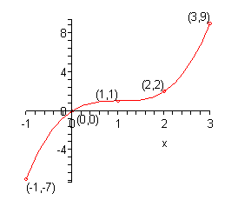
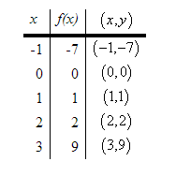
Many of you may remember this: (Junior Cert style question)

Slide 8

And this … (Combining functions)

Slide 9
Demo
Basic functions
Composition
Pipelining
Higher order functions
Immutability

Slide 10
Functional vs Object Oriented
Both offer two completely different views on how to solve software
Object-oriented programming is programming through the definition and composition of objects
Functional programming is programming through the definition and composition of functions

Slide 11
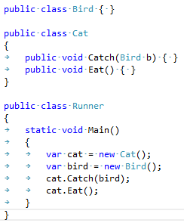
Functional vs Object Oriented
Problem definition: A cat catches a bird and eats it
OOP focuses on the nouns which encapsulate each of the actions (i.e. verbs)

Slide 12
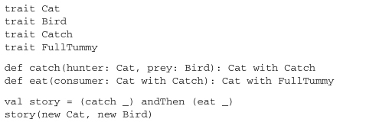
Functional vs Object Oriented
Problem definition: A cat catches a bird and eats it
FP focuses around the two verbs catch and eat

Slide 13
Functional vs Object Oriented
Driven from functions
Makes more use of the type system to explain what the program is doing
Use of combining functions together to get required result
Each function returns new instance of Cat attached to different state type – side effect free

Slide 14
Pure functional behaviour – side effect free
If the result of a pure expression is not used, it can be removed without affecting other expressions.
If a pure function is called with arguments that cause no side-effects, the result is constant with respect to that argument list (sometimes called referential transparency), i.e. if the pure function is again called with the same arguments, the same result will be returned (this can enable caching optimizations such as memoization).
If there is no data dependency between two pure expressions, then their order can be reversed, or they can be performed in parallel and they cannot interfere with one another (in other terms, the evaluation of any pure expression is thread-safe).

Slide 15
Demo 2
Partial application
Type inference
Discriminated unions
Testability

Slide 16
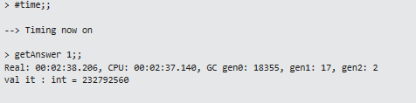
Demo 3 - Euler problem 5
https://projecteuler.net/problem=5
2520 is the smallest number that can be divided by each of the numbers from 1 to 10 without any remainder.
What is the smallest positive number that is evenly divisible by all of the numbers from 1 to 20?

Slide 17
Questions?

