Slide 1
Functional Language Concepts
Billy Stack

Slide 2
What im going to talk about
Functional background
Small bit of lambda calculus
Functional vs OOP
Some core functional concepts
Pure functional behaviour
Higher Order Functions
Immutability
Lazy evaluation
Declarative Code (vs Imperative code)

Slide 3
Functional background
Is a programming paradigm
Treats computation as the evaluation of mathematical functions
Avoids state and mutable data
It is a declarative programming paradigm, which means programming is done with expressions.
Has its roots in lambda calculus
Examples
(Pure) Hope, Rex
(Semi-pure) Common Lisp, Scheme, clojure, F#, Scala, Erlang, Haskell

Slide 4

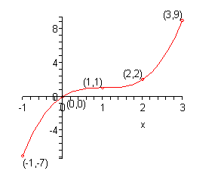
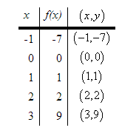
Many of you may remember this: (Junior Cert style question)

Slide 5

And this … (Combining functions)
See Scala demo mimicking this

Slide 6
Functional vs Object Oriented
Both offer two completely different views on how to solve software
Object-oriented programming is programming through the definition and composition of objects
Functional programming is programming through the definition and composition of functions

Slide 7
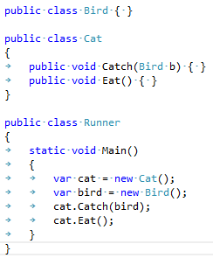
Functional vs Object Oriented
Problem definition: A cat catches a bird and eats it
OOP focuses on the nouns which encapsulate each of the actions (i.e. verbs)

Slide 8
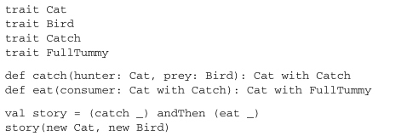
Functional vs Object Oriented
Problem definition: A cat catches a bird and eats it
FP focuses around the two verbs catch and eat

Slide 9
Functional vs Object Oriented
Driven from functions
Makes more use of the type system to explain what the program is doing
Use of combining functions together to get required result
Catch and FullTummy denote current state of the Cat
Each function returns new instance of Cat attached to different state type – side effect free

Slide 10
Functional Concepts We Will Cover
Pure functional behaviour
Higher Order Functions
Immutability
Lazy evaluation
Declarative Code (vs Imperative code)

Slide 11
Pure functional behaviour – side effect free
If the result of a pure expression is not used, it can be removed without affecting other expressions.
If a pure function is called with arguments that cause no side-effects, the result is constant with respect to that argument list (sometimes called referential transparency), i.e. if the pure function is again called with the same arguments, the same result will be returned (this can enable caching optimizations such as memoization).
If there is no data dependency between two pure expressions, then their order can be reversed, or they can be performed in parallel and they cannot interfere with one another (in other terms, the evaluation of any pure expression is thread-safe).

Slide 12
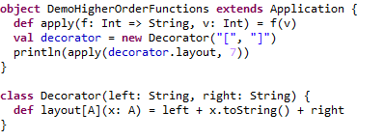
Higher Order Functions
These are functions that take other functions as parameters, or whose result is a function.

Slide 13
Higher Order Function Example: Points of note
The apply function takes another function f and a value v as arguments and applies function f to v
The return type of apply becomes the return type of the applied function
Note the Decorator.layout function being auto-coerced to a value of type Int => String
Note Decorator.layout is a polymorphic method (abstracts over signature types

Slide 14
Immutability
An immutable entity is once that cannot be changed after it has been created
This is in contrast to a mutable object that can be changed after creation
Immutable objects are “thread-safe”
Implementation is guaranteed to be free of race conditions when accessed by multiple threads simultaneously
A piece of code is thread-safe if it only manipulates shared data structures in a manner that guarantees safe execution by multiple threads at the same time
Demo unthreadsafe code

Slide 15
Immutability
Demo immutability – c#
Demo immutable class String – java
In functional languages, everything is immutable by default – no scaffolding
Functions themselves are immutable
For “mutable behaviour” functional languages provide exceptions
Even when changing state – be very careful
Particularly for singletons or shared instances
If an object is transient, has state but only lives within one thread – no problem
Often the words “side-effect free” is associated with functions

Slide 16
Lazy evaluation
Some languages are defined as “pure lazy” (Haskell is an example of this)
On the other hand, Scala has both lazy and eager behaviour
Delays the evaluation of an expression until its value is needed.
Lazy evaluation can lead to
reduction in memory footprint, since values are created when needed
avoidance of needless calculations
Can enable the use of “infinite control structures”
See Scala example for lazy “variable” evaluation
Talk about eager languages using control structures in a “lazy” way
Also known as strict/non-strict

Slide 17
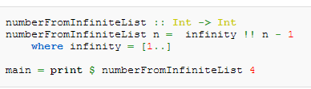
Lazy evaluation
Example of an infinite list in Haskell
In the function numberFromInfiniteList, the value of infinity is an infinite range, but until an actual value (or more specifically, a specific value at a certain index) is needed, the list is not evaluated, and even then it is only evaluated as needed (that is, until the desired index.)

Slide 18
Declarative code
Imperative programming
is what most professional programmers use in their day-to-day jobs. It's the name given to languages like C, C++, Java, COBOL, etc.
In imperative programming, you tell the computer what to do.
Declarative programming
Seeks to describe what you want done rather than specify how you want something done.
Functional programming is a subset of declarative programming
Differences best illustrated by an example …

Slide 19
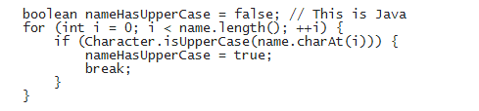
Imperative vs Declarative code
Java method that determines whether a string contains an uppercase character
The imperative style is in evidence here, because the nameHasUpperCase variable is reassigned as a side effect of the for loop

Slide 20
Imperative vs Declarative code
Scala code that does the same thing
Declarative i.e. you are not telling the compiler “how to do it” but rather “what you want done”

Slide 21
How Scala Changed My Programming Style – Bill Venners (author Programming in Scala)
How did Scala change how I think about programming? In short: I learned to appreciate the functional style
The functional style of programming emphasizes immutable objects, variables that can be initialized but not reassigned (final variables in Java), transformation of data structures, and methods and control constructs that result in a value but have no side effects. At the other end of the spectrum is the imperative style, which is characterized by mutable objects, variables that can be reassigned (normal variables in Java), indexing through data structures, and methods and control constructs with side-effects

