Slide 1


Virus Watch Project Introduction
Presented by:
Kevyn Sisante
Colton Barboro
Anas Albedaiwi
Bryan Stahman
Ziang Zhou
Notes:
Order of Operations:
1. Colton Barboro
2. Colton Barboro
3. Ziang Zhou
4. Ziang Zhou
5. Anas Albedaiwi
6. Anas Albedaiwi
7. Kevyn Sisante
8. Bryan Stahman

Slide 2
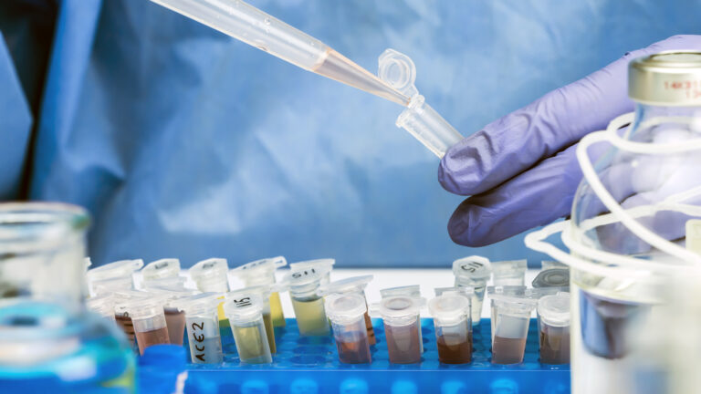

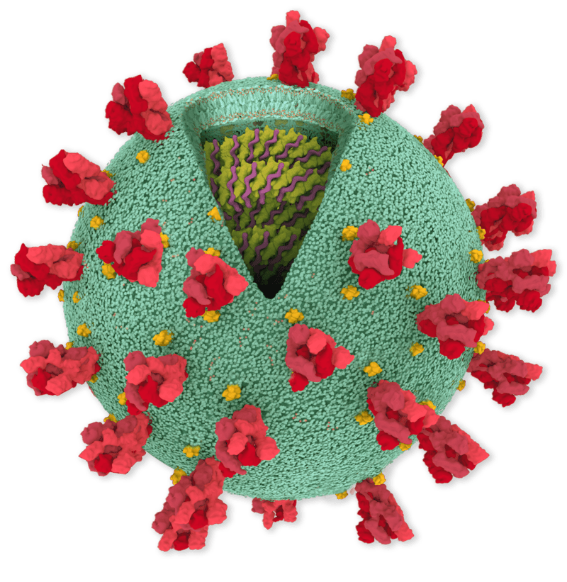
The Project
Notes:
The Coronavirus pandemic has been a moving target problem for researchers since the contagious nature of the virus became known to the global community early in 2020. Various institutions around the globe have worked to devise methods for viral detection and interception with varying degrees of success. As schools around the country have been returning to semi-normal routines, there are significant concerns with viral transmission in high density educational and housing facilities, especially for non-compliant members of the student populations. Because resources for comprehensive universal testing is slim, a potential proposed solution is to use wastewater-based testing surveillance to find potential viral hot spots before a community outbreak occurs.

Slide 3
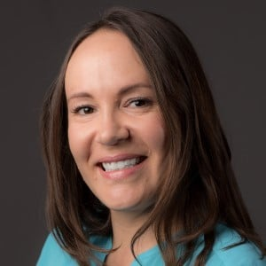
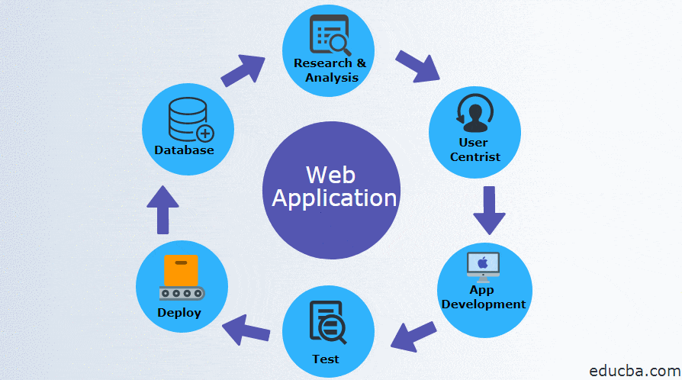
The Project
Dr. Crystal Hepp
The problem: slow process in data analysis and distribution.
The solution: A web based application that will streamline the process and make the data easier to access.
Notes:
Our client, Dr. Crystal Hepp, is an Assistant professor at NAU who is working on moving this testing solution forward as a viable strategy for viral surveillance. A key challenge for her is being able to take the wastewater test data and translate it onto a streamlined and easily accessible platform. Currently, The data is distributed as manually formatted excel sheets to various agencies which is time consuming and slower to get the information to said agencies. Our project is aimed at creating a web application that will allow for the automatic analysis of data taken from these studies to be hosted on a secure server and be accessible to the appropriate agencies seeking relevant data.

Slide 4
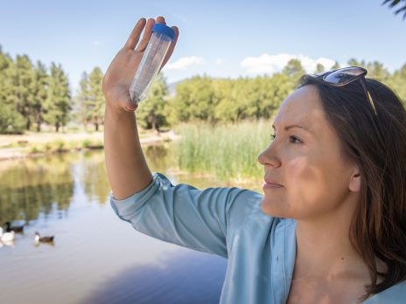
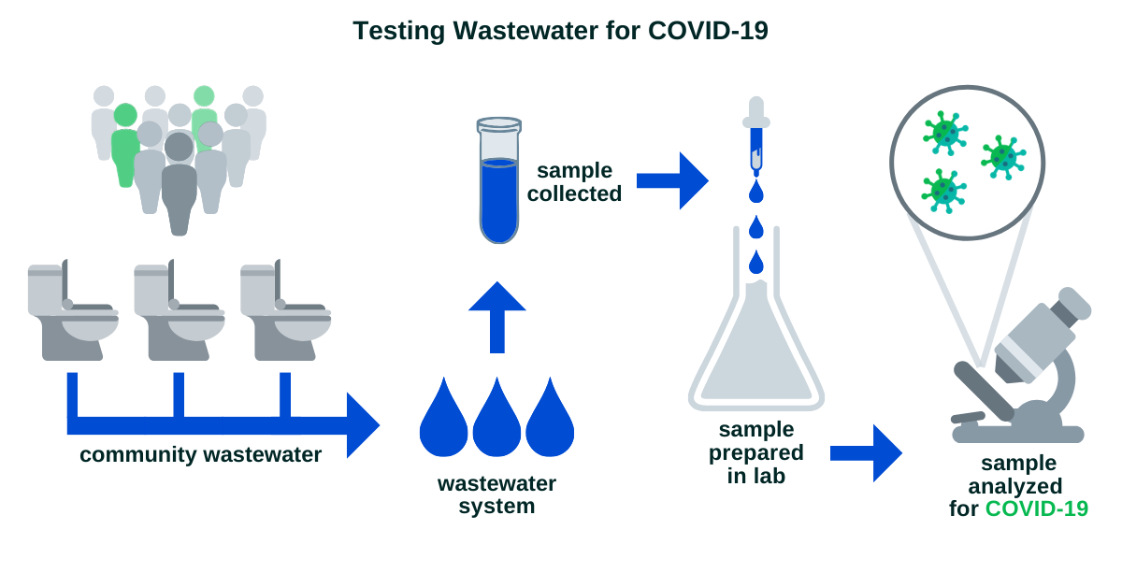
Our client
Notes:
Crystal Hepp is an infectious disease expert and currently works at the Institute of Pathogenic Microbiology at Northern Arizona University. She and her team are tracking the coronavirus by collecting sewage samples. A large number of manual tests are currently being carried out, but from a long-term perspective, such tests cannot be sustained forever. The conclusion of the current experiment is that there is no risk of coronavirus in wastewater. Dr. Hepp believes that total wastewater may be a powerful tool for public health testing.

Slide 5
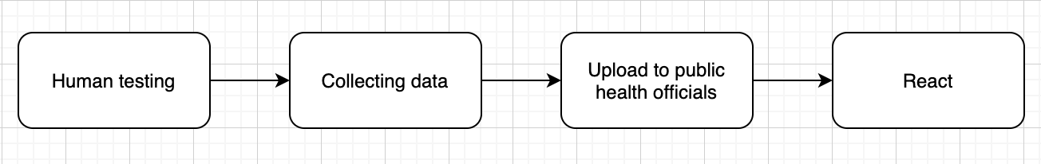
How business works
Notes:
The flow chart that you can see is the current stage of Dr. Hepp’s research process. After manual testing, the data is collected and uploaded to the local department to respond in time to an area that disaster is about to break out. This may seem simple, but it is very difficult to collect data manually. Not only is it impossible to collect data on a large scale (manpower-consuming), but the collection time is too long, and it is easy to miss some critical moments that can be responded to. The next step for Dr. Hepp is to host the virus detection process in wastewater and collect data on a large scale to prevent the coming disaster to a greater extent.

Slide 6




Why better software?
The Old style for submitting information.
Flexibility of using the webapp.
Save and private.

Slide 7



Our Solution outline
wastewater-based testing.
plan to expand to specific locations.
hosting a secure website

Slide 8
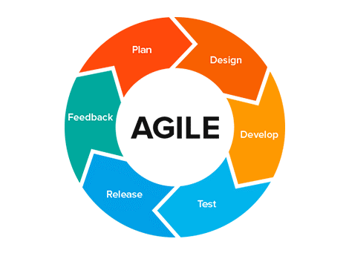
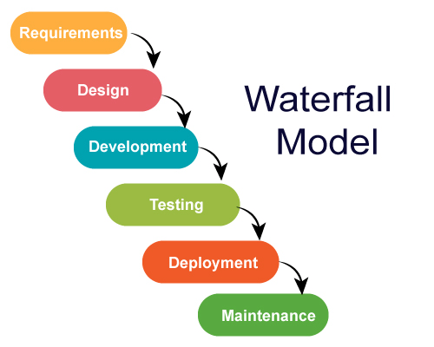

Plan for Development
Requirements Acquisition
Weekly Meetings
Notes:
Kevyn

Slide 9

Plan for Development
Technical Investigation
MERN stack
JIRA
Other issues
Security
Product must be deployed on NAU server.
Notes:
Kevyn

Slide 10
Conclusion
Instead of spreadsheets, our product will provide an easy-to-use, secure and comprehensive solution.
Our product will help policymakers more effectively identify and target outbreaks.
This project could provide a model for the country to use.
Notes:
To conclude, we are Team Virus Watch, and we are working to create a secure web application which will allow various agencies across Northern Arizona to upload, view, and compare COVID wastewater data for our client, Dr. Crystal Hepp who is an Assistant Professor here at NAU.
Whereas currently, Dr Hepp has to submit simple excel spreadsheets each week, our application will make this tedious process much easier by allowing permitted agencies to upload and view various COVID-19 data for a given area over time, thus allowing for quicker and more effective detection of new outbreaks.
Of course, Northern Arizona cities are not the only ones tasked with the problem of identifying new covid outbreaks. Given how recent this pandemic is, the problem of pinpointing emerging hotspots likely exists all over the nation. Our product could easily be adapted for a larger network of locations that could eventually extend nationwide, becoming another tool in our nation’s arsenal to combat this pandemic.
All of us are very excited to work on this project

