Slide 1
Modeling Mechanisms of Podosome Lifecycle
Britton Stanley
Elston Lab

Slide 2
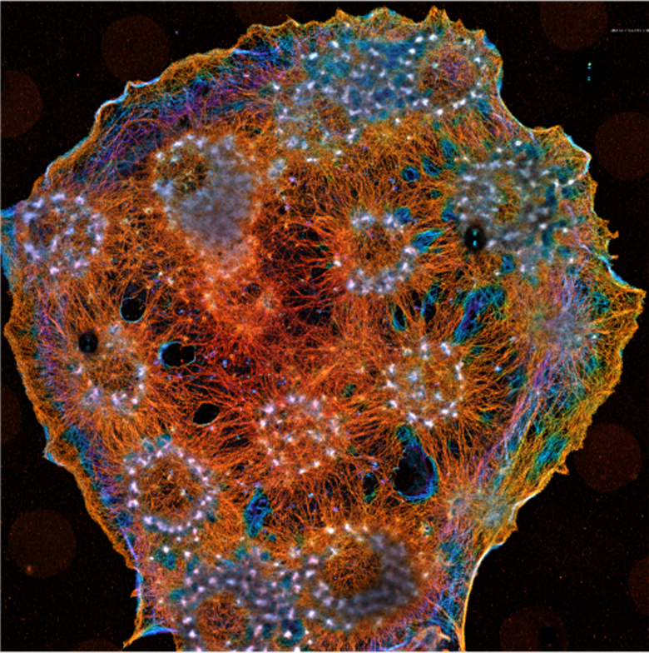
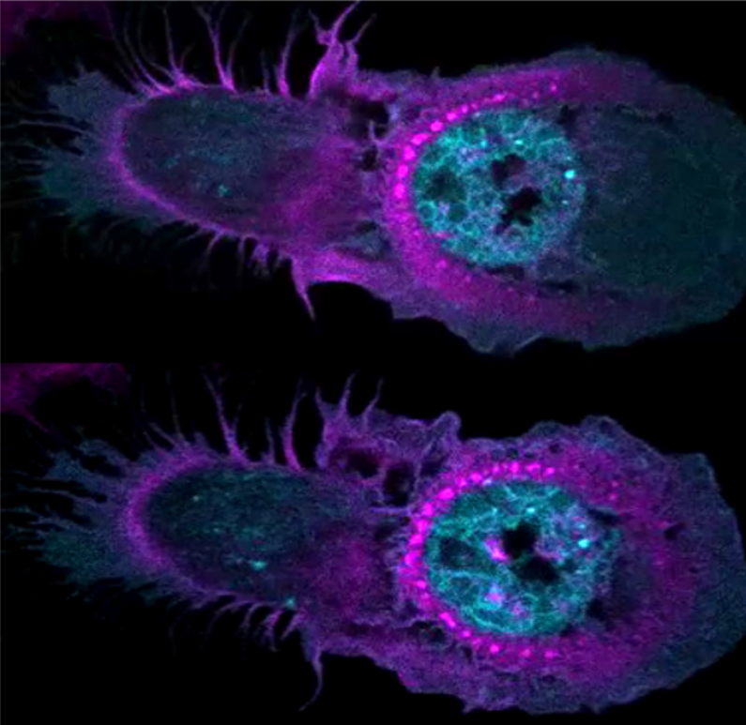
Podosome Formation in
Frustrated Phagocytosis

Slide 3
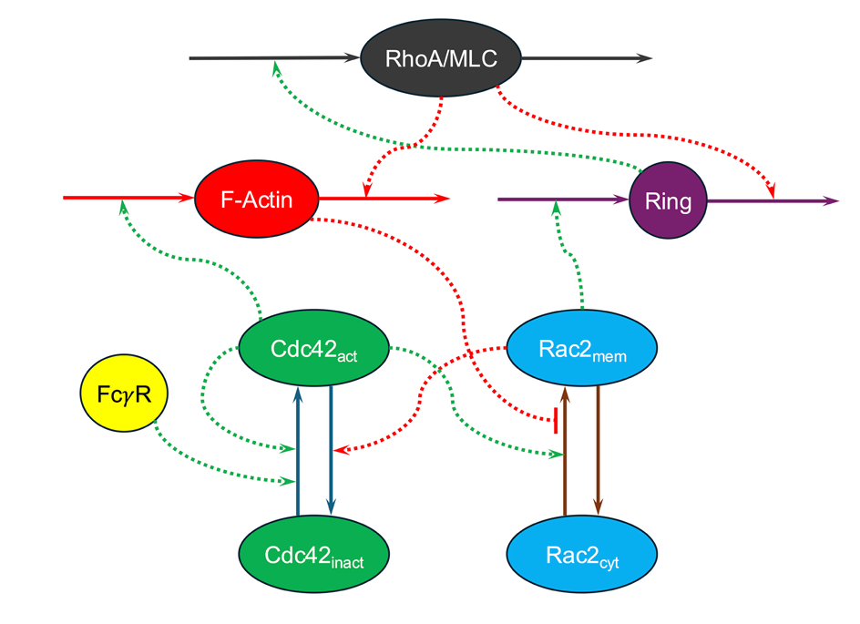
Model Architecture

Slide 4
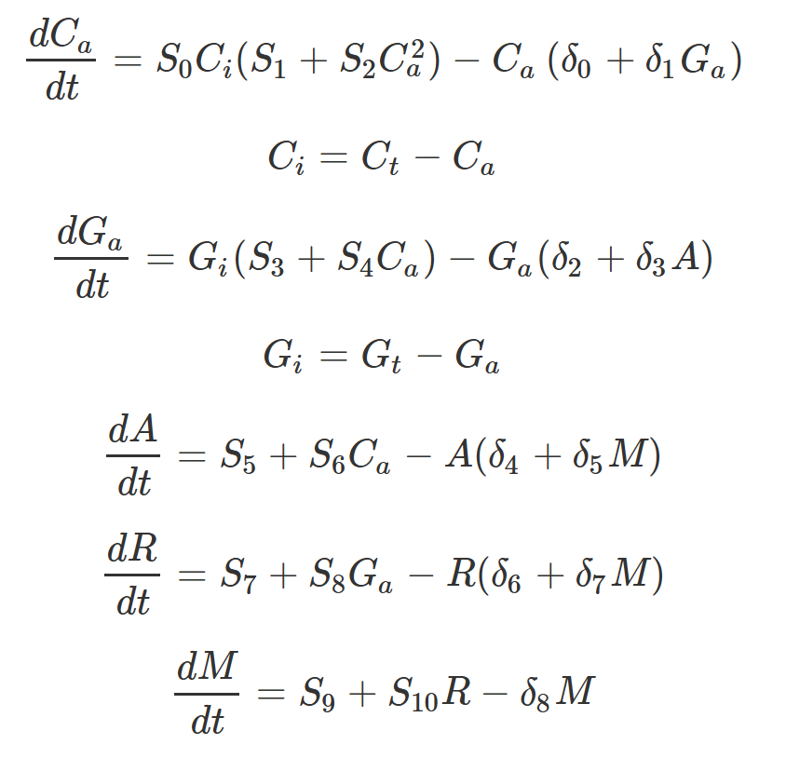
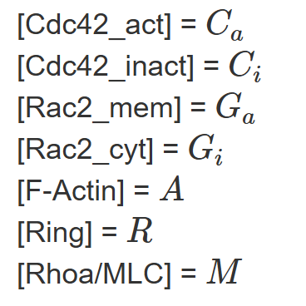
Mass Action ODE Model

Slide 5
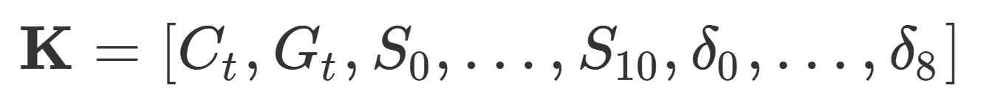
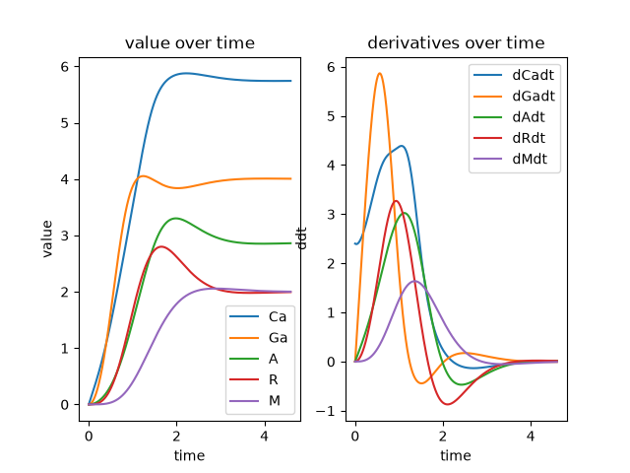
Large Parameter Space

Slide 6
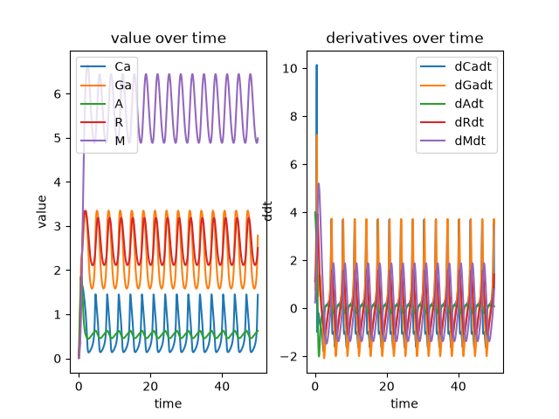
Goal: Oscillatory Behavior
?

Slide 7
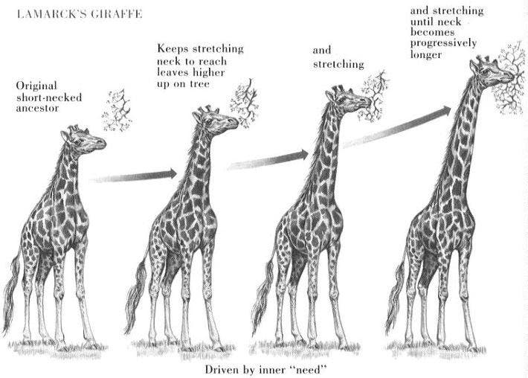
Evolutionary Algorithms
Explore Parameter Space

Slide 8
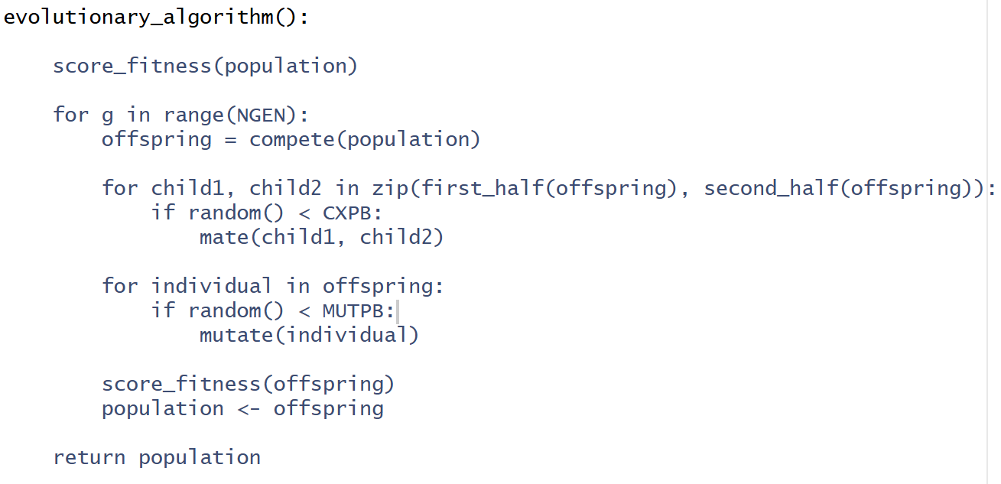
Basic Evolutionary Algorithm

Slide 9
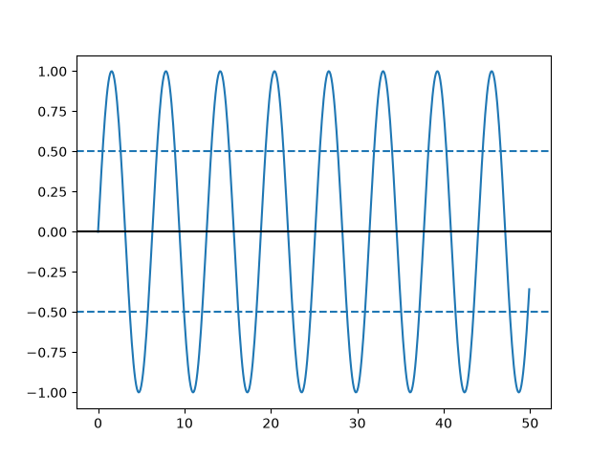
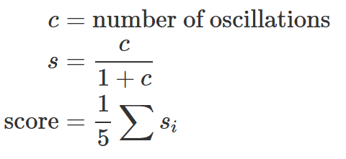
Fitness Function for Oscillatory Behavior

Slide 10
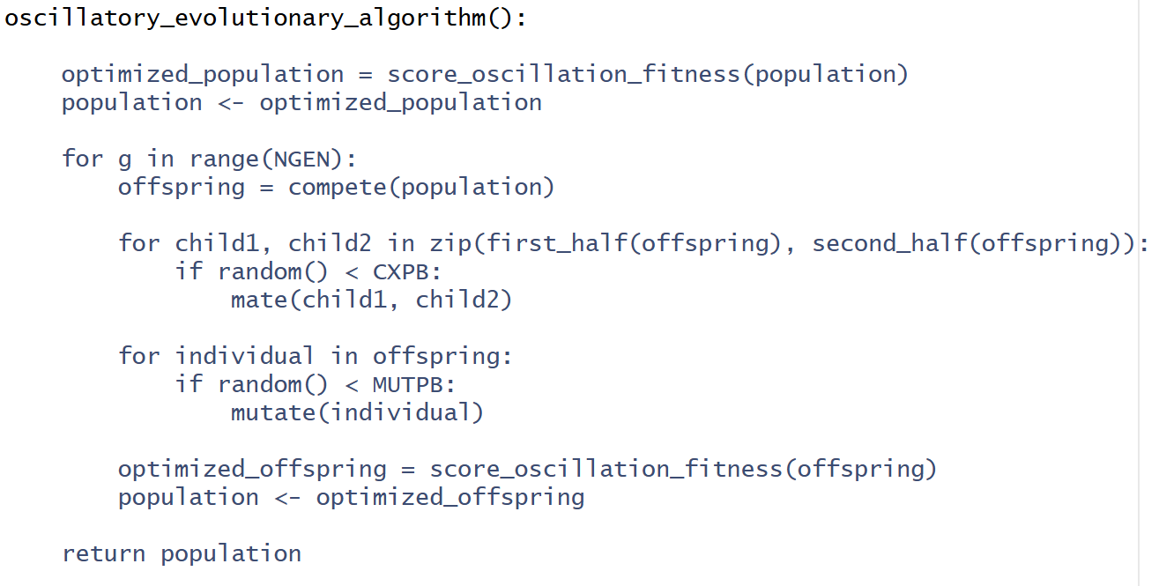
Evolutionary Algorithm For Oscillation

Slide 11
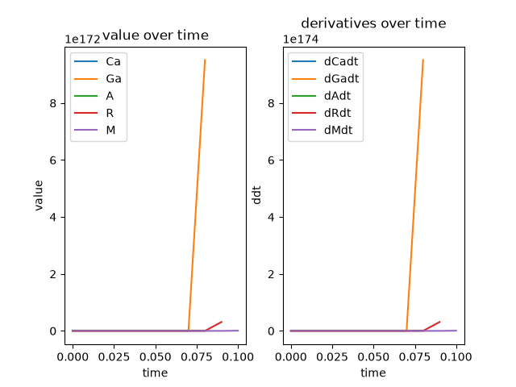
Challenges: Exploiting Limitations of Euler Evaluation
Solution: Cap max S_0 and max Ct.
Penalize Systems that blow up (overflow error).

Slide 12
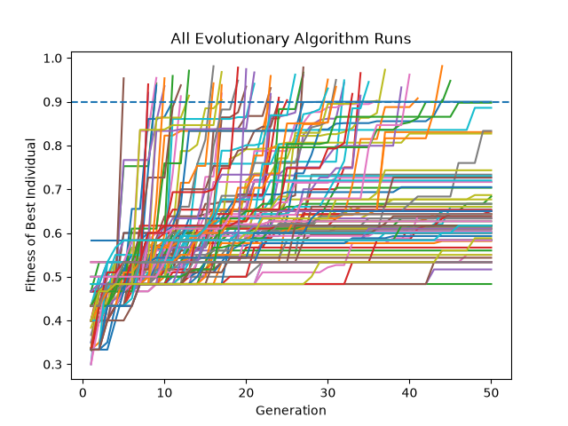
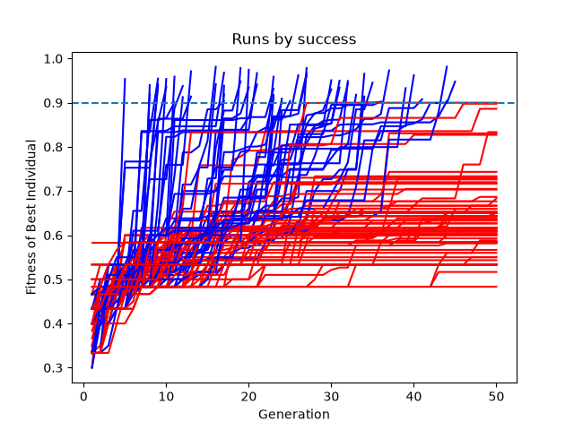
Results
NGEN = 50, NIND = 200, CXPB = 0.5, MUTPB = 0.2, OSCT = 0.9
# Runs = 150, # Successes = 57

Slide 13
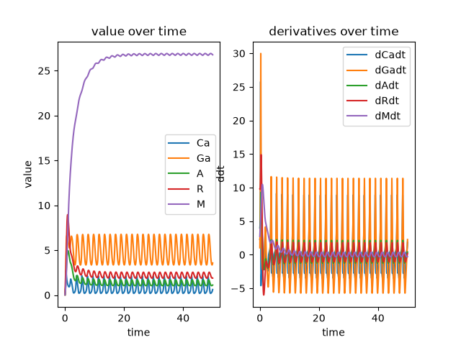
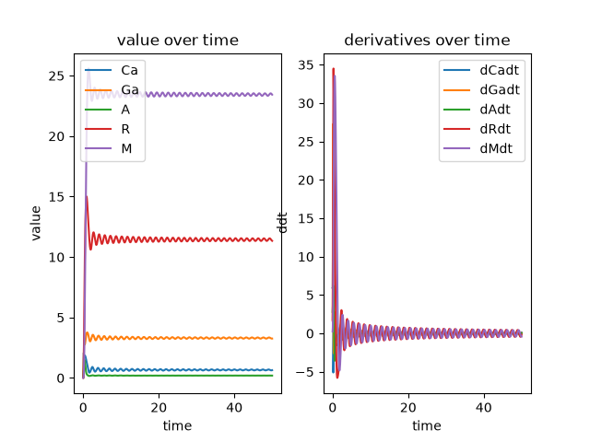
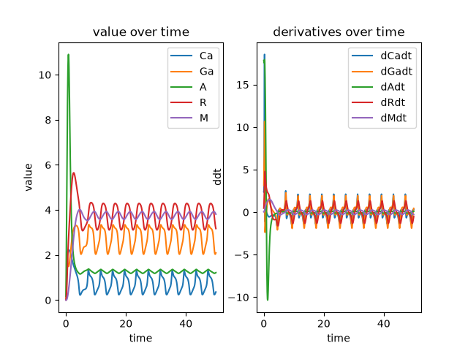
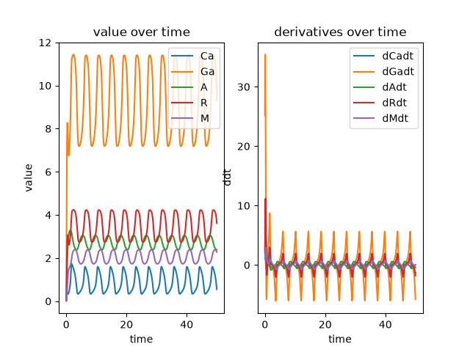
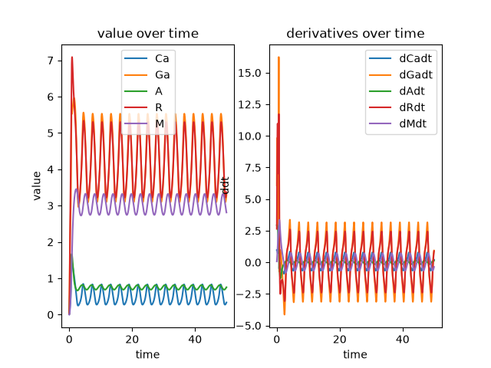
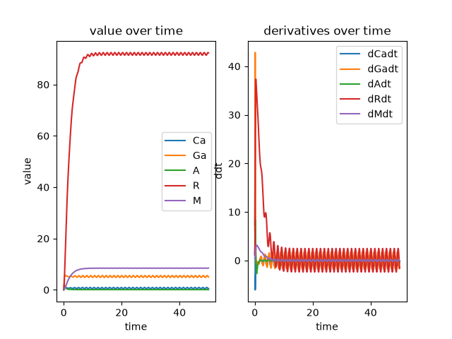
Examples of Oscillatory Systems

Slide 14
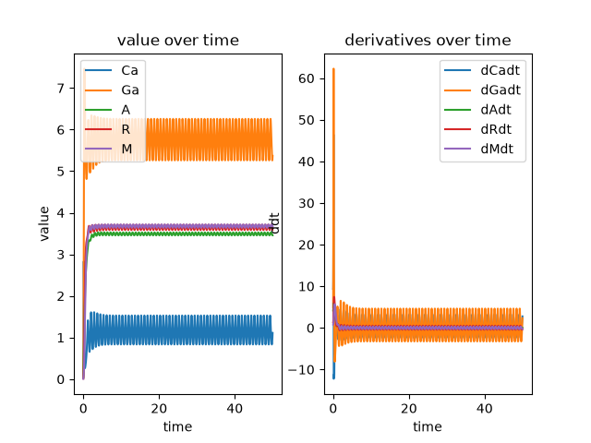
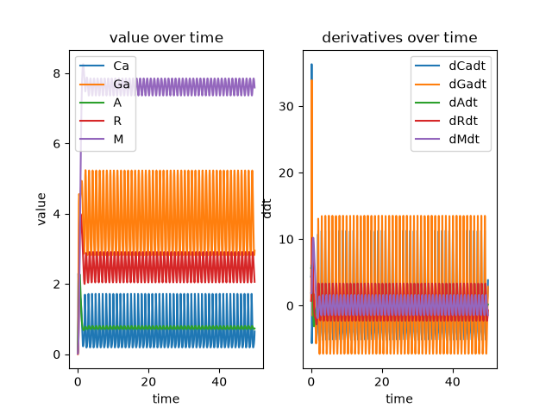
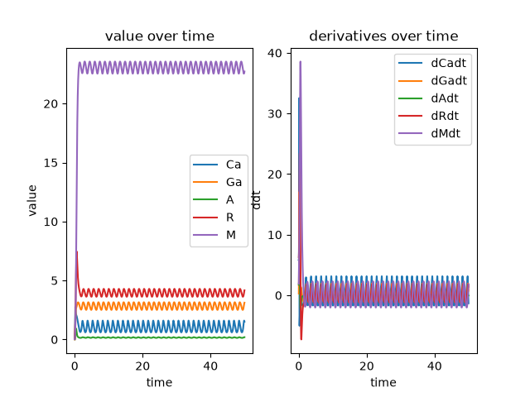
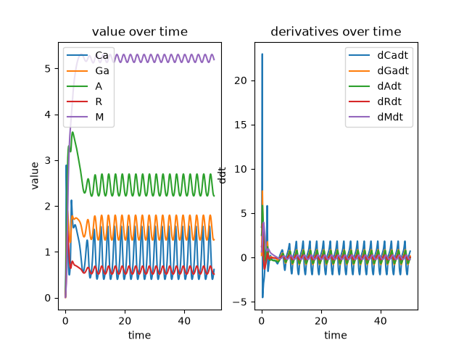
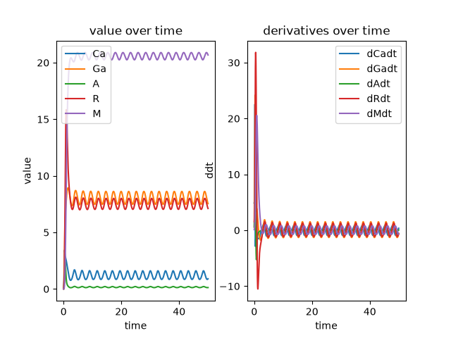
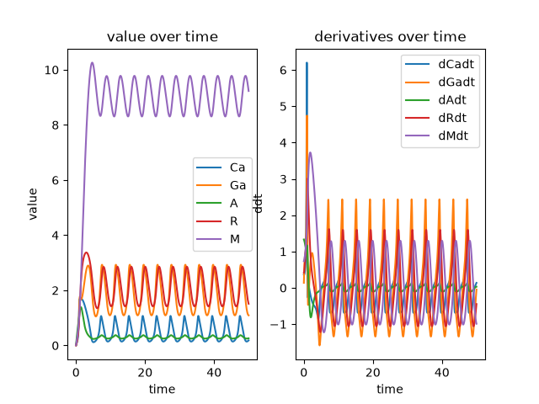
Examples of Oscillatory Systems

Slide 15
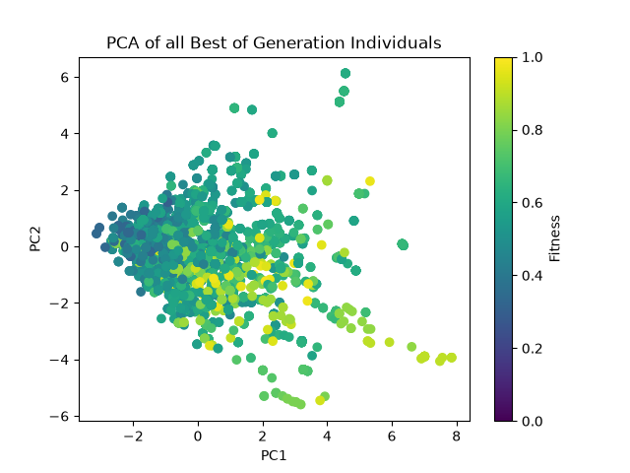
Analysis of Optimal Parameters

Slide 16
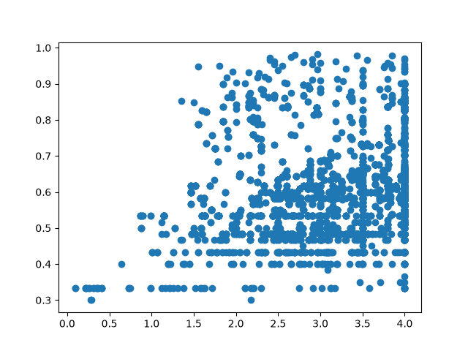
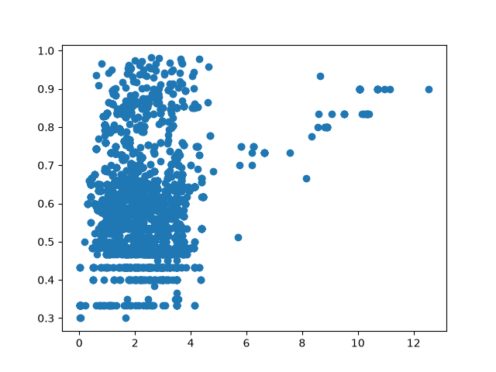
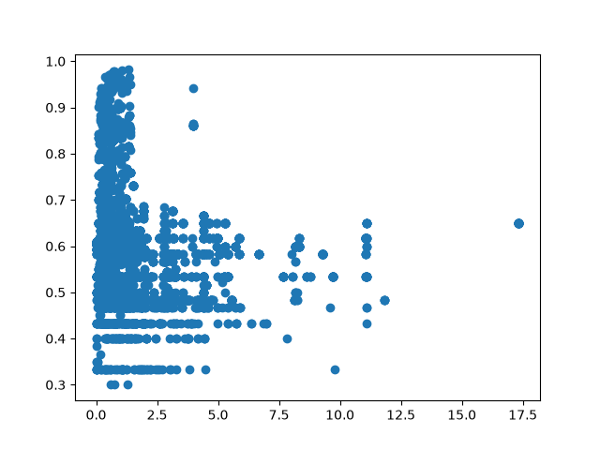
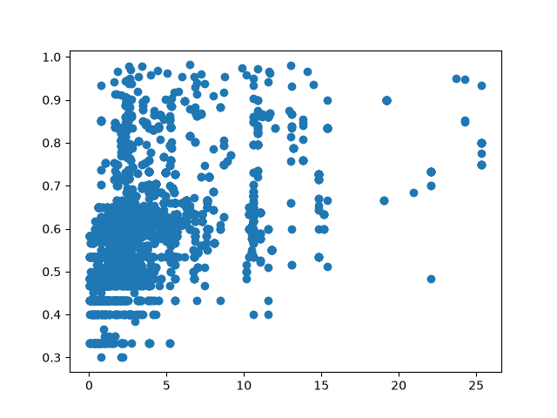
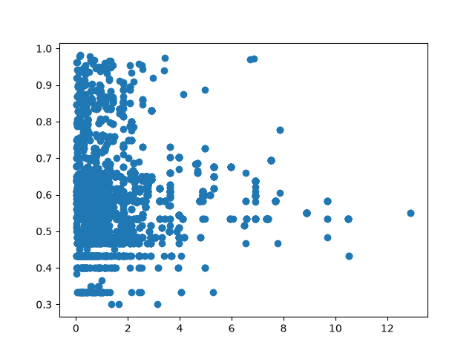
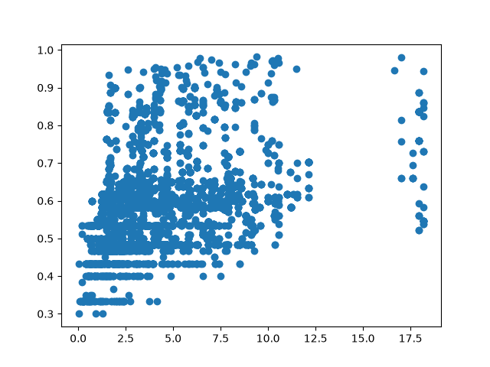
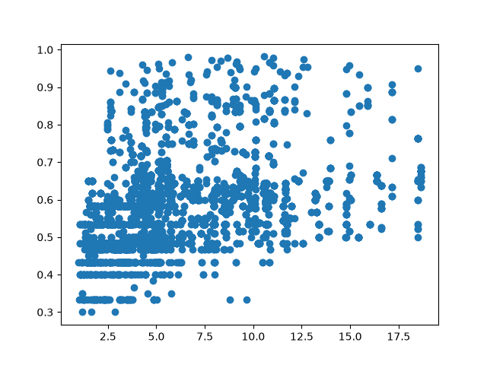
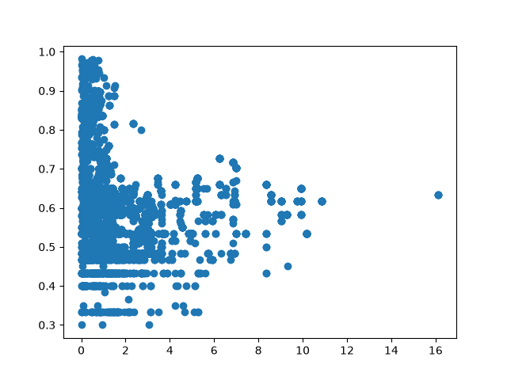
Analysis of Optimal Parameters

Slide 17
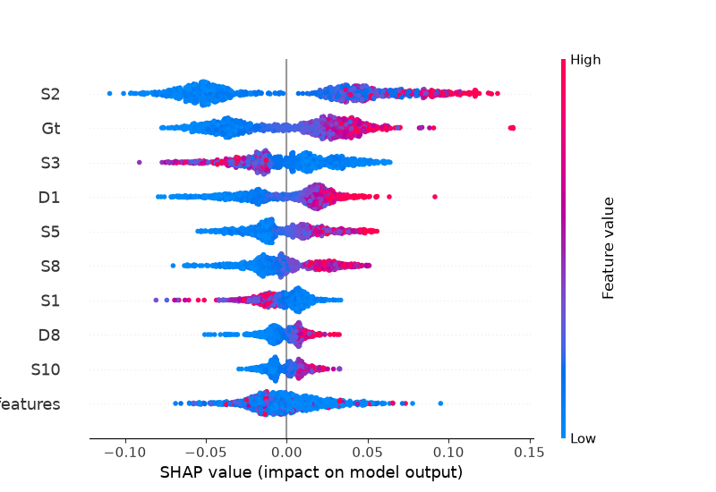
SHAP Plot for Random Forest Regressor
R^2 = 0.72

Slide 18
Next Steps
Partial Least Squares Regression
More advanced ODE Model
Secondary Oscillatory Behavior?

