Slide 1


Git Fundamentals For Engineers
Brian Standage
2025 DEC 3

Slide 2
Agenda
Quick History
Setting up Your Machine for Git
Understanding Git Fundamentals
Branching, Merging, Rebasing
Industry Standard Workflow
Hands On Exercise
Automation and Quality
Submodules
Q & A

Slide 3
Quick History

Slide 4
Git is a Time Machine for Your Code
Live Demo: Exploring the First Git Commit
What does this show us?
Git stores the entire evolution of a project, allowing you to:
Track every change you make
Recover lost work
Jump back in time to any version
Work together without stepping on each other
Even the Git source code itself is a Git repository
A Git repository: often referred to as a "repo," is a fundamental concept in the Git version control system.
It is essentially a folder or directory where Git tracks and manages all changes made to a project's files.

Slide 5
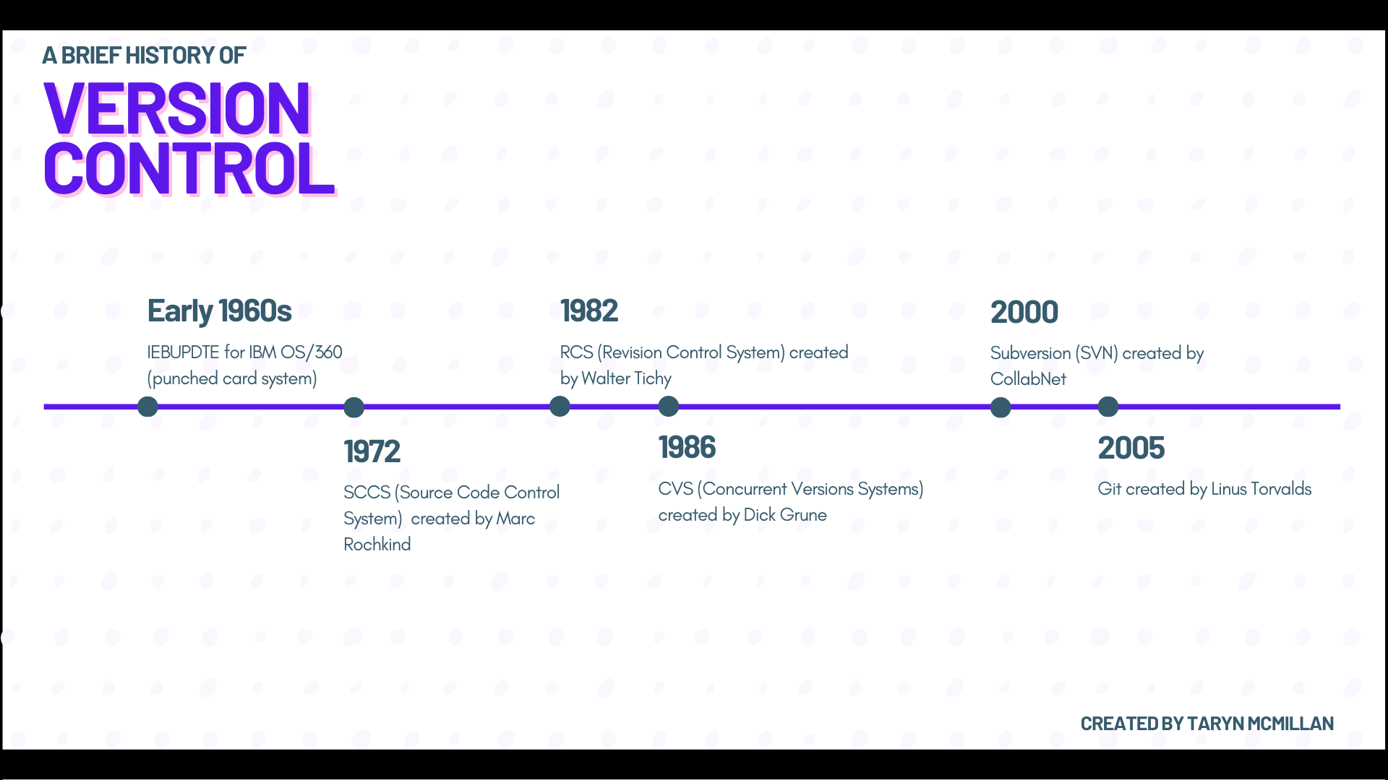
Why Git Exists
Git was created in 2005 during a major crisis in the Linux kernel community
Project outgrew its previous version control tools
Linus Torvalds built Git to be fast, distributed, corruption resistant VCS
Every Git repository is a full copy of the entire project history
Used by organizations such as:
- Microsoft
- Google
- Amazon
- Meta
- NASA Jet Propulsion Laboratory
- The Linux Foundation
- Open-source communities across every major language
- Most Fortune 500 engineering teams

Slide 6

Setup Your Machine for Git

Slide 7

Installing Git
Git Install macOS:
Install HomeBrew:
/bin/bash -c "$(curl -fsSL https://raw.githubusercontent.com/Homebrew/install/HEAD/install.sh)”
Install Git:
brew install git
Git Install Windows:
https://git-scm.com/install/windows
Run the installer, accept defaults, and add to path
Git Install Linux (usually preinstalled):
https://git-scm.com/install/linux

Slide 8
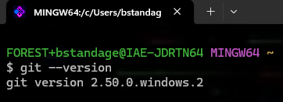

Verify Install and Configure Git
To verify installation, open a terminal/command line/shell and run the command:
git --version
Git needs to know who you are. Set your name and email:
git config --global user.name “Your Name”
git config –global user.email “your.email@usf.edu”

Slide 9

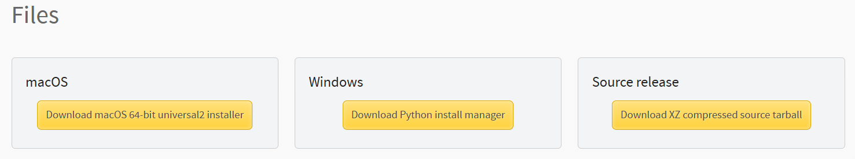

Optional but Recommended Tools
Recommended IDE: VS Code
For the exercise, install Python: https://www.python.org/downloads/release/python-3140/ (Python is no longer needed for the exercise)
Scroll down and find your OS
Verify Python install with
python --version or python3 --version

Slide 10
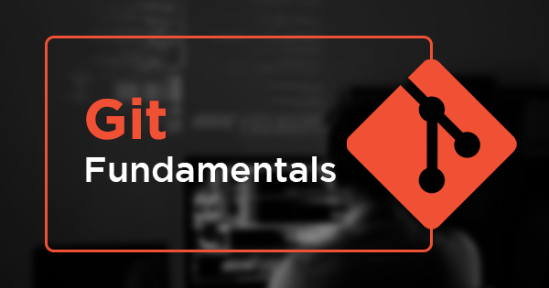
Understanding Git Fundamentals

Slide 11

How Do I Create a Repo?
For repos that must live in the USF GitHub organization:
Create an IT Ticket including:
Repository name
Names/Emails of people who need access
Permissions (view, edit, admin, etc.) for each person
You can also create a repo outside the USF Organization yourself through the GitHub GUI
Once your repo has been created, clone it:
git clone <org-repo-url>

Slide 12
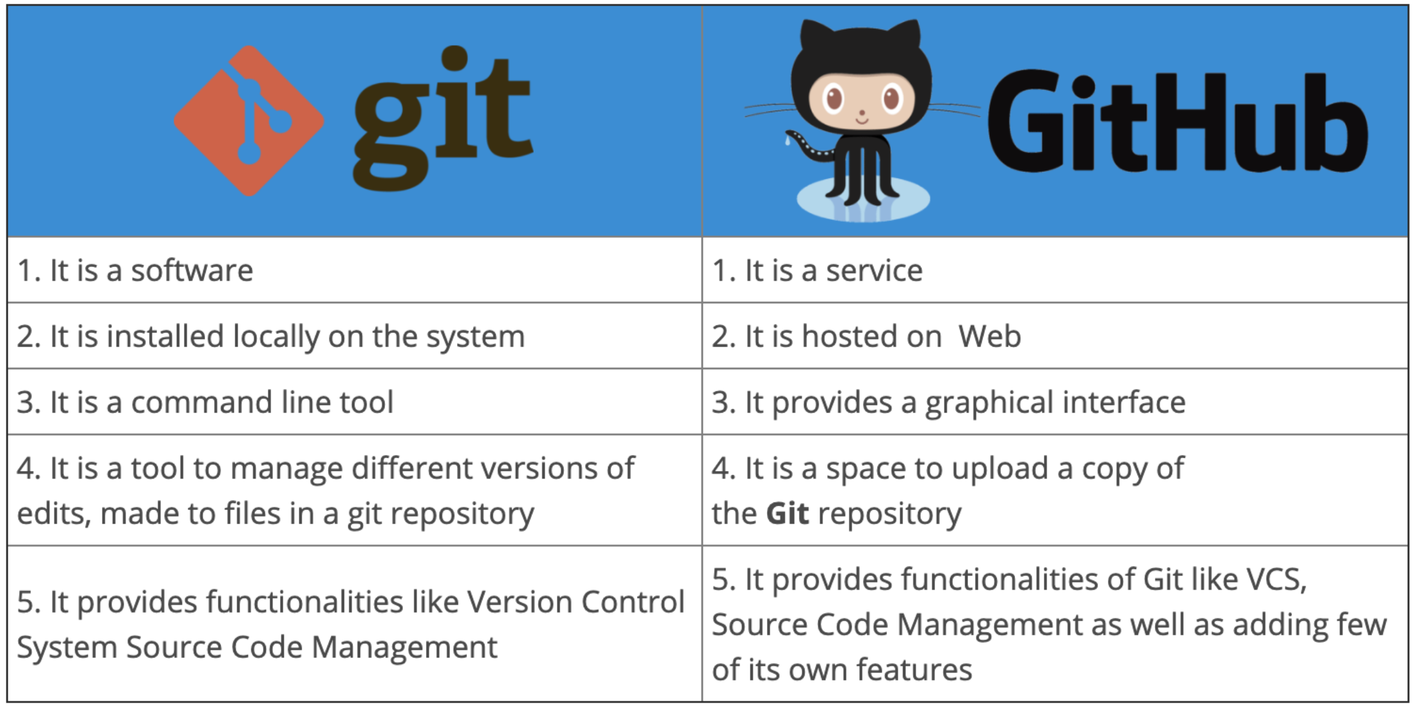
Git vs GitHub
Git: version control system, local + distributed, tracks commits, branches, history
GitHub: cloud-hosted platform, remote repo, collaboration (PRs, reviews, CI/CD)
Git can exist without GitHub
GitHub adds visibility and workflow tools
There exist alternatives to GitHub

Slide 13
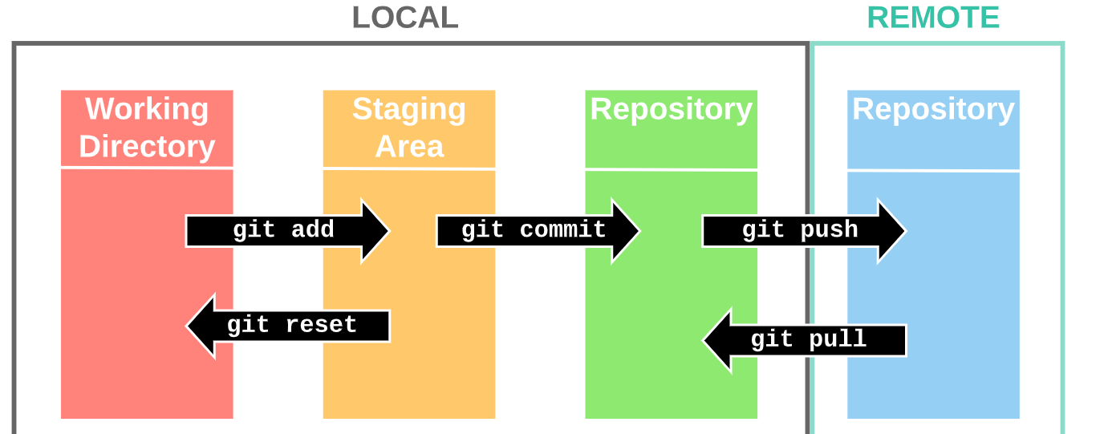
The Git Model
Working Directory: your local editable files
Staging Area: prepares changes for commit (git add)
Local Repository: stores committed snapshots (git commit)
Remote Repository: shared version of the repo on the cloud (git push / git pull)

Slide 14
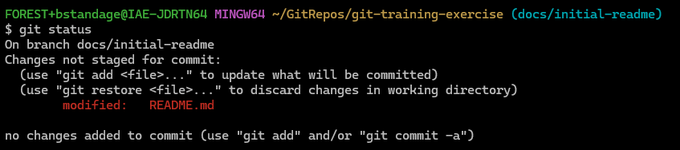
Working Directory
The files on your machine you actively edit
Git monitors this directory for changes
Untracked, modified, and ignored files live here
Changes in the working directory will be lost if they are not saved to git
git status:
shows what changed in the working directory
shows the files in your staging area

Slide 15
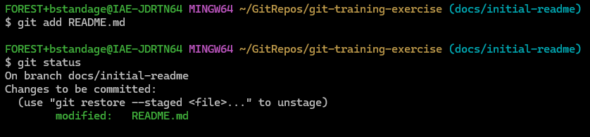
Staging Area
Where Git starts tracking and saving changes
A holding area where you prepare changes before a commit
Lets you choose what is present in your next snapshot of the local repository (commit)
You can stage part of a file, or multiple files intentionally
git add moves changes from working directory → staging area

Slide 16
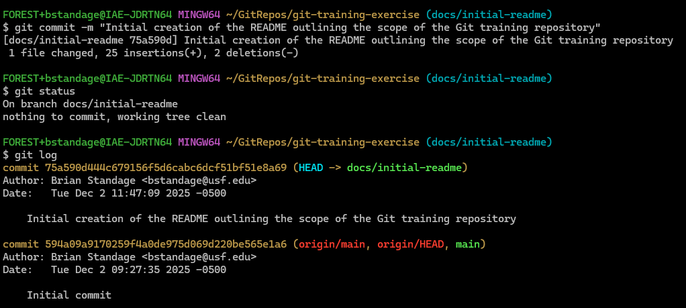
Local Repository
Stores complete commit history locally
Each commit is a snapshot with a unique hash ID
You can revert, inspect, compare, or branch from any commit
git commit moves staged changes → local repository

Slide 17
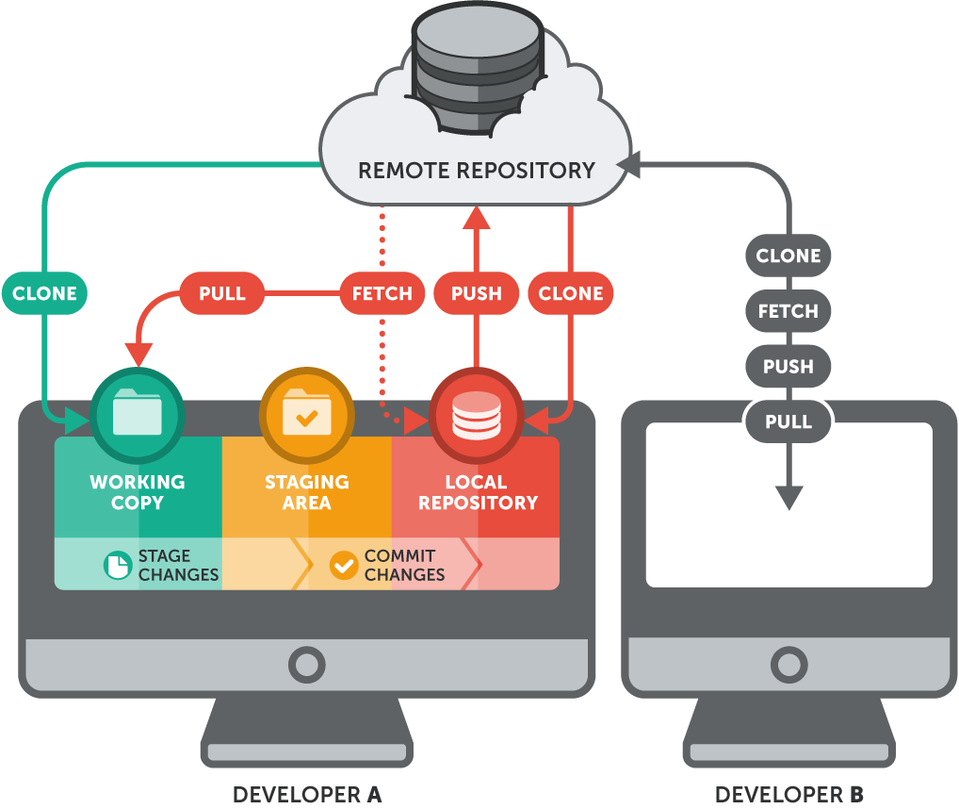
Remote Repository
Hosted version of the repo on Github, GitLab, etc…
Acts as the shared source of truth for the team
You push your commits to share them with your collaborators
You pull to sync changes that others made
git push and git pull move commits between local and remote

Slide 18
Putting It All Together
Edit → Stage → Commit → Push → Pull
Stage changes: git add <file>
Commit snapshot: git commit -m "message"
Push to remote: git push
Pull updates from remote: git pull
Git ensures every change is traceable and recoverable

Slide 19
Basic Git Commands
git status
Shows what changed and what stage things are in.
git add <file>
Move changes from working directory to staging area.
git add .
Stage everything currently modified.
git commit -m "Message"
Save staged changes into your local repository.
git log
View commit history.
git push
Upload your commits to the remote repository.
git pull
Get the latest commits from the remote repository.
git checkout -b <branch>
Create and switch to a new branch.
git checkout <branch>
Switch to an existing branch.
git branch
Show all branches in working directory

Slide 20
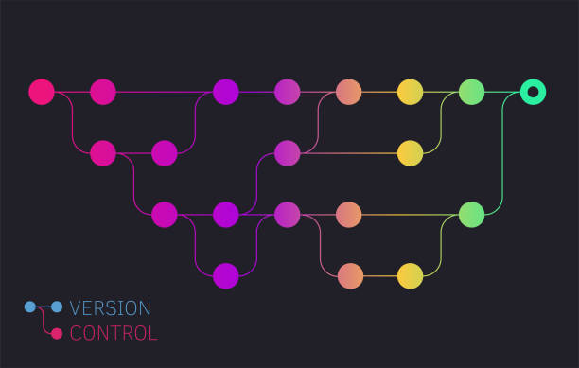
Branching, Merging, Rebasing

Slide 21
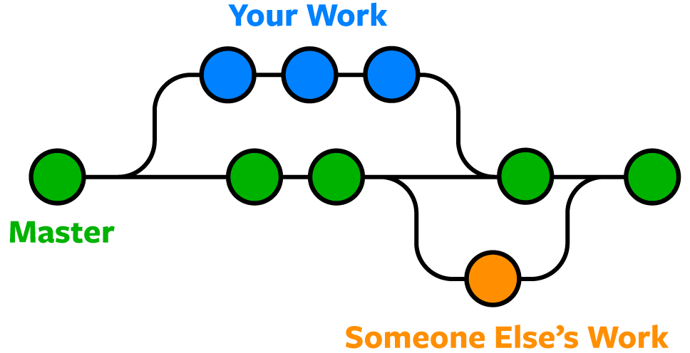
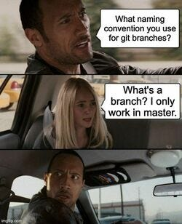
What is a Branch?
Branch = lightweight pointer to a commit
Easy to create and delete
Main (master) branch = stable production code (the project baseline)
Feature branches = isolated work for experiments or new features
Branches encourage parallel development and safe experimentation
Standard to create a branch off main
Branches can be made off other branches

Slide 22
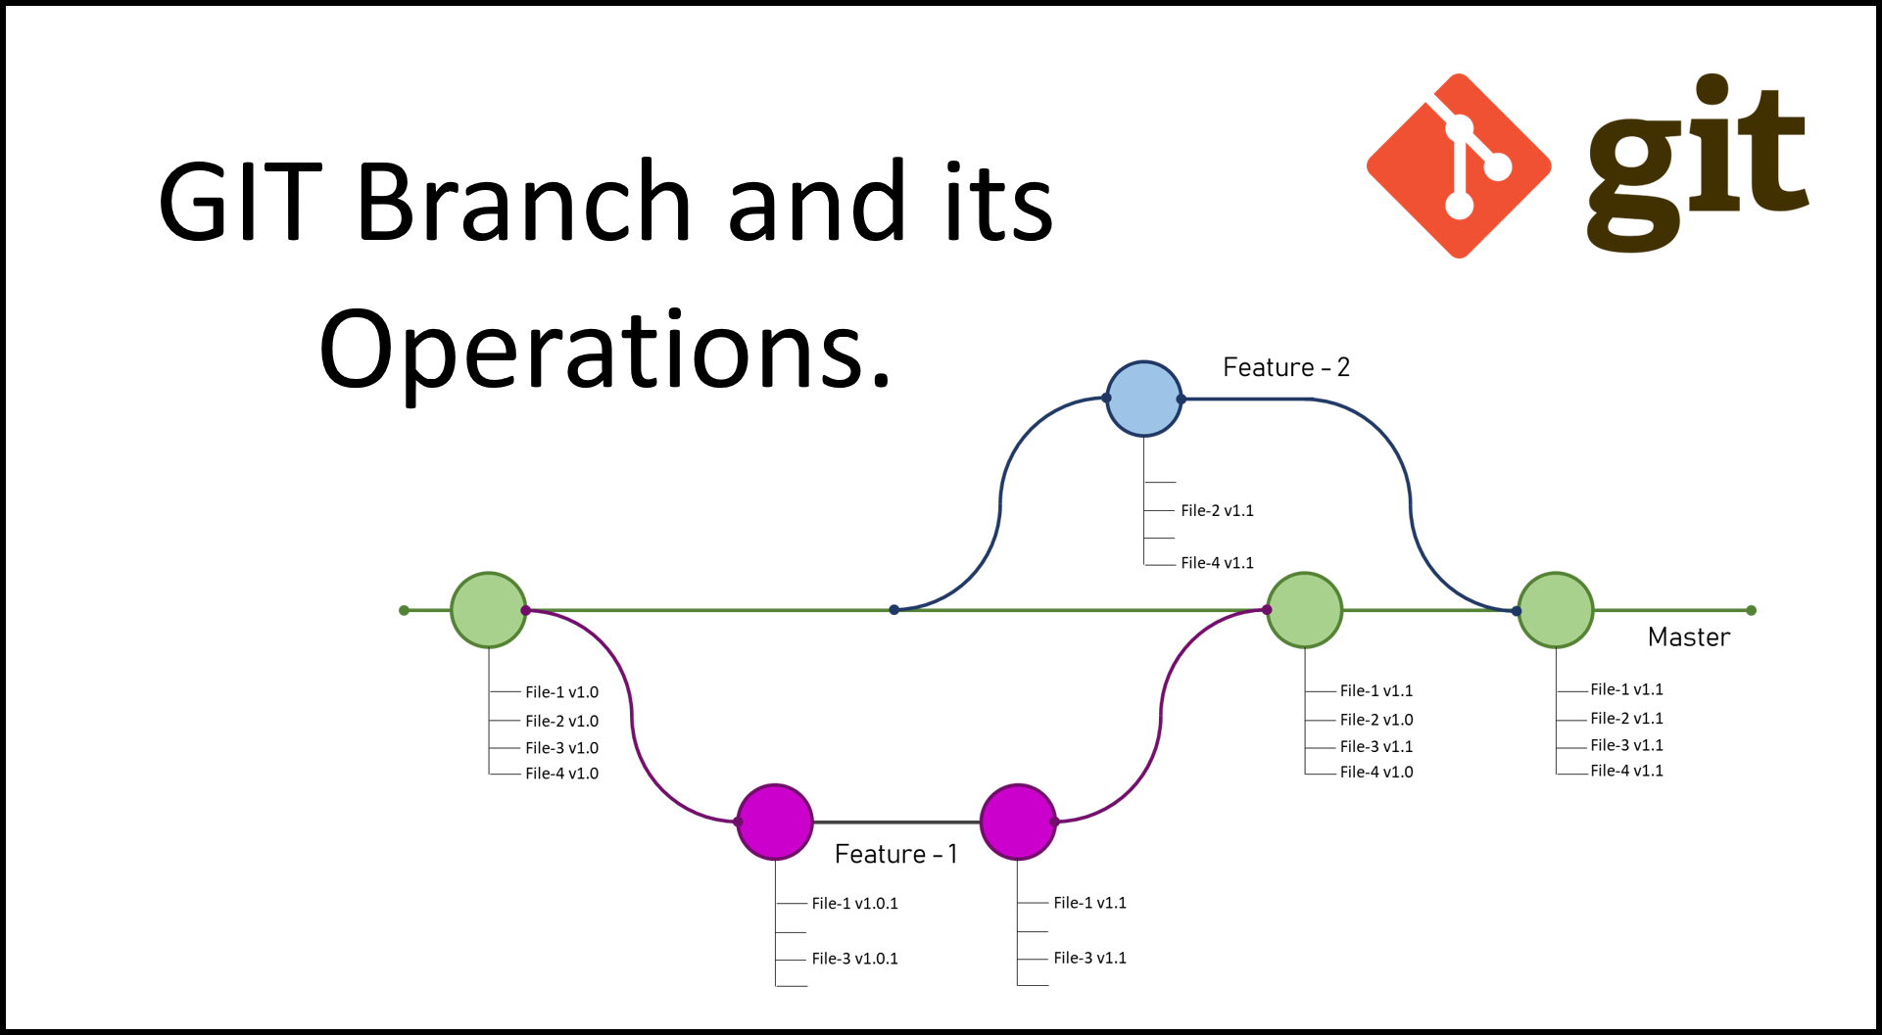
Creating and Managing Branches
Create a branch
git checkout –b branch_name
Switch branches
git checkout other_branch
Push a branch not yet on the remote
git push --set-upstream origin branch_name
Delete a local branch
git branch –d branch_name
does not delete from remote or other people’s working directory
Delete a remote branch
git push origin --delete branch_name
Easier to just do on GitHub
Remember: keep branches short lived and focused

Slide 23
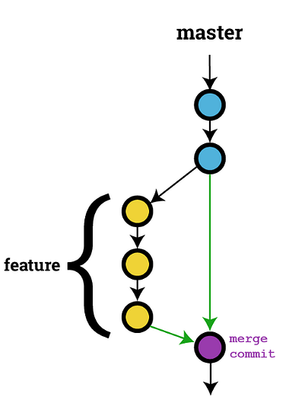
What a Merge Does
Combines the history of two branches
Creates a new merge commit by default
Keeps full commit history exactly as it happened
Ideal when working in shared team environments
Helps maintain clear historical context
Common command:
git merge branch_name
To bring changes from main into your branch
git merge main

Slide 24
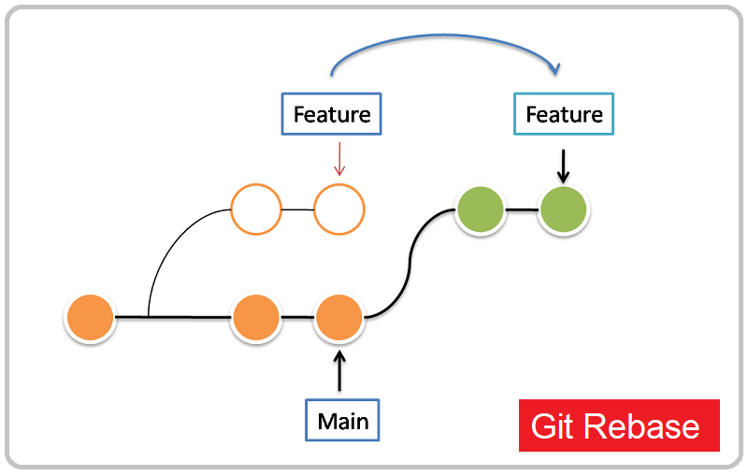
What a Rebase Does
Moves your branch to start at a new commit
Rewrites history by creating new commits
Creates linear branch history
Removes the “merge commit” that exists when merging
Think of it like cutting and pasting your work on top of the latest code
“Take my commits and move them to start from the latest version of another branch.”
Common commands:
git rebase main

Slide 25
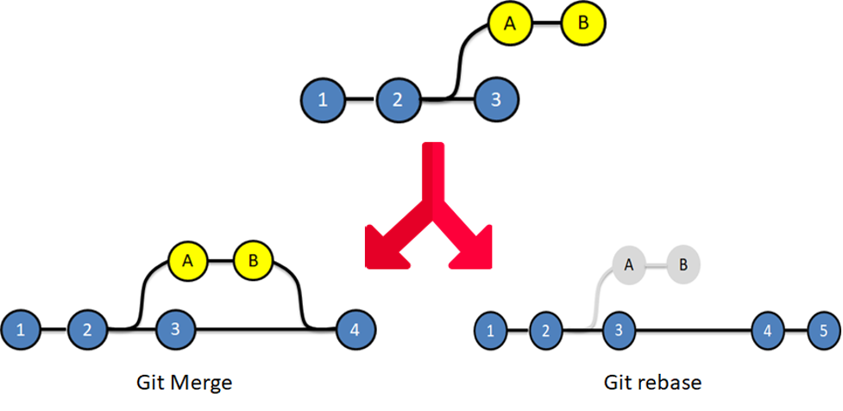
Merge vs Rebase
Merge:
Keeps all original commits
Creates a merge commit
Preserves branching structure
Easier to audit history
Rebase:
Rewrites history
No merge commit
Creates a cleaner, linear history
Can be risky if misused
Merge is safer for teams; rebase can clean up history if used carefully
Different teams choose workflows based on clarity vs auditability

Slide 26

Industry Standard Workflow

Slide 27
Branch Conventions
Use consistent, descriptive naming patterns
Common prefixes:
feature/
bugfix/
hotfix/
experiment/
docs/
Keep branch names short but meaningful
Avoid ambiguous names like “did-things”, “some-stuff” “meh”, “a-feature”
Potentially include ticket/issue numbers if applicable
feature/1234-add-login

Slide 28
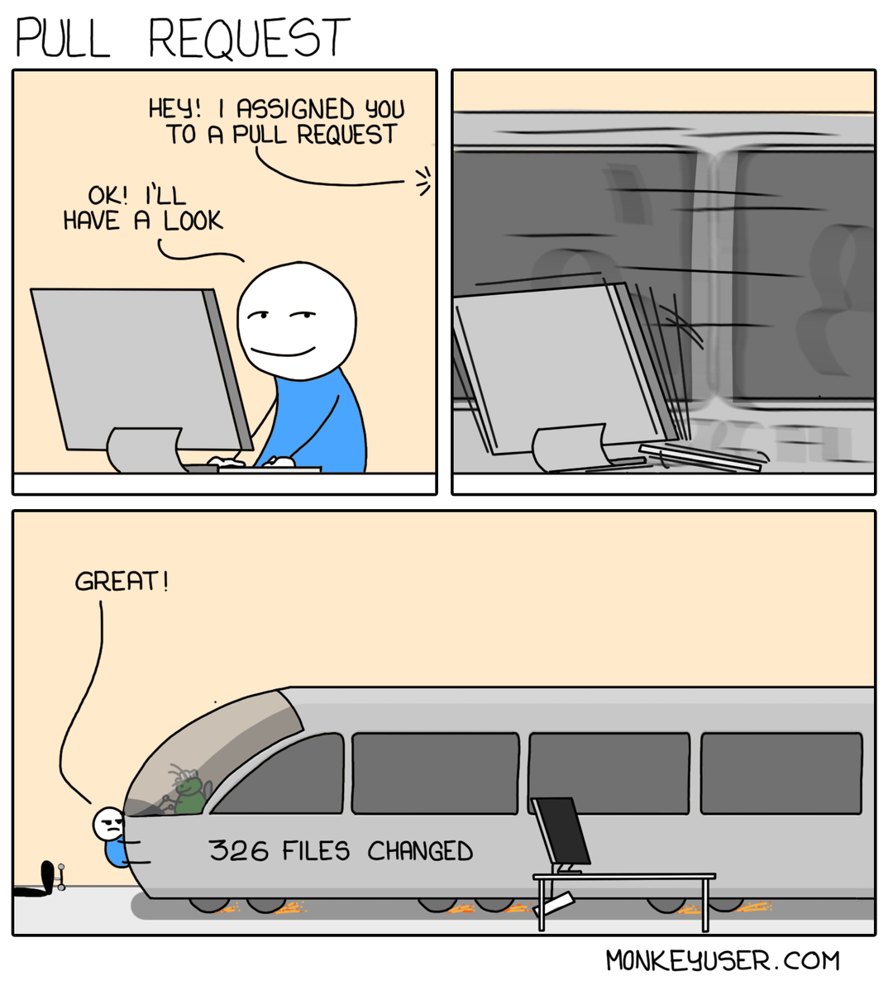
Feature Branch Workflow
Never commit directly to main/master
Create a branch for every feature, bug, task, etc.
Commit early and commit often
Merge or rebase frequently to stay up to date with main
Open a Pull Request when the feature is complete and tested

Slide 29
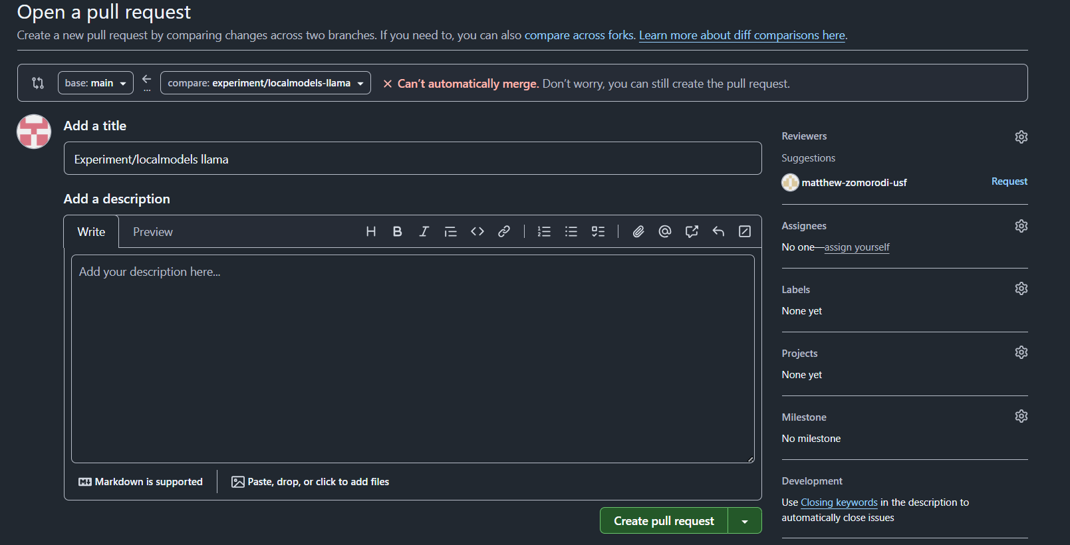
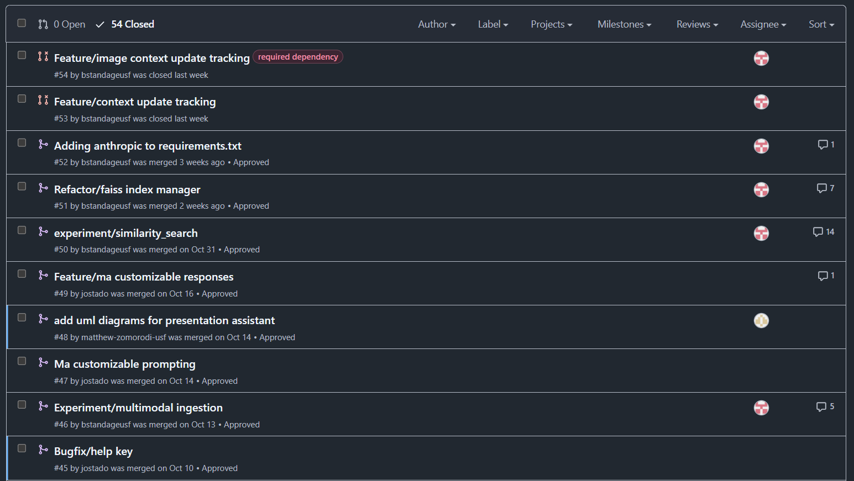
PR Etiquette
What a Pull Request is:
A request to merge your branch into the main codebase
Write a clear PR description: purpose, changes, testing notes
Keep PRs small and focused (avoid mega PRs)
Avoid noisy PRs (unrelated changes packaged in)
Request reviewers proactively
Don’t merge your PR until it has been approved by the reviewers

Slide 30
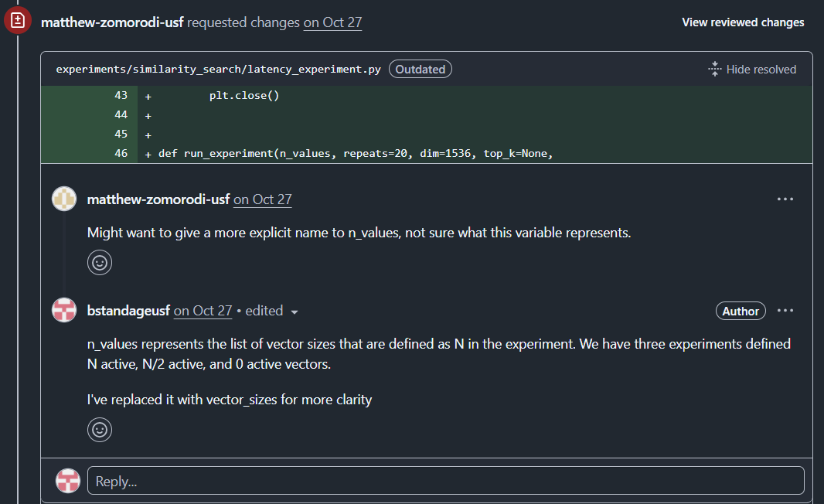
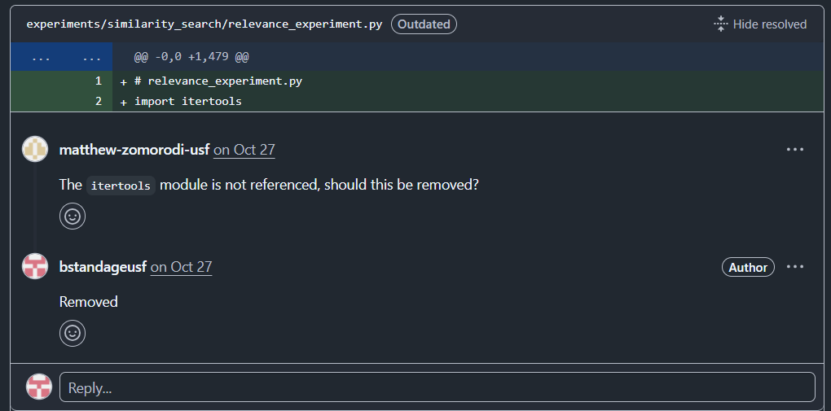
Code Review
Review for correctness, clarity, and maintainability
Provide valuable and actionable feedback
Don’t be afraid!
It’s an opportunity for your collaborators to learn even if nothing is wrong
Remember: goal is to improve code, everyone’s image of perfect code looks different
Approve when you the changes are correct and safe

Slide 31

Hands-On Git Team Exercise

Slide 32
Exercise Instructions
Clone the repo: https://github.com/bstandageusf/git-training-exercise
Form a small team
Create a branch using your team name
Open the file in VS Code
Answer ONLY ONE question in the list of questions
Add each team members’ names to [Contributors]
Update your team's name in the field [Last Team to Contribute]
Do not erase other teams who contributed before you
Stage and commit your changes
Merge latest main into your branch
Make sure you checkout main and pull the latest changes first!!
Resolve any conflicts by combining collaborators names and their question answers
Push your branch to the remote repo
Open a PR on GitHub
Optionally review another team’s PR and leave a comment

Slide 33
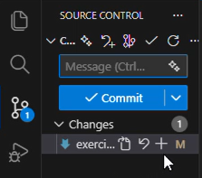
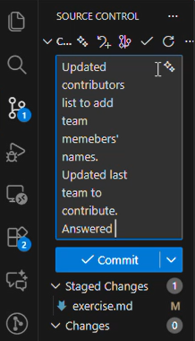
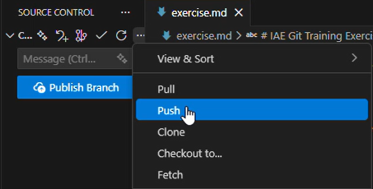
Git Workflow in VS Code
Open the Source Control tab
View changed files
Click the + to stage a file
You can stage as many files as you want to be in the same commit
Enter a commit message in the input box
Click the blue commit button
Click the three dots (…) and click push
Click the three dots (…) and click pull to bring in latest changes
To get updates from main:
Click (…) -> checkout to -> main -> (…) -> pull

Slide 34

Git Workflow in Command Line
In a terminal, command line, git bash, etc…
git add <filename> to stage
You can stage as many files as you want to be in the same commit
git commit –m “commit message here” to add a commit the staged files
git push to push the changes
If the branch was created locally, you must do git push --set-upstream origin <branch_name>
git pull to pull changes in from the branch you have checked out
To get merge updates from main:
git checkout main → git pull → git checkout - → git merge main
You can use git checkout – to checkout your last branch

Slide 35


Automation, Enforcement, and Extras

Slide 36
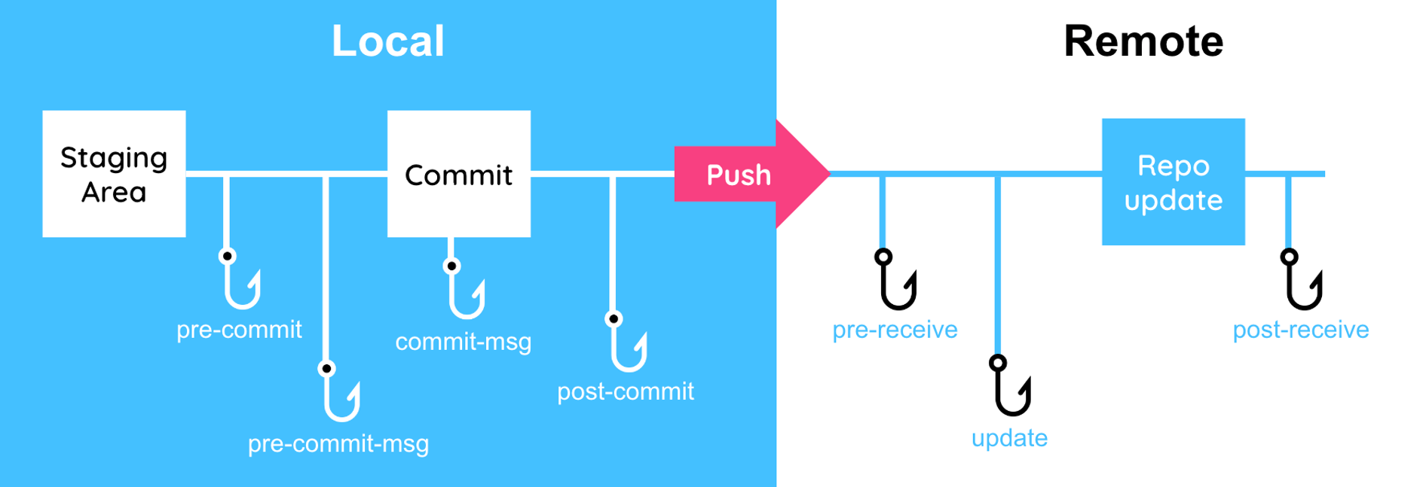
Pre-commit Hooks
Automatically check code before committing
Catch mistakes, enforce formatting
Example: Prevent committing secrets like API keys
Tip: Setup via .git/hooks/pre-commit

Slide 37
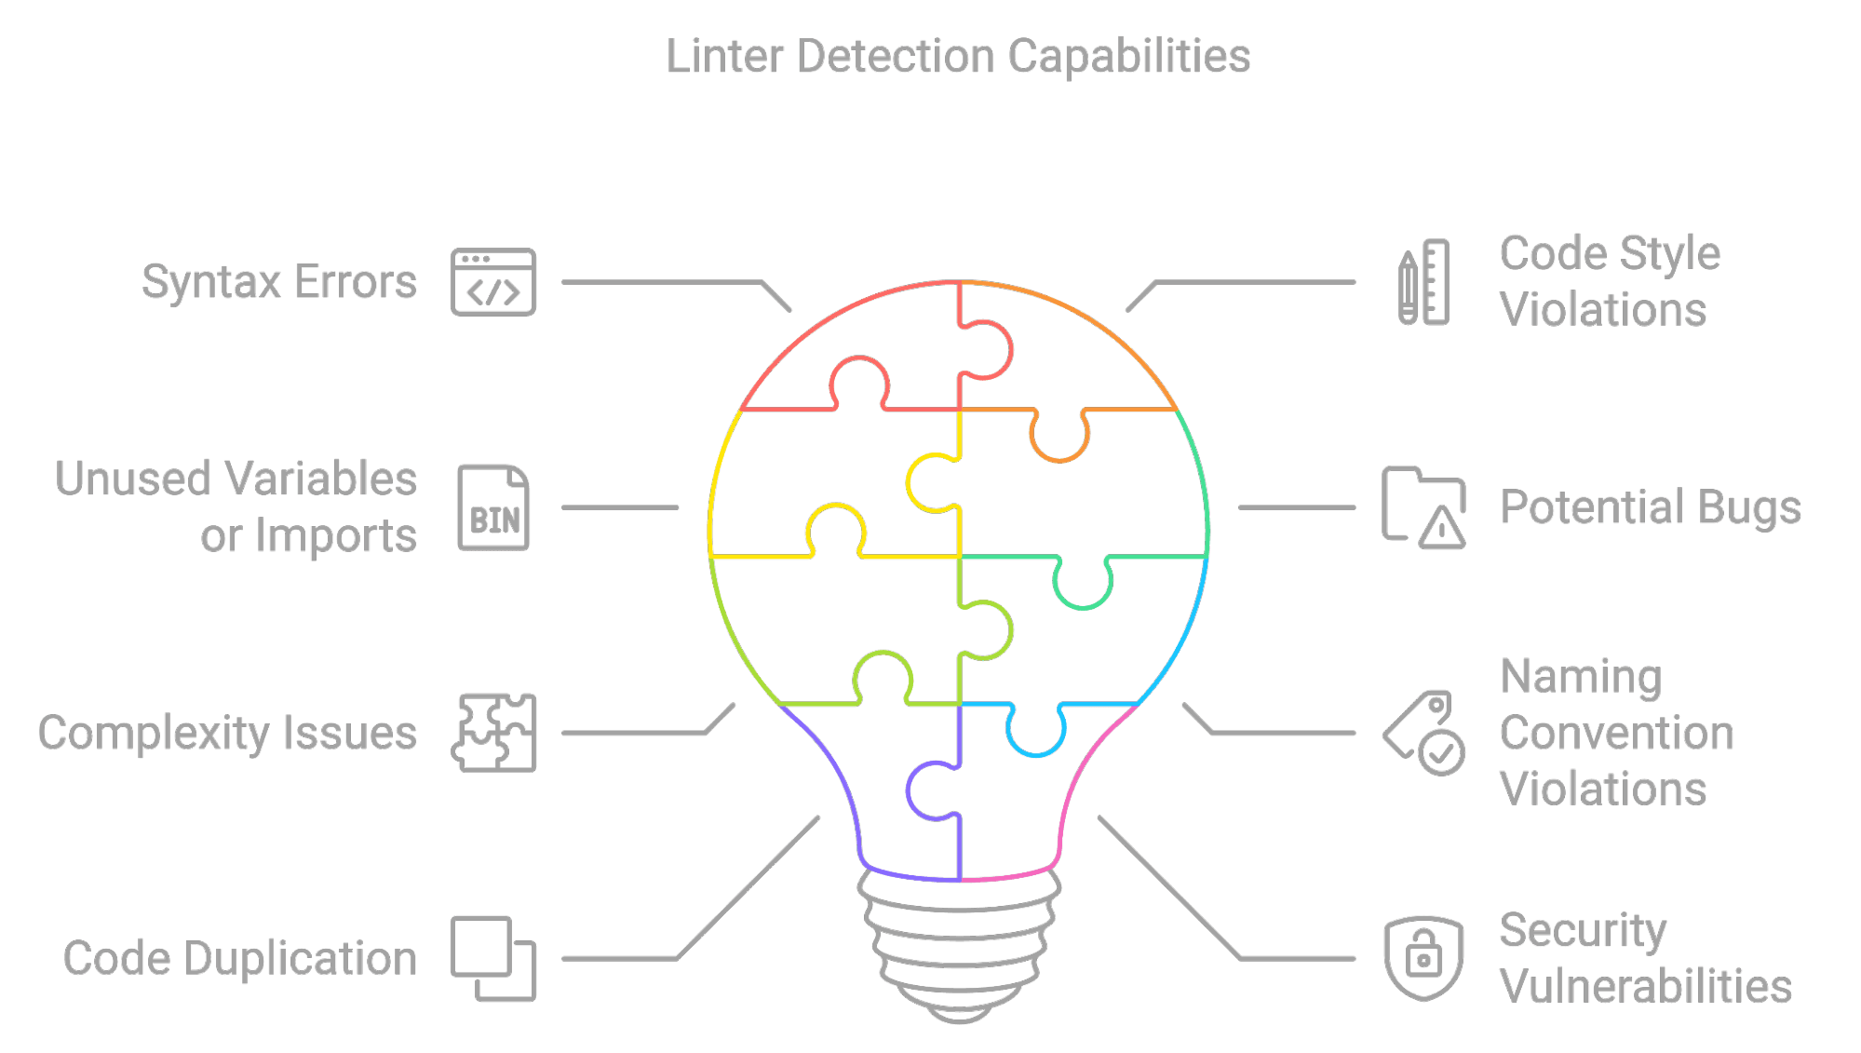
Linters
Check code style and quality automatically
Popular Python linters: flake8, pylint, black
Helps maintain consistency across the team

Slide 38
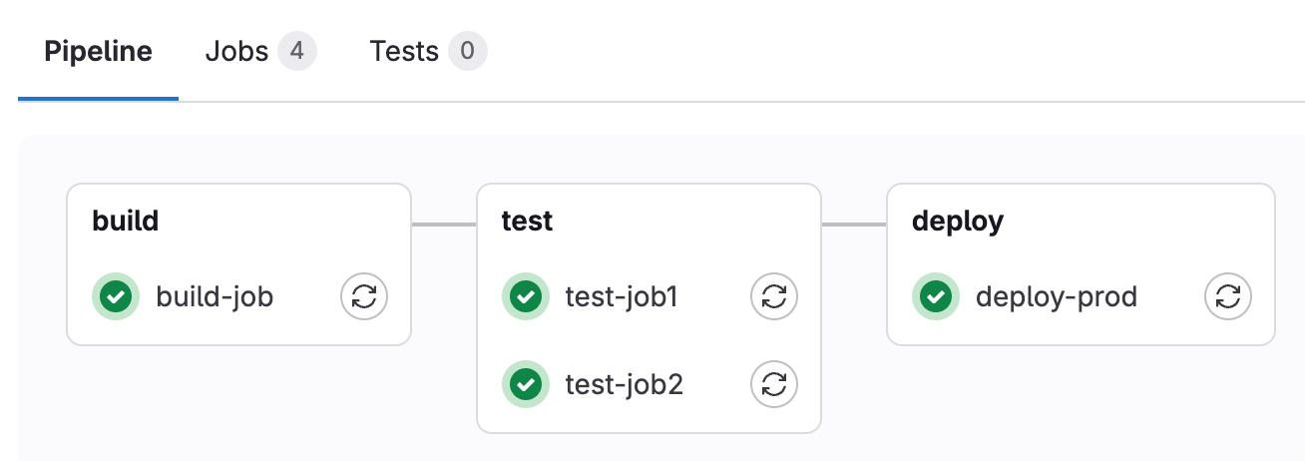
Pipelines
Automate tests, builds, and checks on every commit/PR
Ensures code quality before merging to main
Verify branch naming standards or other organization standards post-commit
Pipelines can not be enforced pre-commit

Slide 39
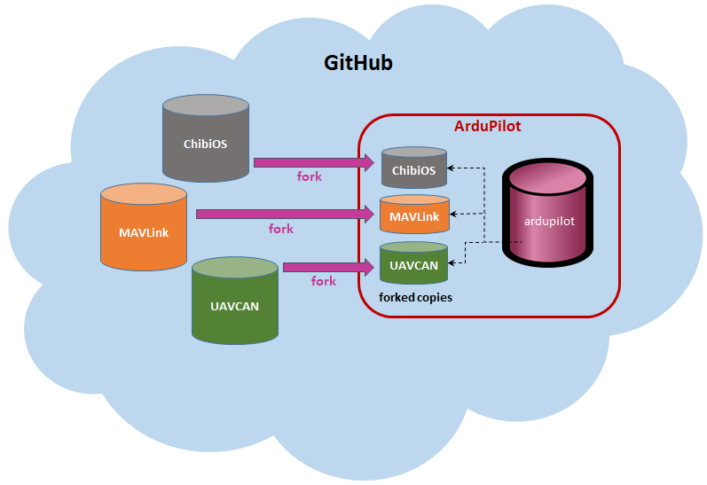
Submodules
Include another Git repository within a repo
Useful for modular projects (like DASH and ACP)
Commands:
git submodule add
git submodule update --init
Helps manage external dependencies consistently
Allows updates to shared functionality to be made in a centralized location
Can be tricky at first!

Slide 40
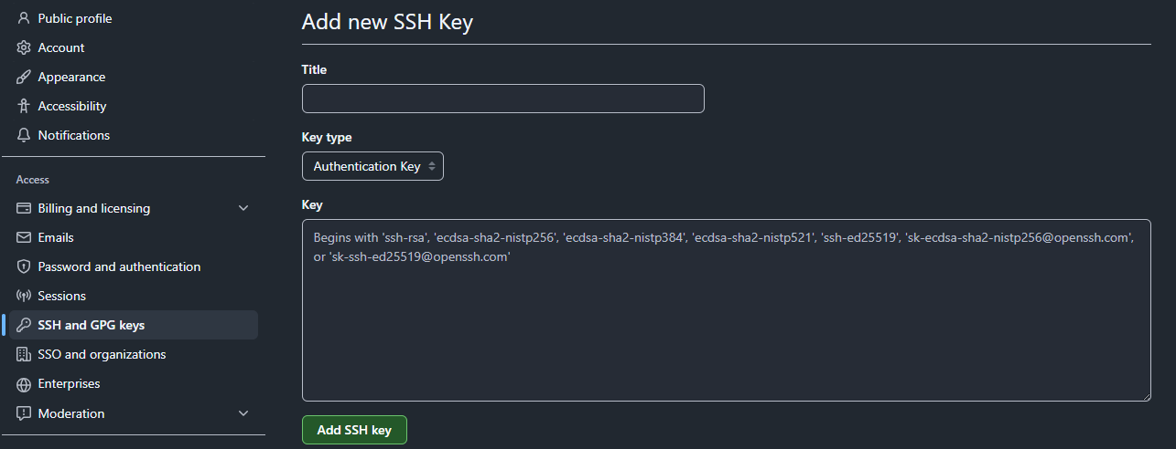
SSH Keys
Secure GitHub authentication without passwords
Generate your key using ssh-keygen
ssh-keygen -t ed25519 -C your_email@usf.edu
Accept default save location
On GitHub go to Settings → SSH and GPG keys → New SSH Key, then paste your key and save
Test your ssh key with:
ssh -T git@github.com
Simplifies pulling and pushing greatly

Slide 41
Closing Section

Slide 42
Additional Resources
Git SCM tutorials: https://git-scm.com/docs
LinkedIn Learning: Git Fundamentals course
Awesome interactive game on Git: https://learngitbranching.js.org/?locale=en_US
Git cheat sheet: https://education.github.com/git-cheat-sheet-education.pdf

Slide 43
Q & A
Thank you, everyone!

