Slide 1
Secure Remote Access to your Serial Console Ports
"You progress not through improving what has been done, but reaching toward what has yet to be done."
-- Kahlil Gibran (1883-1931)
Notes:
This presentation is a supplement to my console services web pages, located at http://www.conserver.com/consoles/.
These pages have a substantial amount of information noted below each slide. I do this to help minimize the amount of note-taking that you need to do during the talk, and this should give you more time to listen to the talk, instead of taking notes. But, if you feel that you learn better by taking notes, please feel free to do so.
This presentation is meant to be a brief overview and introduction to the topics of Terminal Server and Console Server hardware, and to logging Console Server applications. Please look into the Open Source “Conserver” application, which is freely available from http://www.conserver.com, if the idea of adding a logging capability to your console remote access service is appealing to you.
We will also explore some real-life deployments, to explore some of the points made during the talk.
Due to the length of the talk tonight, we will sacrifice some depth, in order to get breadth of the information.

Slide 2
BigBand Networks Overview
Based in Tel Aviv, Israel
  US main office is in Redwood City
Manufactures Digital Video Processing Hardware, primarily used by the Cable TV industry
  Chassis are SNMP managed, but can also be controlled using a Command Line Interface (CLI)
  We’re installing remote access for ‘local’ use, but Tel Aviv engineers will benefit as well.
Notes:
BigBand Networks Inc. is my current employer. The equipment we make helps cable companies make better use of the finite bandwidth on the cable plants. I manage the US development lab, perform systems integration duties, and I have some input on network and security issues.
Prior to working at BigBand, I worked for 4.5 years for Certainty Solutions and Global Networking and Computing, where I supported the Web-TV property of Microsoft, including networking and data support of their on-site cable plant, and “Web-TV service” (ISP) and internal (corporate) networking. Other prior employers include;
Apple Computers (eWorld Tech Ops Manager)
Cisco Systems (Comm Server PME)
Telebit Corporation (NetBlazer Product Support, Supervisor)
Network Equipment Technologies (Corp Networks and Telecom)
Veri Fone, Inc. (US Mainland IS Support)
I’ve been working on serial communication for well over a decade, and I’ve presented on the topic at two LISA conferences.

Slide 3
Who’s on first (call) tonight?
How many of you could be paged tonight, to go back to work to help restore an ailing machine to service?
How many could check the status of that ailing machine from the podium, now?
How many wouldn’t worry about exposing your root passwords while doing it?
How many folks would like to be able to do it, without worry?
Notes:
Remote Access to your serial consoles is a “Big Picture” issue. There is a significant initial outlay for the hardware to make this work well, but the payback can be huge. It will enable you to change your operating procedures, reduce response time, and reduce the running around that you need to do to manage machines without this service. These are the reasons you would spend the initial money.
However, once the hardware is in place, you can make a couple of smaller investments, and add a large amount of value to your remote console access infrastructure. By adding a client-server access/logging application, you can add logging to any/all serial consoles (providing forensics data); restrict (and log) access to various consoles; add multiple simultaneous user access (which can enable mentoring); integrate the logging with your existing network and/or system monitoring tools to provide better resolution and trigger alerts. You do this with open source packages, and some homebrew coding, or you can purchase commercial servers with support agreements.
Additional benefits include easing the load on your admin staff, giving them better access, improving their ability to manage their equipment, and helping keep users out of data centers and wiring closets (by giving the users a console to hosted gear, rather than a key to the room…)

Slide 4
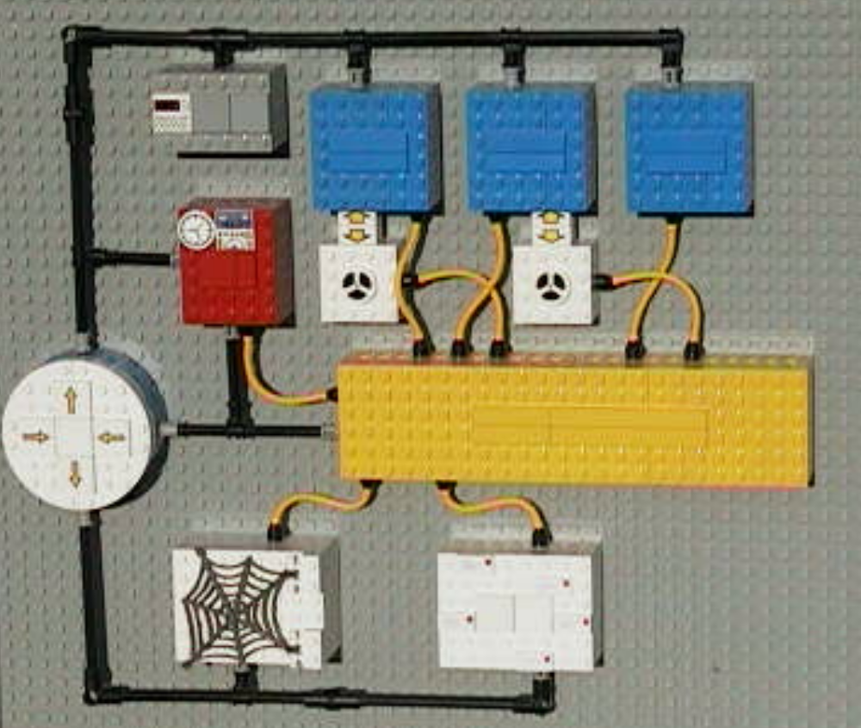
Don’t Worry, it’s easy!
Notes:
This was a model I built using LEGO, as part of a presentation I prepared for LISA 2000, to demonstrate the concepts of connecting all of your serial consoles.
The blue boxes are hosts, and a couple have externally connected storage devices.
The gray box was a network monitoring device. The red box was the Network Management Host, connected to multiple networks.
The yellow box is the console server, and the yellow “cables” (hoses) are the serial console connections.
The round white thing is the firewall/router, with the white “web” host and mail machines on the DMZ.

Slide 5
Why consoles are important
Local consoles (serial port, or keyboard and screen) are needed when network access and remote control applications have failed.
When in-the-middle network gear has failed
Secure devices want to be configured using a ‘local’ connection.
Some devices don’t have network stacks
Notes:
Before you get your equipment configured on your network, you need to get them started somehow. This is usually done using the ‘local console’.
It’s not practical to have a keyboard/screen per machine in a data center environment, so many folks deploy a Keyboard/Video/Mouse switching device to connect many devices in adjacent racks, but this has physical distance constraints, and limit the number of simultaneous users.
You can get K/V/M devices that will let you connect to a ‘virtual screen’ over TCP/IP connections, but these are high-cost, and limit the number of simultaneous users.
Some data centers use “crash carts” or “jumpstart carts”, and roll them to the rack to connect to problem machines, but these limit the number of simultaneous users, and block the data center aisles…
Not all machines can support serial console connectivity,
But many can and do today.

Slide 6
Remote Access to Serial Consoles
Most Unix machines support a serial console during operation.
Most non-Intel platforms support boot-up control using the serial console.
Many Intel platform BIOS makers are offering an option for serial console redirection of Power-On Self-Test (POST) messages, but there are limitations, and they are not consistent.
Add-in cards for PCs can provide access!
Notes:
Sun, SGI, and other hardware makers provide serial output during boot-up, as well as operation. You can also use the serial console to control boot parameters, take the machine into single-user mode, etc.
Many Intel server makers (Dell, HP, Compaq, and others) offer a BIOS upgrade to allow serial console redirection of POST, but most vendors presume you will be using a modem on each server (cables need to provide DCD signal, or the server won’t use the console or respond to it).
Console redirection also usually has trouble, when BIOS hands off to “smart” NICs and drive controllers. These controllers write to video directly instead of through the BIOS, so you cannot interact with them.
The PC Weasel (www.realweasel.com) provides an add-in card which looks like a video card to the BIOS (and NICs and drive cards), but provides output to a serial port, and then the OS can use the same port after the system has started.

Slide 7
Virtual Presence
If you can remotely access serial consoles
  No need to run to the server rooms
  Your response to outages/problems is faster
  You can easily check machines in other buildings, even in other cities
  Reduced downtime saves the company money!
Time = Money
Downtime = Anti-money
  Believe me, it gets measured, somehow
Notes:
One company I worked for turned the downtime issue into real numbers. Whenever there was a problem, they reported it to an admin, who tracked the duration, and which employees were affected. The time for each employee was then turned into a dollar amount, based on their salary.
(Confidential individual info was not available. HR added the numbers, and gave us a monthly roll-up amount…it was the “your department’s outages cost our engineering efforts$14,000 last month” discussions at the director level.)
But, we turned this to our benefit. By examining the outages, we were able to go to our CIO, and explain how spending $7,000 on hardware would reduce or eliminate the problems in coming months…buying what we needed would SAVE the company money.
Reducing the duration of an outage does have real, tangible, sometimes monetary benefit.

Slide 8
Terminal Server Review
How terminal servers provide remote access to consoles
  Reverse Telnet
    Workstation telnets to Terminal Server address:port
    7-bit session? 8-bit clean?
    Can you escape from the session?
  Vendor-specific port formulae
    Different ranges for 7-bit, 8-bit...
  Vendor-specific features
Notes:
Originally, modems or ‘dumb terminals’ were connected to terminal servers, and users would telnet from the terminal server to other points around the network.
Today, most terminal servers allow you to open a socket-based connection to the IP address of the terminal server, but at a high TCP port number, to connect to a particular serial port.
Some vendors allow only 7-bit sessions, while others provide the option for full 8-bit sessions, and even “non-escapable” sessions (where the attached device needs to drop the DCD or hardware handshake lead to disconnect you session).
The list below tells you the formulae to determine the TCP port number for two of the more popular terminal servers (where ‘n’ is the line (serial port) number you wish to connect).
Cisco: 2000 + n
Xyplex and iTouch: 2000 + (100 * n)
IOLAN: 10000 + n

Slide 9
Terminal & Console Servers
Terminal Servers were designed to allow ‘dumb terminals’ to access hosts on IP networks.
Reverse Telnet allowed users on the network to connect to serial ports on terminal servers
Console Servers are a newer, enhanced Terminal Server, meant for supporting console access.
Notes:
Terminal servers are still readily available, and you can pick them up fairly cheaply on eBay, or other dot.com auctions.
However, Terminal Servers didn’t need to care about Serial BREAK in the old days, and sometimes it was designed to send BREAK when sessions cleared up (to reset a modem, for example). So an older unit may send Serial BREAK to attached devices under some conditions. If you have SUN computer consoles attached to your terminal server, a BREAK can halt your SUN.
Serial BREAK is actually a Good Thing, in moderation, and useful for administration of your hosts. You can get more information from my Serial BREAK-off testing pages, http://www.conserver.com/consoles/breakoff.html
Newer Console Servers are generally better about not sending Serial BREAK at the wrong time, but if you have SUN gear, you should make sure that the equipment you are buying is marked “Sun-safe”, or otherwise states that it won’t send Serial BREAK unless you want it to.

Slide 10
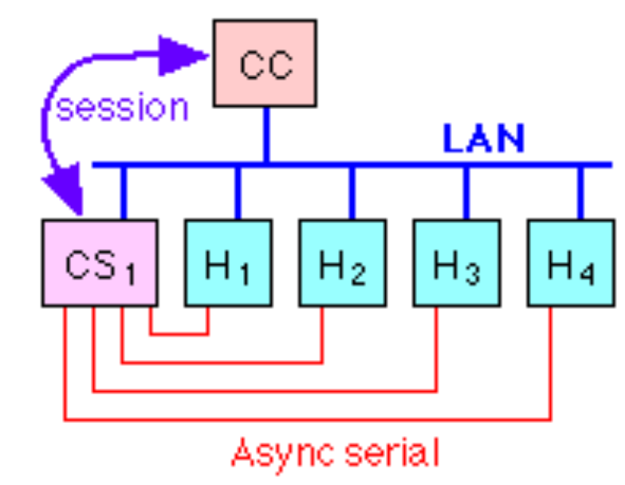
Basic Serial Hookups
Console Server connected to the same LAN with the hosts
Serial connections from the consoles of each host to the Console Server
Notes:
In the most basic configuration, you connect all of the consoles that you care about to a serial port on a Terminal Server or a Console Server.
Each serial port can be configured for different serial speeds (that is, for any of the common serial speeds), as well as setting the number of bit, parity, and stop bits.
In a simple, isolated deployment, the console server would be connected to the same Ethernet network as the hosts. (We’ll discuss other connection options later in the tutorial.)
The console server could be a host with a multi-port async module, or a dedicated Console Server device. If the console server is a host, with it’s own keyboard and mouse and screen, it may not need to be connected to the network at all.

Slide 11
Security is already available
Most Console Servers have SSL and/or SSH implementations for access
Many have IP access control, so you can allow connections only from ‘trusted hosts’ to the high TCP ports
You can also set up your access so users need to use SSH, or other secure methods to authenticate on the trusted host before they can connect to the Console Server
Physical access should be part of your plan
Notes:
The good news is that many vendors now see a market for these goods, and the sysadmins who are buying them are pressuring them for security and more features. However, it’s not all good news…
There is no interoperability standard for this security access to console servers. It’s not always clear what SSH source is used in a given console server. (How often does *your* console server vendor call you to notify that there is a security patch upgrade available?)
While you can get SSL, “official” certificates are costly, so many folks use home-rolled certificates. Certificate management also gets tricky when you have multiple console servers, and multiple users. (It’s very difficult to restrict certain users to certain ports in this scenario.)
Using a separate Management or Console Network can be a big part of simplifying your access while increasing the security of it.

Slide 12
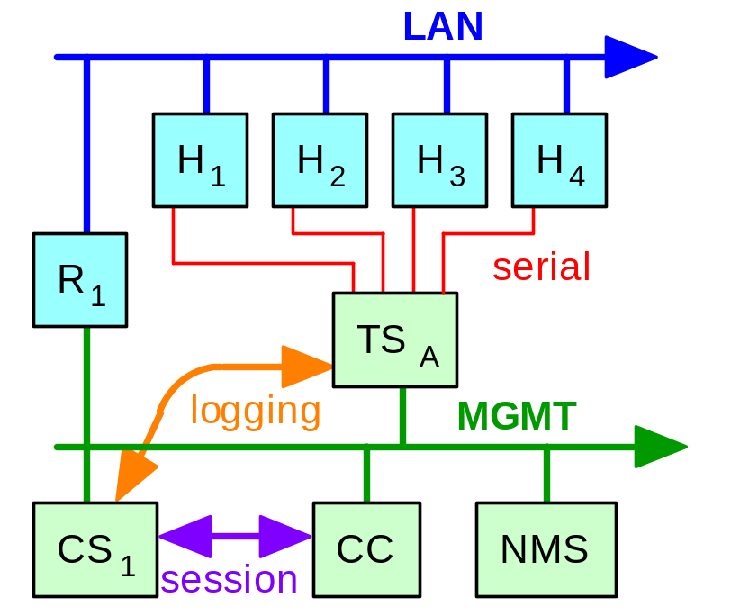
Advanced (Security) Architecture
Addressing Security Concerns
  Add a management Network
  Put console server and clients there
  Added security costs money…
Notes:
If you are concerned about someone sniffing the client-to-server connections, or the logging streams, then you probably already have a control/management network in place, where your monitoring and control activities take place.
In this model, the console server Application host (CS1), and the client(s) all live on the management network, so that the client sessions, and the logging activity, only happen across the management network. The Interop+Networld Show Net routinely used a separate management network (per Carl Zwanzig).
A good practice is to ensure that your management network is connected using switches, rather than hubs…this reduces the risk of someone sniffing the client-to-server console session traffic. (On a hub, anyone connected has the chance to hear whatever traffic comes through the hub, including the console traffic.)
Few console servers use SSL or SSH for the client-to-server connections, so these sessions travel in clear text. For this reason, if you are located outside of the management (or security) perimeter, you should consider making an SSH connection to a ‘hardened’ trusted host on the management net, and making the client connection to the console server from there.

Slide 13
Logging Adds Value to your Access
With the Terminal/Console Server, only one person can be connected to a single port at any given time.
Using an intermediary server allows for logging, and multi-user access, and easier access/restriction authorization.
Logging mechanisms make it easier to automate monitoring and reporting, and provide forensic details for post-event analysis of events.
Notes:
The one-user-at-a-time problem was significant in shops with multiple administrators. Providing an intermediary server was a great help with this, and this was one of the initial tasks that Conserver was designed to resolve, back in 1990! The addition of logging was also considered to be necessary in the original implementations.
The original version was meant to be used with multi-port add-in cards, but the ability to use reverse TCP connections was added in the mid-90’s.
There are commercial servers as well, for shops that don’t want to support open-source software. (Personally, if something allows folks to get access to my serial consoles, I want to know how it works…)

Slide 14
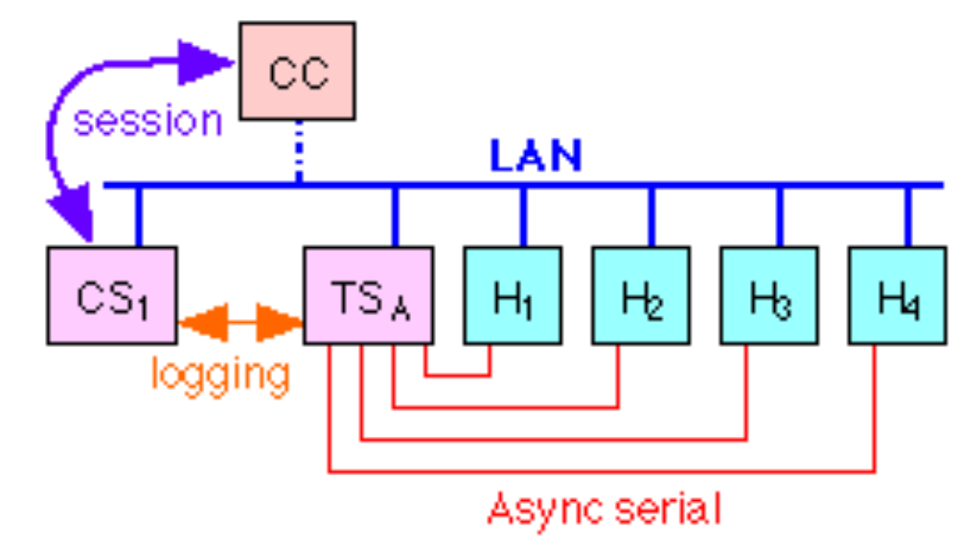
Advanced Architecture, Part Two
Adding a Conserver host
  Conserver host makes all Reverse TCP calls
  CC is now a Conserver client
  Client connects to Conserver host
  Clients are connected to logging streams
Notes:
The Conserver host makes all of the Reverse TCP sessions to your console (or terminal) server ports, so it becomes the only user. (Nobody else can connect to the ports, because the Conserver Host is already connected.) Anything coming into the console server serial port(s) is returned to the Conserver Host on a separate stream for logging.
The Conserver Client now makes a call to the Conserver Host, versus trying to contact the console server hardware.
If the port is available, the client sessions is connected to the existing stream between the Conserver and the requested console server serial port.
If some other client is already connected to the desired port, the second client can watch, but not control the session. The second client is not refused, and they are advised who the controlling client is.

Slide 15
Connecting Serial Devices
Most Console Server hardware vendors don’t have a wide variety of cables and adapters
Usually left as an exercise for the hardware buyer
Pre-wired adapters will make your life easier!
Check the host-to-adapter web pages for more clues.
Notes:
Please pardon what may seem like ‘blowing my own horn’, but I’ve compiled some web pages which are intended to make it easy to connect various devices to Console Server hardware. I’ve collected RS-232 signal information on more than 300 devices, and worked with Americable to have them produce and sell pre-wired and labeled adapters and cables for a variety of Console Server devices.
Go to http://www.conserver.com/consoles/, and select one of the four Console Connection Guides. Use the links to view the host-to-adapter guides, which tell you what adapters to use to connect any particular devices to the Console Server hardware you have.
I understand that Cyclades has also talked to Americable about making assorted adapters for their hardware as well. (Cyclades provides up to six different adapters in some of their new units.)

Slide 16
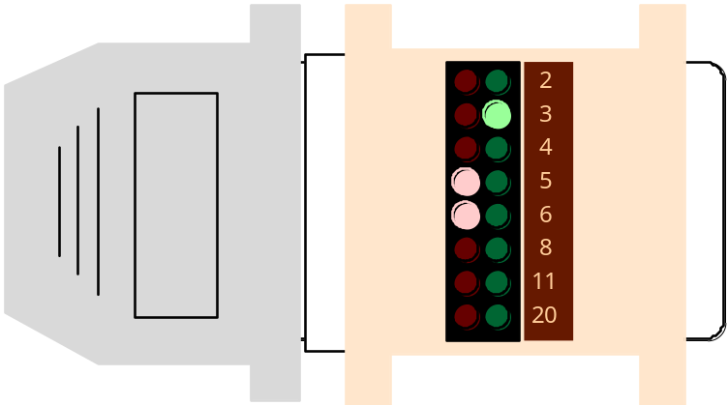
Connecting Consoles/Devices
Establish the Physical Link First.
Use Pre-wired Adapters.
Use Passive Signal Tracers.
Use 8-wire cable, CAT-5 preferred
Notes:
Once your terminal server is connected, your next task is to connect various serial consoles to the terminal server ports.
Pre-wired adapters will save you time and trouble, and we highly recommend using them. (The biggest benefits: consistently wired and labeled.)
If you are using different wiring on the RJ-45 connector for different vendors terminal servers, you should order your parts with distinctive colors, so you will know at a glance if you have a properly wired adapter for a specific vendors terminal server.
Passive signal tracers are the best tool for determining if you have the correct adapter, and if you have data passing between devices. We strongly recommend using them.
We’ll show you how to use pre-wired adapters and signal tracer in the slides ahead.

Slide 17
Establish a Physical Link First
It’s easy to debug software settings when you know the physical link is in place.
It’s easy to establish the physical link with pre-wired adapters.
Testing the physical link is easier with an RS-232 Signal Tracer.
Notes:
You could use an asynchronous serial protocol analyzer to determine whether your software settings are correct. Or, you could use a small, passive device to help you get the hardware signals in place.
I find it is easier to get the hardware signals connected, and then work on the software settings. Using a signal tracer or breakout box will help you determine if the wiring is correct.
Using pre-wired adapters helps ensure that all of the signal leads are properly connected. Then you can hack with the software settings with confidence that your hardware connection is ready to pass data and hardware signaling.
You can find my Console Information Guides for a number of vendors at http://www.conserver.com/consoles/ which include reference pages for Cisco, Xyplex/iTouch/MRV, IOLAN, and Xylogics/Annex/Bay/Nortel servers.

Slide 18
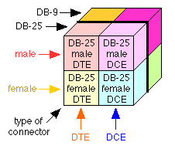
So Many Possibilities
Not only are the choices finite, but the number of choices is rather small.
Four choices for each connector type.
Notes:
At first, the number of choices may seem overwhelming, but you will find that more than 80% of the serial consoles that you want to attach to are going to be either DB-25 or DB-9.
While there are a lot of possibilities with each type (Do they support flow control? Hardware handshaking?), The basic serial connection only needs three wires…transmit data, receive data, and a common signal ground. If you disable flow control and handshaking (at least initially), you can get a connection established rather easily.
You don’t usually need flow control on a port-to-port link, since both devices should be able to receive as fast as they send. (When you are using a modem link in between, there is *usually* some speed-shifting going on, and flow control is *usually* needed over a modem link.
Most store-bought serial cables support all signal leads, while many hand-built cables only have 3, 5, or 7 wires connected. (DCD is normally wired only for talking to modems, but there is also some confusion over this signal lead.)
There is no such thing as a “Standard Null Modem”. You need to check the wiring on any null-modem that you buy. I prefer the adapters that have the schematic on the adapter label.

Slide 19
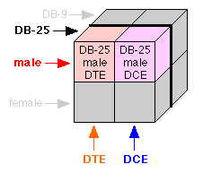
Whittling down the list
When connecting devices, you know the connector type, and the gender(s)…
Pick one connector for one end, and take one of each for the other end!
Notes:
Consider that you are connecting two devices ( such as a laptop serial port to a server you want to configure). This gives you two possible adapters for each device, or 2 to the 2nd power possible combinations…just four possible combinations.
It doesn’t matter which adapter you use on the laptop, since for whichever adapter you pick (DCE or DTE), one adapter on the server will work, and the other adapter will not. That is, for either choice on the laptop, one adapter on the server is a “straight through connection”, and one is a “null modem”.
You could try one adapter on the server, and if it doesn’t seem to work (based on trying to get a response over the serial link), you could try the other. But, there may be serial port settings mismatched somewhere. It’s better to use a passive signal tracer to check the signals, to be sure that you’ve got the correct combination.
See http://www.conserver.com/consoles/msock.html (look at the “Signal Tracer” demo)

Slide 20
Use Pre-Wired Adapters
Saves time (no assembly)
Consistent wiring (no mistakes)
Consistent colors and labels.
Assortments make it easy.
Console guides available
  http://www.conserver.com/consoles/
  http://www.stokely.com/
Notes:
Most of the terminal server vendors will supply a small assortment of RJ-45 adapters with their devices. Other vendors make these adapters available as an option. Many of the vendors also show wiring examples for a few adapters in their manuals. (If you make them yourself, you should always label the adapters!
Making connections quickly is easier when you have a good selection of reliable adapters. (More on this later…)
Pre-wired adapters can also be ordered in different shell colors. If you have more than one RJ-45 wiring format in your shop, it’s a good idea to use different shell colors to separate the different RJ-45 wiring formats. Maybe use black for Cisco, green for IOLAN, blue for Xyplex, red for Annex/Bay/Nortel.
In a co-location facility, you may have a variety of terminal servers deployed, each with a different RJ-45 wiring format. In a large installation, you may have to install “strategic partner” equipment next to your own. In these cases, having different colors for the shells makes it easier to see when a device is plugged into the wrong terminal server.
Americable, Inc. carries a wide range of adapters for a variety of terminal server RJ-45 wiring formats. More information is available at http://www.conserver.com/consoles/ under Console Adapters Kits.
http://www.conserver.com/consoles/ciscokit.html

Slide 21
Time Synchronization
Important for logging
  backup and file sharing too
Comparing logs from many devices after an ‘event’?
  Security devices
  Hosts, servers
  Network (routers, switches, load balancers)
  Check non-network devices often
Notes:
In a distributed file system, time synchronization is an important issue. It is also important if you are going to be comparing logs between distributed machines.
NTP is a practical solution for synchronizing the time between various machines and the logging server.
Network devices and servers should be configured to include date/time information in the messages sent to the serial console. If you are logging devices which cannot include timestamps in the messages, you can ask conserver to include periodic timestamps from the server in specific log files, which can provide a basic reference timestamp. (But the conserver host will need to be set to the same time as the hosts that can properly timestamp.
Consider the issues of comparing logs from machines across multiple time zones. If the machines keep their time in the ‘local’ time zone, the administrators will have to mentally compensate for the time differences when searching through the log files.
However, if you decide to sync all devices to a single time zone (GMT perhaps?), you then have the problem that admins still need to “do the math” and convert to their local time zone for resolving single-machine issues.
The bottom line here: Someone will have to convert timestamps some of the time. You should decide when it would be better; during a crisis, or day-to-day.

Slide 22
Real World Examples
There are many sites around the world using Conserver today, to control enterprise installations, as well as running small-but-vital server cores.
Conserver.com has a searchable email digest, if you want to go digging…
Notes:
The talk session tonight is short. If I’ve gotten to this point quickly, then talking about some of these real sites will help fill the time, as well as let me reinforce some of the advantages of using remote console access, and integrating it with a logging server.
On the other hand, I expect that my time is going to be pretty short about this point in the talk, so the notes on these sites will have to fill in the gaps, if I have to gloss over them…

Slide 23
Synopsys
Multiple distributed data centers
35+ field offices
Field sites host a Conserver
Router supports
  Dial-in/out ISDN access
  Local authentication
  Console ports
Notes:
Synopsys has been using Conserver for more than a decade. They had expanded their implementation across the major data centers for the company, and during 2000, they replaced older ANNEX terminal servers for all Cisco 3600-series hardware, to eliminate Serial BREAK problems.
After attending the LISA 2000 tutorial on Conserver, Jeff Komori architected a transition to distributed mode multiple Conserver hosts, and they deployed it across all of their medium and large field offices.
The model for a field office was a Cisco 3640 chassis, with Ethernet, WAN WICs (Serial and ISDN links), MICA modems, and NM-32A serial modules. The High-speed serial WAN link and Ethernet continued to play their traditional WAN/LAN router role. The ISDN and MICA modems provided high-speed modem dial-up access into the field office, reducing the corporate dialup costs. And the async serial card provided console access.
The big win was during a WAN link outage, where a Network Admin could see both sides of the failure, and where console logs turned up configuration needs on field office hosts when the WAN link was down.

Slide 24
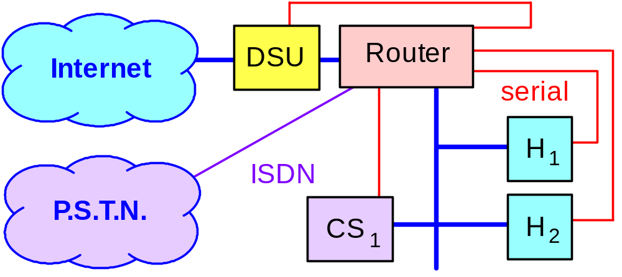
Synopsys Basic Field Office
WAN for main traffic
PSTN (ISDN) for field dialup
  (Public Switched Telephone Network)
Local Conserver Host
Notes:
In the field office, the field office router also became the Console Server, and the ‘local dialup connection’ for staff near the field offices.
By adding a local Conserver host in each field office, the system administrators now had a tool to understand what happened to the servers in the field offices when the WAN link failed. This helped uncover system dependencies (such as libraries mounted over the WAN, or DNS dependencies) that would hamper ‘local’ work if the WAN was down. Knowing about a problem is the first step in fixing it.
The dialup access saved significant ISP costs each month. By using an ISDN line into each office, the dialup connections could support speeds greater than 28.8 and 33.6 Kbps. However, this also provided the network administrators a method to ‘be on both sides of a broken WAN’. With the primary link down, they could now perform diagnostics from the field office, as well as from their NOC. This required a local authentication host at the field office, which could be managed from the main office while the WAN was working normally.

Slide 25
Tellme
Two main data centers
1700+ consoles
Secure access to each center
Not distributed mode
PIC Dog!
  LCD display
  Temperature
  Soft power control
  Messaging and more
Notes:
Tellme has been using Conserver for more than two years.
Since naming between the two data centers was very similar, they opted to not use distributed mode, in an effort to reduce the chances for typo mistakes, such as rebooting the wrong host.
Only the Network Operations folks can make changes on the Conserver hosts (including adding access and privileges for users, and modifying the hosts/console lists).
Cary Roberts has developed a special interface board for their servers, called “PICDog”, and this option is being resold now by Rackable Systems in their 2-U tall “1000 series” rack-mount PC chassis (the option is called “Phantom”). It uses phantom power from the server, has an LCD display (2 lines, 20 characters), and connects as a pass-through device on one of the COM ports, providing a variety of features, similar to the control you can achieve with the PC Weasel cards. It adds temperature, and other signaling as well. The PC BIOS also supports console redirection.
http://www.rackable.com/
http://www.rackable.com/lightsout.html
http://www.rackable.com/advantages.html

Slide 26
WebTV/MSNTV
Three data centers (distributed)
  Dedicated management network
2000+ console ports
25+ terminal servers
Centralized change control
Backup hosts at each data center
  Backup host can also mange the console of the primary host!
Notes:
Conserver followed a few senior Network Admins from Synopsys to WebTV. Microsoft later acquired WebTV, and later still Microsoft morphed the service into MSN TV.
During the growth of this ISP service, they added more data centers, and the number of hosts and conserver users grew significantly. The Network Operations folks changed out most of the Console Server hardware to Cisco 3600 series, except for a few nodes where serial BREAK would not be a problem. All of these console servers require SSH to access and manage the console servers.
Conserver is tightly integrated to monitoring tools, and is a core tool of the NOC operators. As a result, the change control processes for their distributed mode deployment also copies the files onto a second host in each data center. If the conserver host in a data center fails, it is an easy process to bring up conserver on the secondary host, and then continue capturing logs from other hosts while the primary host is rebuilt.The secondary server can also allow admins to access the console on the primary server.

Slide 27
Wrap-up
Suggested Reading and Vendor Info pages are at the rear of the presentation.
Q&A?
Thanks for your interest!
Notes:
Hopefully I’ve done what I came to do, which is to teach you enough about Conserver and related Console Server hardware to decide if it can benefit you at your site. And I hope that I was able to answer some of the questions and concerns that you may have had coming to the talk.
Thanks for attending tonight.
David K. Z. Harris BigBand Networks

Slide 28
Suggested Reading
Aurora Technologies
  http://www.auroratech.com/
  A good primer for console services, and an even-handed discussion of “Distributed Servers” versus “Console Servers plus Terminal Servers” topic
Cyclades
  http://www.cyclades.com/
  A different view, discussing remote management in terms of consoles, remote power, and remote control applications.
Notes:
There are very few comprehensive works, explaining how to set up serial console services, which is why we developed this tutorial. However, Aurora Technologies has provided a good discussion of the topic, called “Guide to Multiport Connectivity for Solaris and NT”
The Aurora folks lean more towards a commercial server application (with support!), and they favor using many servers with multiple-port async cards installed in the servers.
While Conserver can support multi-port cards in the servers, I also feel that Terminal Servers are probably a better solution for large sites, or for sites with needs to connect many distributed ports.
The Cyclades booklet examines the topic at a slightly higher level, and is a good tool for educating your management about the applications and benefits of remote management.

Slide 29
Web Links
Stokely Consulting
  http://www.stokely.com
Conserver.Com
  http://www.conserver.com/ http://www.conserver.com/consoles/
Notes:
Celeste Stokely has been providing a lot of useful information on her website, and you can find a good deal of information about the problem that Serial BREAK can cause a Sun CPU, as well as a vast array of systems administration topics and tutorial pages. (There are other useful pages as well. Check it out!)
Bryan Stansell has put Conserver.Com on the Internet, to make it easier for folks to find the most recent version of the Conserver code, as well as providing email lists for new version announcements, and for a users support forum.
David K. Z. Harris has been working on his serial console guides for 8+ years, and moved them to the conserver.com. These include Console connection guides, as well as some basic serial tutorial pages.
Both Bryan and David worked for Certainty Solutions (formerly GNAC), and both continue their support of Conserver while pursuing new efforts.

Slide 30
Vendor Links
Cisco Systems
  The 2600 and 3600 series.
  Use the NM-32A 32-port modules.
  Americable sells patch panels.
Xyplex, iTouch Communications
  The InReach line is now “Sun-safe”
  The older Xyplex line is NOT!
Notes:
Terminal Server Vendors
Cisco Systems http://www.cisco.com
http://www.cisco.com/univercd/cc/td/doc/pcat/2600.htm
http://www.cisco.com/warp/public/cc/pd/rt/2600/prodlit/2600_ds.htm
http://www.cisco.com/warp/public/cc/pd/rt/3600/prodlit/seral_ds.htm
http://www.cisco.com/warp/public/cc/pd/rt/3600/prodlit/3600_ov.htm
Xyplex (was nBase, now iTouch Communications, becoming MRV)
http://www.itouchcom.com/products/index.cfm?cat=scs
http://www.itouchcom.com/news/display.cfm?nwid=2002_07_01
Adapter Vendors
Americable 800-328-7954 http://www.americable.com
http://www.conserver.com/consoles/ciscokit.html
(also annexkit, iolankit, and xyplexkit)

Slide 31
Vendor Links, cont’d.
Cyclades
  Built-in Linux core
  TS2000 is a great device!
  PC multi-port cards available
  Most products are Sun-safe
Digi Communications
  Many devices available
  PortServer CM is a good tool
  Many products are now Sun-safe
Notes:
Cyclades and Digi are both long-time makers in this arena.
Cyclades was the first (and only) console server hardware we found in our Serial BREAK testing that had a software-controlled BREAK problem. Once the recipe was sent on how to demonstrate the problem, we received a patch within a few days which resolved the issue. The TS2000 hardware was also enhanced during the design phase to ensure that the BREAK problem did not exist in the final product.
Digi has also entered the Console Server hardware arena, with the PortServer CM product line. The CM32 is also a good fit with Conserver. The existing PortServer Terminal Server line is also still available.
Cyclades
http://www.cyclades.com/products/ts_series.php
http://www.cyclades.com.pe/Productos/Anexos/ReleaseSerieTS.txt
Digi
http://www.digi.com/solutions/devtermsrv/cm/index.shtml
http://www.digi.com/solutions/devtermsrv/termsrv/index.html
http://support.digi.com/support/techsupport/hardware/portserver/sun_console.html

Slide 32
Vendor Links, cont’d.
Perle (Perle Systems Ltd.)
  CS9000 is Sun-safe
  Cables, status LEDs on same side
    Good or bad? You decide…
  Good integration with MS Windows
    May be useful in a mixed environment
Lantronix
  Still a workhorse in the industry
Notes:
Perle System took on the Chase Research IOLAN line, as well as Specialix products. You can still get support, and buy hardware from Perle if you want these lines. (The IOLAN model 102 and 104 servers are Sun-safe.)
The Perle CS9000 is comparable to the Cyclades TS2000, and the Digi CM32, in that they are all 32 ports, Sun-safe, I rack-unit tall, lightweight. One difference that stands out, to me, is that the transmit and receive data LEDs on the CS9000 are integral to the RJ-45 jack, putting them on the same side of the unit as the cables. (On the Cyclades and Digi units, the LEDs are on the opposite side from the jacks.) Whether this is a benefit or a deficit in your mind will likely depend on how you decide to mount the units.
Lantronix has been making serial-to-network interfacing devices for over a decade, and should also be on your list of candidates to investigate.
Perle
http://www.perle.com/products/prod_family/console_server/cs9000.html
http://www.perle.com/products/resources/pdfs/CS9000%20Dis%20paper.pdf
http://www.perle.com/products/prod_family/serial_servers/iolan_pl.html
Lantronix
http://www.lantronix.com/products/cs/index.html
http://www.lantronix.com/learning/tutorials/ds.html
http://www.lantronix.com/learning/wp/conserv_wp.html

Slide 33
Accessory Vendor Info
Nu-Data non-BREAK adapters
PC Weasel in-server cards
ASP Technology
  CatWalk interface
  Power interface for Xyplex, Digi
DataTran passive signal tracers
Notes:
Nu-Data is the sole source for a “Non-aborting Serial Console Adapter” (part number 4723), but their website PDF links have been broken for longer than I can remember. The units cost about $100 per port, which is OK if you only have a few devices that you need to protect. If you have 10 or more devices to protect, you should consider getting a Sun-safe console server device instead.
http://www.nudata.com/ v) 800.844.5757 f) 732.905.5708
http://www.nudata.com/workstationproducts1.htm
Real Weasel produces the PC-Weasel cards. This is the sweetest solution I know for MS-OS machines, and their PCI version has been out for about a year now. It gives you soft power control, and gets around the BIOS limitation in systems with Smart NICs and Smart drive controllers. They also have a couple other references on their web site for other hardware solutions, but none is as sweet, in my opinion. Clever Canucks! Try the web demo!
http://www.realweasel.com/ v) 403.705.2025 f) 403.705.2026
http://www.realweasel.com/oph.html
ASP Technology sells a console server application, but they are clever hardware hackers as well. The in-line dongles for the power leads on Xyplex and Digi product make them Sun-safe, but the CatWalk lets you put a local terminal on sensitive hosts, while leaving them connected for remote access by console server hardware. Very clever indeed.
http://www.asptech.com/ v) 970.686.1211

Slide 34
Accessory Vendor Info
Weeder Technologies
  Serial interfaces for process control
  Counters, timers, motor control
  Analog and digital I/O
Black Box Corporation
Patton Electronics
Notes:
Weeder Technologies
If you are looking for ways to get information from devices that don’t have consoles, check out this site. While there are a few places to find process control interfaces, this is probably the best site. Useful info, compact products, and a good variety should fill many of your unusual needs, and help you put a console on hardware.
http://www.weedtech.com/ v/f) 850.863.5723
Black Box has always been a favorite resource. They OEM and rebrand many products, and provide a wide array of interfacing devices. I’ve also used their catalogs as teaching materials, because they have useful block diagrams, and informational notation for using many of the products. Consider getting a printed catalog for your bookshelf.
http://www.blackbox.com/ v) 724.746.5500 f) 724.746.0746
Patton Electronics is another vendor with a wide array. The problem with that is that it’s hard to find a solution on a website if you don’t know what the solution is already. Luckily, you can easily request a printed catalog from their web site.
http://www.patton.com/ 301.675.1000

Slide 35
Remote Power Control
American Power Conversion
  MasterSwitch line
BayTech
  RPC product line
Server Technologies
  Sentry product line
Notes:
American Power Conversion has been a long-time UPS maker, and a leader in developing SNMP management for UPS gear. Their MasterSwitch product line allows for serial port access to power outlets, as well as telnet and HTTP control.
http://www.apcc.com/
http://www.apcc.com/products/family/index.cfm?id=70
http://www.apcc.com/support/contact/index.cfm
BayTech has been developing power control products for nearly a decade, but they’ve been working on digital equipment for more than 25 years. Their remote control power strips can be controlled via a serial connection, or some have an integrated modem.
http://www.baytech.net/cgi-private/product/ v) 800.523.2702
http://www.baytech.net/cgi-private/product?catagory=RPC+SERIES
http://www.baytech.net/support/demoinst.shtml
Server Technologies is new to me, but their Sentry line looks very interesting. It’s larger than the APC and BayTech units, but it also can switch more power. (Both APC and BayTech have some units witch can switch lots of power. If you need to switch high-current loads, do your homework and check all three!) I like the Power Tower power strip, but other units also switch a console port as well as switching a power connection.
http://www.servertech.com/ v) 775.284.2000
http://www.servertech.com/products/vac/vacvertical.htm

Slide 36
Americable
Custom cables and adapters
  Serial adapter kits for consoles
    Annex/Bay/Nortel
    Cisco/Lantronix
    IOLAN
    iTouch/Xyplex
Short power cords
Fiber and Ethernet gear/cables
Fast turnaround
Notes:
I’ve used Americable as a vendor for more than 6 years, and I’ve been very happy with them as a vendor. They’ve been able to turn some important orders around very quickly. Some of my other vendors haven’t passed this test…
Americable has also worked with me to define and stock special serial adapters for Console Server use, as well as making special adapter and cable bundles for the Console Server vendors listed above. These kits have helped many folks get consoles connected to their networks quickly. But what is important to me is that they made the effort to define and build these parts and kits, before there was a demand, based on my requests. As a vendor, they make efforts to provide or acquire whatever we’ve been looking for. In many cases, buying something through Americable has been cheaper than buying it on my own from the manufacturer.
It’s amazing how much short power cords and appropriate-length cables can clean up a rack! My contact has been Steve Vacik (svacik@americable.com, x-3824), but I like everyone that I’ve met at Americable.
http://www.americable.com/ v) 800.328.7954 f) 952.944.8021
http://www.conserver.com/consoles/ciscokit.html

