Slide 1
Heart Attack Analysis & Prediction – Final Project
By Nathan Alegria, Brandon Stanyer, & Christine Kwan

Slide 2
Introduction
Our project aims to create models which predict if an individual is at risk of cardiovascular issues. Using patient medical data, such as blood pressure and cholesterol, we will train machine learning models to identify individuals who may be at risk of heart attack.
The dataset offers an in-depth look at factors related to heart attack risks, including patients' medical history, lifestyle, and physiological measurements. Collected from reputable medical studies and hospital records, it features indicators like age, gender, cholesterol levels, blood pressure, and smoking status. The dataset also includes labels showing whether patients had a heart attack, making it useful for analyzing patterns and developing predictive models. It is valuable for healthcare professionals, researchers, and data scientists working on cardiovascular health, risk assessment, and prevention strategies.

Slide 3
About the Heart Attack Dataset
01
05
06
This dataset contains 303 entries and 14 different attributes
Attribute Information:
age: Age of the patient.
sex: Sex of the patient (0 = female, 1 = male).
cp: Chest pain type (0 = typical angina, 1 = atypical angina, 2 = non-anginal pain, 3 = asymptomatic).
trtbps: Resting blood pressure in mm Hg at the time of hospital admission.
chol: Serum cholesterol in mg/dl.
fbs: Fasting blood sugar > 120 mg/dl (1 = true, 0 = false).
restecg: Resting electrocardiographic (0 = normal, 1 = having ST-T wave abnormality, 2 = left ventricular hypertrophy).
thalachh: Maximum heart rate achieved.
exng: Exercise-induced angina (1 = yes, 0 = no).
oldpeak: ST depression induced by exercise relative to rest.
slp: The slope of the peak exercise ST segment (0 = upsloping, 1 = flat, 2 = downsloping).
caa: Number of major vessels (0-3) colored by fluoroscopy.
thall: Thalassemia (0 = normal, 1 = fixed defect, 2 = reversible defect).
output: Target variable (0 = less chance of heart attack, 1 = more chance of heart attack).

Slide 4
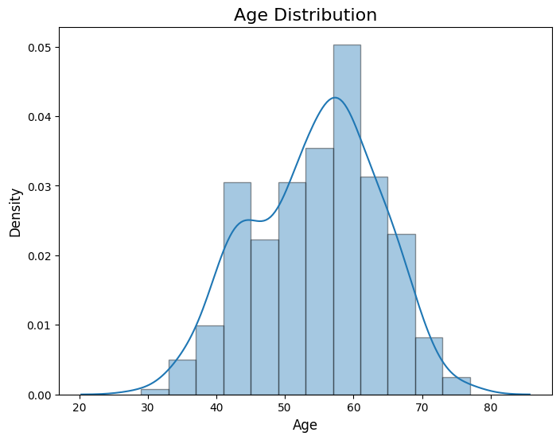
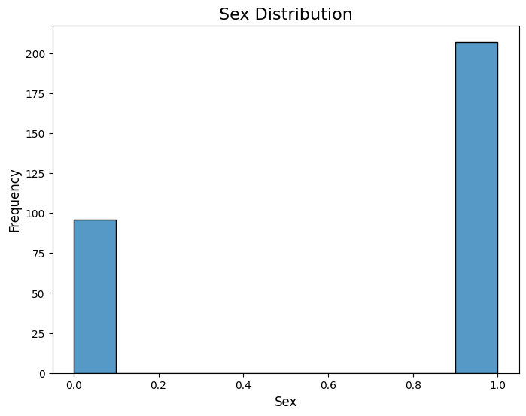
Data Exploration
Demographic:
Age
Most individuals between 50 and 60 years old
Concentrated in middle-aged groups
Sex
More males (labeled "1") than females (labeled "0")
Male-heavy dataset
The distribution is imbalanced

Slide 5
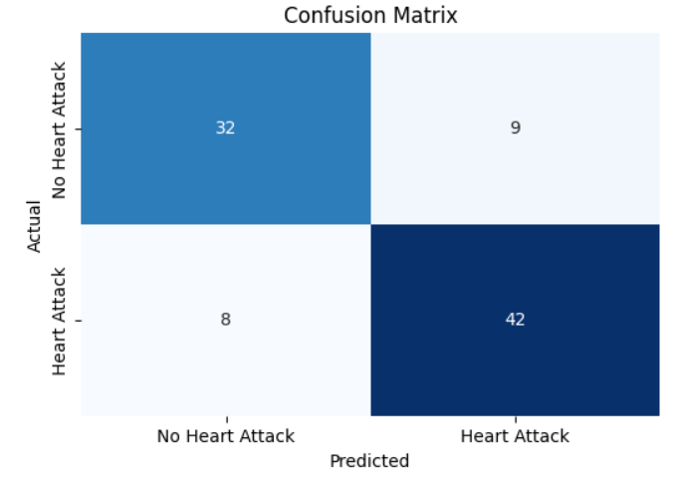
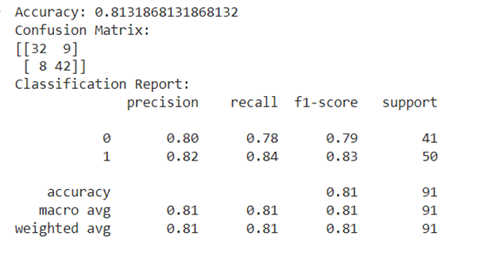
Logistic Regression Model
The overall accuracy of 81% means that the model correctly classified 81% of the cases, combining both true positives and true negatives.
The KNN model shows strong performance based on the confusion matrix, with 42 true positives (correctly identified heart attack risks) and 32 true negatives (correctly identified individuals without heart attack risk). These correct predictions outnumber the false positives (9) and false negatives (8).

Slide 6
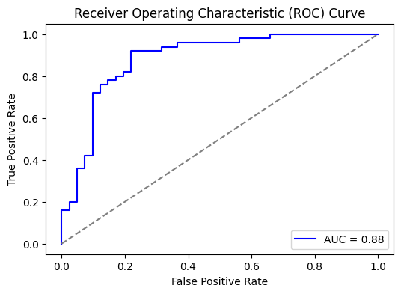
Logistic Regression – ROC Curve (Cont.)
ROC Curve
The AUC (Area Under the Curve) is 0.88, which indicates that the model performs very well.
This means the model has an 88% chance of correctly distinguishing between a person who is at risk of a heart attack and a person who is not.

Slide 7
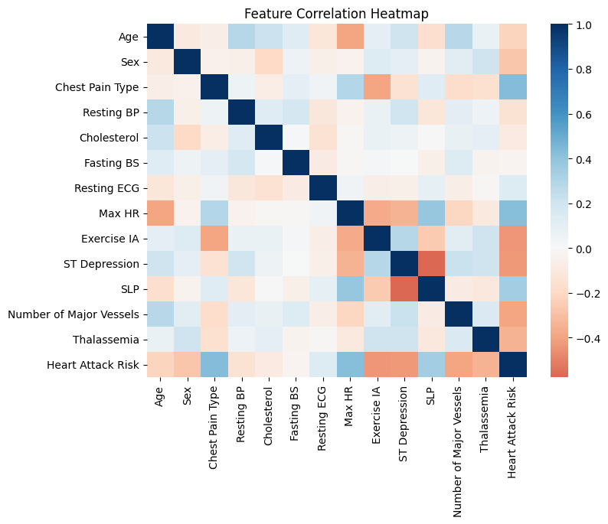
Logistic Regression (Cont.) – Heatmap
Blue areas show positive relationships (darker blue means stronger positive correlation).
Red areas show negative relationships (darker red means stronger negative correlation).
Lighter colors indicate weaker or no relationship
Color Relationship

Slide 8
Logistic Regression – Heatmap (Cont.)
Positive Correlations
Negative Correlations:
Number of Major Vessels and Heart Attack Risk: A higher number of affected vessels correlates with increased heart attack risk.
Chest Pain Type and Heart Attack Risk: Chest pain is linked to higher heart attack risk.
ST Depression and Heart Attack Risk: Increased ST Depression correlates with higher heart attack risk.
Exercise IA and Heart Attack Risk: Exercise-induced angina is strongly associated with increased heart attack risk.
Max HR and Heart Attack Risk: Higher maximum heart rate is linked to lower heart attack risk.
Exercise IA and Max HR: Individuals with exercise-induced angina tend to have lower maximum heart rates.
Age and Max HR: Older individuals tend to have lower maximum heart rates.

Slide 9
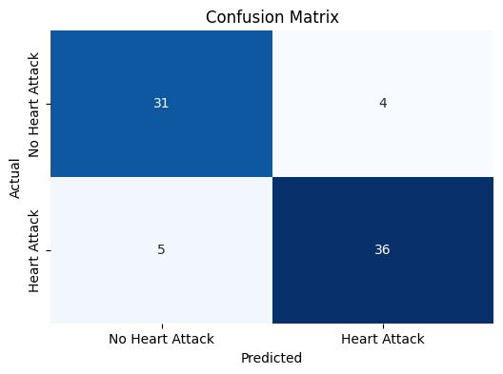
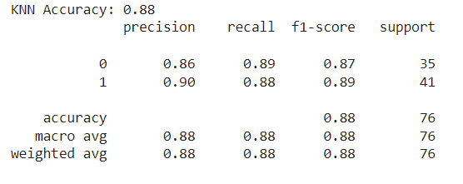
K-Nearest Neighbor (KNN)
The overall accuracy of the KNN Model was 88% means that the model correctly classified 88% of the cases
The confusion matrix, demonstrates good results for both true positives (36) and true negatives (31), which indicate correct predictions for individuals with and without heart attack risk. It is a good sign they outnumber the false positives (4) and false negatives (5).

Slide 10
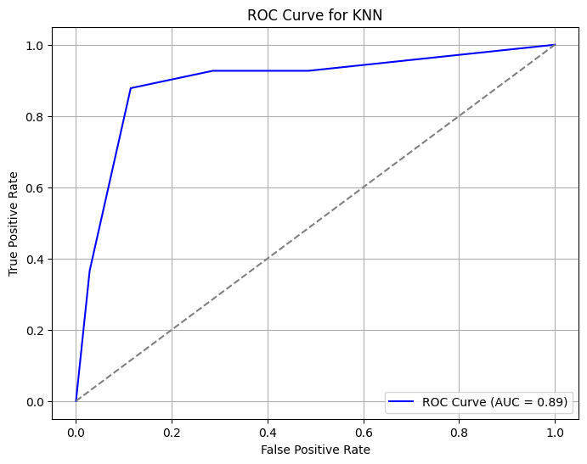
K-Nearest Neighbor (KNN) – ROC Curve
The AUC (Area Under the Curve) is 0.89, which indicates that the model performs very well.
This means the model has an 89% chance of correctly distinguishing between a person who is at risk of a heart attack and a person who is not.

Slide 11
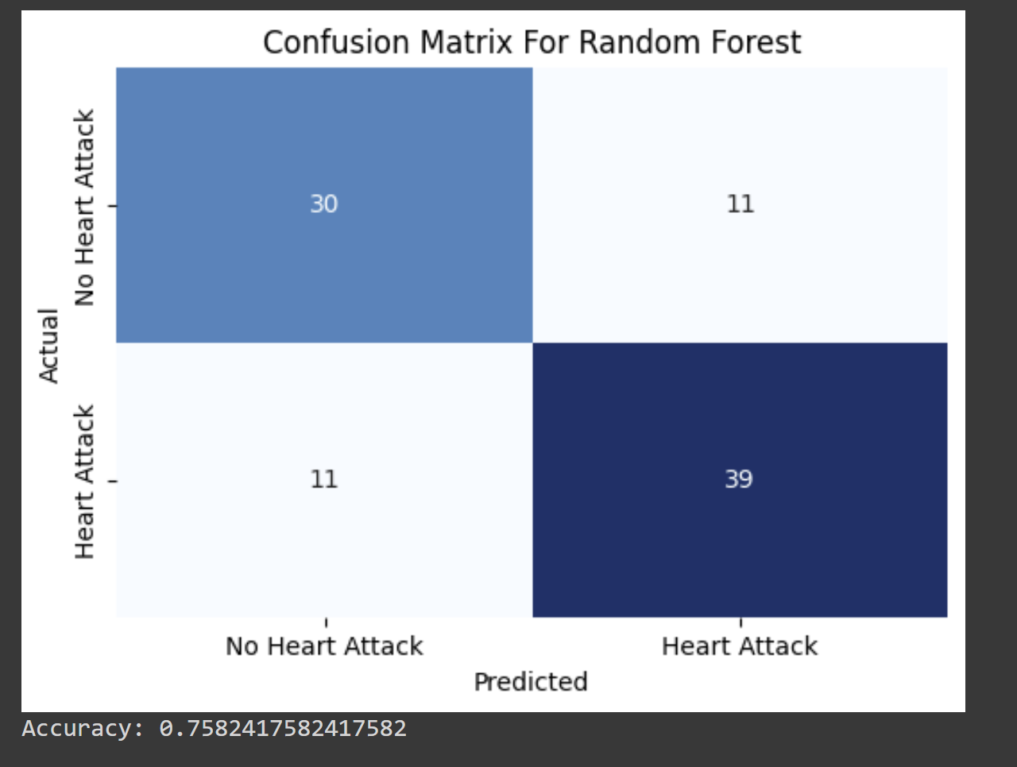
Random Forest
Utilized Hyperparameter Tuning to tweak model performance for optimal results
Model Accuracy is 75.8%
Confusion Matrix :
True Positive = 30
True Negative = 39
False Positive = 11
False Negative = 11

Slide 12
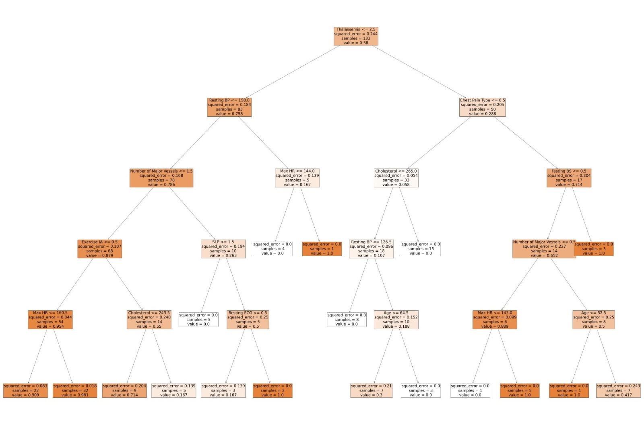

Slide 13
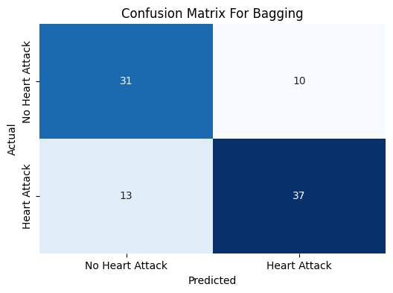
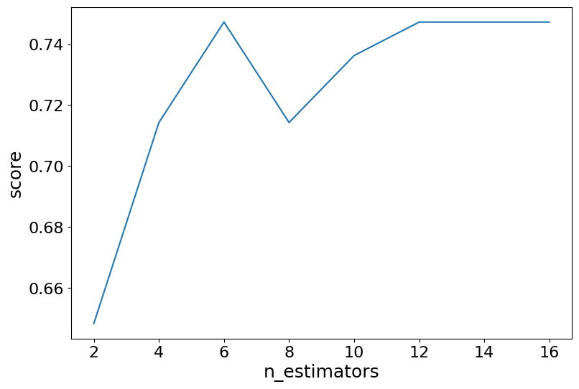
Decision Tree Bagging
Generate the Accuracy vs n_estimators for pruning the model
Model Accuracy is 74.7%
Confusion Matrix :
True Positive = 31
True Negative = 37
False Positive = 10
False Negative = 13

Slide 14
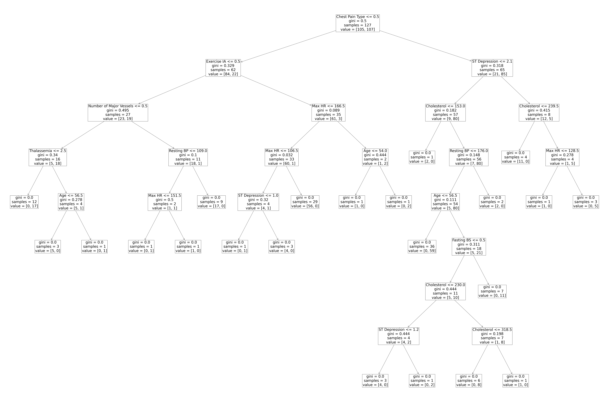

Slide 15
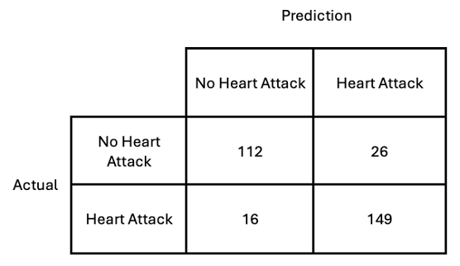
Support Vector Machines Model
This model was created using the LinearSVC function of pyspark. The support vector machines model achieved the following performance with moderate parameter tuning.
Test Accuracy: 0.861
Precision: 0.862
Recall: 0.861
F1-Score: 0.860
The SVM model had great performance and minimal bias.
However, the results are difficult to visualize and interpret.

Slide 16
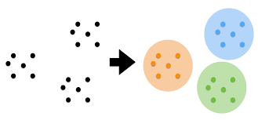
Results
Of the 4 types of machine learning models used, KNN was the best suited for predicting if a patient is at risk for a heart attack. This model is preferred because:
The Highest Accuracy of 88%
Easy to tune
Easy to adjust parameters
A clustering model like KNN applies well to categorizing people based on health metrics. With Principal Component Analysis and fine tuning, this type of model can easily be interpreted and adjusted.

Slide 17
Conclusion
Proper diagnosis and treatment is difficult, even by trained professionals. This project shows that machine learning models can be an effective tool to support diagnosis of various diseases.
As seen in this project, machine learning models like KNN, with sufficient data, can provide early indications of critical health conditions.
In the future, we may see machine learning become a more prevalent tool in assisting health care workers in the proper diagnosis of their patients.

