Slide 1
Library Management System Design
Hernan Orozco
Bailey-Ann Slaughter
Brandon Stanyer
Kory Wakeman

Slide 2
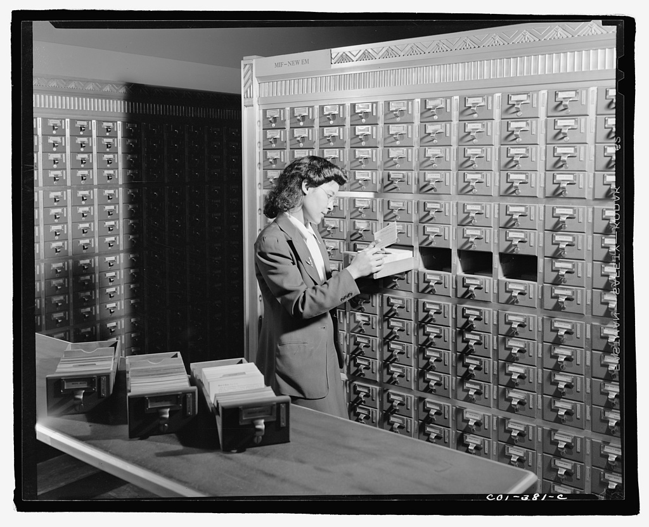
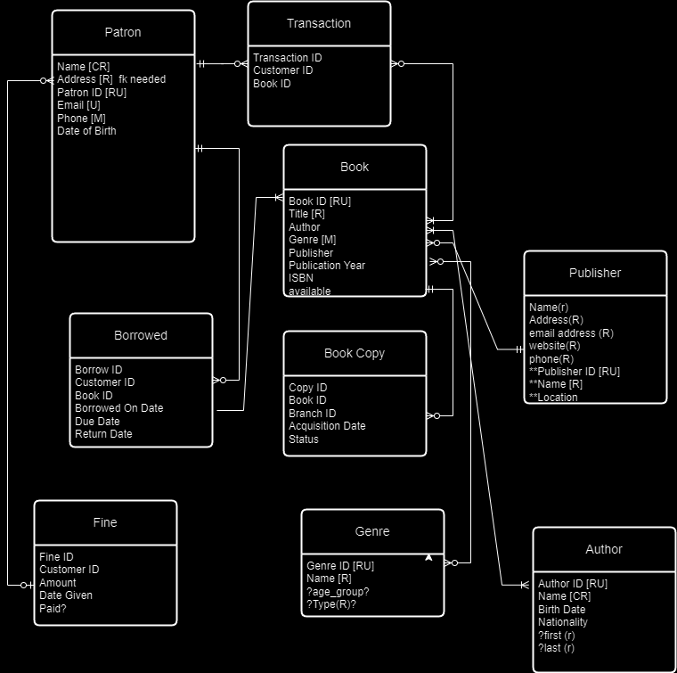
Introduction
Updating a paper-based library management system to a SQL database involves several simple but critical goals that will significantly improve the efficiency and effectiveness of library operations. Our intent for the customer’s processes is improving…
Automation
Data Accuracy
User Experience Enhancement
Security
Reporting and Analytics
Member Management
Scalability
Cost Savings
Disaster Recovery

Slide 3
Goal
The goal for transitioning this paper-based library management system to a digital solution is to create a seamless, simple, and user-friendly platform that staff and patrons are quick to master and recognize its time-saving and efficient behaviors.
Stakeholders:
Library staff
Patrons
Library Board or Trustees
Financial Department
Marketing Team
Software Developers

Slide 4
Requirements
Develop a user interface that is intuitive and easy to navigate.
Prioritize user experience to ensure both staff and patrons.
Successfully migrate entire existing paper-based records into the database.
Implement validation checks to ensure data integrity during migration.
Create a reporting module that generates accurate and insightful reports for management and decision-making.
Design the system architecture to be scalable, accommodating future growth and technological advancements.
Communicate the transition plan, benefits, and impact of the digital system to staff and patrons.
Address concerns and provide regular updates throughout the transition process.
Solicit feedback from stakeholders and make necessary adjustments based on their input.

Slide 5
Business Rules
Transfer existing paper-based records to digital format.
Ensure complete accuracy and integrity during data migration of existing catalog.
Every item in the library collection must have a unique identifier (ISBN).
Patrons must have a valid library card to borrow an item.
Library items will be borrowed for a finite amount of time.
Monetary fines will be issued to patrons for items not returned on time.

Slide 6
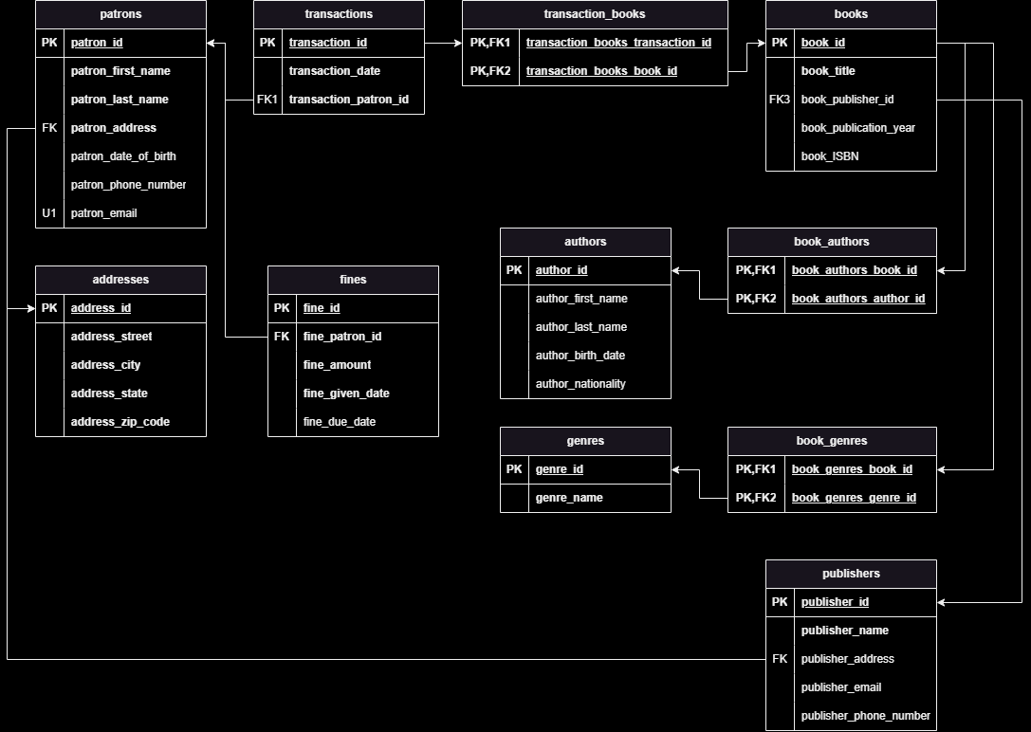
Conceptual Model to Logical

Slide 7
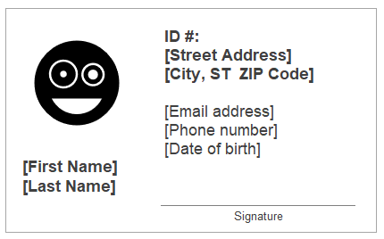
Library Card Design
Captures all requirements for patron table in new SQL database
Simple and very visually similar to the library card carried by patrons prior to library management system change
ID # will be changed to align with database requirements
Email address is also a new addition and secondary key

Slide 8
Customer Questions with Answers
What is the current state of the library's collection and inventory?
The SQL database now provides real-time data on the library's collection, including the number of books, their titles, authors, current availability, and overdue book status. This information is continuously updated as books are returned and borrowed.
How has this transition to digital affected the library’s cost saving goal?
Physical space: Maintaining paper records and documents requires physical storage space, which can be costly in terms of rent, maintenance, and security.
Labor: Automating manual data entry, sorting, and searching with a database can reduce the labor hours needed for these tasks, leading to potential staff cost savings.
How has the transition affected the library staff's efficiency?
The digital system has streamlined cataloging, check-in/check-out, and inventory management processes, reducing the time and effort required for these tasks. Staff can now focus more on patron assistance and library services.
What is the status of overdue books and fines management?
The new SQL system has enabled automatic overdue notifications and fine calculations, resulting in more efficient management of overdue books and timely fine collection.
How has staff training and patron support been handled during and after the transition?
Staff members received training on the new system in lieu of their normal manual data entry tasks, and specific members of the staff with higher comfort on the new systems have been established to assist patrons with any questions or issues they may encounter as a replaced duty to library card management.

