Slide 1
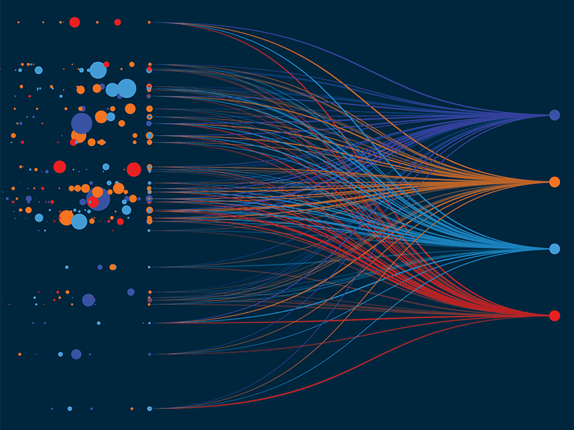
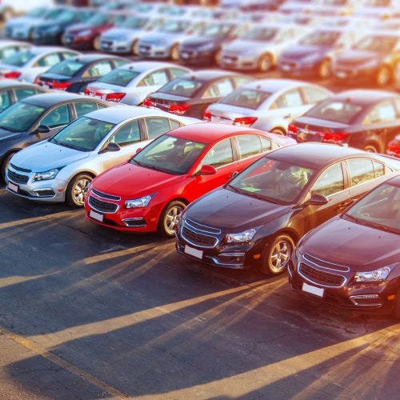
IST 707 – Applied Machine Learning - Final Project
Using Machine Learning Models to Predict the Price of Used Vehicles
by Brandon Stanyer

Slide 2
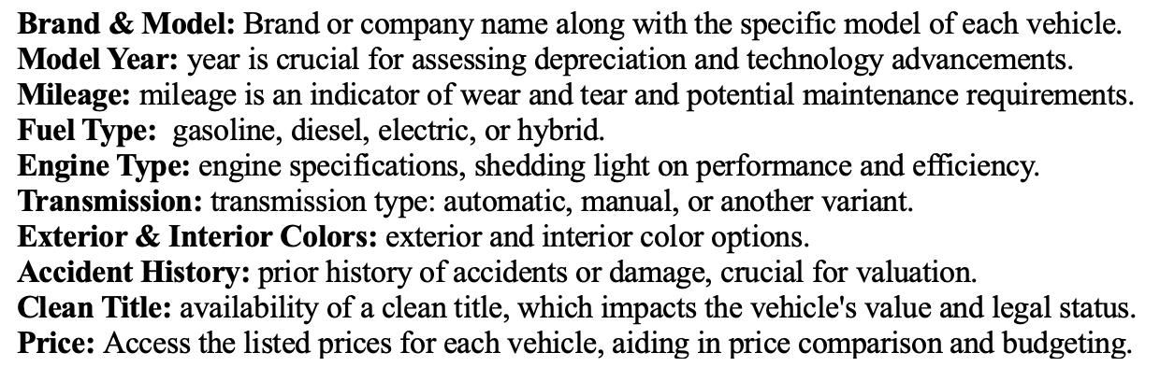
About the dataset
This dataset contains 4,009 rows which each represent a different used vehicle for sale. Each vehicle has the following attributes:

Slide 3
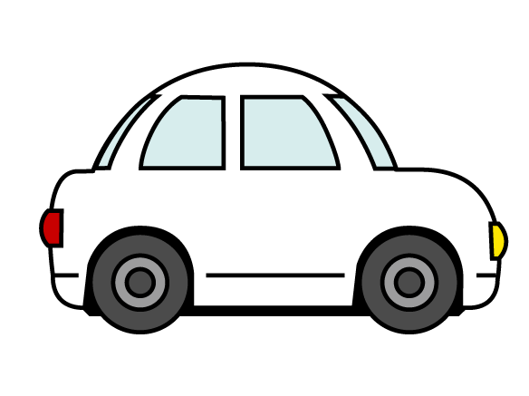

Objective
The objective of this project is to create a machine learning model which can predict the price of a vehicle based on its attributes.

Slide 4
Machine learning models
This project involved using three different machine learning algorithms to predict vehicle price. The three machine learning algorithms were:
Decision Trees
K-Nearest Neighbor
Support Vector Machines
Each of these models were set up as regression models, as opposed to classification models. This setup was necessary to predict continuous variable like price.

Slide 5
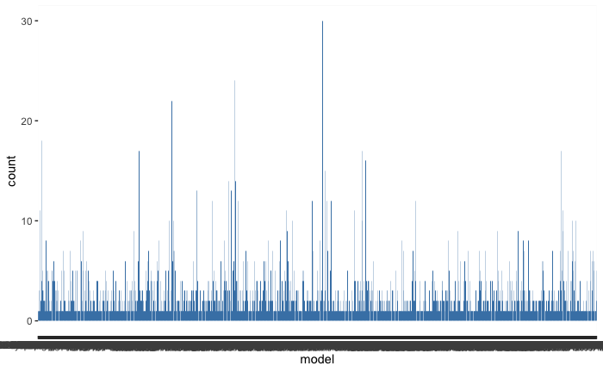
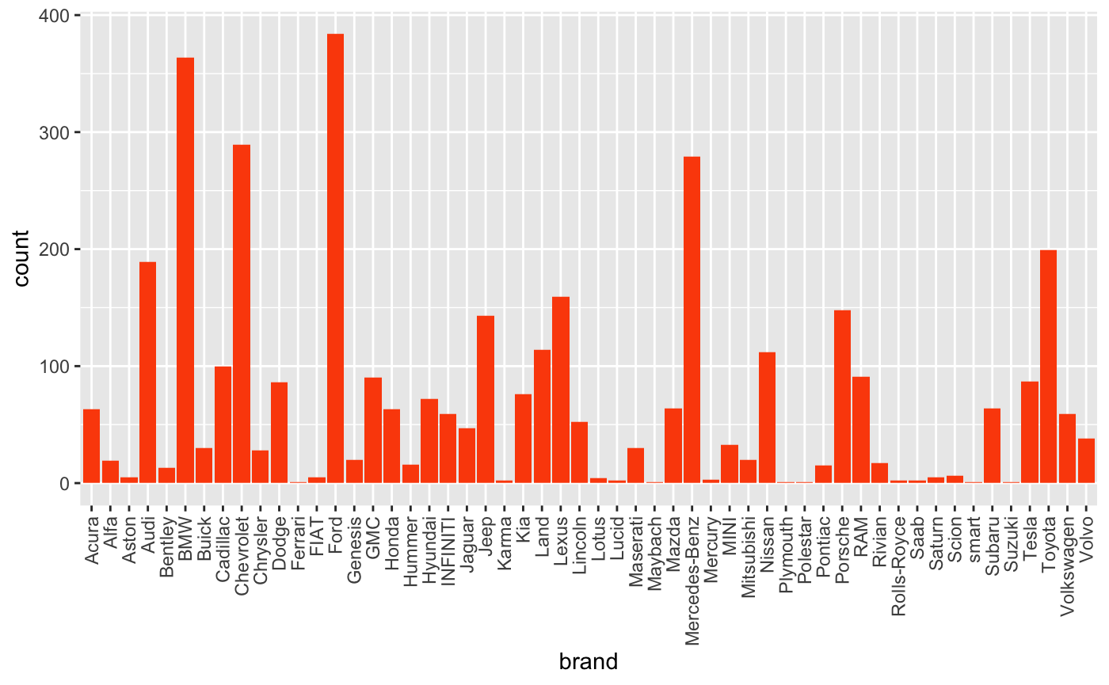
Exploratory Data Analysis & Data preprocessing
This visualization showcases the scarcity of vehicles based on model type. The multitude of models without comparable vehicles creates a challenge for building an accurate model.
This visualization showcases how many of the vehicle brands have many cars represented. However, a few brands have very little representation. Brands with fewer than 10 vehicles had their corresponding rows removed.

Slide 6
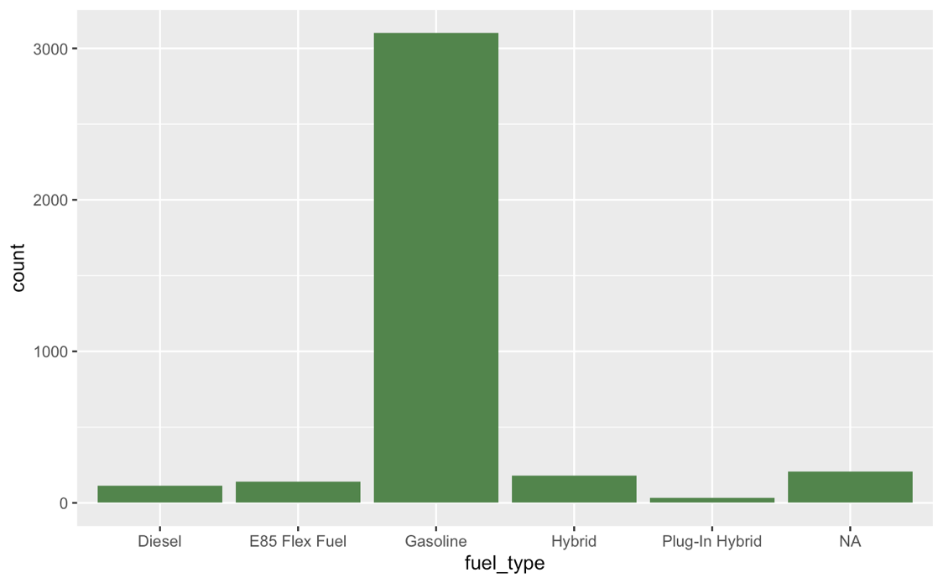
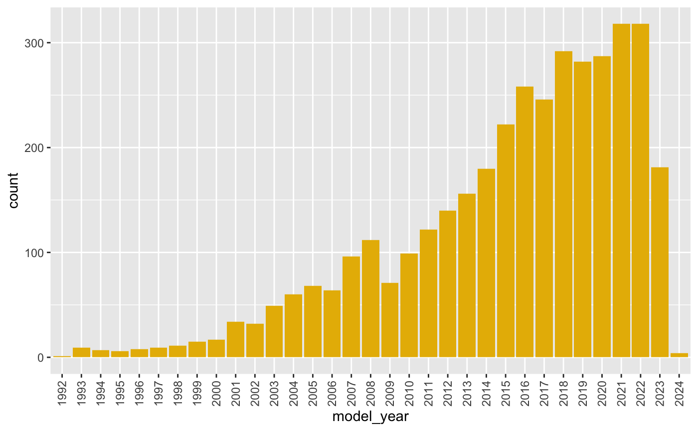
Exploratory Data Analysis
Exploratory Data Analysis & Data preprocessing
The majority of vehicles in the dataset were gasoline powered. The lack of vehicles with other fuel types led to a decision to remove vehicles of other fuel types.
The dataset has a leftward skew in the distribution based on model year. Due to the lack of older models, vehicles with a model year before 2000 were removed from the dataset.

Slide 7
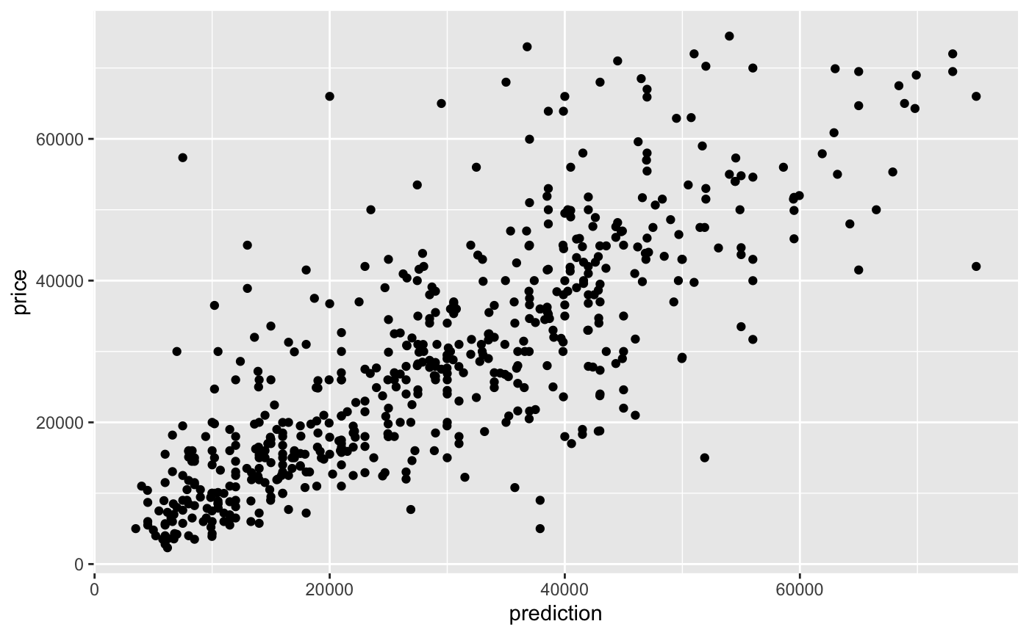
Decision Trees
The decision tree models was slightly effective at predicting vehicle price. The best decision tree model generated a Root Mean Square Error (RMSE) of 10,286. This value is interpreted as how far apart the predicted price was from the actual price on average.
There is clearly a correlation between the predicted price and the actual price, indicating the model is working. However, the error in price prediction makes this model not effective.

Slide 8
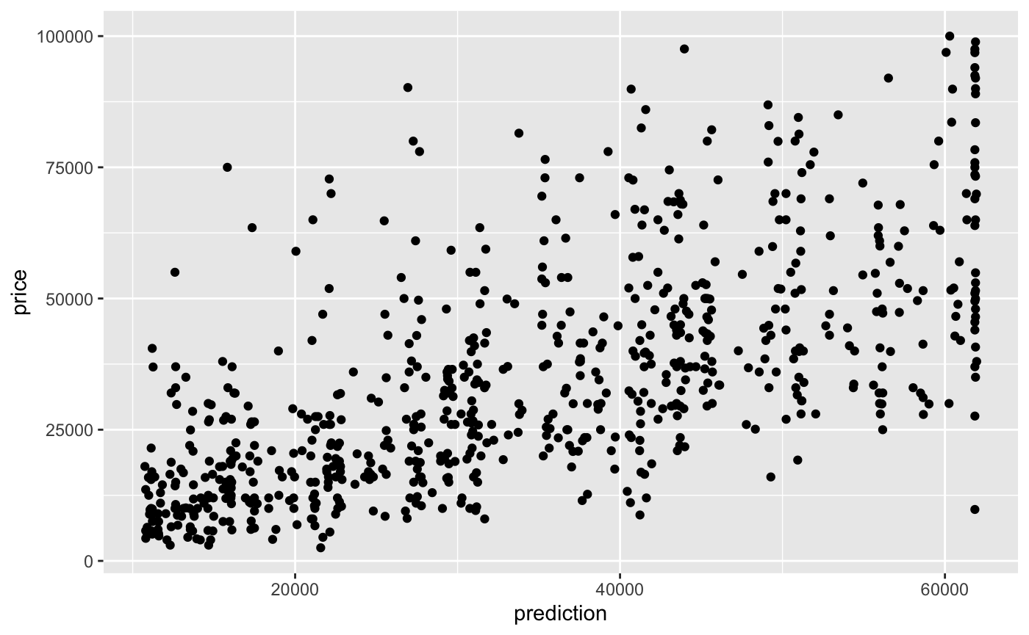
K-Nearest Neighbor
The KNN model was the least effective of the machine learning models used. The best KNN model achieved an RMSE value of 15,968.
There is some correlation here, but this could hardly be considered effective. It can be speculated that this has the potential to be a highly effective model with a much larger dataset.

Slide 9
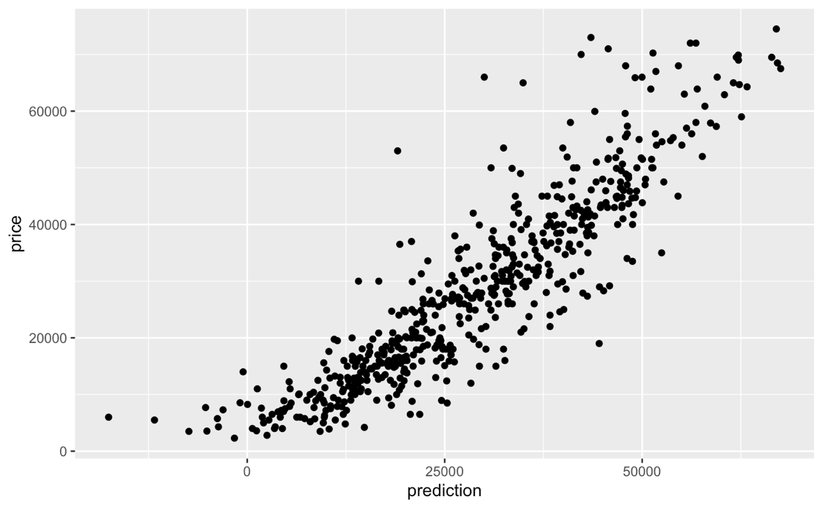
Support Vector Machines
The SVM model generated meaningful results. As with the other model, it struggled with the larger number of outliers. Despite this, the model was able to achieve an RMSE of 7,316.
Although this amount of error is still too great to be considered highly effective. This has great potential with additional data and more model tuning.

Slide 10
Conclusion
This research showcases that machine learning models are in fact well-suited to predicting used vehicle prices.
The SVM models were the most effective, but their difficulty in interpretation may necessitate the use of inferior models such as decision trees or KNN.
For future work, a few key elements are needed to create a highly effective model:
More data – There is not enough data present to accurately classify all vehicle models
Removal of Outliers – Rare vehicles present a great deal of issue in machine learning models
Investigation of Other Models – Ensemble models, neural networks, or artificial intelligence offer great promise for complex classification such as vehicle price prediction

