Slide 1

OHMYHOTEL.Biz Page Manual
www.ohmyhotel.biz

Slide 2
Ohmyhotel.Biz
- Log In -

Slide 3
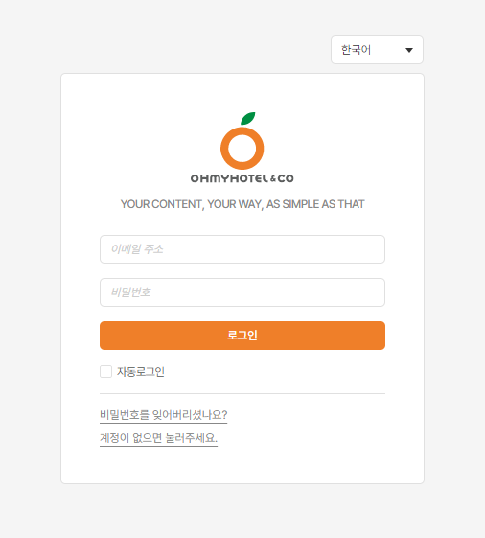
Seller – Log In
Ohmyhotel.Biz URL
- https://ohmyhotel.biz/login
Select language
Log in after entering account and password
If you have not signed in your company account yet, please registered by pressing the ① key on the left image.
※ If you want to add Operation(Staff) account, please let us know.
1

Slide 4
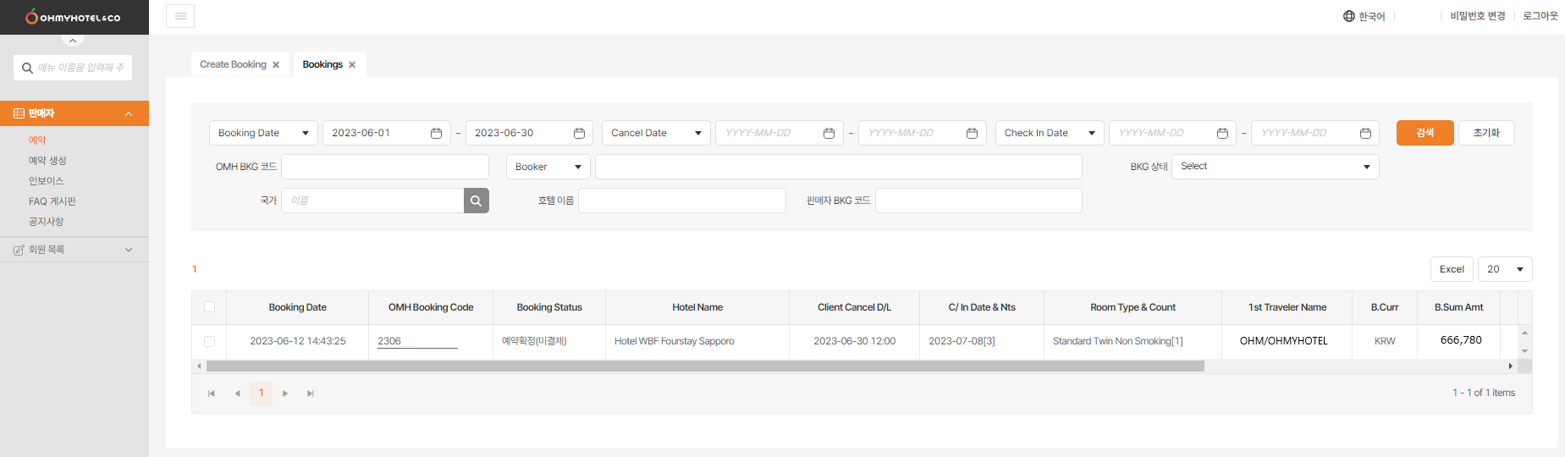
Seller – Confirm a Reservation
1. Menu
Booking Date ex) 2023-06-30 11:16:53
OMH Booking Code
ex) 230630MQ33P01
Booking Status
Hotel Name ex) Hotel WBF Fourstay Sapporo
Client Cancel D/L (Deadline) ex) 2023-07-08 17:00
C/In Date & Nts (Nights) ex) 2023-07-13[3]
Room Type & Count ex) Standard Twin Non Smoking [1]
1st Traveler Name ex) HONG/GILDONG
B.Curr : Bank Currency, ex) KRW
B.Sum Amt : Bank Summary Amount ex) 666,780
BKG Cancel Date : Booking Cancel Date ex) 2023-06-28 12:35
Invoice No. ex) 456123
Dispute YN (Yes or No)
Dispute Remark
1

Slide 5
Ohmyhotel.Biz
- Confirm a Reservation -

Slide 6
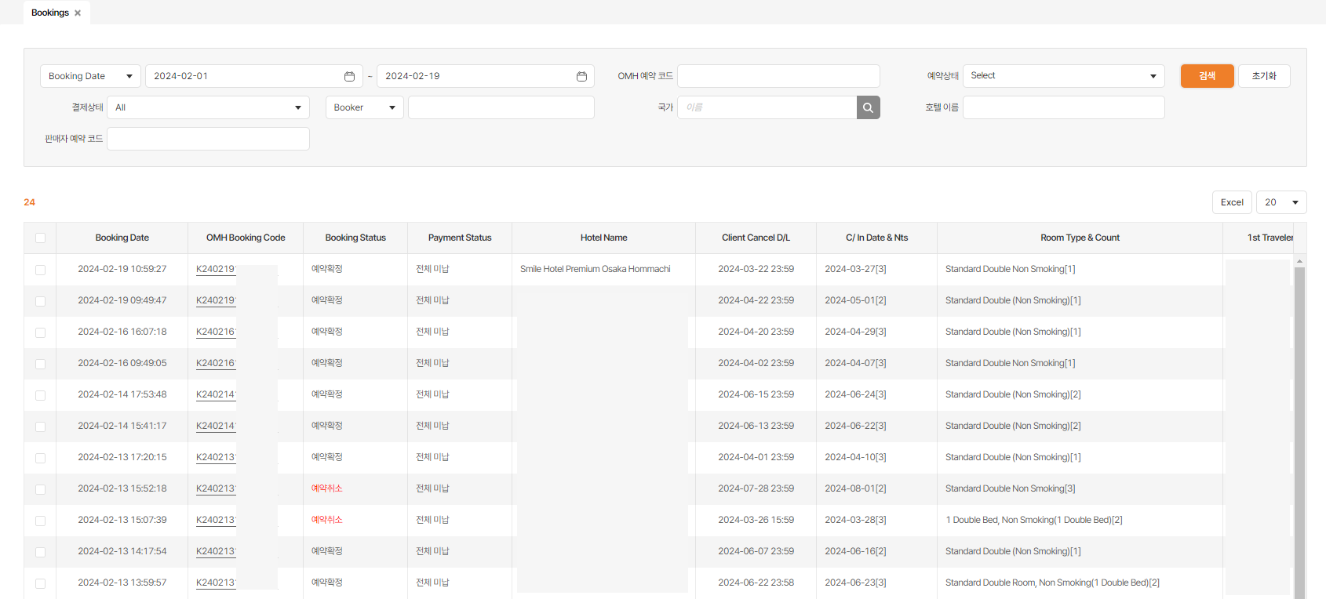
Seller – Confirm a Reservation
Reservation Number Click to see the details of reservation in a model window.
BKG status: Booking status - Pending - Confirmed - Cancelled - Unavailable
EXCEL All the reservations that you searched are available as an EXCEL file.
3
1
2

Slide 7
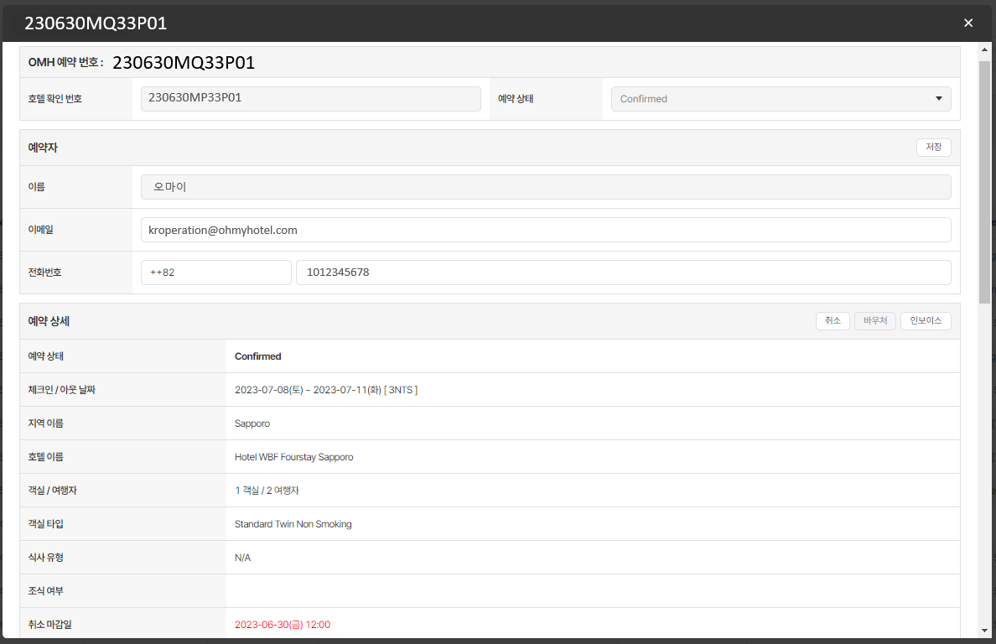
Seller – Confirm a Reservation
Reservation number and status - OMH Reservation number - Hotel’s confirmation number - Reservation status
Booker’s Information - Booker’s name - Email - Contact number
Booking Detail - Booking status - Check in/out date - Region and Hotel name - Rooms/Travelers - Room Type - Meal Type -Breakfast -Cancellation D/L
Cancel/Voucher/Invoice Cancel: Booking cancellation key Voucher: Send email / Print Invoice: Send email / Print
1
2
3
4

Slide 8
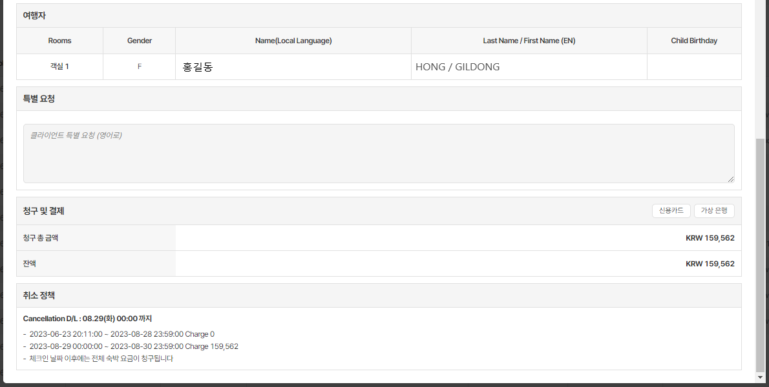
Seller – Confirm a Reservation
Travelers - Name - English Name - Child Birthday
Special Request - In English
Billing and Payment - Confirm billing amount and balance
Select Payment Method - Credit Card - Virtual Bank
Cancellation Policy - Confirm cancellation deadline and
cancellation policy
1
2
3
4
5

Slide 9
Ohmyhotel.Biz
- Make a Reservation -

Slide 10
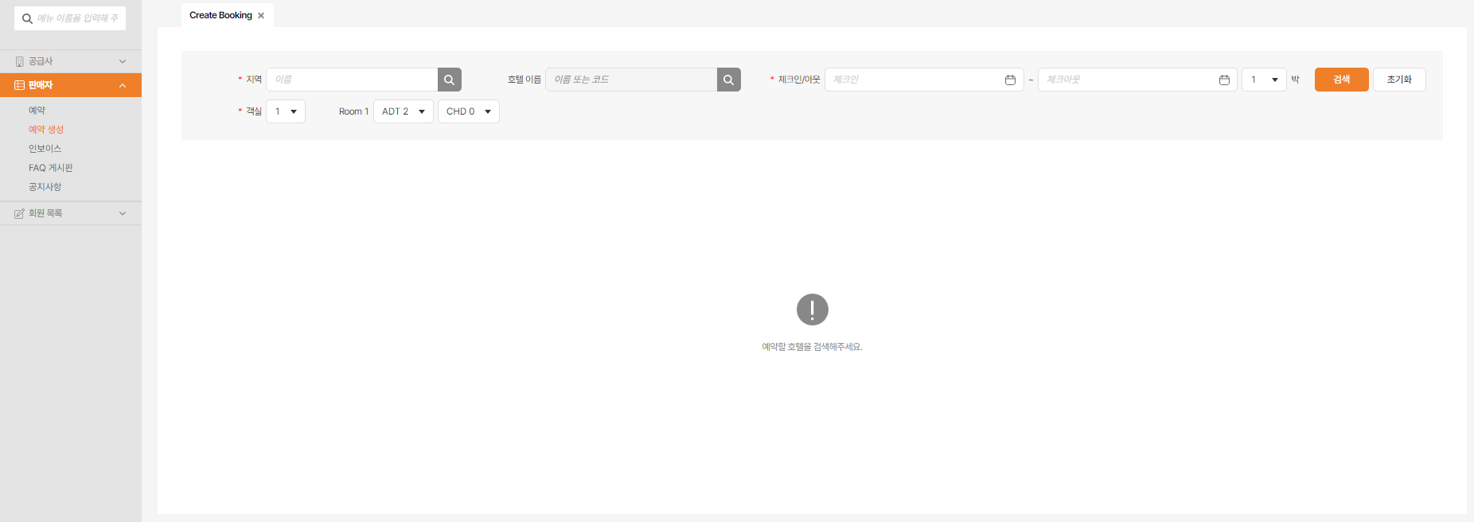
Seller – Make a Reservation
2
Make a reservation
Search Conditions - Destination (Required) - Hotel Name - Check In/Out (Required) - Rooms (Required)
Check In/Out
Rooms Default – One room(for 2 adults) If there is a child, then you must fill the child’s age.
3
1
4

Slide 11
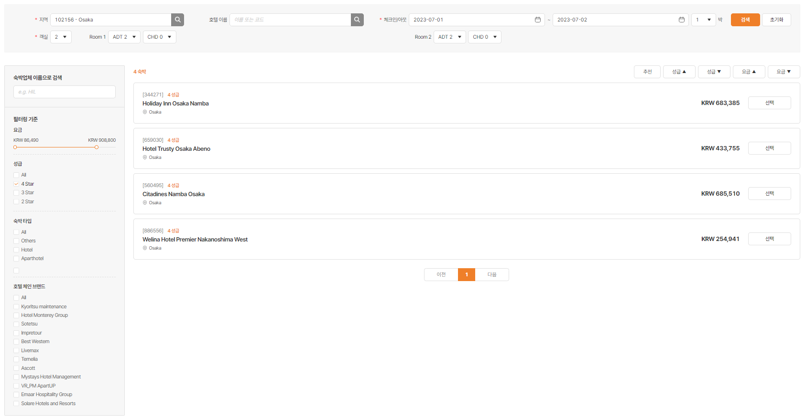
Seller – Make a Reservation
Hotel List Lists of hotels available for booking - Hotel English Name - Hotel Star Rating - Fare
Sorting Order - Recommendation - Star Rating - Fare
Search and Filter - Search by accommodation company name - Fare / Star Rating / Accommodation Type / Filter chain hotel brands
When you click ‘Select’, you can confirm the corresponding hotel information and available rooms. When you click ‘→’, you can open the same screen as next to it.
3
2
1
4

Slide 12
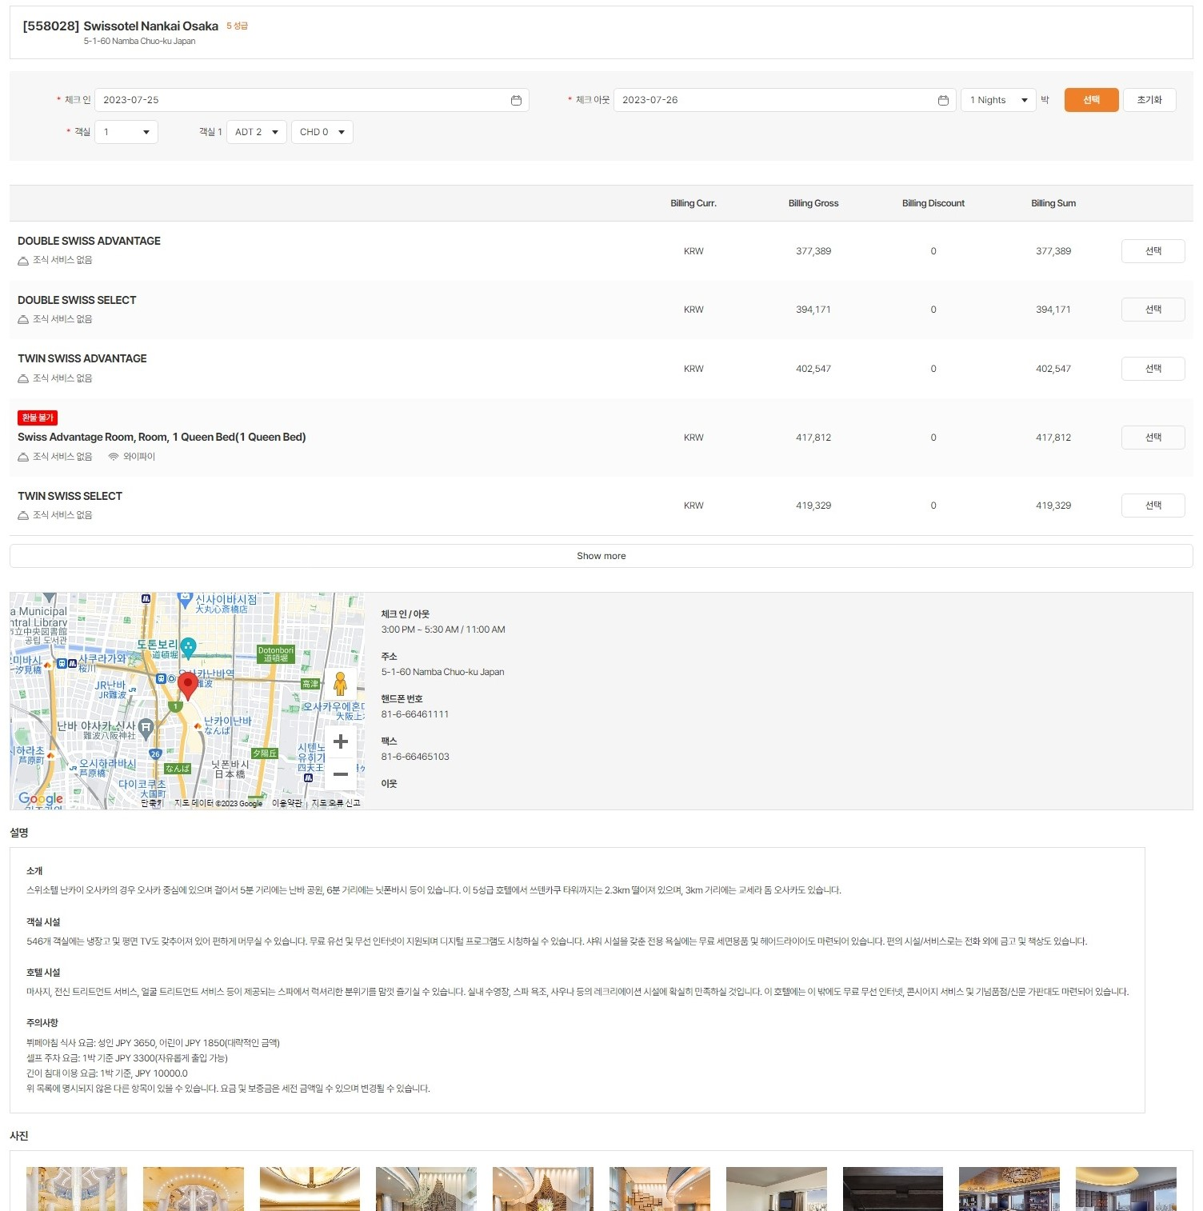
Seller – Make a Reservation
1
To change search conditions Check In/Out & Rooms ★ If children are traveling together, the current system is not running properly and may not be able to make accurate search. If the query is not successful, please contact us.
List of available rooms for booking Room Type/Breakfast or not/To check the amount.
Hotel Information To check hotel address and information.
Hotel Photos
When you click ‘Select’, you can move to the booking page.
2
5
3
4

Slide 13
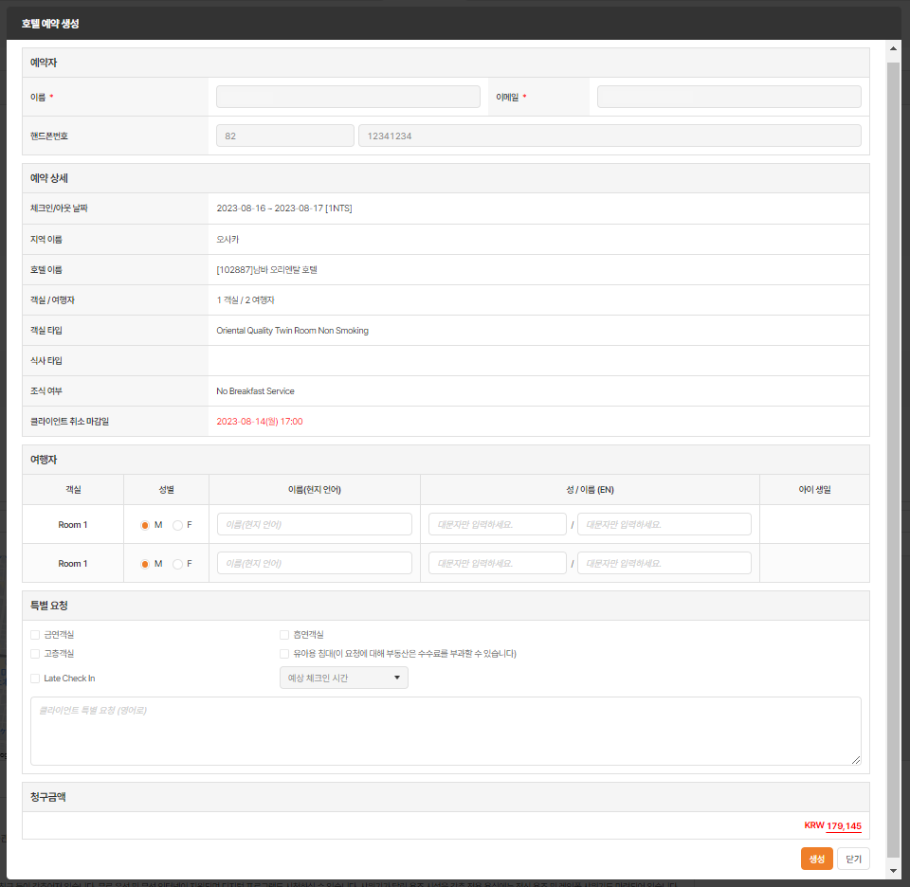
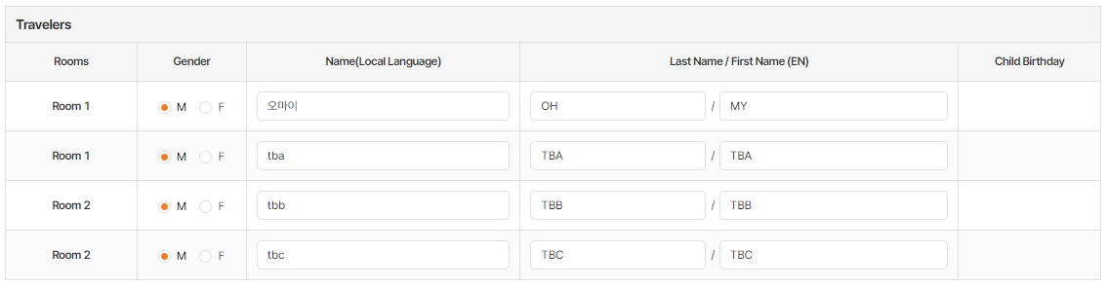
Seller – Make a Reservation
1
Booker The OP account information that you typed will be displayed.
Booking Detail To confirm hotel name, check in/out date and room type.
Travelers Information and Special Request Please fill in the guest’s name properly. If there are children, please fill in children’s birthday. 1. If there is no companion’s name, it can be filled in as TBA/TBA,TBB/TBB, but every name has to be written in different letters.
Claim Amount To check the payment amount of the hotel.
‘Create’ button If you click the button, you can make the reservation.
2
3
3-1
4
5

Slide 14
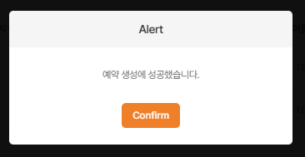
Seller – Make a Reservation
Window for a successful reservation
1

Slide 15
Ohmyhotel.Biz
- Confirm Billing -

Slide 16
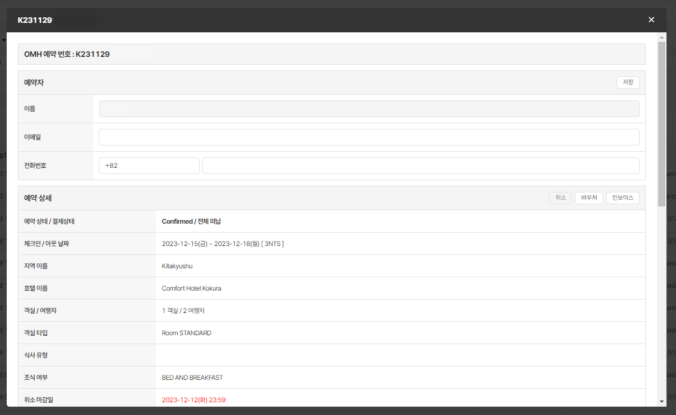
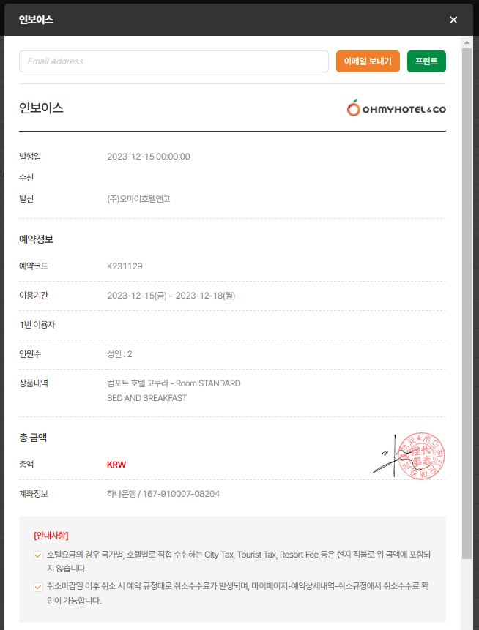
Confirm Billing (Prepaid Company）
Search Reservation>Click OMH Booking code>Click Invoice
After opening the invoicing simulation window, detailed information and account number can be confirmed.
It can be sent as an email or printed. (PDF File)
2
3
1

Slide 17
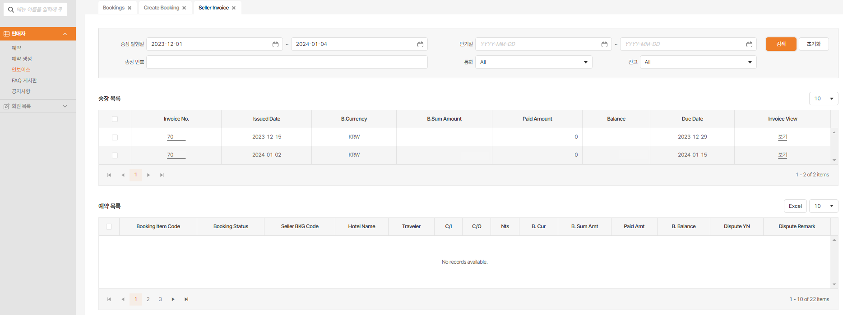
Confirm Billing (Prepaid Company）
2
Seller > Click on invoice category
Searching after setting the invoice date
There will be an invoice list at the bottom.
※ The invoice will be issued after the person in charge of Oh my hotel generates the invoice.
1

Slide 18
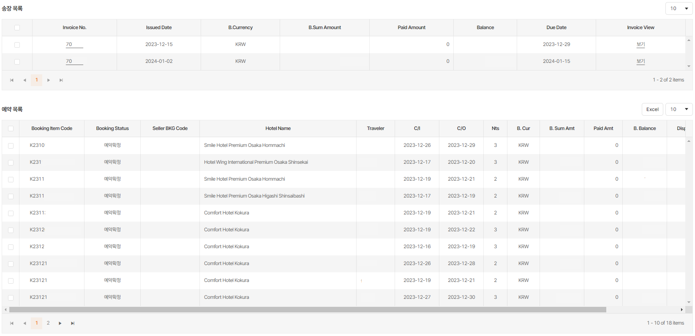
Confirm Billing (Prepaid Company）
1
3
Click on the invoice number
To confirm the invoice reservation list in the ‘reservation list’.
Click on the ‘Invoice View’ key to confirm billing.
※ The invoice will be issued after the person in charge of Oh my hotel generates the invoice.
2

Slide 19
Ohmyhotel.Biz
- Staff List -

Slide 20
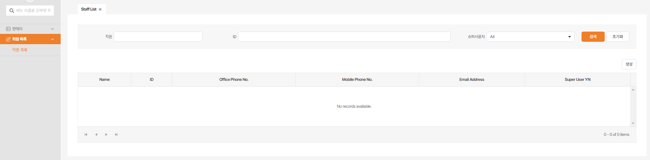
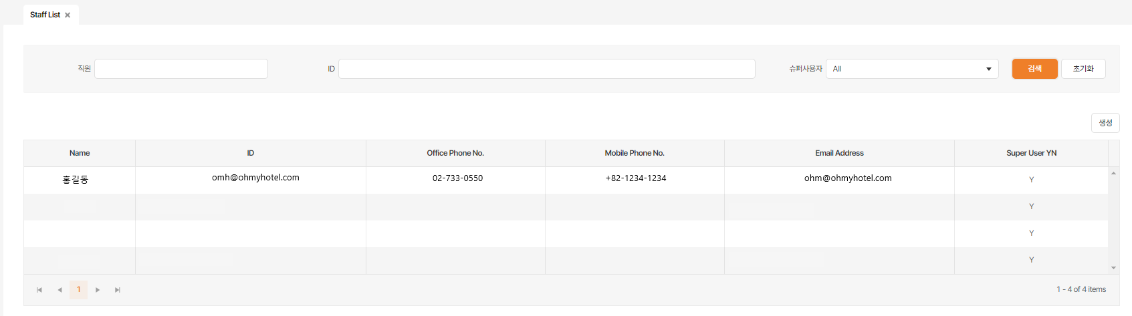
Member List – Staff List
1
To query and generate a list of staffs.
When you click search, the list will show like image 2.
Staff list example
2

Slide 21
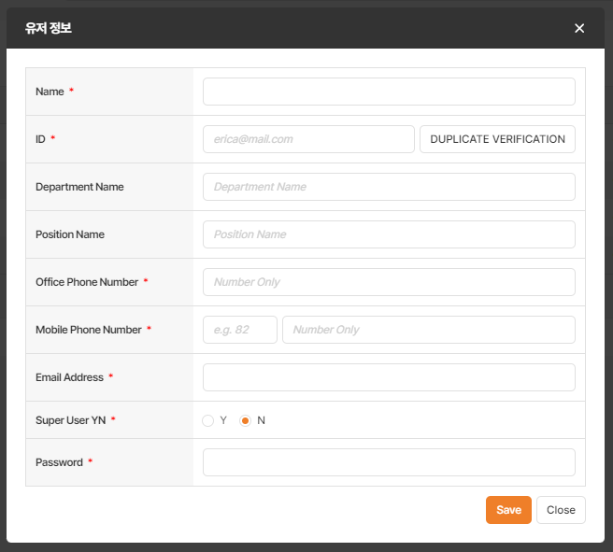
Member List – Staff List
1
New When you click, it will show like image 2.
User Information A new ID is created by clicking the save button 3 times after filling in the required value (*denotes).
Save
2
3

Slide 22

Thank you.
If you have any questions, please contact us.
Mail : sales@ohmyhotel.com​

