Slide 1


Slide 2

Data visualizations with ggplot2 Jure Demšar and Gregor Pirš

Slide 3
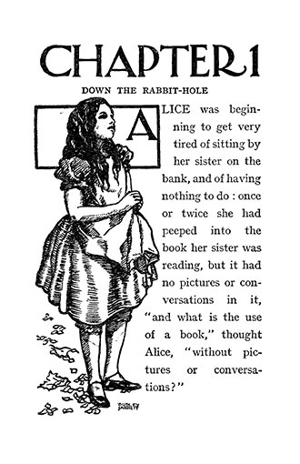
What is the use of statistical analysis without data visualizations?

Slide 4
Types of data
Nominal (discrete, no ordering, e.g. male/female)
Ordinal (discrete, ordering, e.g. sad/OK/happy)
Interval (numeric, no “true zero”, no ratios, e.g. degrees)
Ratio (numeric, has “true zero”, can calculate ratios, e.g. weight)

Slide 5
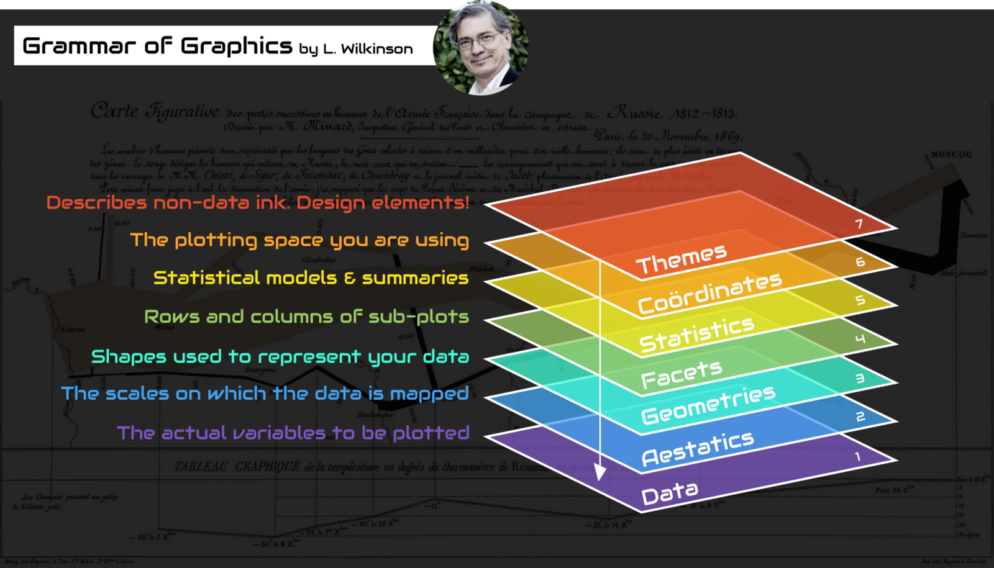

Slide 6
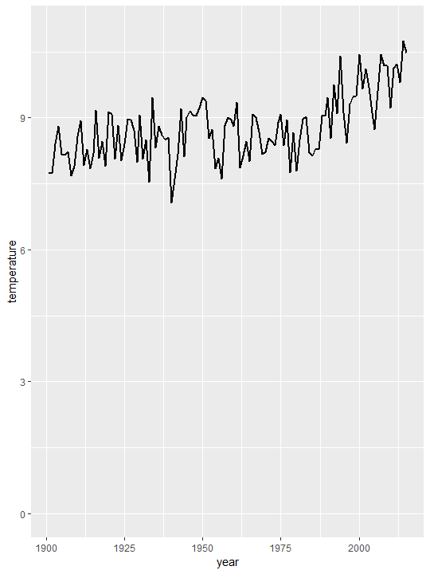
Line chart (geom_line)
Good for:
continuous data,
ordered data,
visualizing trends,
time series.

Slide 7
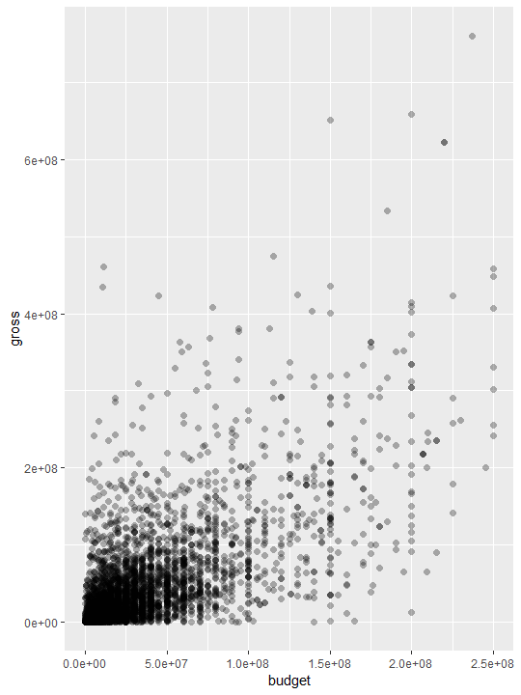
Scatter plot (geom_point)
Good for:
exploratory analysis,
visualizing distributions,
visualizing relationships.

Slide 8
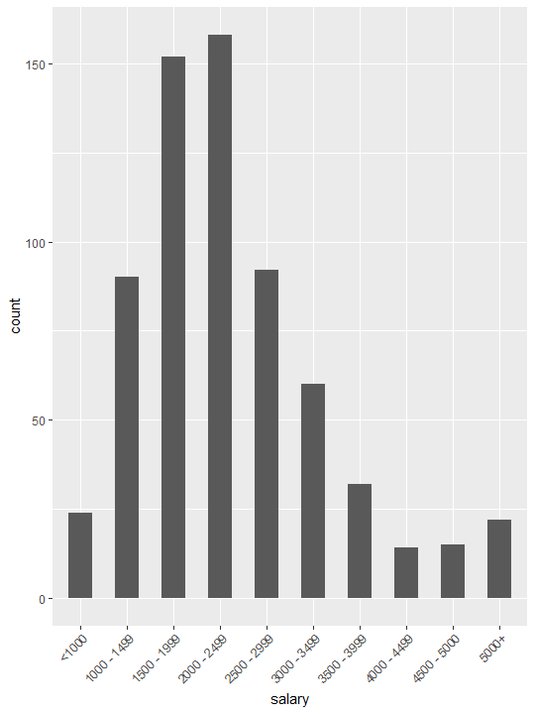
Bar chart (geom_bar)
Good for:
value comparison,
ranking,
visualizing ratios.

Slide 9
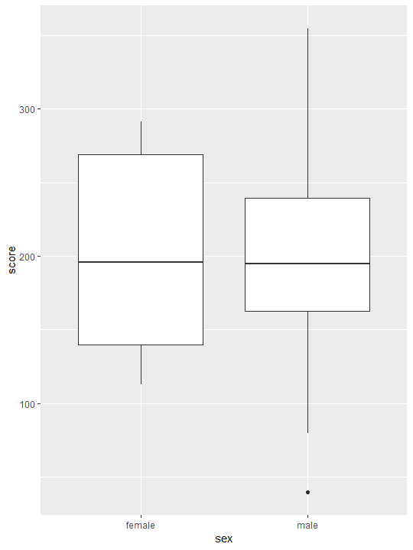
Box plot (geom_box)
Middle line shows the median value.
Box shows 25th and 75th percentile.
Whiskers show extremes.
Dots show outliers.

Slide 10
Pie chart
Good for:
?

Slide 11
And many more …

Slide 12
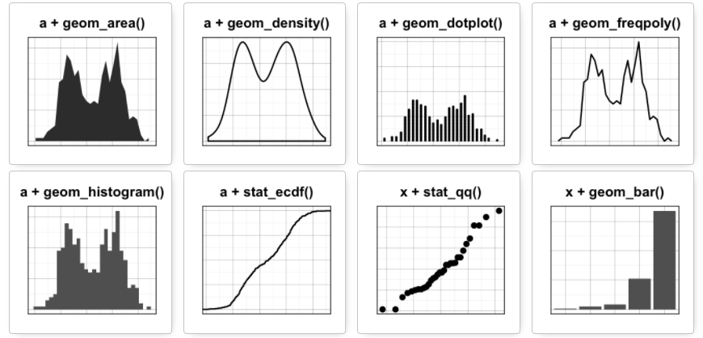

Slide 13
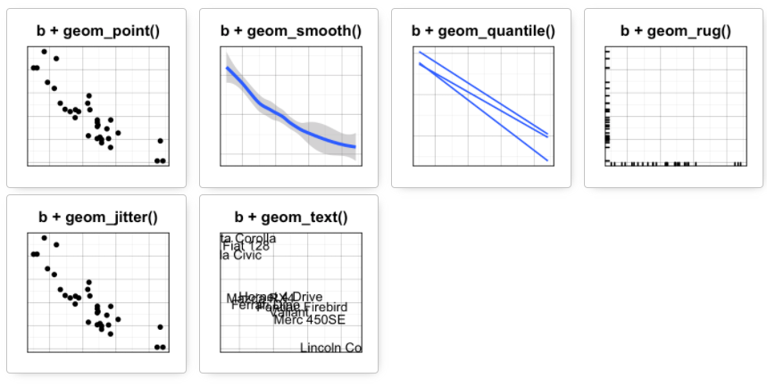

Slide 14
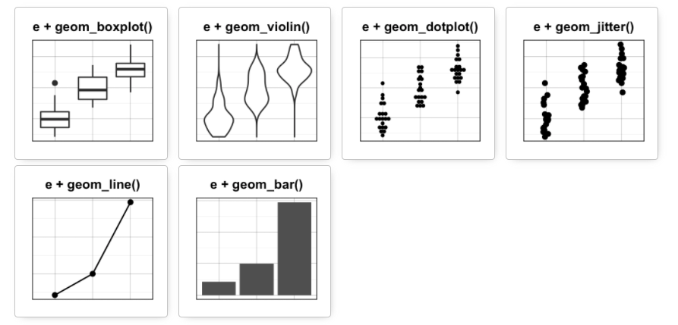

Slide 15
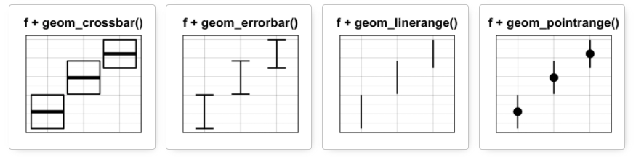

Slide 16
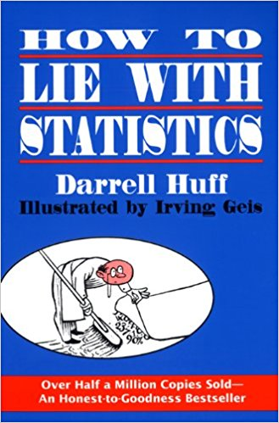

Slide 17
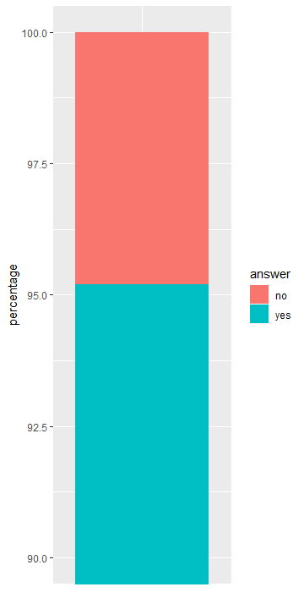

Slide 18
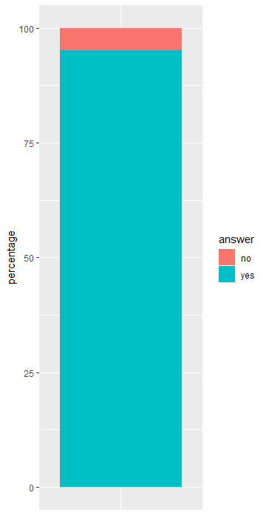

Slide 19
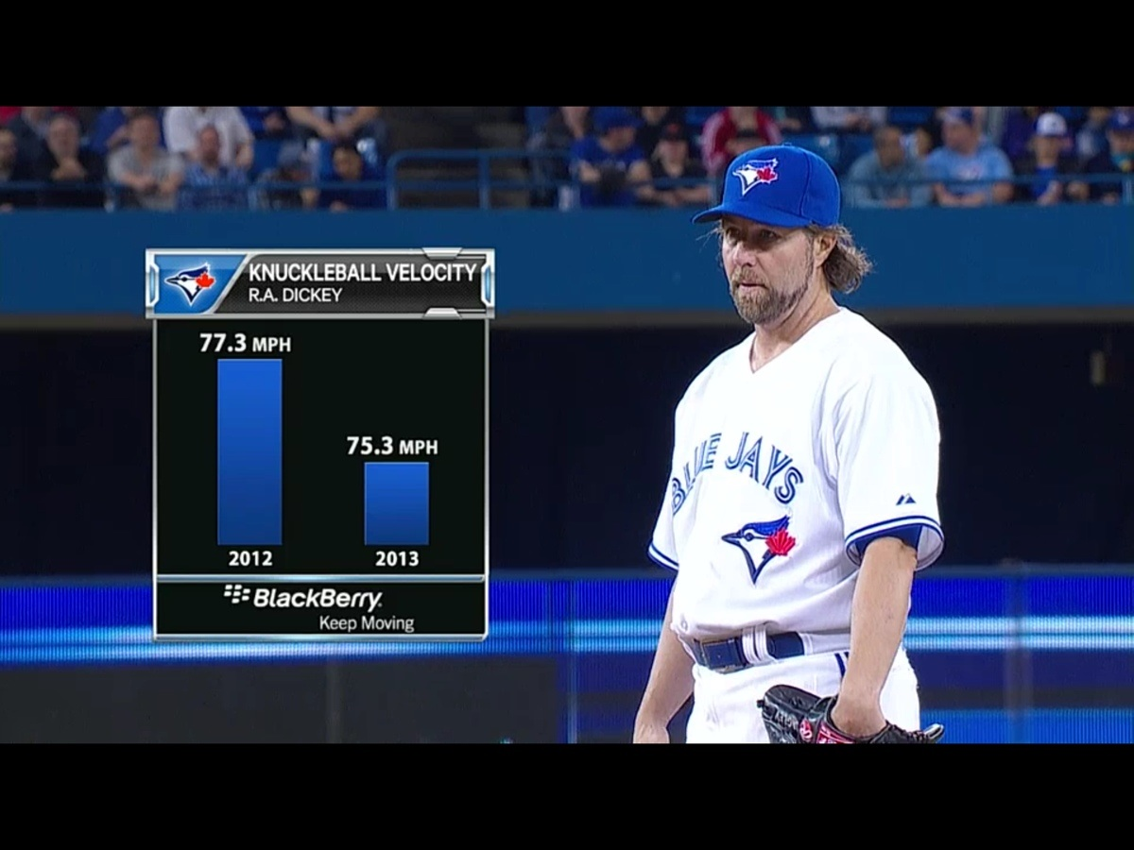

Slide 21
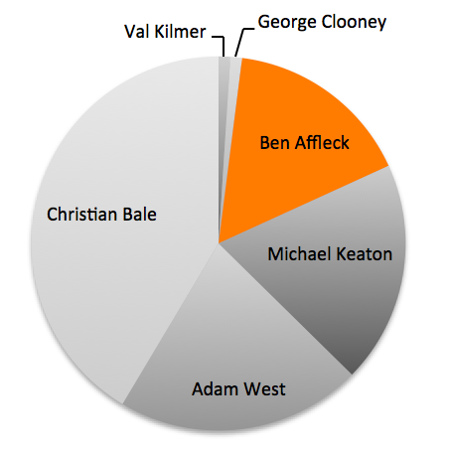
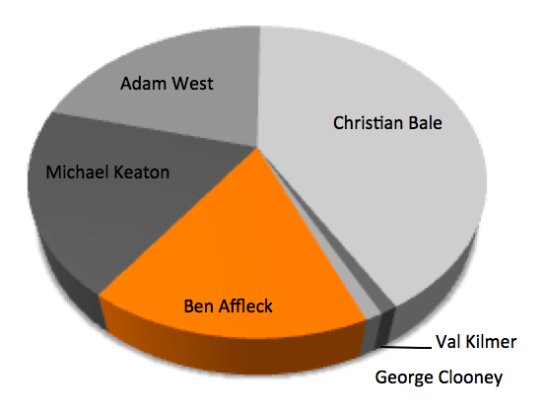

Slide 22
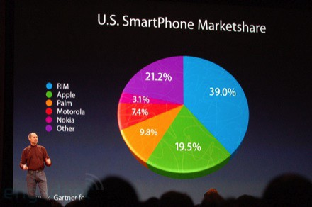

Slide 23
Colors
Be friendly to color blind!
Be friendly to black & white devices!
Use Color Brewer (http://colorbrewer2.org) palettes!

Slide 24
Color palettes
Sequential: ordered data.
Diverging: ordered data, two classes, e.g. positive/negative.
Qualitative: unordered data,
largest possible visual difference.

Slide 25
Credits and references
Andraž Matkovič – Introduction to R, Faculty of Arts, 2018
Iztok Lebar Bajec – Graphic Design, Faculty of Computer and Information Science, 2018
Leland Wilkinson – The Grammar of Graphics, 2005
Chris Nielsen – Lying with charts is pretty easy [https://medium.com/chris-nielsen/lying-with-charts-is-pretty-easy-13b81e787773]
Ravi Parikh - How to Lie with Data Visualization [https://heapanalytics.com/blog/data-stories/how-to-lie-with-data-visualization]
Miha Sušnik – Plače razvijalcev 2018 [https://medium.com/@mihec.susnik/pla%C4%8De-razvijalcev-2018-7a71d4befb1]

