Slide 1


Slide 2

https://github.com/bstatcomp/ppworkshop wifi: FRIevent / 1program3R

Slide 3
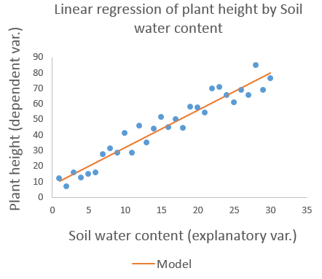
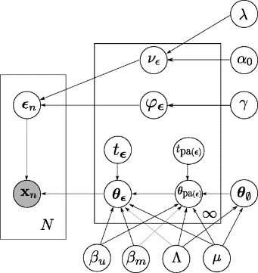
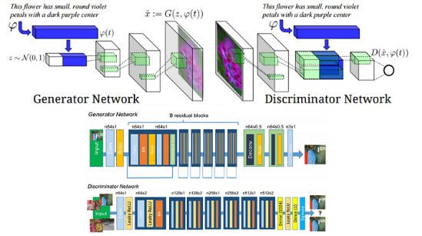
Why should I care about probabilistic thinking and programming?
classic applied statistics
probabilistic graphical models
Integral to statistical modelling and probabilistic machine learning.
Quite possibly the future mainstream of data engineering.
Must-learn topic for the modern quantative analysis professional!
(generative) deep learning

Slide 4
Challenge Each of these 30 characters long sequences was generated using the same process. Can you provide more information about the process I used to generate these sequences?
100100101011011001111111111101 110000010101110001101110111011 000101111111111010111111100111 011011111111001101111111110101 110010010110101010111111111111 110101011100101010110110111111 000010101111011111110110111111 000001111110110001001101011111 010000101101110111101111111101 000101011110001011011111111111

Slide 5

OUTLINE
Part 1 Uncertainty and probabilistic thinking.
Part 2 Statistical modelling.
Part 3 Probabilistic programming & Stan.
Part 4 MCMC-based inference First aid kit.
Hands-on Three modelling tasks.
I‘m assuming good programming skills and a basic understanding of randomness and probability.

Slide 6
Interactive Workshop Equipment Test

Slide 7
Part 1
Uncertainty and probabilistic thinking.

Slide 8
Q: Is it going to rain in Ljubljana next week?

Slide 9
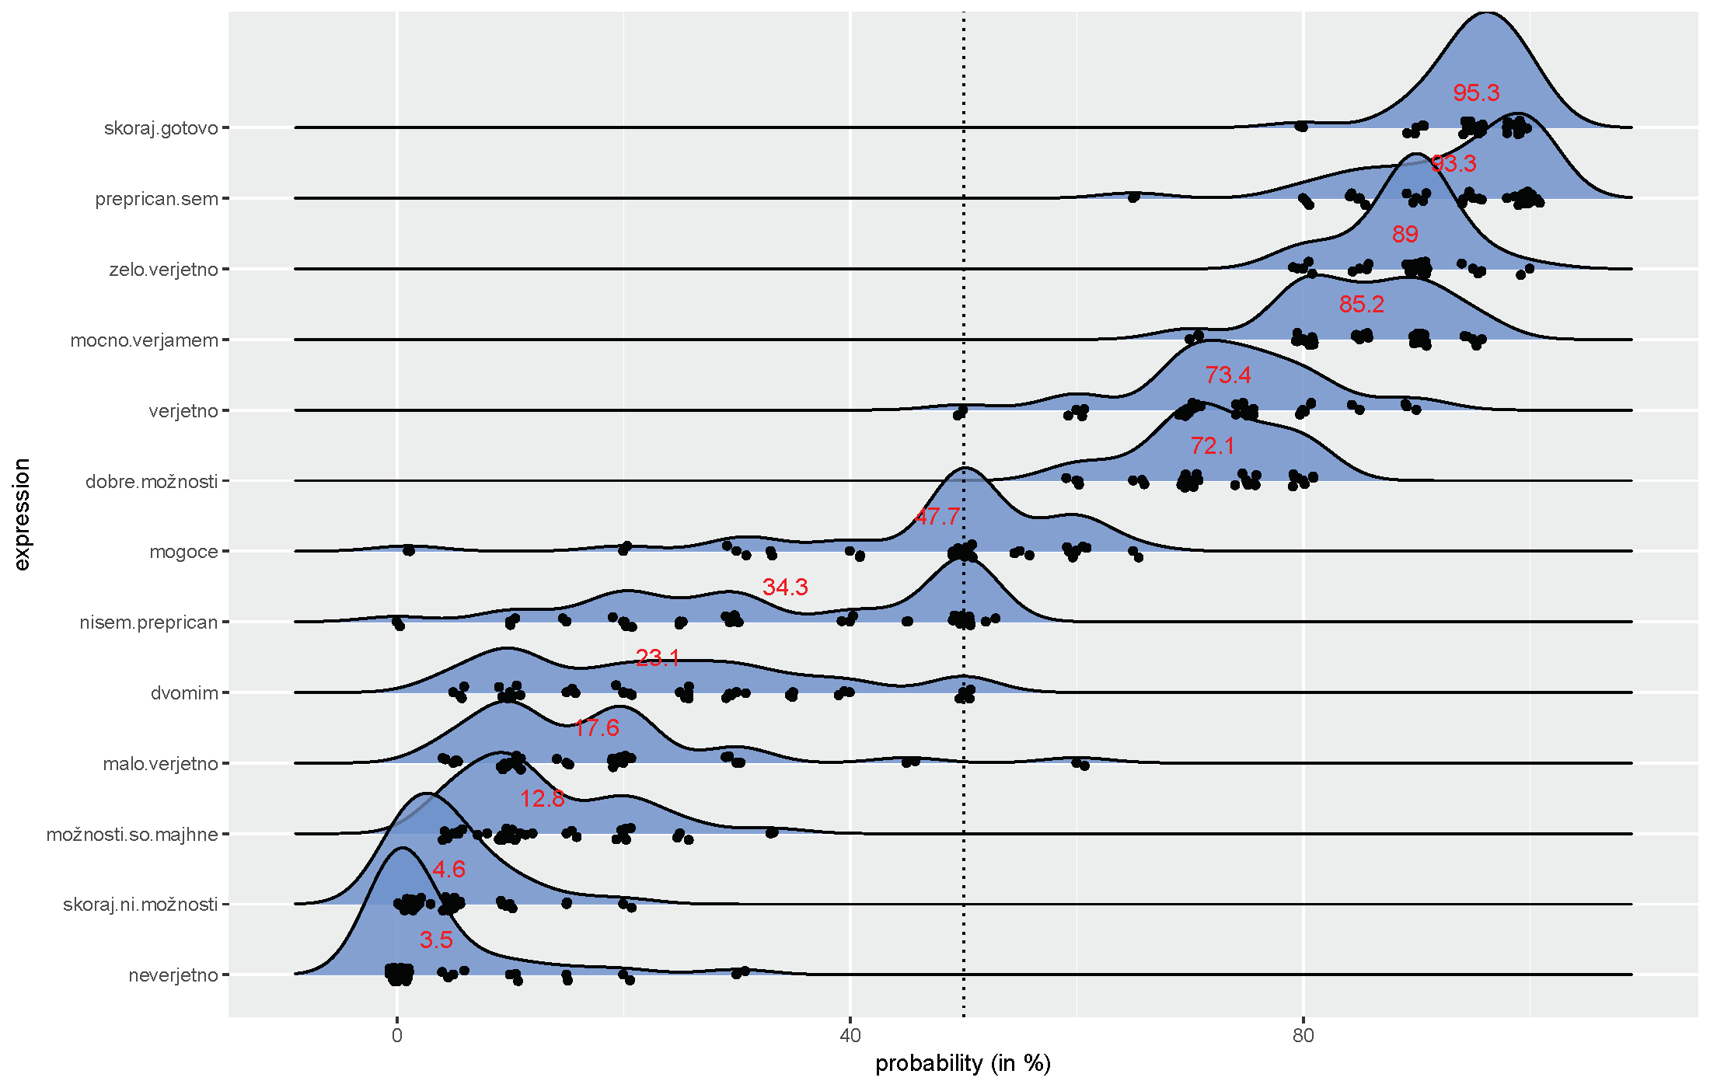
Expressing uncertainty with natural language

Slide 10
Q: How cold (°C) will it be in LJ tomorrow at noon?

Slide 11
Natural language is incoherent, imprecise, and lacks expressiveness for serious quantitative work!
Good news A suitable language has been developed long ago.¹
Bad news It is Probability Theory and mathematics cannot be avoided.
Good news We don‘t have to learn even all of undergraduate-level probability theory.² What we really need is the language, not the computation.
¹ Modern probability is relatively young as far as fundamental maths go (< 100 years).
² We really should though, especially if we want to be a competent quantitative analysis professional.

Slide 12
The grammar of Probability Theory

Slide 13
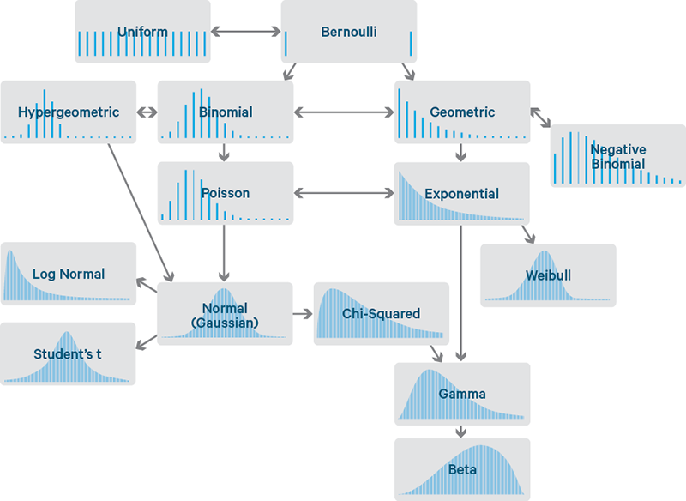
Distributions
Probability distributions are the elementary expressions of probabilistic thinking and
the basic building blocks of statistical models.
Distributions follow the rules (grammar) of probability and are therefore coherent and precise statements.
The more we know about distributions the more expressive we can be.

Slide 14
A word a day...

Slide 15
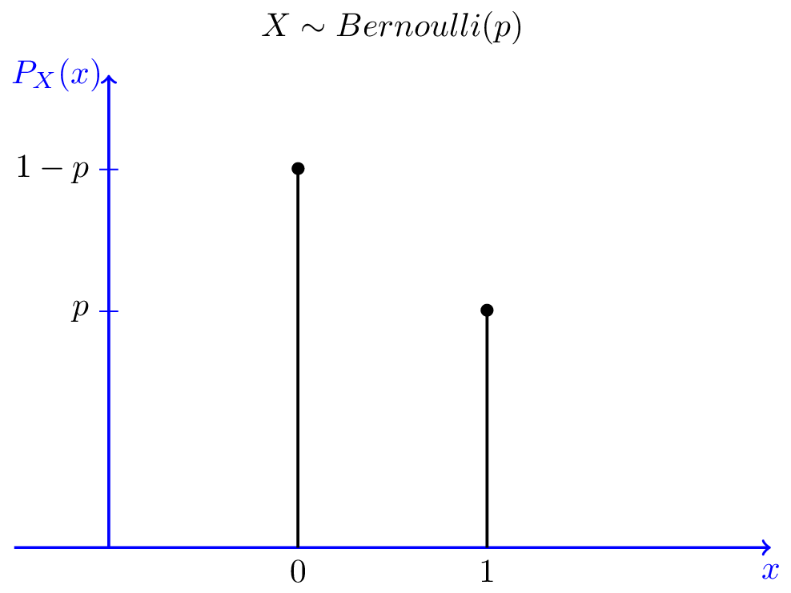
Bernoulli distribution

Slide 16
Bernoulli distribution
Q: Is it going to rain in Ljubljana next week?

Slide 17
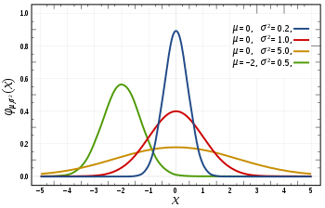
Normal (Gaussian) distribution

Slide 18
Normal (Gaussian) distribution
Q: How cold (°C) will it be in LJ tomorrow at noon?

Slide 19
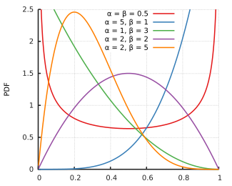
Beta distribution

Slide 20
Beta distribution
Q: What is the probability of rain in LJ next week?

Slide 21
Tricky questions
Assume that these are independent tosses of a (possibly unfair) coin:
T T H T T H T T T H (?)
Q1: Did the flipped coin land heads or tails next?
Q2: What is the coin‘s probability of landing heads?
Q3: Is this coin fair (is its probability between 49% and 51%)?

Slide 22

Subtle points to think about
The Probabilistic
Police
Stop! Where are you going with that boat?
TO THE TOP OF THE HILL! There is a 99.9% CHANCE THAT THE WORLD ENDS TODAY!
OK. YOU MAY PASS.
A FEW MINUTES LATER...
HMM...
We use probability theory as a precise and coherent language.
If we don‘t follow the rules of probability, others won‘t understand what we are saying!
However, we‘ve never said that probabilistic opinions have to be objective or even sensible.
We find it natural to have probabilistic opinions about properties that are arguably not random (the outcome of an already tossed coin, the probability of the coin being fair,...).
Using probability as a tool to express uncertainty is inherently Bayesian!
HEY! WAIT!!!
WHAT IS THE PROBABILITY
OF EVERYTHING
BEING OK?
0.01% !!!
AHA, OK!
I had to CHECK.. There‘s A LOT OF INCOHERENT PEOPLE OUT THERE.

Slide 23
Part 2
Statistical modelling.

Slide 24
Statistical model =
a hypothesis of how the data were generated.

Slide 25
You really can‘t do modelling without a model.

Slide 26
No, seriously, you can‘t.

Slide 27
Q: Write down any method that is used for prediction, pattern recognition, classification, statistical inference...

Slide 28
A sequence from the challenge (= data):
100100101011011001111111111101
Statistical model (= an attempt at a statistical interpretation):

Slide 29
A sequence from the challenge (= data):
100100101011011001111111111101
Statistical model (= an attempt at a statistical interpretation):
This sequence was generated by flipping 30 times a coin with unknown probability θ.
Prior opinion about the parameters:

Slide 30
A sequence from the challenge (= data):
100100101011011001111111111101
Statistical model (= an attempt at a statistical interpretation):
This sequence was generated by flipping 30 times a coin with unknown probability θ.
Prior opinion about the parameters:
I really don‘t know what θ might be, therefore, I have no preference for any θ.
Inference (= learning):
Given all these assumptions and following the rules of probability, what should my probabilistic opinion of θ be after I see the data?

Slide 31
A sequence from the challenge (= data):
100100101011011001111111111101
Statistical model (= an attempt at a statistical interpretation):
This sequence was generated by flipping 30 times a coin with unknown probability θ.
Prior opinion about the parameters:
I really don‘t know what θ might be, therefore, I have no preference for any θ.
Inference (= learning):
Given all these assumptions and following the rules of probability, what should my probabilistic opinion of θ be after I see the data?

Slide 32


A sequence from the challenge (= data):
100100101011011001111111111101
Statistical model (= an attempt at a statistical interpretation):
This sequence was generated by flipping 30 times a coin with unknown probability θ.
Prior opinion about the parameters:
I really don‘t know what θ might be, therefore, I have no preference for any θ.
Inference (= learning):
Given all these assumptions and following the rules of probability, what should my probabilistic opinion of θ be after I see the data?

Slide 33
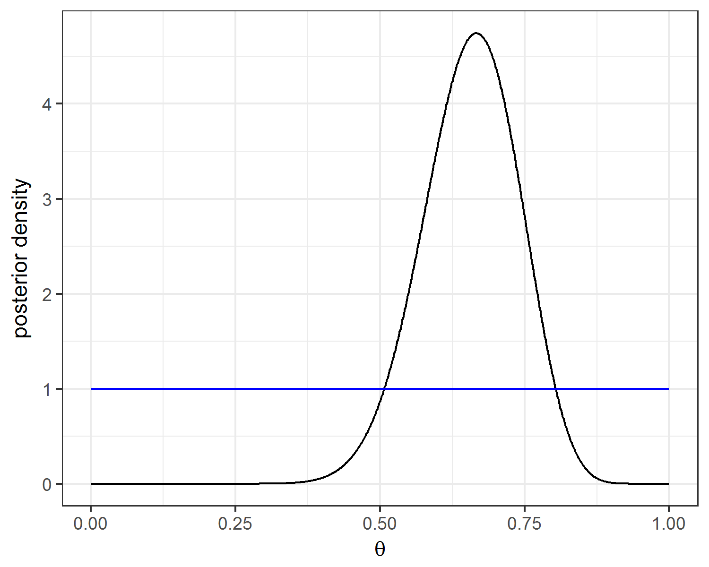
Our opinion about θ before and after seeing the first sequence (20 ones and 10 zeros).

Slide 34
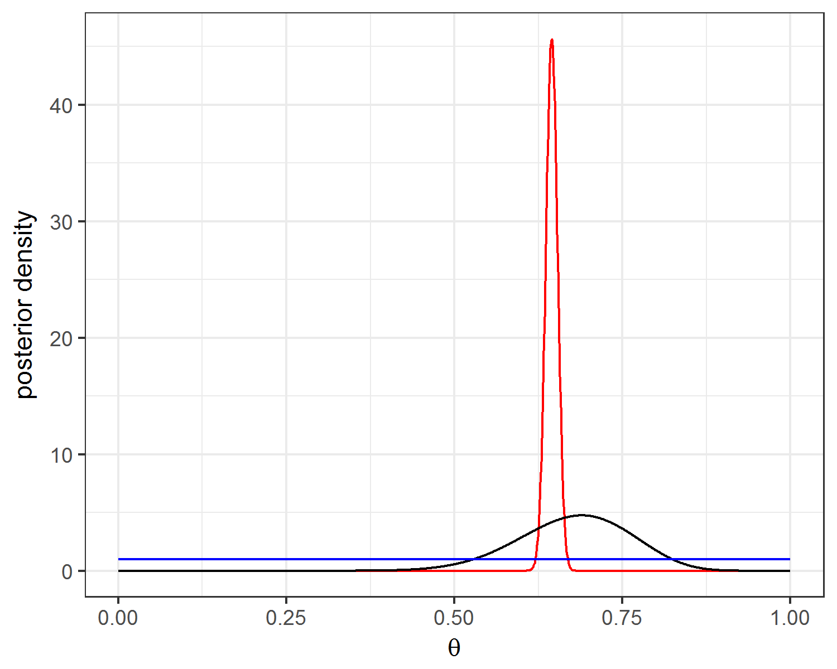
Our opinion about θ before and after seeing all the data (1934 ones and 1066 zeros).

Slide 35
Part 3
Probabilistic programming & Stan.

Slide 36
A probabilistic programming language (PPL) is a programming language designed to describe probabilistic models and then perform inference in those models.
Source: Wikipedia

Slide 37
A probabilistic programming language allows us to focus on the modelling and skip the mathematical and computational difficulties of inference.

Slide 38
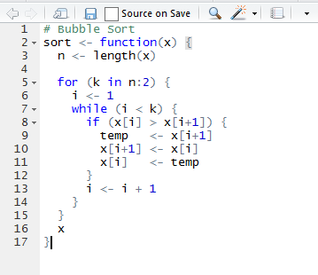
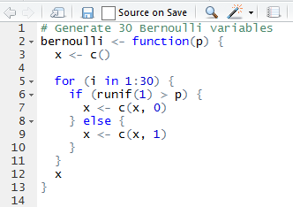
Two examples of imperative programming

Slide 39
Pure imperative programming vs Statistical modelling
Inferring the relative frequency in this sequence
100100101011011001111111111101
Start with input data & parameters,
produce correct output data.
Start with input & output data,
assume a model that generated the output,
infer what the parameters were.

Slide 40
A probabilistic programming language is an imperative (or functional) programming language with additional constructs for describing models and probabilistic opinions.

Slide 41
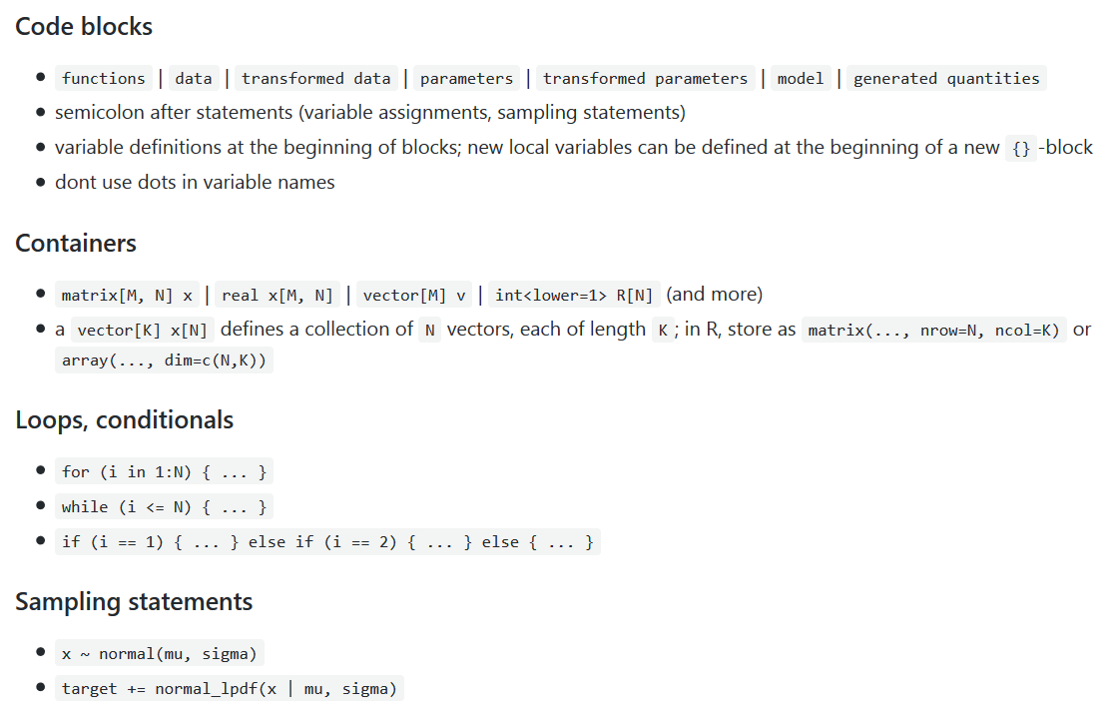
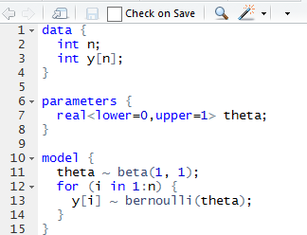
Our model written in Stan
https://github.com/sieste/Stan_cheatsheet

Slide 42
Stan software for Bayesian inference
Programming language + inference algorithms.
Open source (BSD, PLv3).
Written in C++ (Win, Mac, Linux).
Stan PPL Models are compiled to C++ code.
Interfaces for R, Python, MATLAB, Julia, Stata...
Excellent manual, active community.
Inference:
Comprehensive Auto-differentiation library.
MCMC: No-U-Turn-Sampler, Hamiltonian Monte Carlo.
Approximate inference: Variational inference, Laplace.
Optimization: L-BFGS.

Slide 43
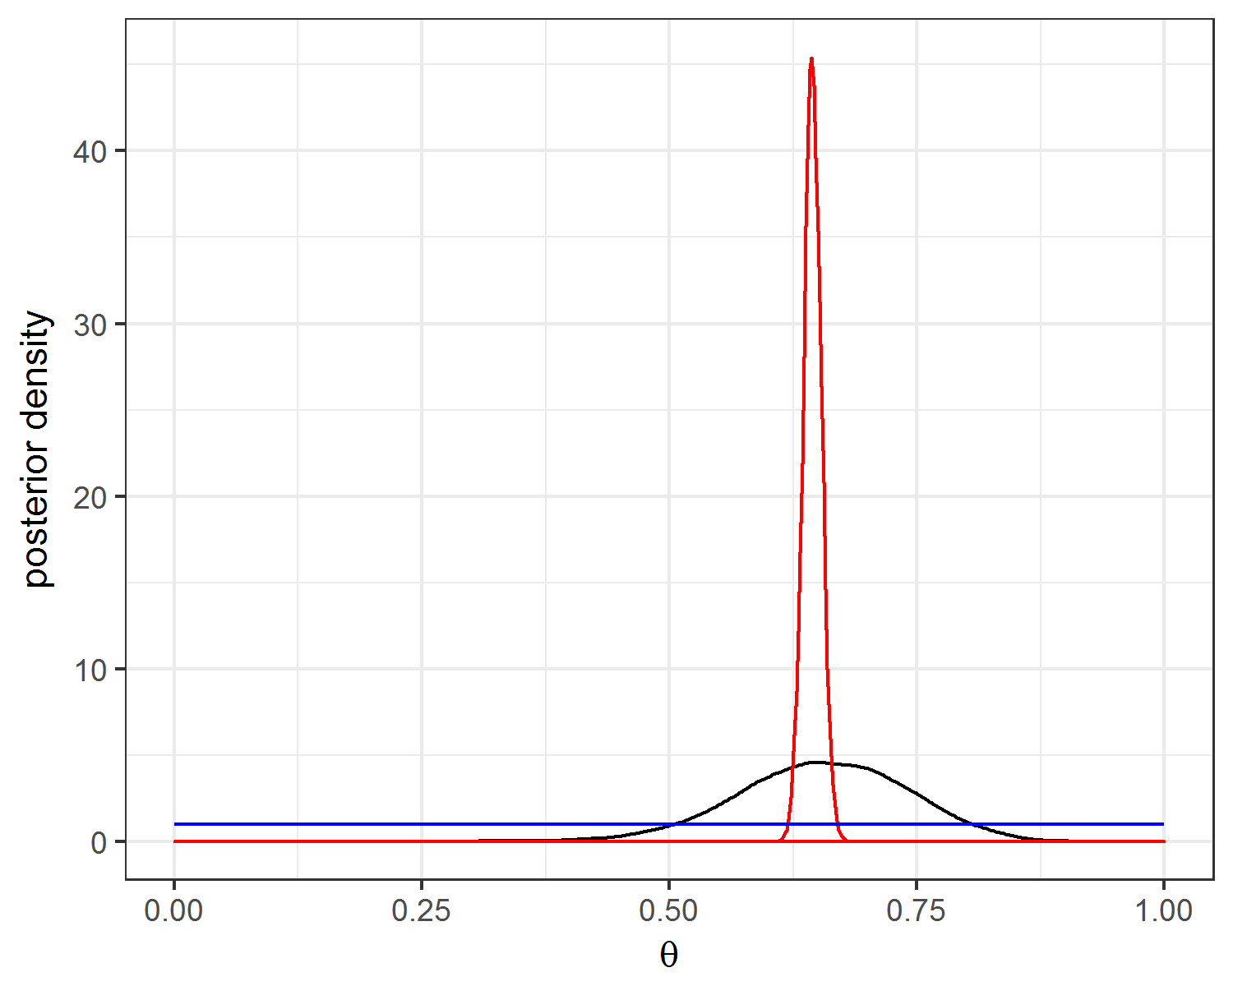
Our opinion about θ before and after seeing all the data (1934 ones and 1066 zeros).

Slide 44
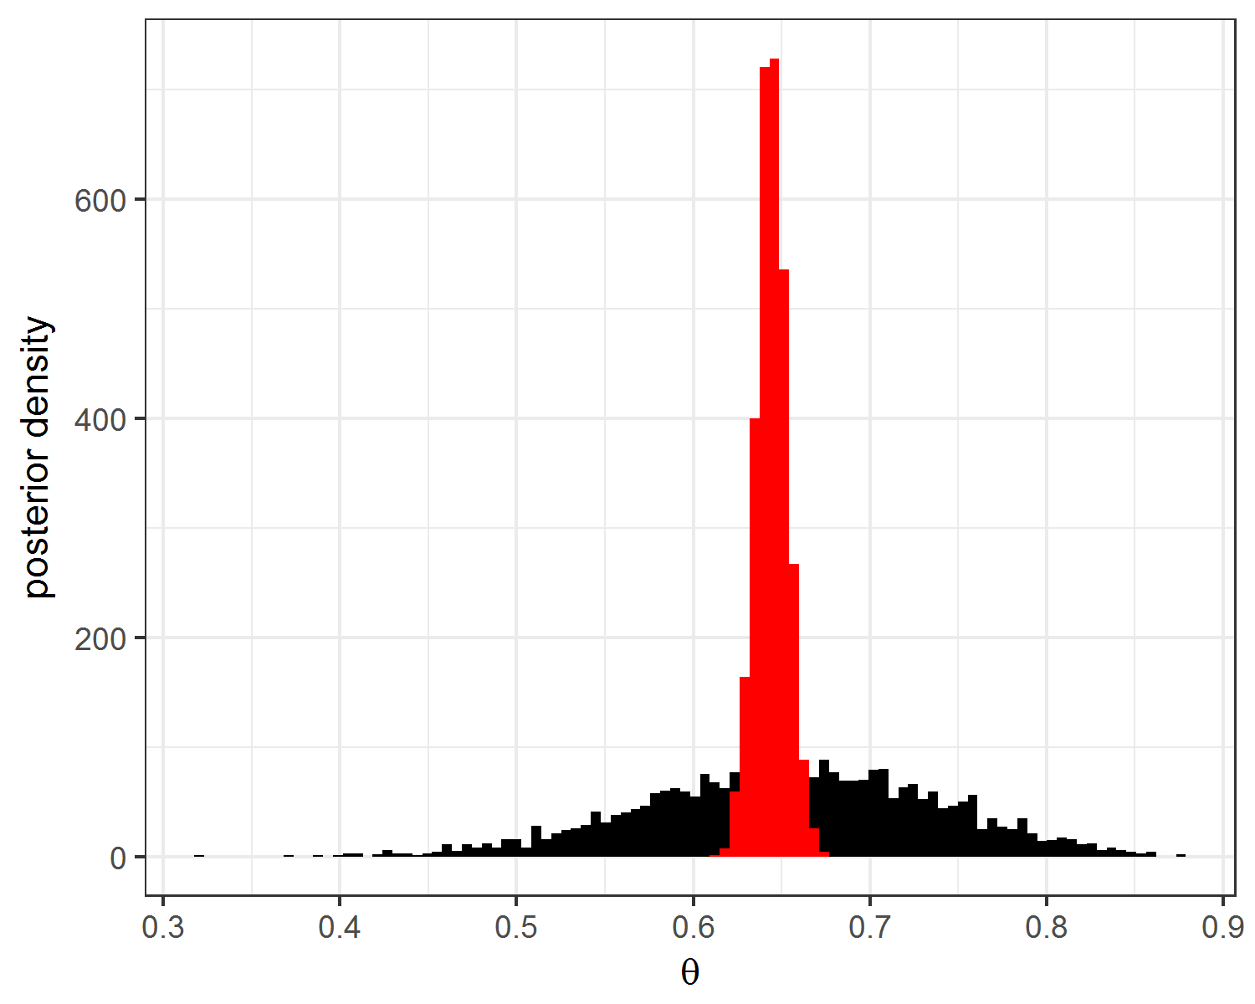
Our opinion about θ before and after seeing all the data (1934 ones and 1066 zeros).
Modern general-purpuse Bayesian inference is MCMC-based (Markov Chain Monte Carlo).
We get samples that converge to the true distribution.
That is, we only get approximate solutions.

Slide 45
Part 4
MCMC-based inference First aid kit.

Slide 46
Why do we have to resort to sampling-based approximation?
The posterior opinion p(θ|y) is typically a high-dimensional function. For example, linear regression with n input variables already has n+1 parameters.
Any general-purpose inference algorithm is limited to evaluating p(θ|y). The user can specify a variety of models and prior opinions, most of which result in intractable posterior opinions.
It is computationally intractable to get a global understanding of p(θ|y) if we can only evaluate it at any point. The user can specify a variety of models and prior opinions, most of which result in intractable posterior opinions.
Without a global understanding of a function, we can‘t efficiently get completely independent samples. The best we can count on are dependent samples but this introduces new problems.

Slide 47
MCMC methods are based on constructing a sequence of dependent samples (a Markov Chain) that will eventually converge to the target density.
Typically, the samples are autocorrelated.
Autocorrelation increases approximation error and we need more samples (compared to independent sampling).
Extreme autocorrelation can result in useless results.
Severe problems can typically be diagnosed by:
plotting a traceplot for the parameters of interest.
Running several chains and checking if they all eventually result in the same distribution.
Effective Sample Size: ESS is a simple single-number summary of the effectiveness of a MCMC sampler is ESS – The number of independent samples our samples are equivalent to.

Slide 48
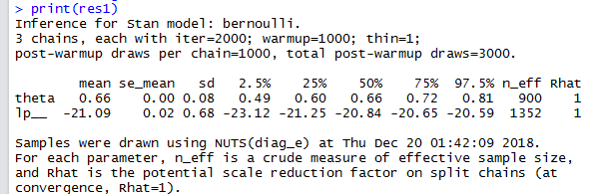
Our Stan example
ESS about a third of the actual 3000 samples.
Not bad, but there is clearly autocorrelation.
Noticeable autocorrelation for 4-5 samples apart.
From a traceplot of the first 100 samples
we can see that samples are not independent.
All three chains behave similarly, which is a good sign.

Slide 49
Disclaimer: MCMC diagnostics can only reveal serious issues with MCMC. They can not confirm that everything is OK.

Slide 50
Hands-on
Three modelling tasks.

Slide 51

Task 01 Is the expected weight of an adult female green anaconda more than 35 kg? Hint: It is reasonable to assume that a snake‘s weigth is normally distributed around the expected weight.

Slide 52

Task 02 How are a movie‘s year of release and budget connected to its gross? Hint: It is reasonable to assume a linear relationship between the two input variables and the output. Add some noise to explain why the points do not fit perfectly.

Slide 53
Task 03 Can you provide more information about the process I used to generate these sequences? Hint: You‘re on your own for this one..
100100101011011001111111111101 110000010101110001101110111011 000101111111111010111111100111 011011111111001101111111110101 110010010110101010111111111111 110101011100101010110110111111 000010101111011111110110111111 000001111110110001001101011111 010000101101110111101111111101 000101011110001011011111111111

Slide 54
Break!

