Slide 1

Loading and tidying data.
Basic data analysis.
Gregor Pirš Jure Demšar
Erik Štrumbelj
Getting started.
Visualization
and ggplot2.
Why R?
Dynamic reports.
Hands-on.

Slide 2
What is R?
R is software for statistical computing and graphics.
R is an interpreted and dynamically typed programming language.

Slide 3
Advantages of R
It’s free.
Tailored to data manipulation and analysis.
Large community.
Extensive 3rd-party libraries (packages).
Integration (MSSQL, SAS, Tableau, LaTeX...).

Slide 4
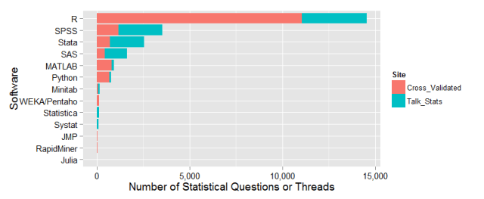
https://r4stats.com/2015/10/19/using-discussion-forum-activity-to-estimate-analytics-software-market-share/

Slide 5
Disadvantages of R
Relatively slow.
Clunky object oriented programming.
Less than ideal memory management.
Bottom line: Not something that one would use for production-level software development.

Slide 6
Should I learn R?
A professional in the field of data analysis should be fluent in R.
If analyzing data is important to your work and you’ll learn only 1 programming language in your life, learn R.
If you already know other programming languages or work in less-statistical areas (machine learning, engineering), R might not be the best first choice.

Slide 7
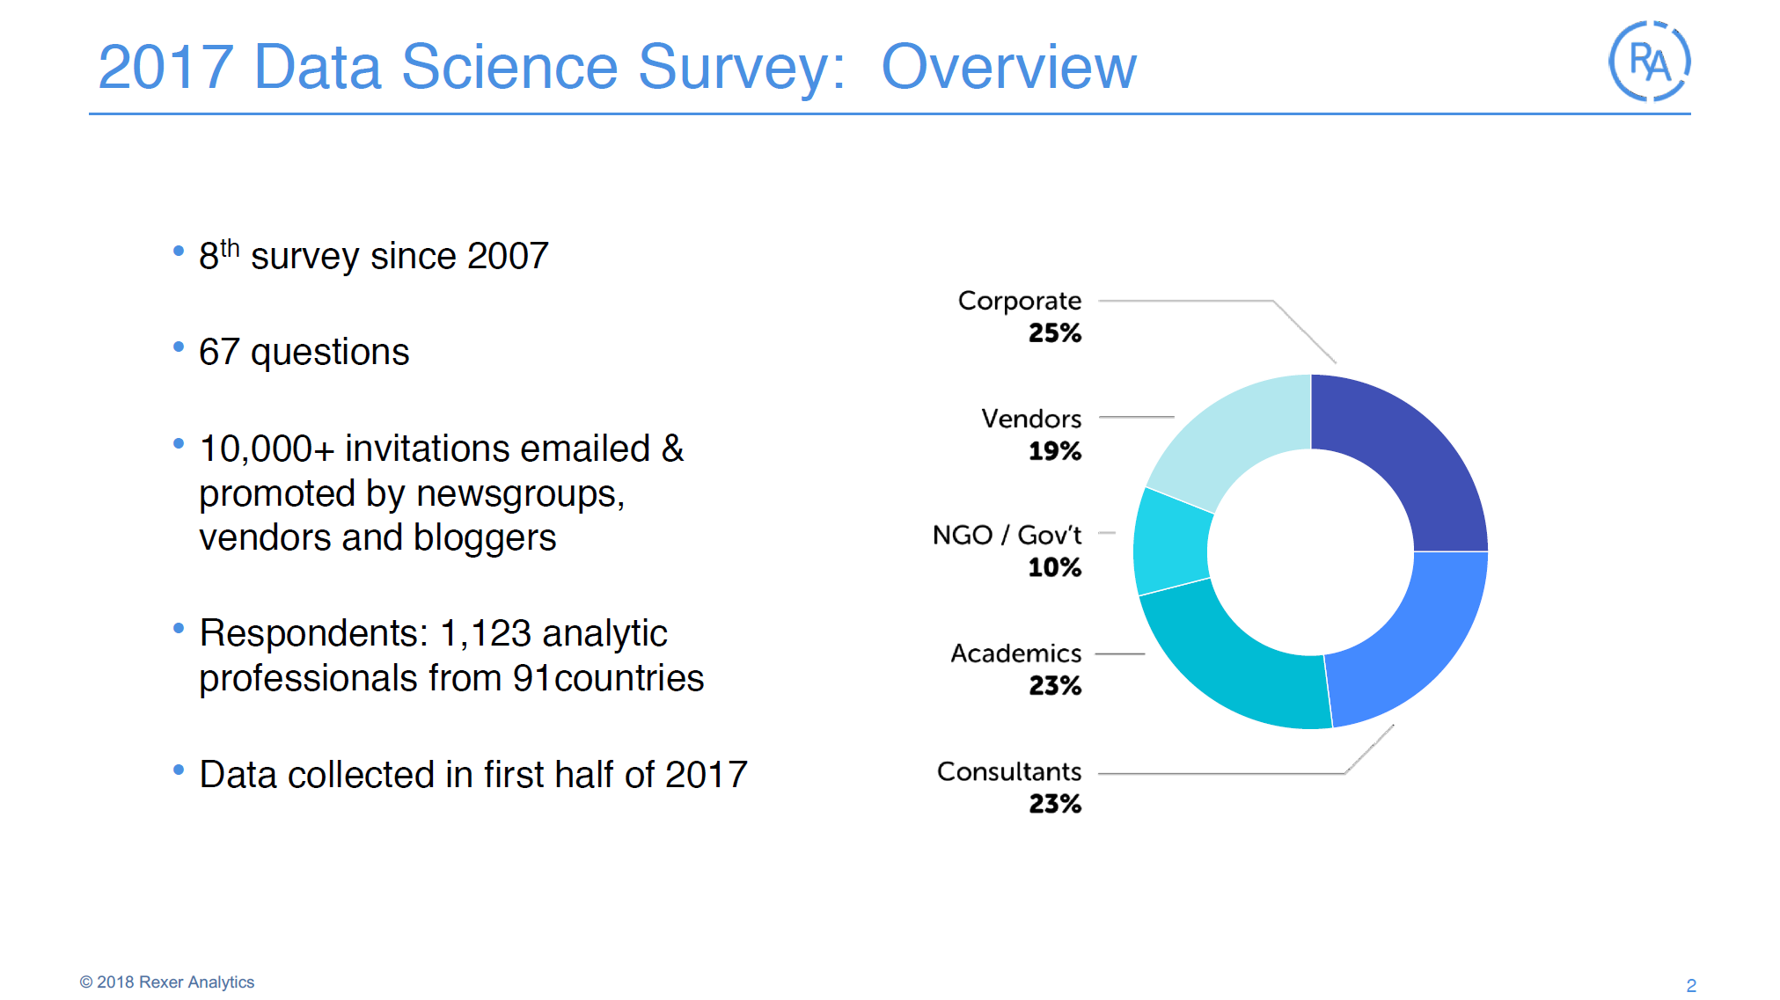

Slide 8
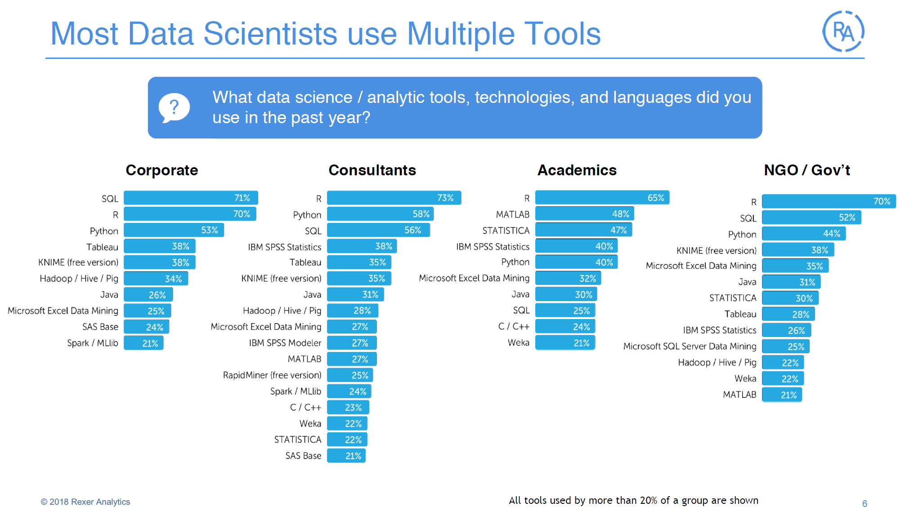

Slide 9
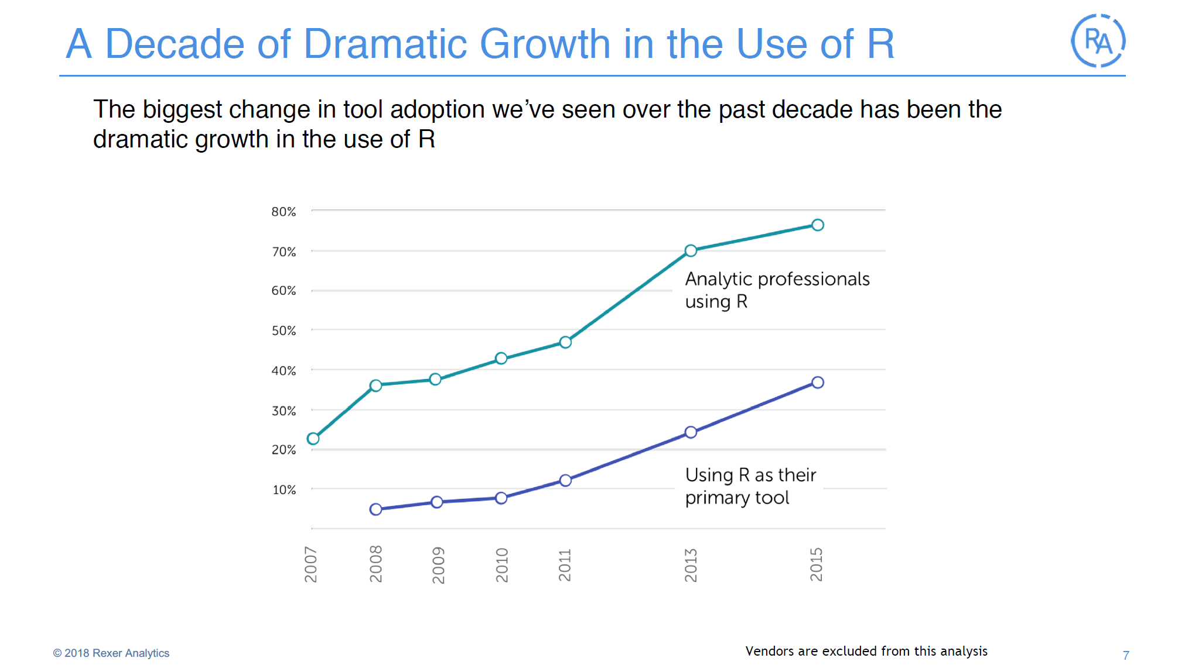

Slide 10
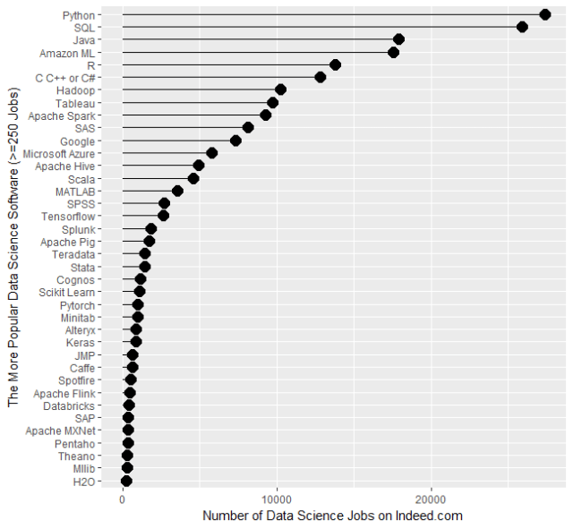
R in the job market
http://r4stats.com/articles/popularity/

