Slide 1
Data visualization
The science and art of communicating information more efficiently and effectively by representing it visually.

Slide 2
The wooden cabin stood alone on the edge of a snow-covered field against the backdrop of a lush pine forest. The rising mist obscured the sun, but could not hide the towering mountains in the background.

Slide 3
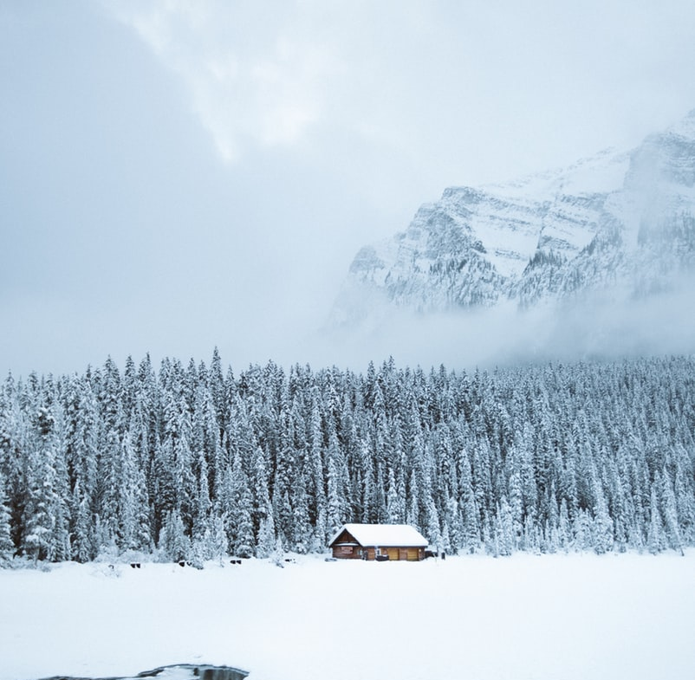
This is what it looked like.

Slide 4
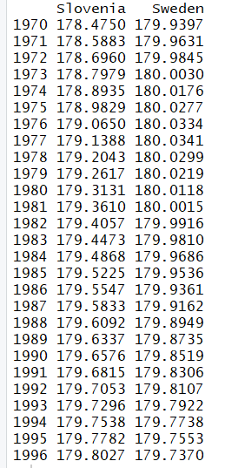
Average height of 18-year old men
How does Slovenia compare with Sweden over time?

Slide 5
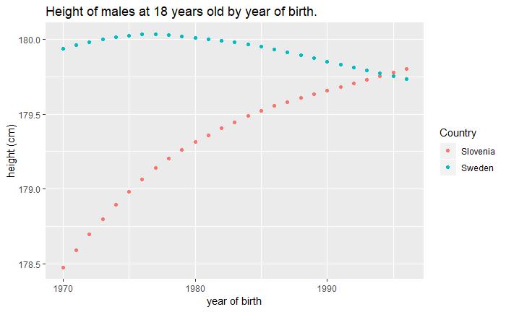
Average height of 18-year old men
How does Slovenia compare with Sweden over time?

Slide 6
Data visualization
General principles (grammar of graphics, common types of plots, best practices)
Tools (R + ggplot2)

Slide 7
Grammar of graphics
= Systematically breaking down statistical graphics into (independent) components that can be used to describe plots in a concise and flexible way:
Data & Mapping to plot aesthetics
Geometric object (point, line, bar…)
Statistical transformation (boxplot, bin, density)
Position adjustment
Scales
Coordinate system
Grouping (faceting)
a layer
Wickham, H. (2010). A layered grammar of graphics. Journal of Computational and Graphical Statistics, 19(1), 3-28.

Slide 8
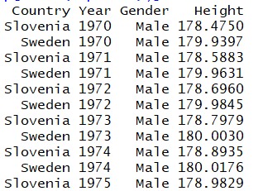
Grammar of graphics
data (data.frame)
aesthetics mapping
Year -> x-axis,
Height -> y-axis,
Country -> colour
(there are others, such as shape, size, fill…)
geometric object (geom)
point

Slide 9
ggplot2
= An implementation of
the grammar of graphics.
An explicit use of the grammar:
ggplot() +
layer(data = tmp, geom = "point", mapping = aes(x = Year, y = Height, colour = Country), stat = "identity", position = "identity") +
ggtitle("Height of males at 18 years old by year of birth.") + ylab("height (cm)") + xlab("year of birth")
ggplot2 implements “shorthand” instructions for common plots:
ggplot(tmp, aes(x = Year, y = Height, colour = Country)) + geom_point() + ggtitle("Height of males at 18 years old by year of birth.") + ylab("height (cm)") + xlab("year of birth")

Slide 10
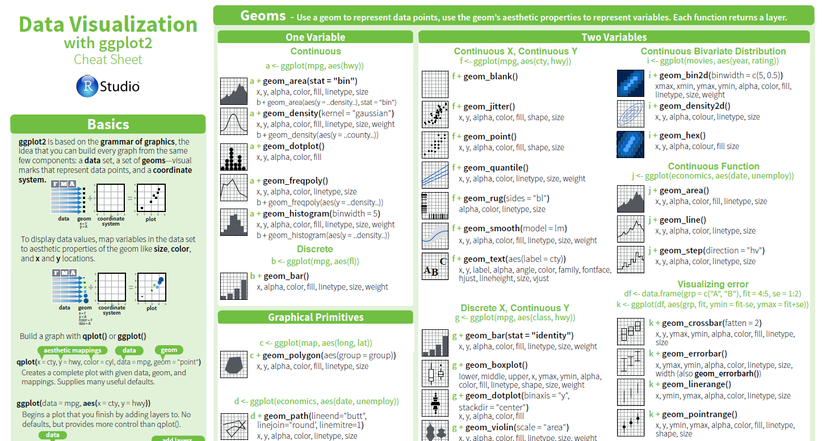
ggplot2 cheat sheet
https://www.rstudio.com/wp-content/uploads/2015/03/ggplot2-cheatsheet.pdf

Slide 11
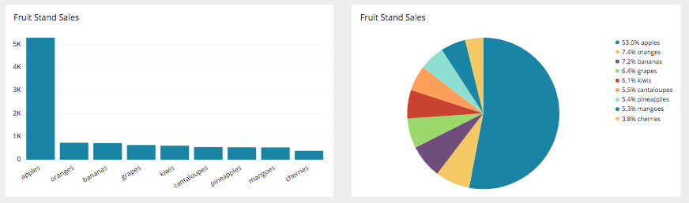
Don’t use pie charts!
People are not good at judging/comparing angles and non-rectangular areas.
A bar chart is always more appropriate.
There is, however, one exception where a pie chart is clearly the best choice…

Slide 12
