Slide 1
Welcome to the PacMan Game!

Slide 2
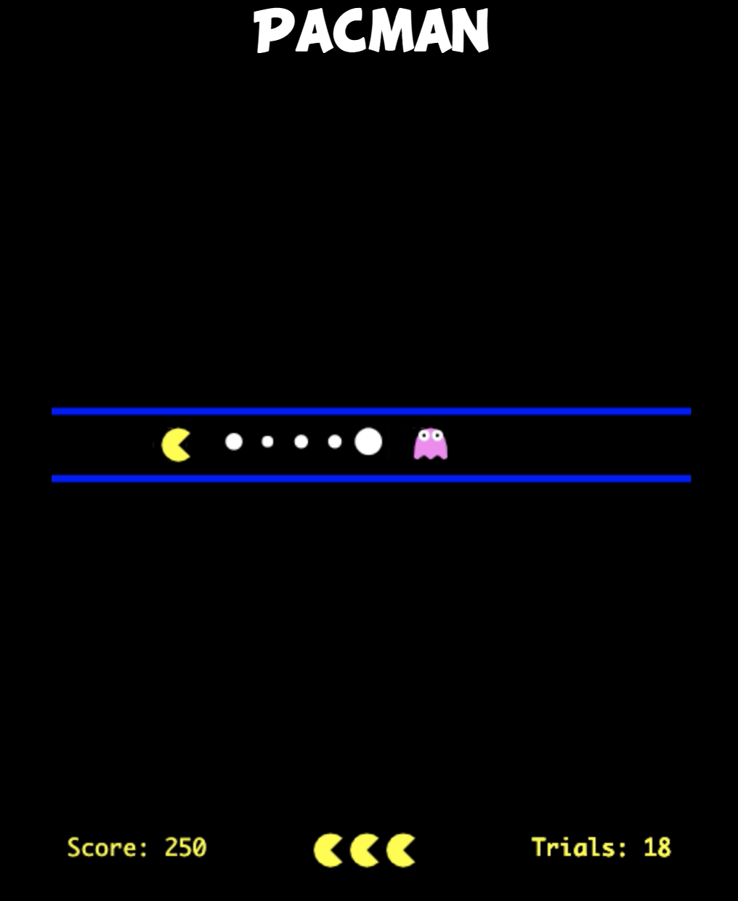
You are going to play a simplified version of the game PacMan. The picture on the right shows how a normal game will begin.
In this game, your job is to collect as many dots as possible while avoiding the ghost!

Slide 3
Controls: Press the left arrow key to move left, and the right arrow key to move to the right.
Additionally, you can press p to pause the game and press p again to resume. There will be an option to pause every 20 trials. Please try to only pause the game during the given breaks.

Slide 4
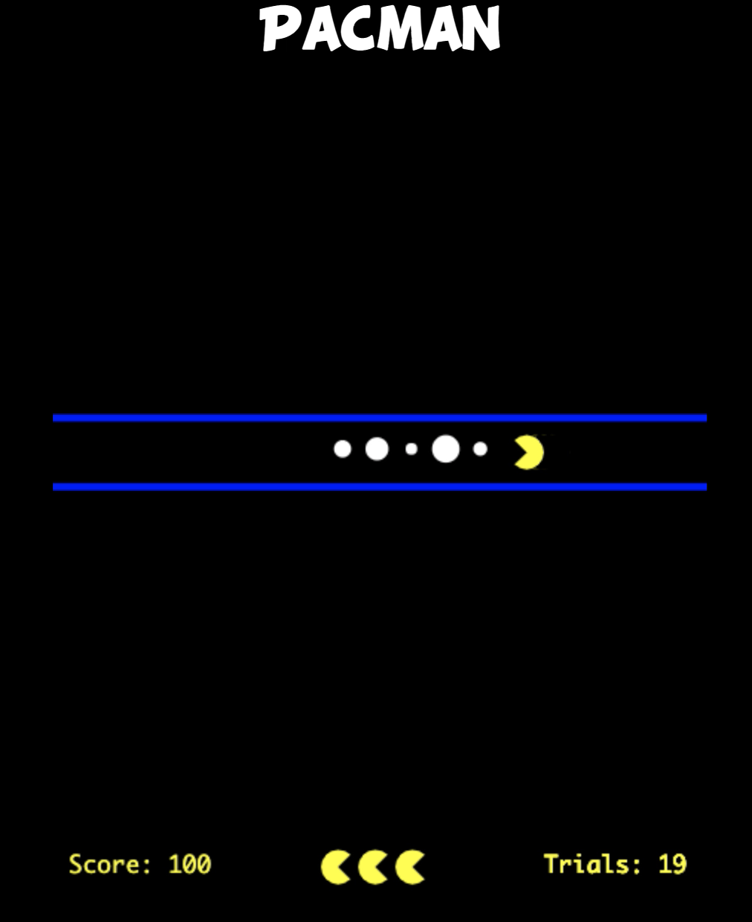

Your score is the sum of all the dots you collect. Large dots are worth 20 points and smaller dots are worth 10 points.
You can see your total score across trials by looking at the bottom left of your screen.

Slide 5
You must avoid the ghost, or you will lose one of your three lives as well as all the points you earned on that trial.
When you lose all three lives, you lose the game, and your score is reset to 0. You can see your remaining lives by looking at the number of pacmans at the bottom center of your screen.

Slide 6
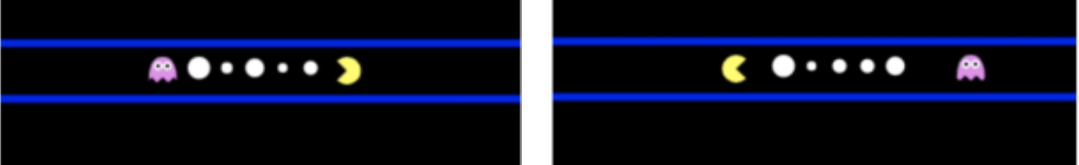

You can exit the trial by exiting the corridor, and you can exit the trial at any point. You do not need to collect all the dots before you exit the trial.
You always exit the corridor by turning away from the dots.
In this case, the exit is on the right Here, the exit is on the left

Slide 7
Finally, occasionally you will see some trials where the ghost is missing. When the ghost is missing, you may collect all the dots without any risk.
You must still exit the trial by going in the opposite direction as the dots.

Slide 8
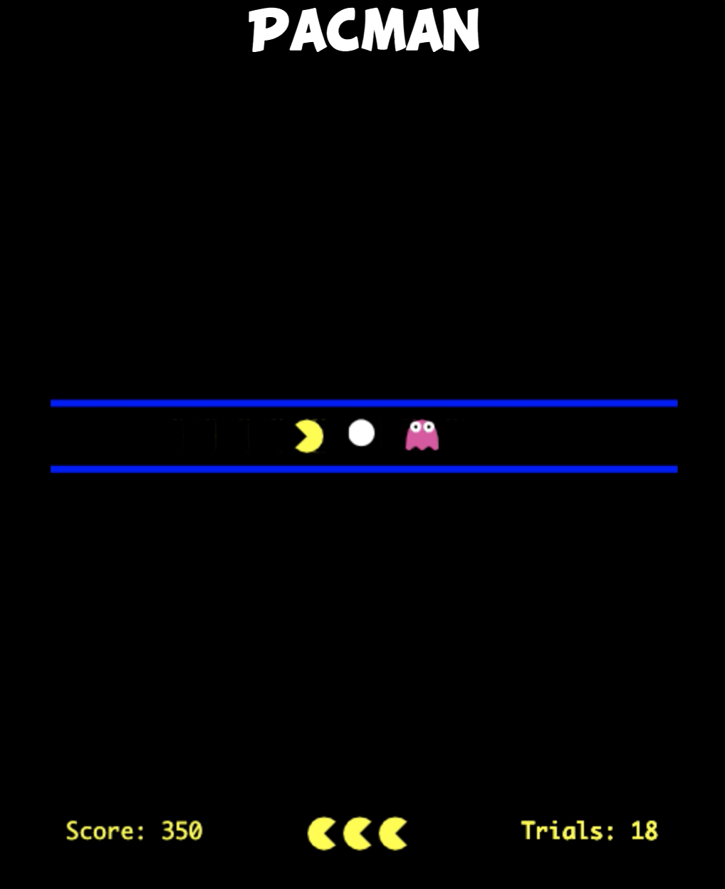
Importantly, as you move the Pac-Man to collect dots, you will have to move closer to the ghost. The closer you move to the ghost the higher the chance that the ghost will start to chase you.
The ghost's speed during the chase is random-- sometimes, if you move away quickly you will be able to escape, but sometimes, if you are too close, the ghost will be too fast for you to avoid.

Slide 9
Tip: Leaving dots can increase the chance that you will not lose all your lives, resulting in a higher score, but leaving too many dots too frequently, will also result in a lower score. To achieve the highest possible score, you need to balance the risks of being caught by the ghost and the rewards of getting as many dots as possible.

Slide 10
Any questions? If not, we will start with a short practice

Slide 11
Please click here to begin: begin_practice After you finish, move to the next slide

Slide 12
Please click here to begin the real game: begin_game After you finish, please return to these slides!

Slide 13
Great Job! Click here to fill out a quick survey: survey

