Slide 1
FaaSLoad: workload injector and monitor for Function-as-a-Service
Workload injector
Mathieu Bacou
mathieu.bacou@telecom-sudparis.eu
Télécom SudParis, IP Paris
Synthetic trace builder
Dataset generator
Monitor

Slide 2
Cloud computing nowadays
Cloud computing: renting remote resources
  Ease of management, mutualization...
Resources are virtual
  Virtual machines, containers, or even just “services”
Question: what application architecture for the cloud?

Slide 3
Serverless cloud computing
Automatic life-cycle management
  Automatic provisioning of 10s of replicas of application’s components
Managed runtime
  Deploy code, not environments*
    *Not contractual
Managed architectural components
  Long-running services
  Automatic backend scalability
Function-
as-a-Service
Backend-
Serverless

Slide 4
Gathering data about FaaS
New cloud paradigm: new needs
  Tools for observation
    Dozens of different functions
    Dozens of invocations per second
  Data for experiments
    Processing of real workload traces
    Synthesis of workload traces
    Injection of workloads
    Building datasets
Parallelism
Concurrency
Compatibility
Flexibility

Slide 5
FaaSLoad: load injector & monitor
Monitor
  Independent monitoring of functions’ resource usage
Trace builder
  Specification and generation
Workload injector
  Configuration
  Execution
FaaS platform
Invoke function
Result
Resources
FaaSLoad
Request invocation resources
injector
monitor
Data of invocation resources
Data
Read injection traces
DB
traces
Trace builder
FaaSLoad architecture

Slide 6
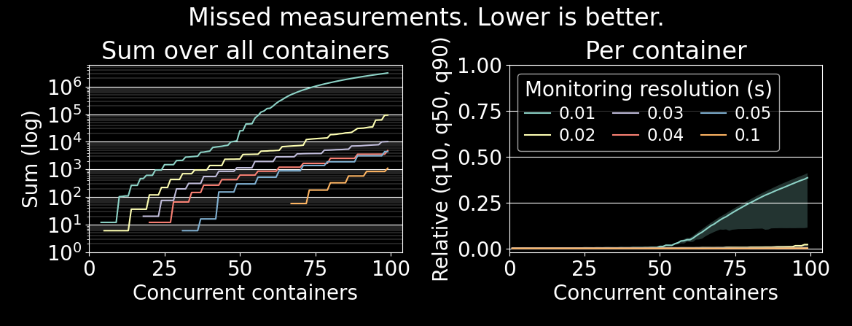
Scalability of monitoring
Major flaw: concurrency in Python
Major drag: opening a cgroup file to read memory usage

Slide 7
Conclusion and perspectives
FaaSLoad: injection and monitoring tool for the FaaS age
  Injection of workload traces
  Monitoring of FaaS platform and dataset production
  Open, flexible, compatible, scalable
Next :
  Industrial trace replayability (WIP)
  Data valorization (WIP)

Slide 8

See you at the poster!
Code available on GitLab: https://gitlab.com/faasload/faasload
Contributions and criticism welcome!
Usage of FaaSLoad in our research:
  OFC: an opportunistic caching system for FaaS platforms.
  Mvondo, Djob and Bacou, Mathieu and Nguetchouang, Kevin and Pouget, Stéphane and Kouam, Josiane and Lachaize, Renaud and Hwang, Jinho
  and Wood, Tim and Hagimont, Daniel and de Palma, Noël and Batchakui, Bernabé and Tchana, Alain. In EuroSys 2021.

