Slide 1
Comparing SINGLE & Double Deep-Q Networks for AI Learning to Play GALAGA
By Braeden Stewart
CS 5640

Slide 2
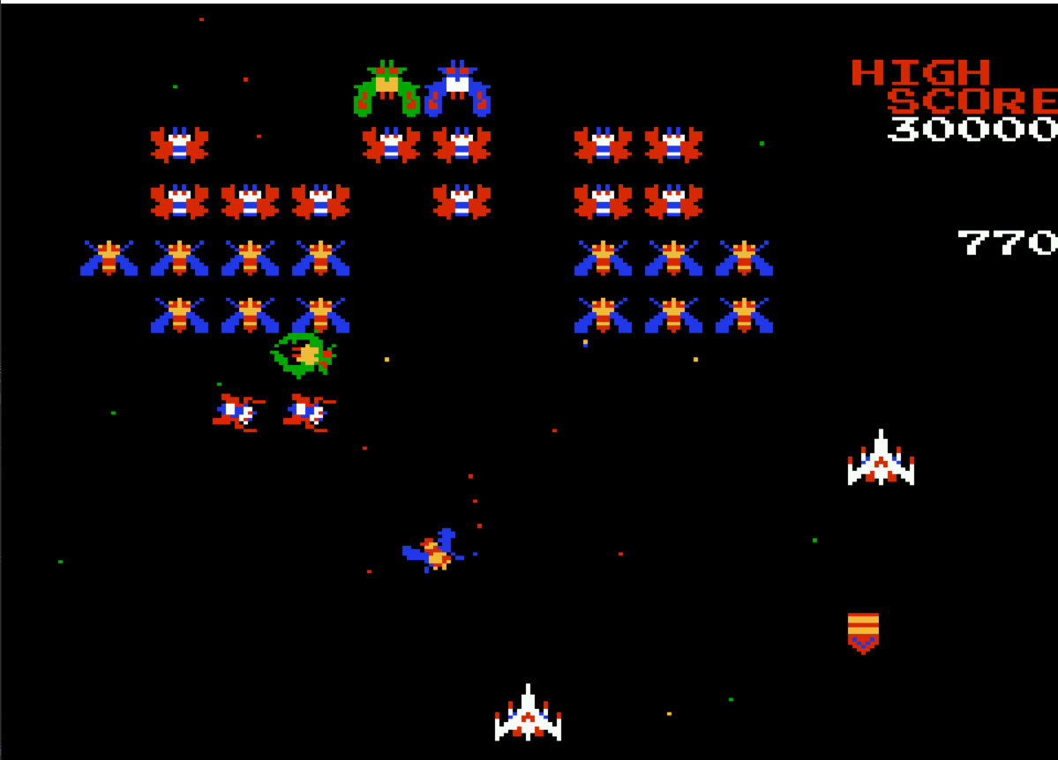
Brief Refresher:
I am comparing a Double DQN vs a normal/singular DQN for an agent learning to play Galaga.
Progress:
The original code provided at Source One is now running but has not been fully migrated to TensorFlow 2.x. I figured out that the original implementation was not actually a Double DQN. I have also built my own DQN implementation based off Source 2. I have preliminary results for both(next slide).
Picture of the video game Galaga (Source One)

Slide 3
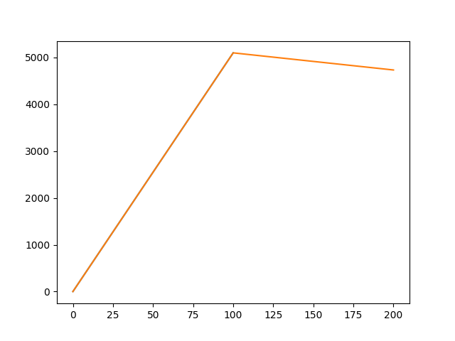
Last 100 Average Score Over number of Episodes
Next Steps:
Implement actual Double DQN using Source 3 as a starting point
Optimize Network to be more accurate and faster
Get Networks to run using the Research Computing Support at CHPC
Experiment with different hyper-parameters, Rewards, Loss functions.
Find another neural network to build and experiment with if time allows
Current Network
Episodes
Original Network

Slide 4
Works Cited:
Source 1: Galaga_AI by georgefidler1709. https://github.com/georgefidler1709/Galaga_AI
Source 2: DQN_Pong by Meredevs. https://github.com/Meredevs/DQN_Pong
Source 3: Double DQN Implementation to Solve OpenAI Gym’s CartPole v-0 by Leo Simmons. https://medium.com/@leosimmons/double-dqn-implementation-to-solve-openai-gyms-cartpole-v-0-df554cd0614d

