Slide 1
Comparing SINGLE & Double Deep-Q Networks for AI Learning to Play GALAGA
By Braeden Stewart
CS 5640

Slide 2
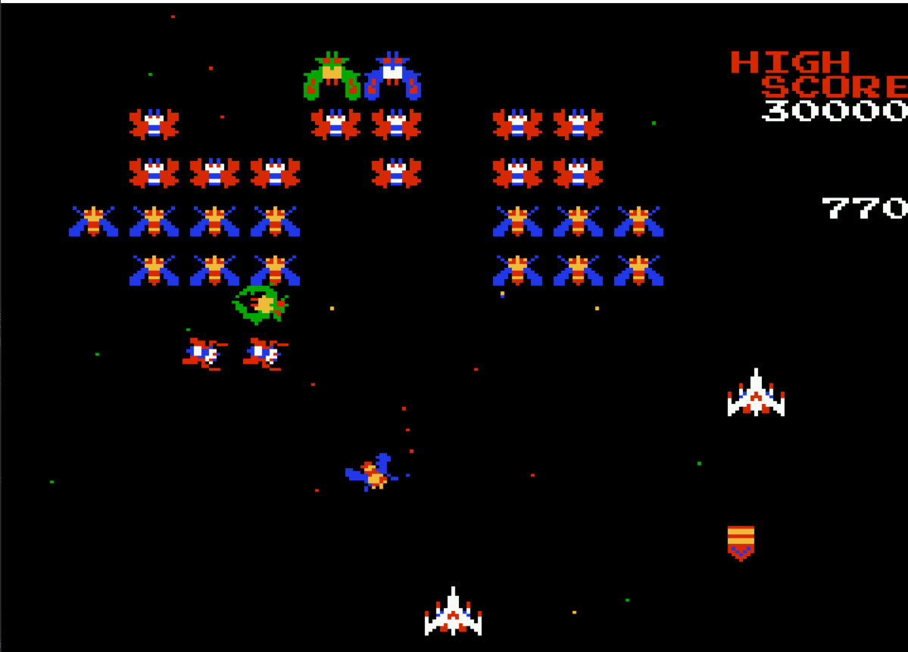
Brief Refresher:
I am comparing a Double DQN vs a singular DQN for an agent learning to play Galaga.
Progress:
I have decreased the exploration rate decay for both agents and I have preliminary results for both after running them using CHPC computing resources (see next slide).
I also have finished a rough draft of my final report.
Picture of the video game Galaga

Slide 3
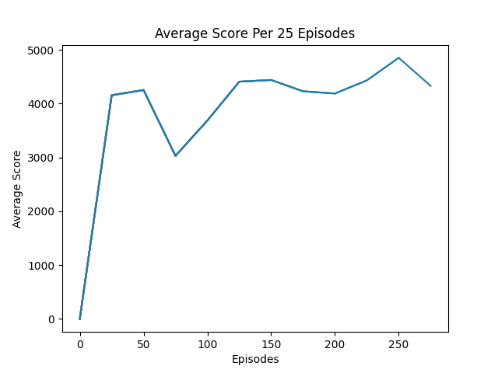
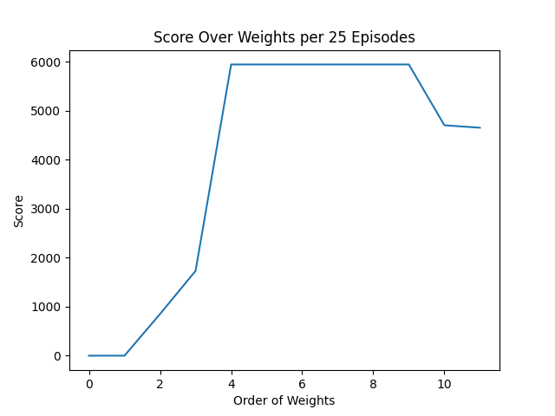
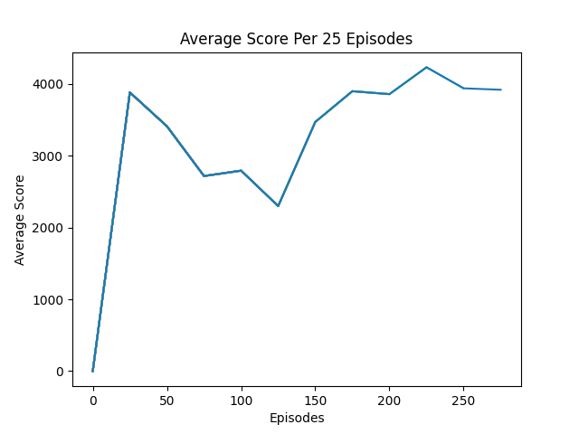
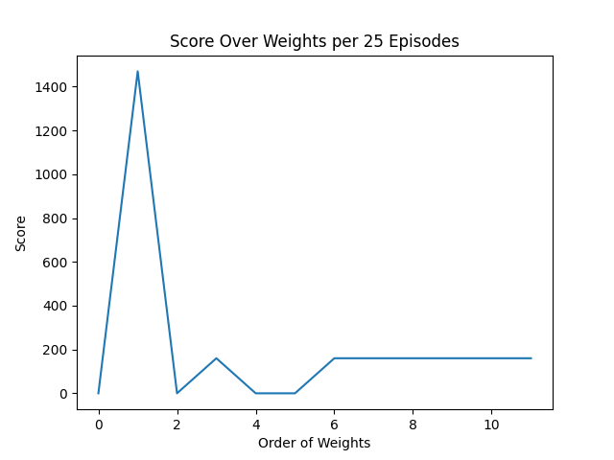
DQN Network
Next Steps:
Train both agents with a new idle steps limitation instead of the hard total steps per episode limitation using CHPC resources.
Write the report
DDQN Network

