Slide 1
Comparing SINGLE & Double Deep-Q Networks for AI Learning to Play GALAGA
By Braeden Stewart
CS 5640

Slide 2
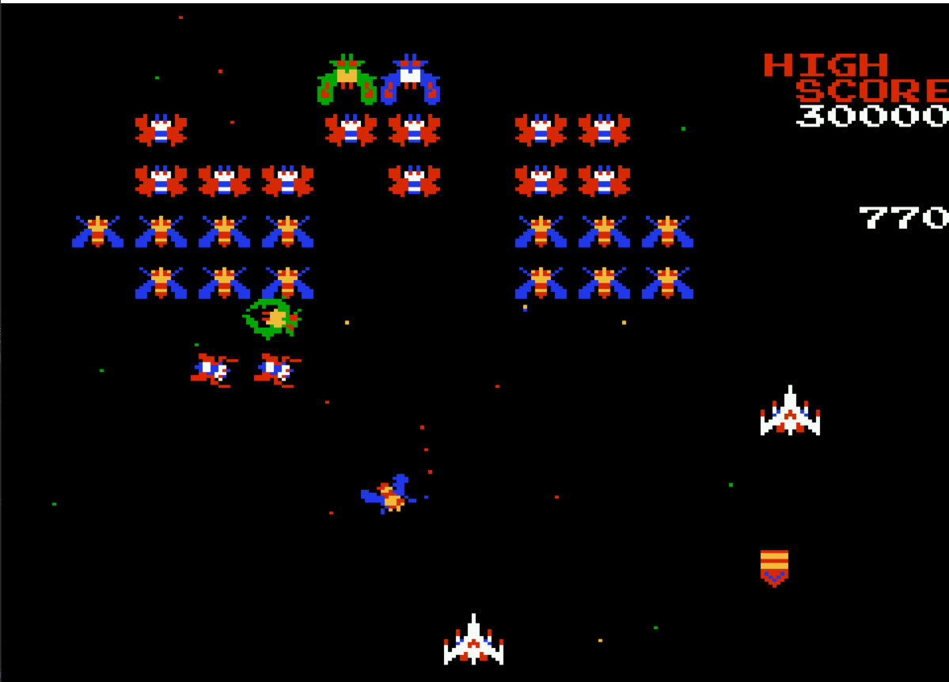
Brief Refresher:
I am comparing a Double DQN vs a normal/singular DQN for an agent learning to play Galaga.
Progress:
I have implemented my own Deep-Q and Double Deep-Q networks based off Source 2 and 3 with a little bit of reference to Source 1. I have preliminary results for both after running them using CHPC computing resources (see next slide).
Picture of the video game Galaga

Slide 3
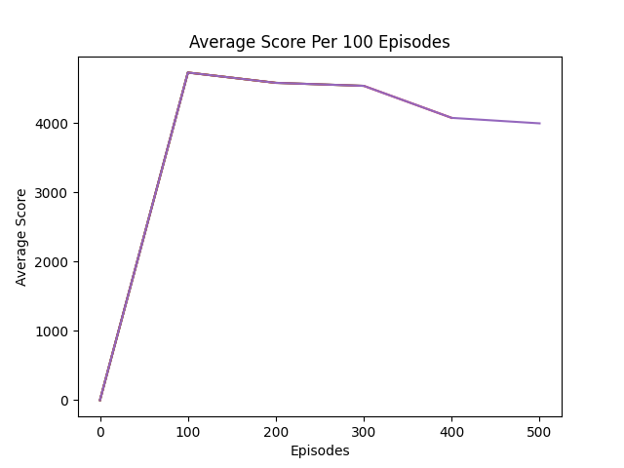
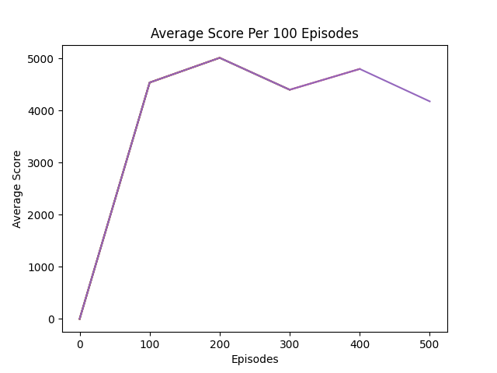
Next Steps:
Optimize Networks to be faster
Figure out and fix what is keeping the networks from learning the correct behavior.
Write the report
DQN Network
DDQN Network

Slide 4
Works Cited:
Source 1: Galaga_AI by georgefidler1709. https://github.com/georgefidler1709/Galaga_AI
Source 2: DQN_Pong by Meredevs. https://github.com/Meredevs/DQN_Pong
Source 3: Double DQN Implementation to Solve OpenAI Gym’s CartPole v-0 by Leo Simmons. https://medium.com/@leosimmons/double-dqn-implementation-to-solve-openai-gyms-cartpole-v-0-df554cd0614d

