Slide 1
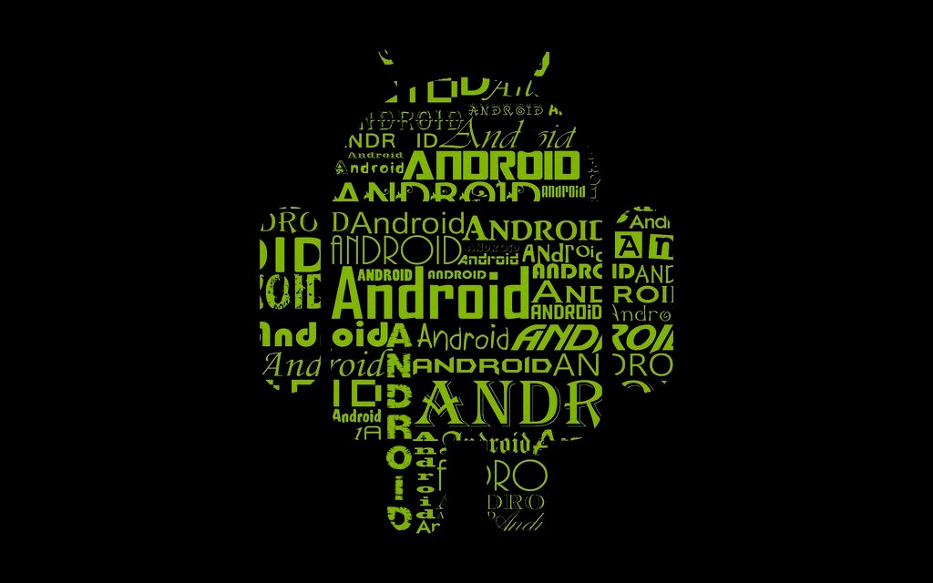
Google ART
runtime
ANDRoid
Presentation By-
Niraj N. Solanke

Slide 2
Contents
Introduction to Android
Layers of Android Operating System
Current runtime of Android(Dalvik)
Working
Advantages/Disadvantages
ART(Android Runtime)
Working
Advantages/Disadvantages
Benchmarks
Conclusion
References

Slide 3
Introduction
Android is an open-source platform developed by Google on 5th Nov. 2007 that's currently available on a wide variety of smart phones. Android is a software stack for mobile devices that includes an operating system, middleware and key applications.
Android is an open source operating system so almost anyone can modify and tweak various components of it thus it makes Android the most favored mobile operating system.
Android OS is developed on Linux platform which is wholly dedicated to open source and so does Android.

Slide 4
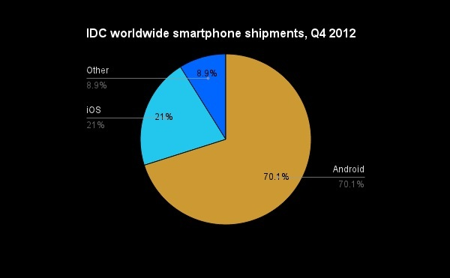
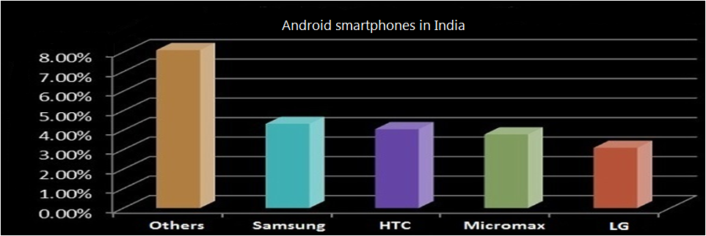

Slide 5
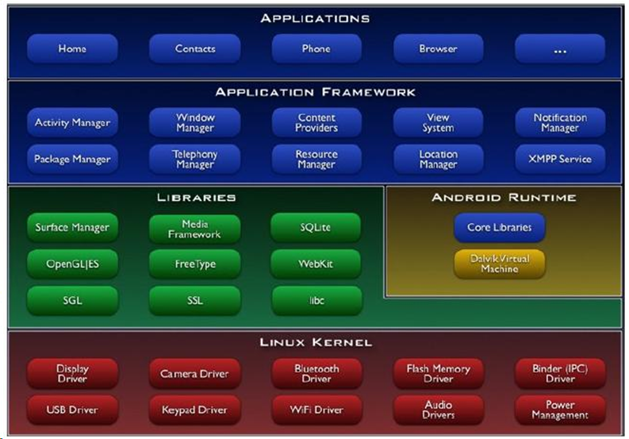
Layers of Android Operating System

Slide 6
Dalvik runtime (current VM)
In standard Java environments, Java source code is compiled into Java bytecode, which is stored within .class files, the .class files are read by the JVM at runtime.
Each class in your Java code will result in one .class file, this means that if you have, say, one .java source file that contains one public class, one static inner class, and three anonymous classes, the compilation process (javac) will output 5 .class files.
On the Android platform, Java source code is still compiled into .class files. But after .class files are generated, the “dx” tool is used to convert the .class files into a .dex, or Dalvik Executable, file.
Whereas a .class file contains only one class, a .dex file contains multiple classes. It is the .dex file that is executed on the Dalvik VM.

Slide 7
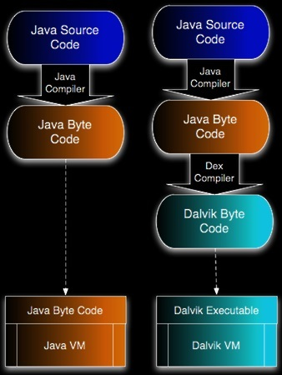
Working of Dalvik VM
Android uses Dalvik and a Just-In-Time (JIT) compiler. This means that Android apps are written in a generic version of code, called bytecode, that is only half-compiled by developers. Whenever the apps are launched, Dalvik compiles the code “just in time” to run.
Fig:- Compiling steps in Dalvik

Slide 8
Disadvantages of Dalvik
As we have seen the working of the Dalvik VM’s working as, “the Android apps are written in a generic version of code, called bytecode, that is only half-compiled by developers. Whenever the apps are launched, Dalvik compiles the code “just in time” to run.”
This means that whenever a new process (application) starts it is compiled and loaded in the RAM to run the application, when the application is removed from the RAM all the compilation work of that bytecode needs to be done again and again thus it is time consuming and significantly affects the battery for all the unnecessary repeated processing power.

Slide 9
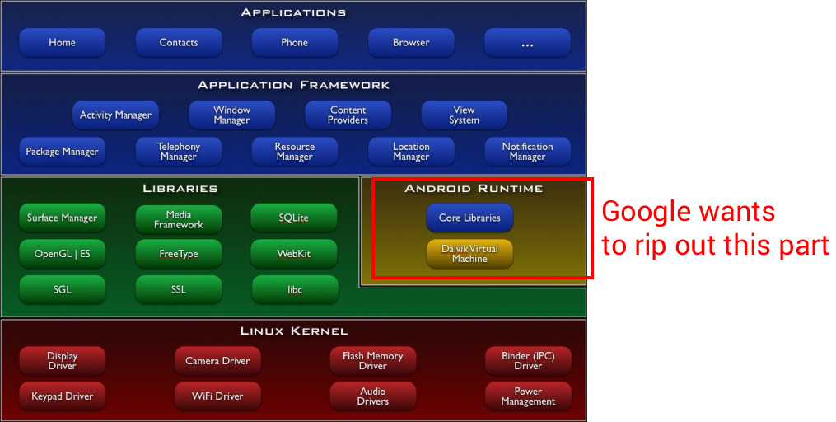

Slide 10

ANDRoid
ART
Right after Android 4.4 was announced, Google
had partially implemented a new runtime compiler
in the software called ART that could potentially
replace Dalvik in the near future.
Android RunTime, that compiles the bytecode when applications are installed as opposed to compiling them just before being launched. This is called Ahead-Of-Time (AOT) compiling and is much, much more efficient on performance and battery life.
Dalvik was originally designed not for speed, smoothness, or power, but to save space. Android devices at the time had very limited storage and memory, and Google's primary concern at the time was fitting everything into a small footprint.

Slide 11

Today, Android runs on much different hardware with tons of power and storage, and Android could see a big performance and battery improvement with a more modern runtime. That new runtime is called "Android RunTime," and it's a newer, speedier replacement for Dalvik.
The Dalvik cache contains compiled bytecode, which still needs to run in the dalvik virtual machine. This is faster than running Java without JIT, but still much slower than native code.
ART compiles Java to native machine language, eliminating the need to spin up a vm for each new app and to interpret byte code.

Slide 12
It’s not without downsides, though. ART
compiled code would take up slightly more room
on a device compared to apps that were only
compiled in use.
But for most devices, the tradeoff is well worth it, installing apps will also likely take longer using ART. Since they’re compiled on installation, on bigger apps that could definitely draw out the process a bit, but for most people I feel like the performance gains would be worth it.
The new runtime is already capable of cutting execution time in half for most applications. This means that long-running, processor-intensive tasks will be able to finish faster, allowing the system to idle more often and for longer. Regular applications will also benefit from smoother animations and more instantaneous responses to touch and other sensor data

Slide 13
Drawbacks of ART
ART will compile bytecode to native code ahead of time. Native code will take up more space than bytecode. Every app will use about 10-20% extra space compared to dalvik version. It won't be multiple GB's though.
The other likely notable drawback will come in the form of a longer install time for apps - the side effect of performing the AOT compilation.
Thus it seems that it has some drawbacks on ART but it is recently being developed and not been fully optimized to operate and it is not selected by default on latest KitKat (4.4) version on android.

Slide 14
Dalvik VS ART
Dalvik has been the default runtime environment of Android since its first public release. It has also been the primary bottleneck of the OS because it uses JIT (just-in-time) compilation, requiring apps to be compiled on the go before running them, which can be quite taxing on performance as well as battery life.
ART (Android RunTime) is a replacement for Dalvik that uses AOT (ahead of time) compilation, meaning your apps are compiled to a ready-to-run state before you even launch them, making the process of launching and using them much faster and smoother. And since this would reduce their compilation frequency significantly, you can expect to start seeing better battery life.

Slide 15
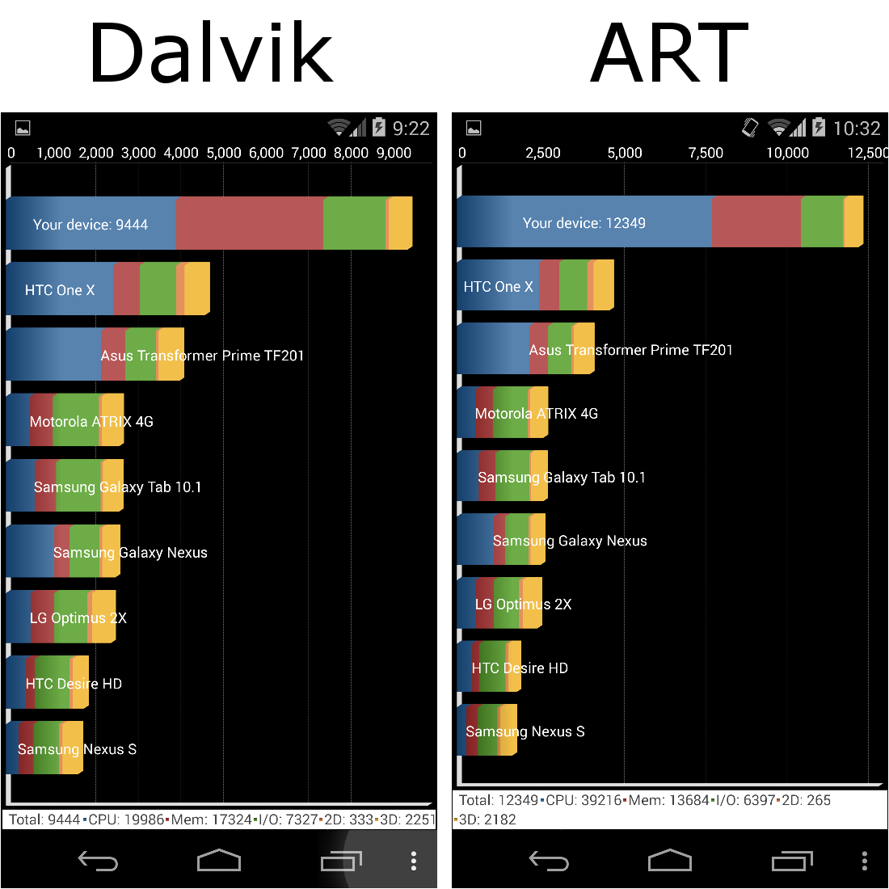
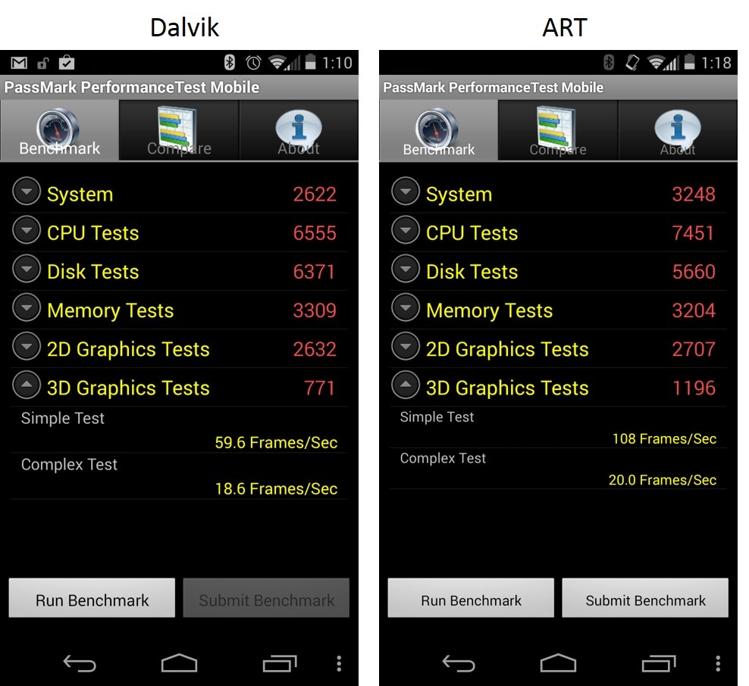
Benchmarks
Performance benchmark

Slide 16
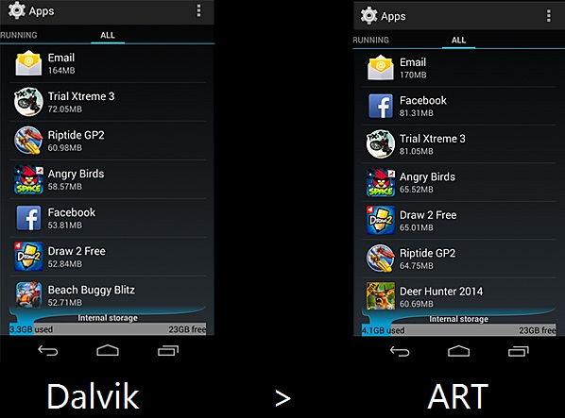
Memory before and after changing

Slide 17
Conclusion
Overall, ART sounds like a pretty amazing project, one that I hope to see as a regular part of Android sooner rather than later. The improvements are likely to be pretty amazing while the drawbacks should be virtually undetectable. It doesn’t mean ART will become the default in official releases from Google for some time as it needs further development.

Slide 18
References
Official link
http://source.android.com/devices/tech/dalvik/art.html
Reddit links
http://www.reddit.com/r/Android/comments/1qb97o/heres_a_simpler_explanation_of_art_for_android_44/
http://www.reddit.com/r/Android/comments/1q9h50/
Other links
http://www.androidpolice.com/2013/11/06/meet-art-part-1-the-new-super-fast-android-runtime-google-has-been-working-on-in-secret-for-over-2-years-debuts-in-kitkat/
http://www.talkandroid.com/182965-art-the-new-android-compiler-added-in-kitkat-gets-detailed-and-explained/

Slide 19

Questions ??

