Slide 1
Automatically Generated PPTx Demo
This ppt was generated automatically using raw text from USCG Broadcast NTM from
2021-10-01 12:54:21 to 2021-10-18 14:06:05
Code Repository: https://github.com/bstrain71/octntm

Slide 2
USCG D5 Messages Summary
Type | Number Sent
HAZ OPS | 10
Cancellation | 11
ATON | 15
GENERAL | 2
REGULATORY | 1

Slide 3
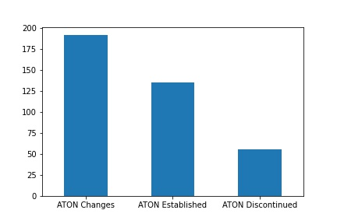
Graph of USCG D5 Messages Summary

Slide 4
Aids to Navigation Changes Summary
Type | Number of Changes
ATON Changes | 192
ATON Discontinued | 56
ATON Established | 135

