Slide 1
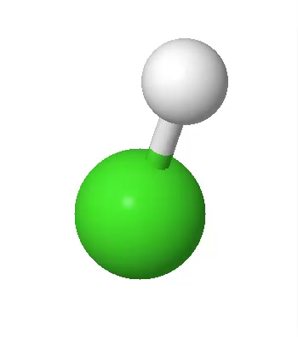
Lab 2
IR Spectroscopy of HCl Gas
From rovibrational lines → molecular constants
Measure
Fit
Compute
Line positions (P/R branches)
Band origin ν̃₀
Quadratic model in m
Extract ν̃₀, B̃₀, B̃₁
Bond lengths r₀, r₁
Anharmonicity xₑ and D₀
Today: analysis of a provided FTIR spectrum (HCl is corrosive — no handling in this session)
Notes:
[Sources]
- Rovibrational spectroscopy overview and branch naming (P/R): https://chem.libretexts.org/Bookshelves/Physical_and_Theoretical_Chemistry_Textbook_Maps/Supplemental_Modules_%28Physical_and_Theoretical_Chemistry%29/Spectroscopy/Rotational_Spectroscopy/Rovibrational_Spectroscopy
[/Sources]

Slide 2
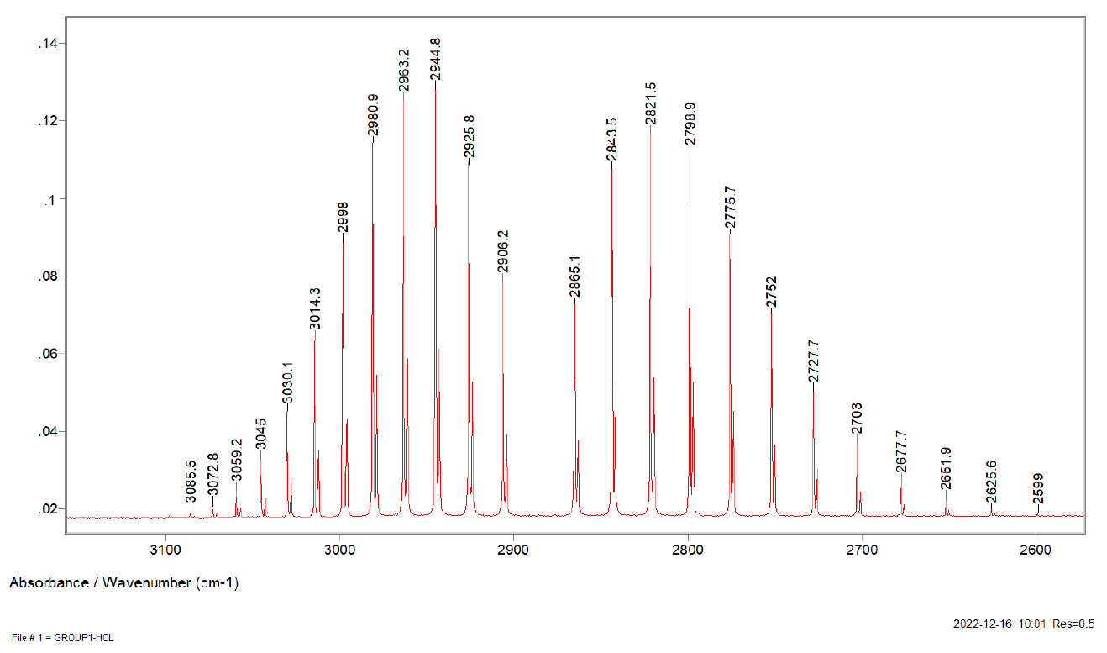
Big picture: what IR rovibrational spectroscopy measures
Different parts of the EM spectrum probe different molecular motions:
UV/Vis
electronic
IR
vibrational
Microwave
rotational
In this lab
What you will see (absorption spectrum)
IR absorption excites vibration, and rotation comes along for the ride → a rovibrational band.
IR-active requirement:
A permanent (or vibration-induced) dipole moment
HCl is IR active. Why?
Output: molecular constants from line positions
Notes:
[Sources]
- IR activity and rovibrational transitions overview: https://en.wikipedia.org/wiki/Rotational%E2%80%93vibrational_spectroscopy
[/Sources]

Slide 3

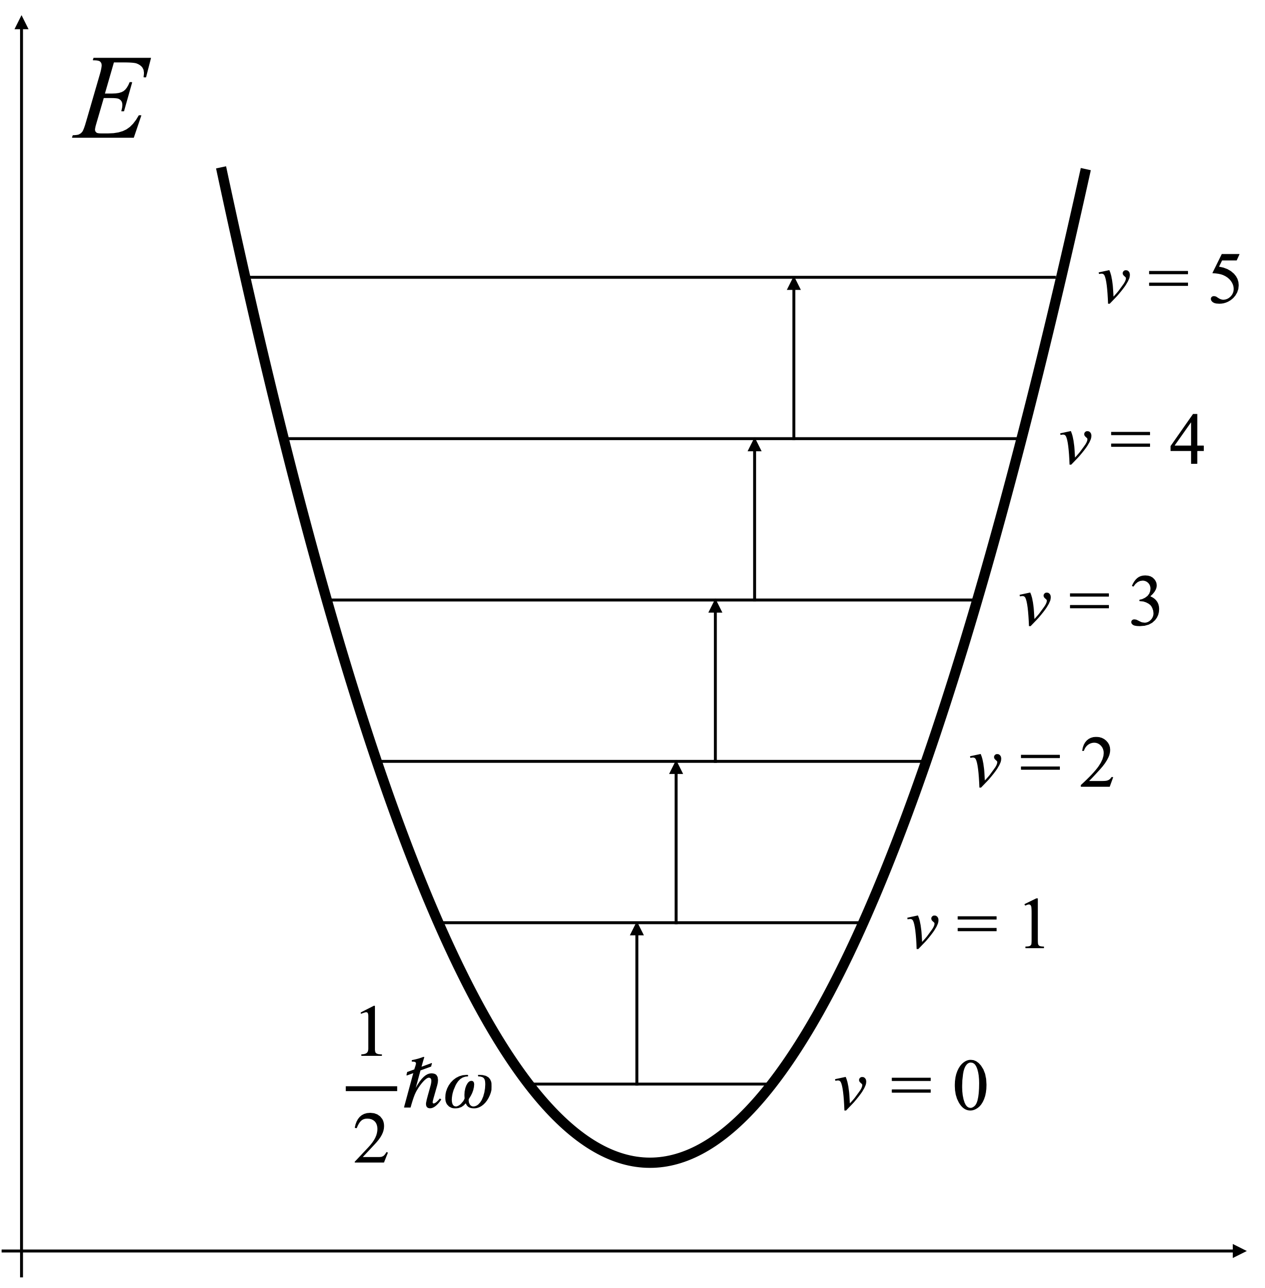
Model 2: harmonic oscillator (vibration)
Key idea: IR excites vibration. In the harmonic model, level spacing is constant.
In a diatomic rovibrational band:
• The band is centered near the vibrational wavenumber
• The fundamental band is Δv = +1
• Spacing is nearly constant if harmonic
• Rotational structure splits it into many lines
Notes:
[Sources]
- Rovibrational spectroscopy background (selection rules and energy spacing discussion): https://chem.libretexts.org/Bookshelves/Physical_and_Theoretical_Chemistry_Textbook_Maps/Supplemental_Modules_%28Physical_and_Theoretical_Chemistry%29/Spectroscopy/Rotational_Spectroscopy/Rovibrational_Spectroscopy
[/Sources]

Slide 4
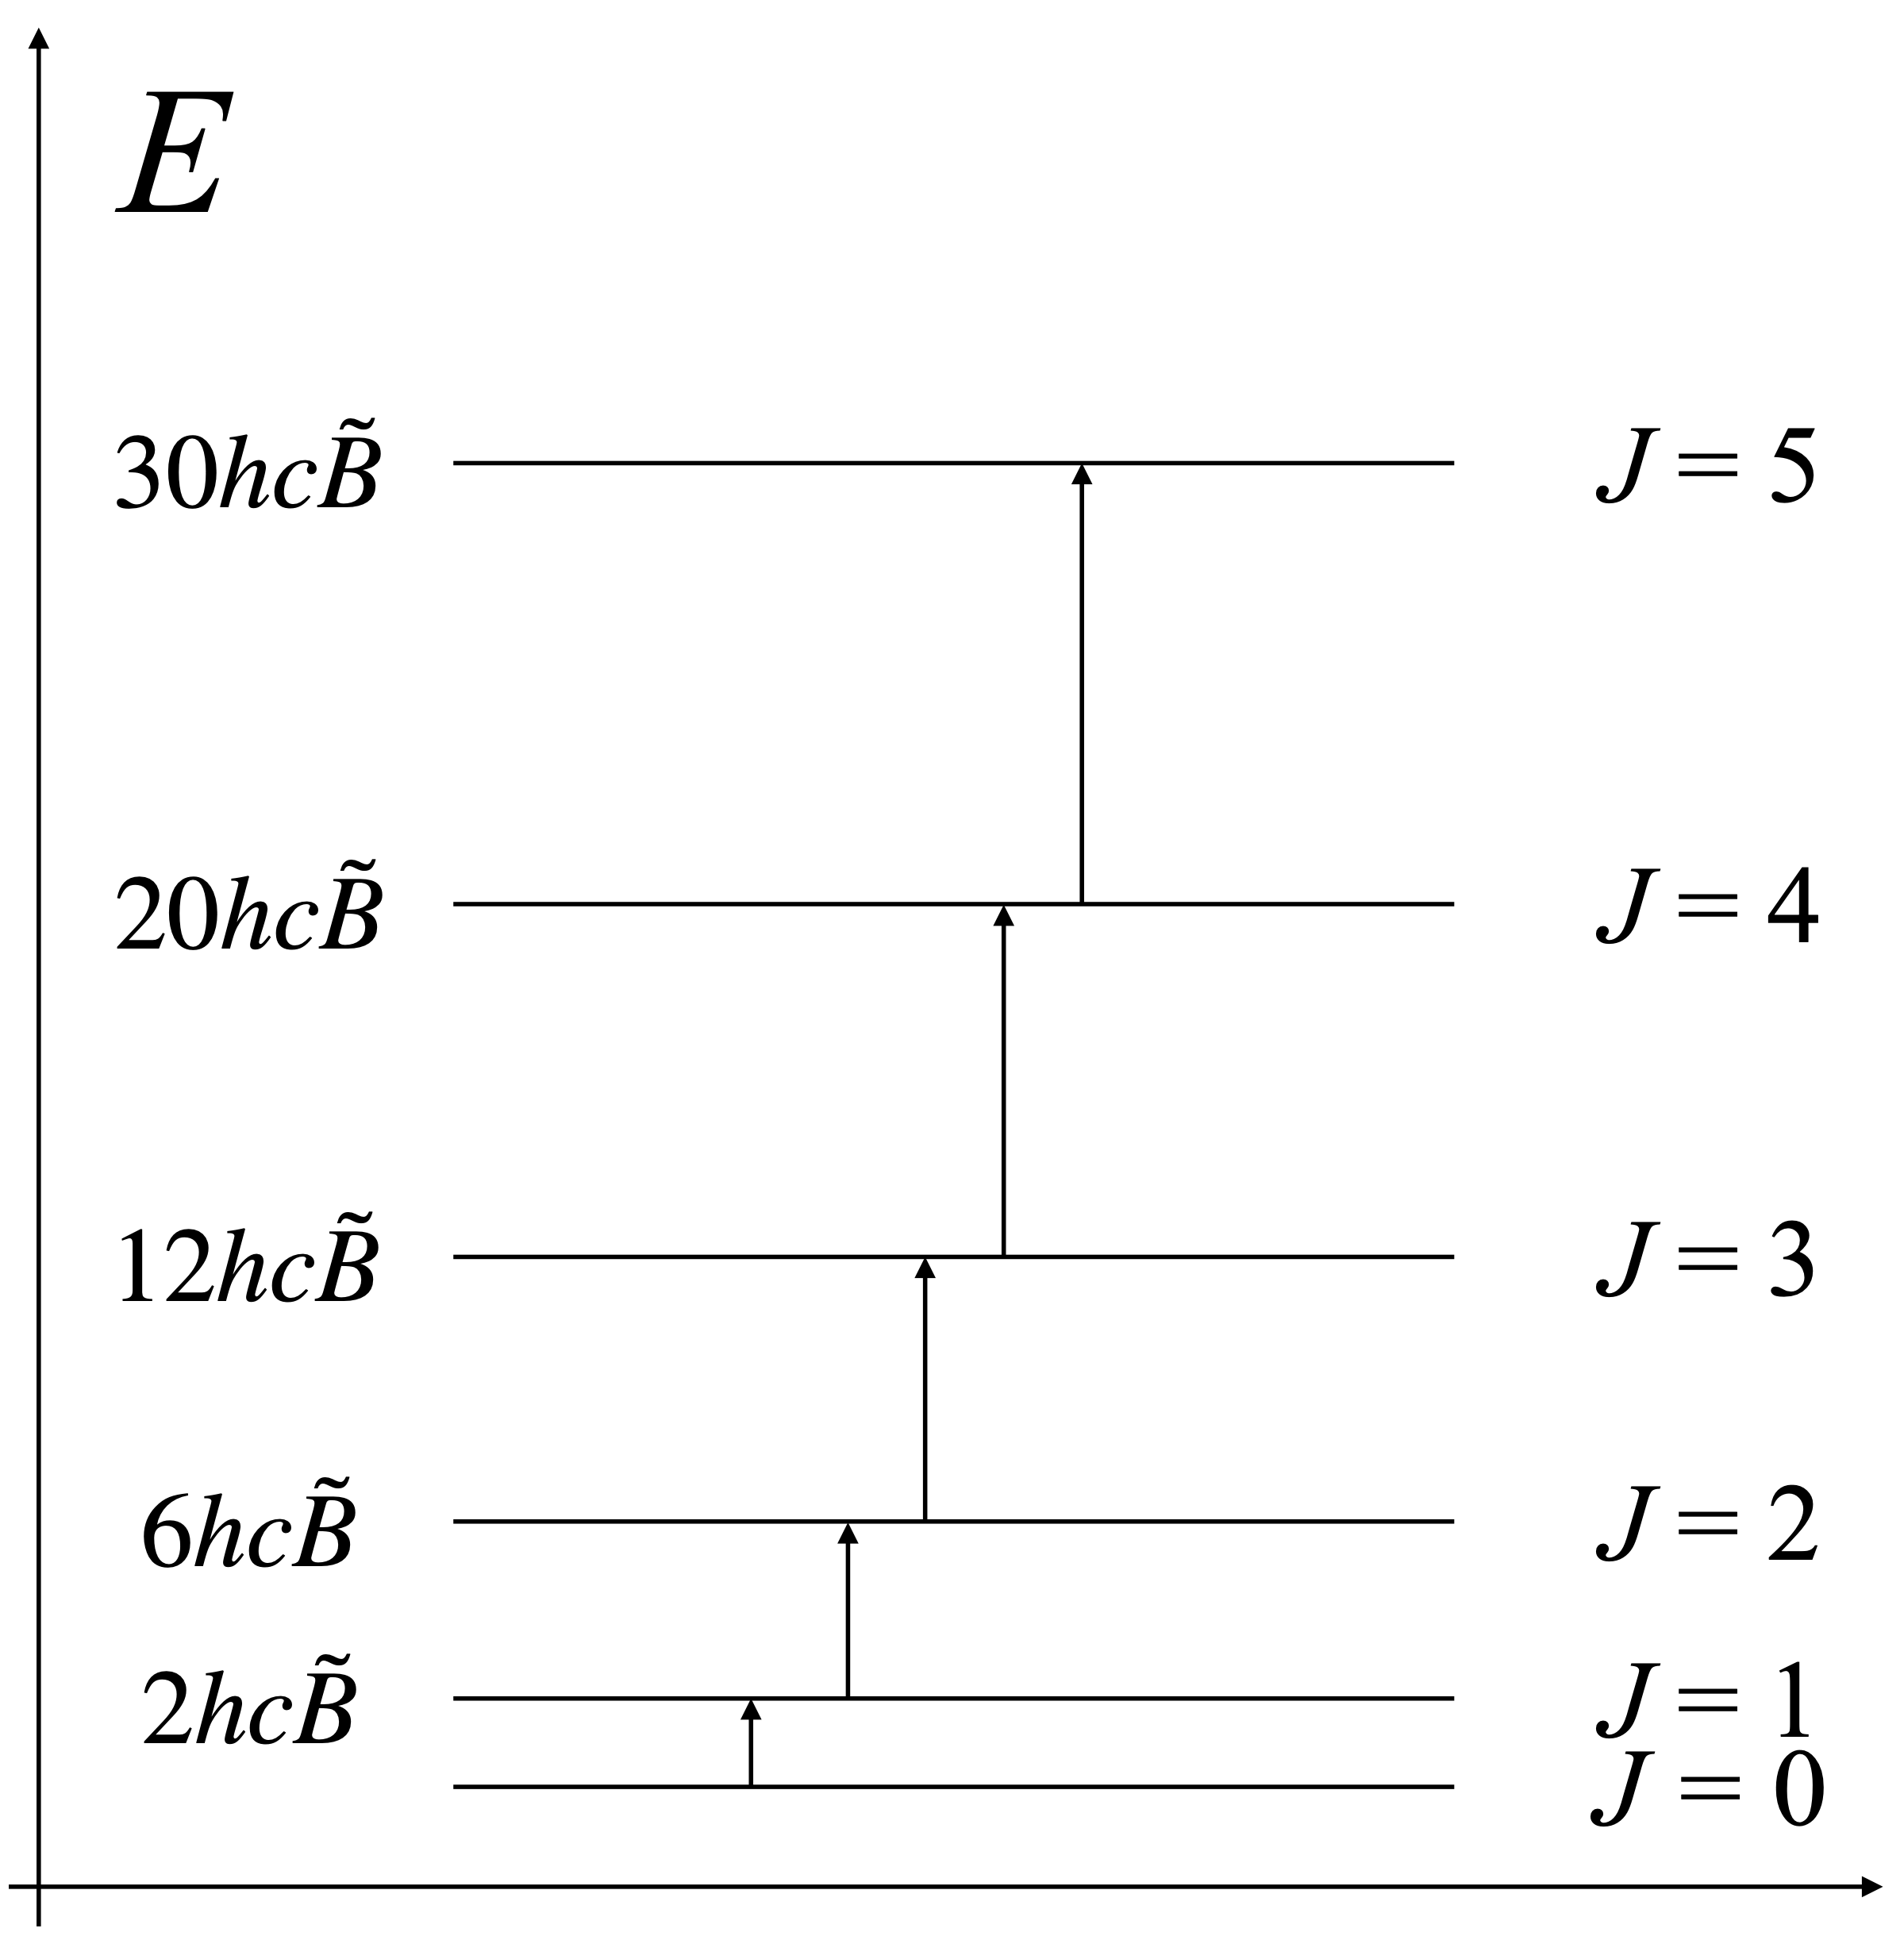
Model 1: rigid rotor (rotation)
Key idea: rotation levels depend on the moment of inertia, so measuring B̃ gives bond length.
• Rotational spacing grows with J
• Selection for Δ J = ±1
Notes:
[Sources]
- Rigid rotor energy levels and relation to moment of inertia: https://vallance.chem.ox.ac.uk/pdfs/MolecularEnergyLevelsNotes.pdf
[/Sources]

Slide 5
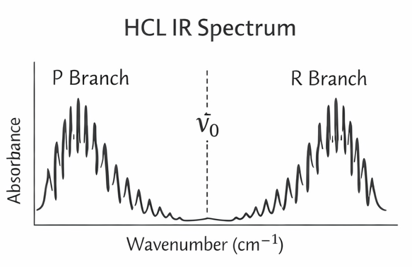
Selection rules → P and R branches
Fundamental band (dominant)
Δv = +1, ΔJ = ±1
R branch: ΔJ = +1 (m > 0)
P branch: ΔJ = -1 (m < 0)
Band origin ν̃₀ is at m = 0 (no Q-branch line)
Intensities follow the Boltzmann population of the lower J levels.
Notes:
[Sources]
- P/R branch definition and ΔJ selection rules: https://chem.libretexts.org/Bookshelves/Physical_and_Theoretical_Chemistry_Textbook_Maps/Supplemental_Modules_%28Physical_and_Theoretical_Chemistry%29/Spectroscopy/Rotational_Spectroscopy/Rovibrational_Spectroscopy
- Alternative concise statement of rovibrational selection rules: https://www2.sci.u-szeged.hu/physchem/indexh_html_files/FTIR_eng.pdf
[/Sources]

Slide 6
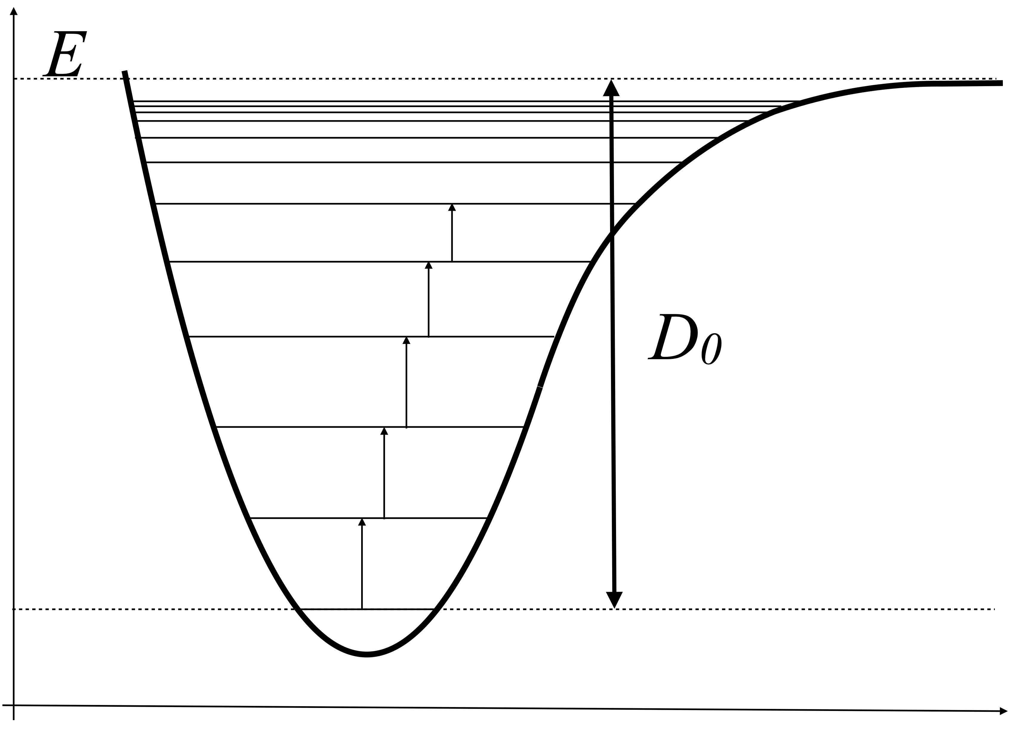
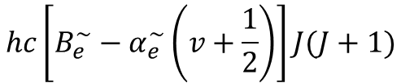
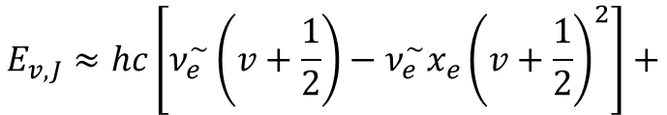
Corrections used in the lab (and one we neglect)
We improve the simplest model by adding:
• Anharmonicity (spacing decreases with v)
• Vibration–rotation coupling (B̃ decreases with v)
Minimal forms you will use:
$$E_{v,J}≈hc\left[ν_{e}^{\sim }\left(v+\frac{1}{2}\right)−ν_{e}^{\sim }x_{e}{\left(v+\frac{1}{2}\right)}^{2}\right]+$$
$$hc\left[B_{e}^{\sim }−α_{e}^{\sim }\left(v+\frac{1}{2}\right)\right]J(J+1)$$
We neglect:
Centrifugal distortion (small at low–moderate J)
Notes:
[Sources]
- Rovibrational constants including B_v = B_e - α_e(v+1/2): https://dpotoyan.github.io/Chem324/ch04/note04B.html
- Discussion of centrifugal distortion as bond stretching at high J: https://www.pci.tu-bs.de/aggericke/PC4e/Kap_III/Rot-Vib-Spektren.htm
[/Sources]

Slide 7
Data analysis: fit line positions in a single variable (m)
You will assign peaks, then fit ν̃ vs m to a quadratic.
m definition (use lower-state J'')
R(J''): m = J'' + 1 (m = +1, +2, …)
P(J''): m = −J'' (m = −1, −2, …)
Do NOT mix isotopologues in one fit
Each line often appears as two close lines, why?
Fit one series at a time (or fit both separately).
Notes:
[Sources]
- Branch labeling and use of lower-state J for line labels: https://chem.libretexts.org/Bookshelves/Physical_and_Theoretical_Chemistry_Textbook_Maps/Supplemental_Modules_%28Physical_and_Theoretical_Chemistry%29/Spectroscopy/Rotational_Spectroscopy/Rovibrational_Spectroscopy
[/Sources]

Slide 8
Deliverables: from lines to structure and energetics
Pipeline (everything comes from your fitted ν̃₀, B̃₀, B̃₁)
Assign peaks
(P/R branches)
Quadratic fit
ν̃(m)
Bond lengths
r₀, r₁
Anharmonicity
xₑ and ν̃ₑ
Dissociation
energy D₀
Measure line positions
Get ν̃₀, B̃₀, B̃₁
via B̃ → I → r
use overtone info
estimate from xₑ, ν̃ₑ
Two things to keep you out of trouble
Use consistent units (cm⁻¹ for ν̃ and B̃; convert to m⁻¹ only inside the r formula).
2) Report uncertainties or at least comment on fit residuals and which lines you trusted.
Notes:
[Sources]
- Rovibrational selection rules and branch structure overview (context for analysis pipeline): https://chem.libretexts.org/Bookshelves/Physical_and_Theoretical_Chemistry_Textbook_Maps/Supplemental_Modules_%28Physical_and_Theoretical_Chemistry%29/Spectroscopy/Rotational_Spectroscopy/Rovibrational_Spectroscopy
[/Sources]

