Slide 1
Git and GitHub DOSO hands-on session
Arthur van Dam
Notes:
Basis from presentation “DD&zo_nov2009.ppt”

Slide 2
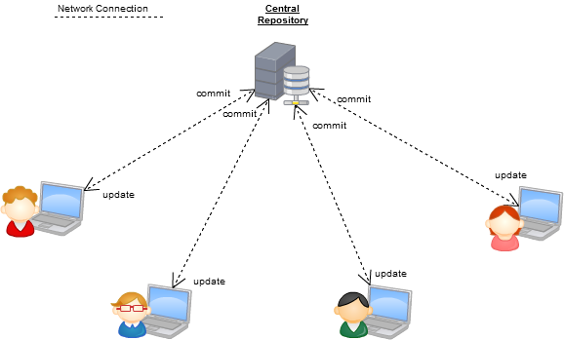
Some differences between Git and Subversion
GIT is distributed, SVN is not
Source: http://boxysystems.com/index.php/5-fundamental-differences-between-git-svn/

Slide 3
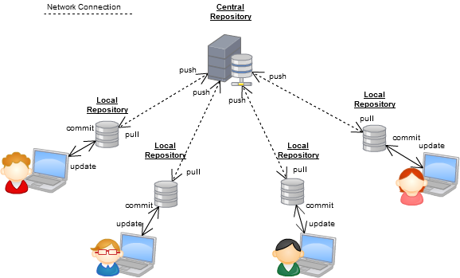
Some differences between Git and Subversion
GIT is distributed, SVN is not
Each local repo contains all:
Logs/history
Commited changes
Branches/tags
Source: http://boxysystems.com/index.php/5-fundamental-differences-between-git-svn/

Slide 4
Some differences between Git and Subversion
GIT branches are not the same as SVN branches
GIT branch:
Your local workspace is always on a branch (possibly the master)
Branches in your local repo don’t always need to have a branch in the remote repo (e.g. small fixes/topics that may simply be pushed to remote master).
Origins + history are maintained.
Switching branches is less scary, because “halfway work” can be committed locally.
SVN branch:
just a copy of a directory (remembering its origin)
Maintains svn:mergeinfo
Switching branches possible, but “halfway work” needs to be committed OR backed up.
Source: https://git-scm.com/book/en/v1/Git-Branching-What-a-Branch-Is

Slide 5
Some differences between Git and Subversion
GIT identifies commits by a unique 40-character SHA-1 hash, whereas SVN has its unique and incremental revision number.
[dam_ar@L01005:sandbox]$ git log
commit cfe2c49b22da47d587d0ef9fed793817321551ff
Author: Mihau <michal.kleczek@deltares.nl>
The first few characters are often unique already:
[dam_ar@L01005:sandbox]$ git show cfe2c
commit cfe2c49b22da47d587d0ef9fed793817321551ff
NOTE:
Git’s HEAD is just a pointer to the local branch+commit you’re on.
SVN’s HEAD is the remote latest revision of your current repository.
Source: https://git-scm.com/book/en/v2/Git-Tools-Revision-Selection

Slide 6
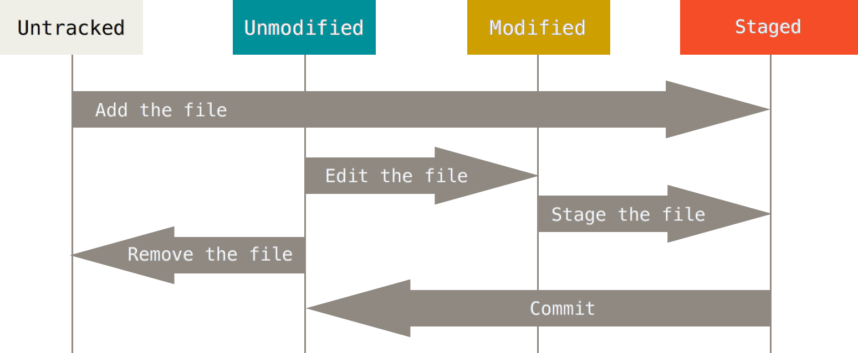
Basic recording of changes to your files
The lifecycle of the status of your workspace files:
Use and bookmark: http://www.ndpsoftware.com/git-cheatsheet.html
Source: https://git-scm.com/book/en/v2/Git-Basics-Recording-Changes-to-the-Repository

Slide 7
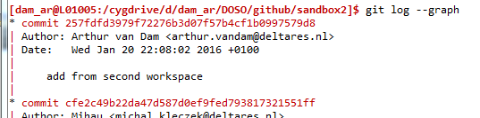
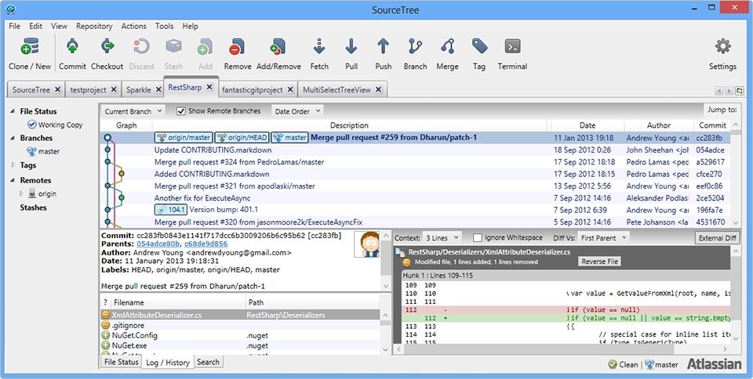
Getting started
Use a commandline client:
And/or use a GUI, for example: https://www.sourcetreeapp.com/

Slide 8
Scenario 1: set up existing project and contribute
Obtain a local copy of the testproject on https://github.com/Deltares/sandbox
Add some files (“test_<YOURNAME>.txt”, etc.), directories, edit some files. Use some (> 1) intermediate local commits for these changes.
Try and get your locally committed changes now into the remote respository.
Use: http://rogerdudler.github.io/git-guide/

Slide 9
Scenario 2: hotfix
Change into the directory “hello_world”
Start working on feature_A in a local branch: Feature_A should print “Goodbye world!” at the end of the program.
A critical issue comes up, which has priority over feature_A, but A is also not finished yet/not ready for pushing. Find a way to fix this issue in your local workspace, based on the latest master commit (i.e. not mixing with feature_A)
Use: https://git-scm.com/book/en/v2/Git-Branching-Basic-Branching-and-Merging

Slide 10
Break..

Slide 11
Scenario 3: Merge conflicts
team up with someone, let that person make some changes in “test_<yourname>.txt”, and commit+push it.
On your own machine, also make some conflicting changes to that file + commit it.
Now you pull from the remote origin and try to resolve the conflicts.
Use: https://git-scm.com/book/en/v2/Git-Branching-Basic-Branching-and-Merging#Basic-Merge-Conflicts

Slide 12

GitHub
GitHub offers a free Git-repository hosting service, with a convenient web interface on top.
GitHub is also popular for hosting open source projects, because it stimulates contributions by others via Forks and pull requests.

Slide 13
Deltares on GitHub
Organization: https://github.com/Deltares
Gather ‘our’ project repositories in one place.
Assign teams and have some access control on specific repo’s.
Organization: https://github.com/openearth
Contains much more repositories, lot of Python + interactive websites and more.

Slide 14
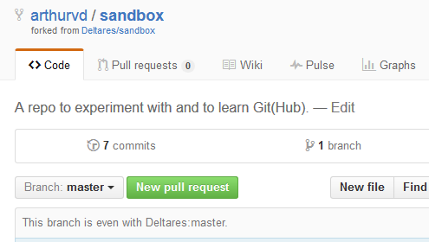
GitHub, forks and pull requests
A fork is a copy of a repository. Forking a repository allows you to freely experiment with changes without affecting the original project.
Most commonly, forks are used to either propose changes to someone else's project or to use someone else's project as a starting point for your own idea.
Standard fetching + merging
from the “upstream” remote
branch.
Source: https://help.github.com/articles/fork-a-repo/

Slide 15
GitHub, forks and pull requests
A pull request is you asking someone else to review some of your changes and pull+merge them into the desired location.
Source: https://help.github.com/articles/using-pull-requests/

Slide 16
Scenario 4: GitHub and pull requests
Fork the Deltares/sandbox repository into your own GitHub account.
Clone your fork onto your local machine
Work on some changes and commit + push them
Use the webinterface or SourceTree GUI to issue a Pull Request for your changes, and ask someone to take up that PR.
See also: https://help.github.com/articles/using-pull-requests/

Slide 17
Several possible workflows
https://www.atlassian.com/git/tutorials/comparing-workflows/centralized-workflow : working together on the same master branch.
https://www.atlassian.com/git/tutorials/comparing-workflows/feature-branch-workflow : do all work in feature branches.
https://www.atlassian.com/git/tutorials/comparing-workflows/gitflow-workflow : for packages with release management, and bugfixing and feature branches.
https://www.atlassian.com/git/tutorials/comparing-workflows/forking-workflow : linux workflow, each contributor a separate repository. People should know what they’re doing and work on separate functionalities.

Slide 18
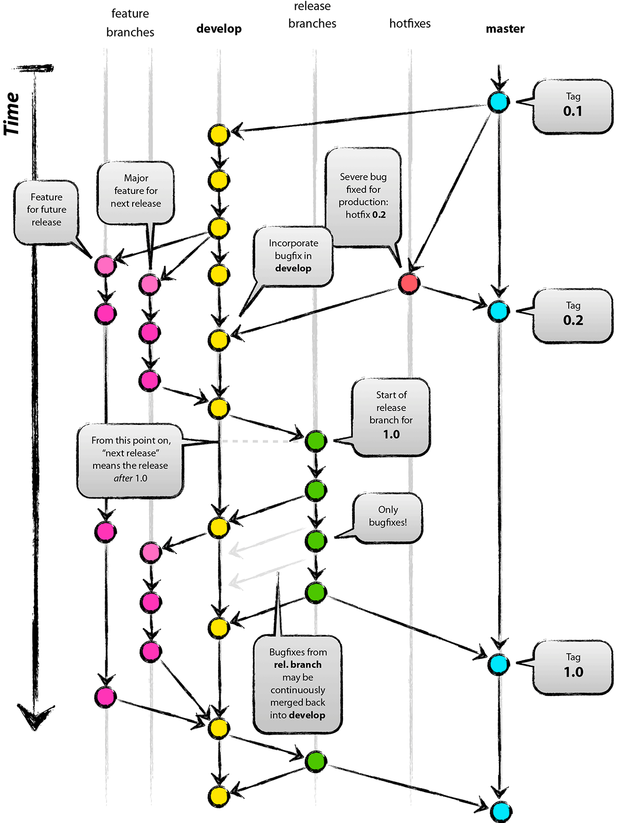
git-flow
Source: http://jeffkreeftmeijer.com/2010/why-arent-you-using-git-flow/

Slide 19
Miscellaneous
Handy: git bisect Interactively do a binary search for the commit that introduced a bug.
Useful: GitHub repo can be used in an svn:externals
svn propget svn:externals ~/unstruc_release/
https://github.com/arthurvd/FLAP/branches/fix/master/avd_contrib@163 third_party_open/FLAP
Once more: http://www.ndpsoftware.com/git-cheatsheet.html

