Slide 1
CPU
Timer 1
Timer 2
1
2
3
4
5
6
Watchdog Task
Wait
Trigger Timer 2
Cyclic Task
Interrupt
Wait For Exceed Time
Trigger Timer 2
End Cyclic Task
Begin Cyclic Task
Reset Timer 2
End Cyclic Task
Reset Timer 2

Slide 2
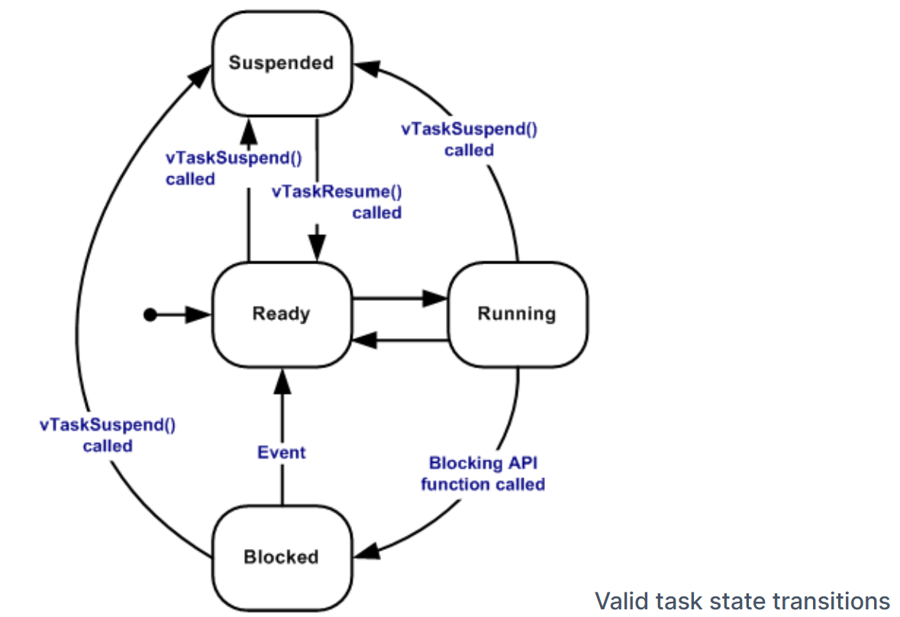
https://www.freertos.org/Documentation/02-Kernel/02-Kernel-features/01-Tasks-and-co-routines/02-Task-states

Slide 3
Core 0
Core 1
1
2
3
4
5
6
7
8
9
10
ESP Now Task
1
2
3
4
5
6
Watchdog Task
UDP Processing Task
Cyclic Task
UDP System Task
Idle Task
UDP Polling Task
Idle Task

