Slide 1
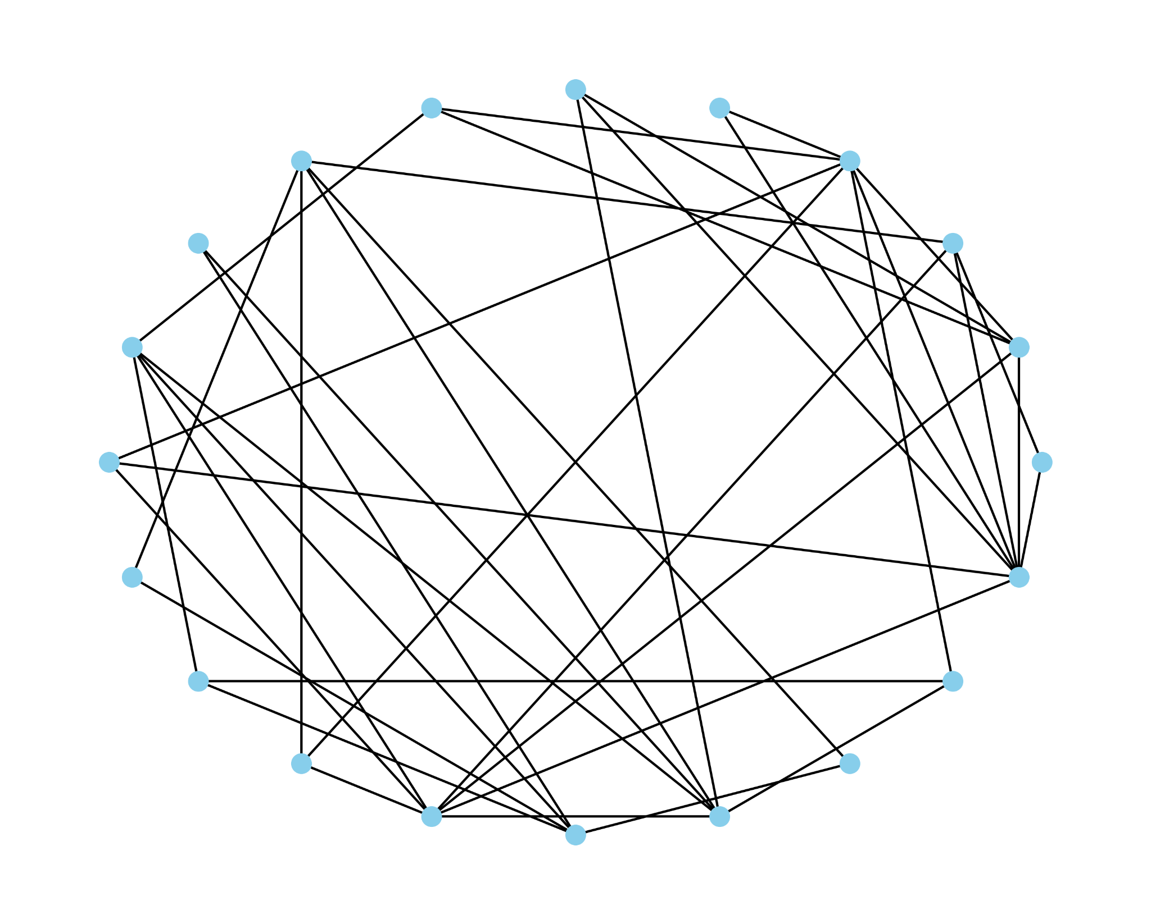
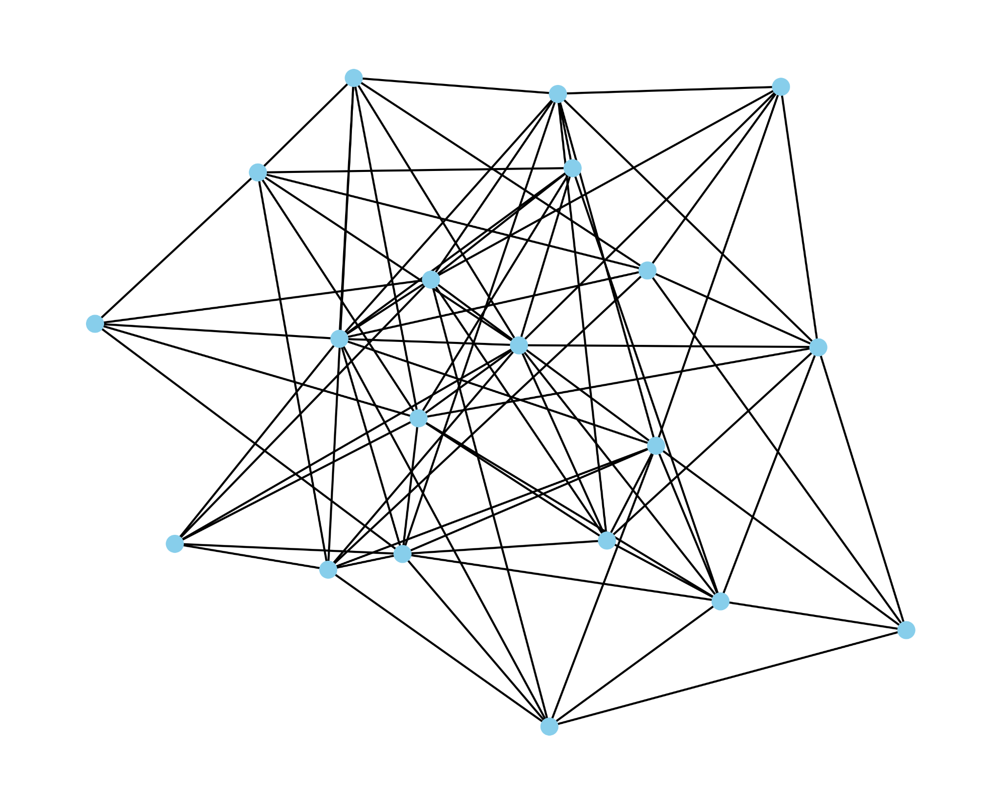
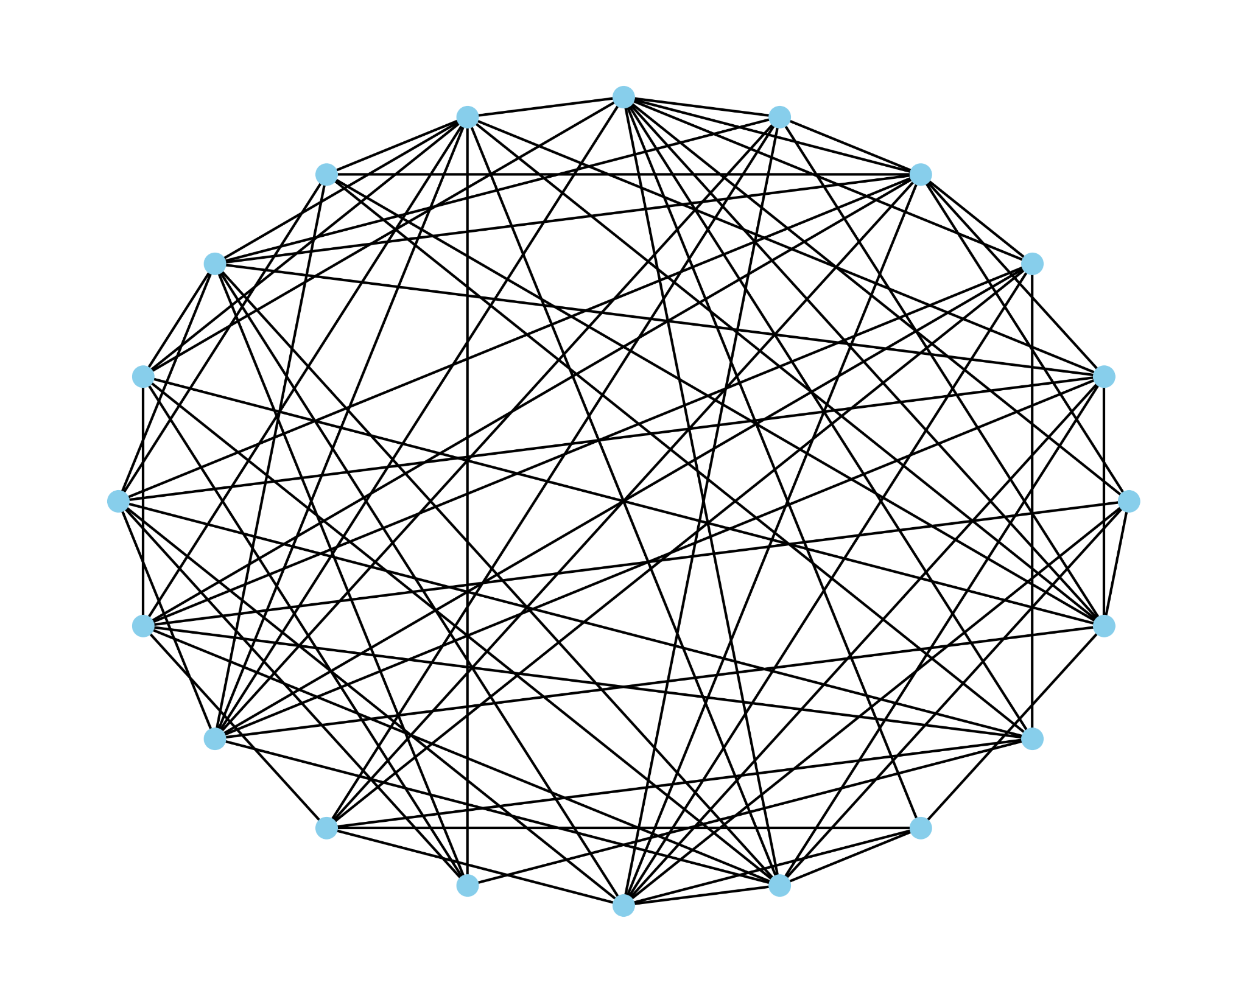
Towards a Science of CNF Encodings
Based on work with Benjamin Przybocki and Andrew Krapivin
Bernardo Subercaseaux (CMU)

Slide 2
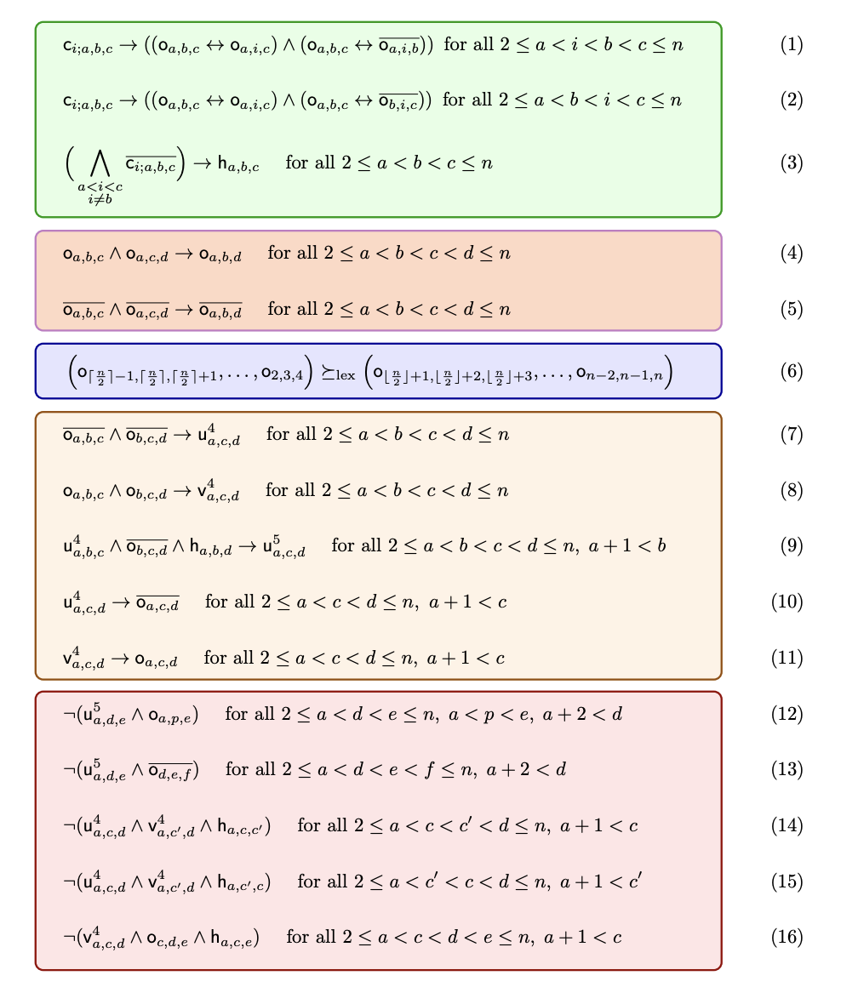
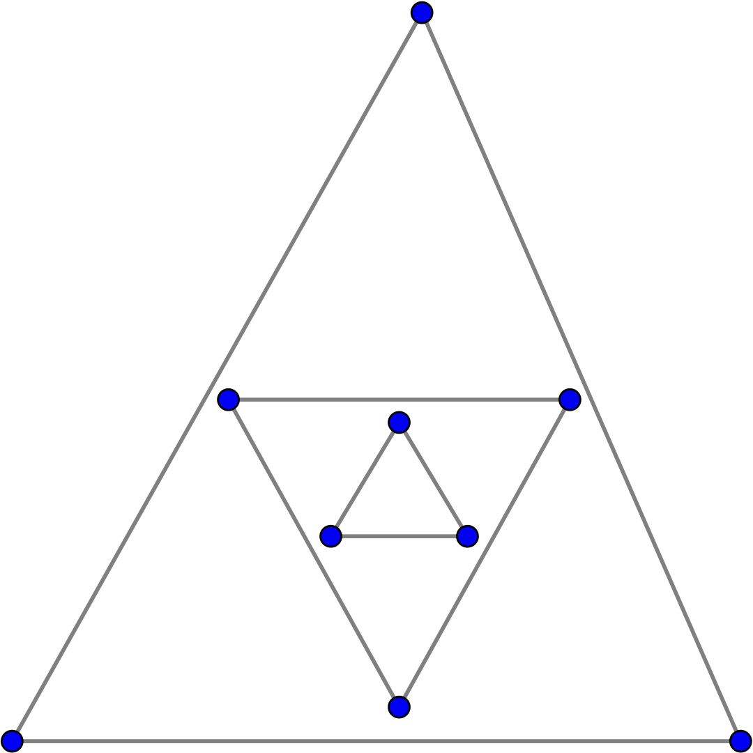
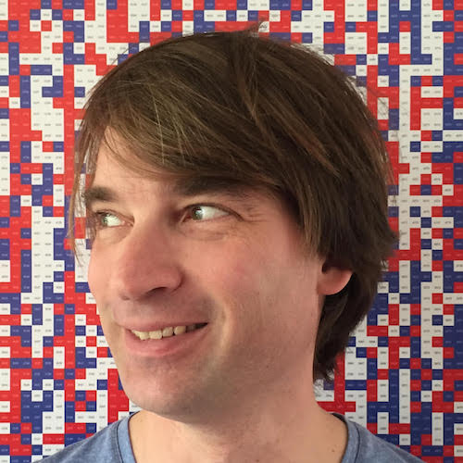
First 4 years of my PhD
Art of CNF
encodings
h(5) = 10
Marijn Heule
Encoding from Heule and Scheucher (2023) for the Empty Hexagon. Verified in Lean by [S. N, G, C, C, H, 2024]

Slide 3
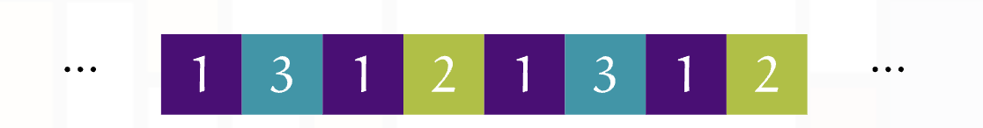
Packing Colorings (Goddard et al., 2002)
Distinct vertices that share color c must be at distance greater than c
Simplified model of radio stations and frequencies:
Two radio stations can share the same frequency only if they’re sufficiently far. But how far depends on the frequency!

Slide 4
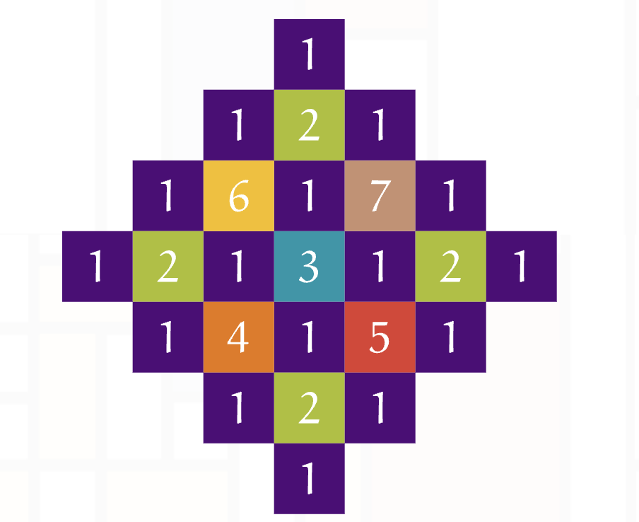
Packing Colorings
Distinct vertices that share color c must be at distance greater than c
Two dimensional is harder!

Slide 5
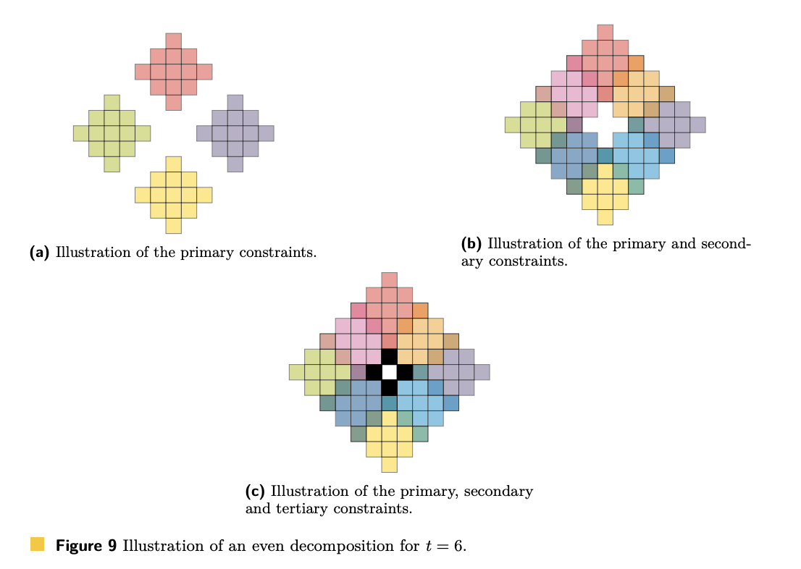
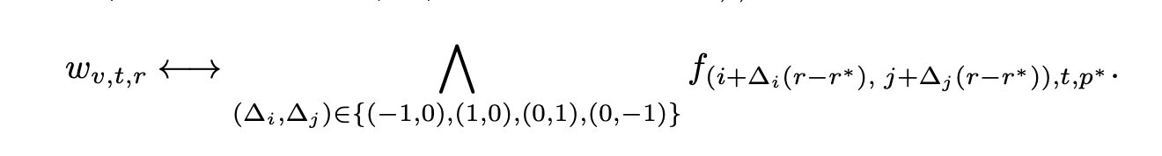
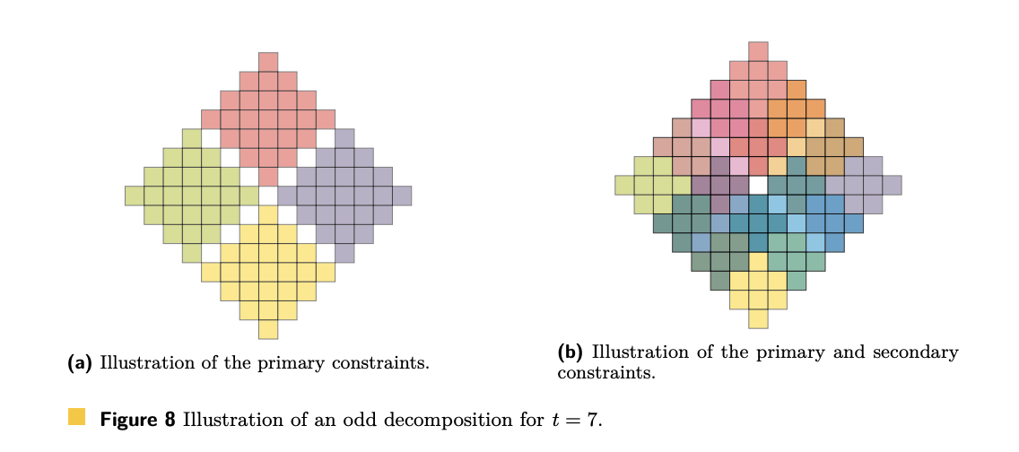
We came up with a complicated but compact encoding

Slide 6
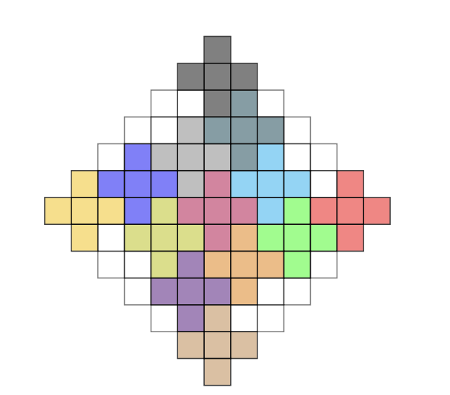
Key Technique: Plus Encoding
Auxiliary variables based on ‘+’ shaped regions

Slide 7
Key Technique: Plus Encoding
Auxiliary variables based on ‘+’ shaped regions
For every region r and color c, we have an auxiliary variable y_{r, c} representing that one of the vertices in that region takes color c

Slide 8
Key Technique: Plus Encoding
Auxiliary variables based on ‘+’ shaped regions
For every region r and color c, we have an auxiliary variable y_{r, c} representing that one of the vertices in that region takes color c
Benefits:
  Maintains symmetry
  Factors conflicts → fewer clauses
  More balanced variables
  Very structured formula

Slide 9
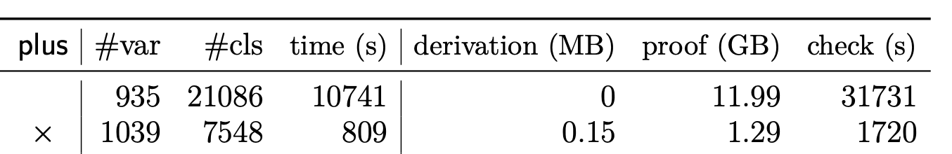
Key Technique: Plus Encoding
Add ~100 auxiliary variables
Divides # of clauses by 3
Divides runtime by 13
Proof size divided by 9
Proof checking divided by 18

Slide 10
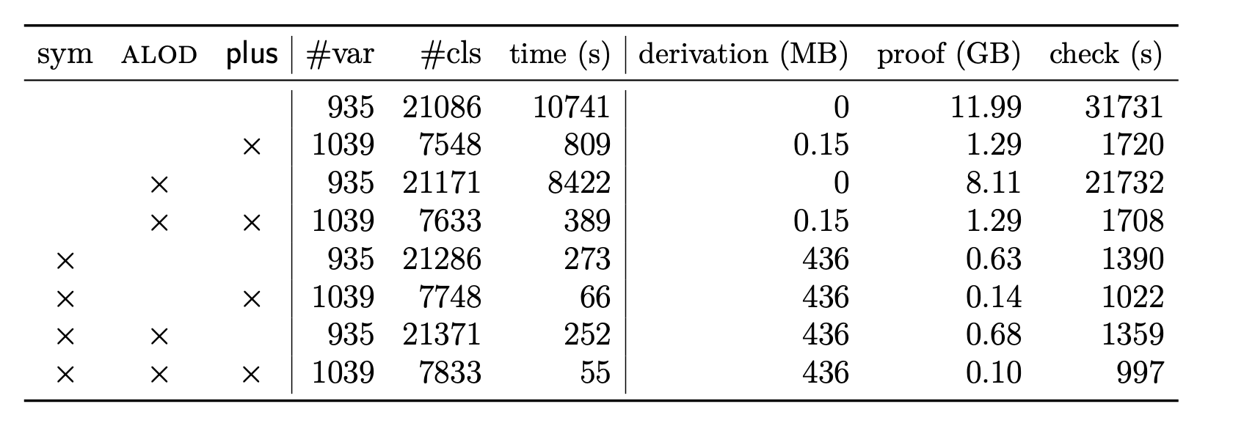
Key Technique: Plus Encoding

Slide 11
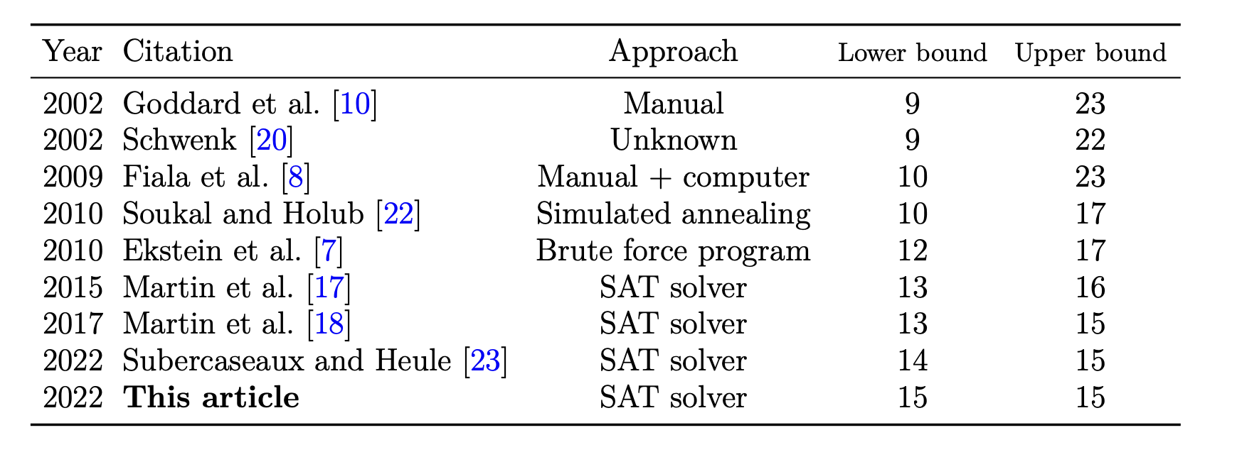
The plus encoding was a key ingredient to solve a 20-year-old problem, even after others had tried SAT

Slide 12
Encoding 1
1400 auxiliary variables
300k clauses
Good propagation properties
Encoding 2
3000 auxiliary variables
120k clauses
Medium
propagation properties
Encoding 3
30k auxiliary variables
50k clauses
Bad
propagation properties
Which one should we use?

Slide 13

So what is a CNF encoding?
We have a Boolean function F(x₁, …, x_{n})
for which we want some satisfying assignment.
An encoding for F is a CNF formula E(x₁, …, x_{n}, y₁,…,y_{r})
such that

Slide 14
What’s the deal with these auxiliary variables?
Suppose the function we want to encode is AtLeastTwo(x₁, …, x_{n})
Without auxiliary variables we need n clauses!

Slide 15
What’s the deal with these auxiliary variables?
Suppose the function we want to encode is AtLeastTwo(x₀, …, x_{n-1})
Imagine each index from 0 to n-1 written in binary
x₀ → 0000
x₁ → 0001
x₂ → 0010
x₃ → 0011
…
x₁₄ → 1110
x₁₅ → 1111

Slide 16
What’s the deal with these auxiliary variables?
Suppose the function we want to encode is AtLeastTwo(x₀, …, x_{n-1})
Imagine each index from 0 to n-1 written in binary
x₀ → 0000
x₁ → 0001
x₂ → 0010
x₃ → 0011
…
x₁₄ → 1110
x₁₅ → 1111
Key idea:
There’s at least two “active” x variables if and only if there’s some bit position for which we have both an active 0 and an active 1.

Slide 17
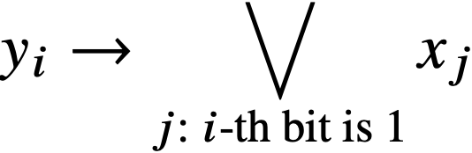
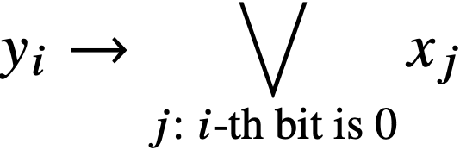

What’s the deal with these auxiliary variables?
x₀ → 0000
x₁ → 0001
x₂ → 0010
x₃ → 0011
…
x₁₄ → 1110
x₁₅ → 1111
Key idea:
There’s at least two “active” x variables if and only if there’s some bit position for which we have both an active 0 and an active 1.

Slide 18
We can encode AtLeastTwo(x₁, …, x_{n})
With 2lg₂ n + 1 clauses and lg₂ n auxiliary variables.
Can we do better?
Yes! Just go ternary! Then we have lg₃ n auxiliary variables, and each of them implies 3 disjunctions instead of 2
3 lg₃ n = (3/lg₂ 3) lg₂ n < 1.89lg₂ n

Slide 19
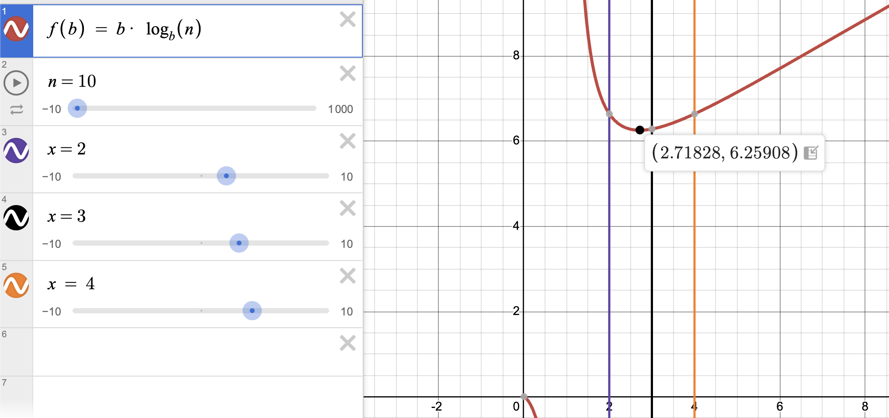
We can encode AtLeastTwo(x₁, …, x_{n})
With 1.89lg₂ n + 1 clauses and lg₃ n auxiliary variables.
Can we do better?

Slide 20
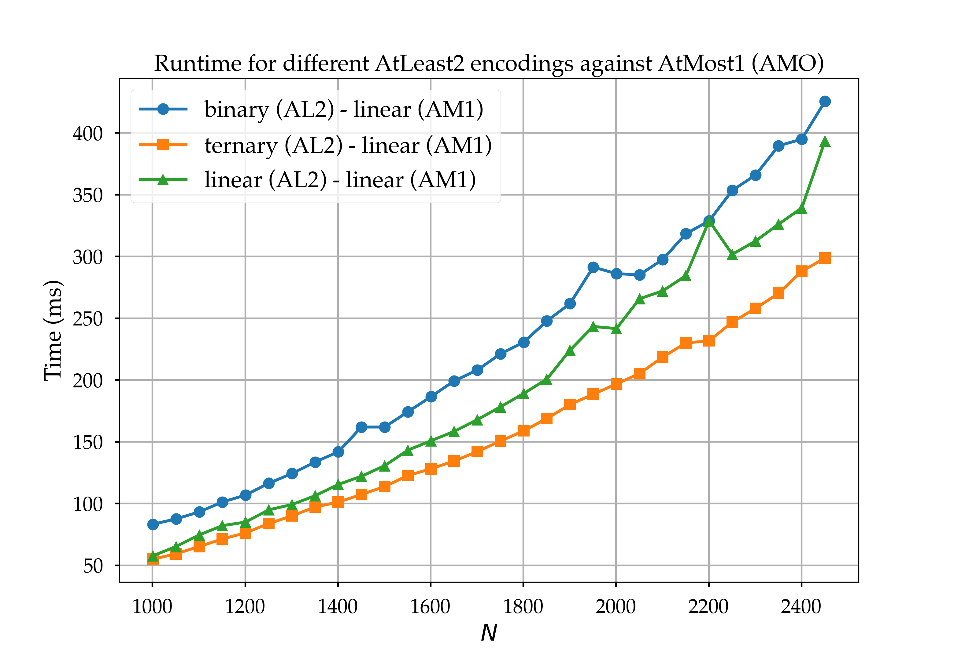

Slide 21
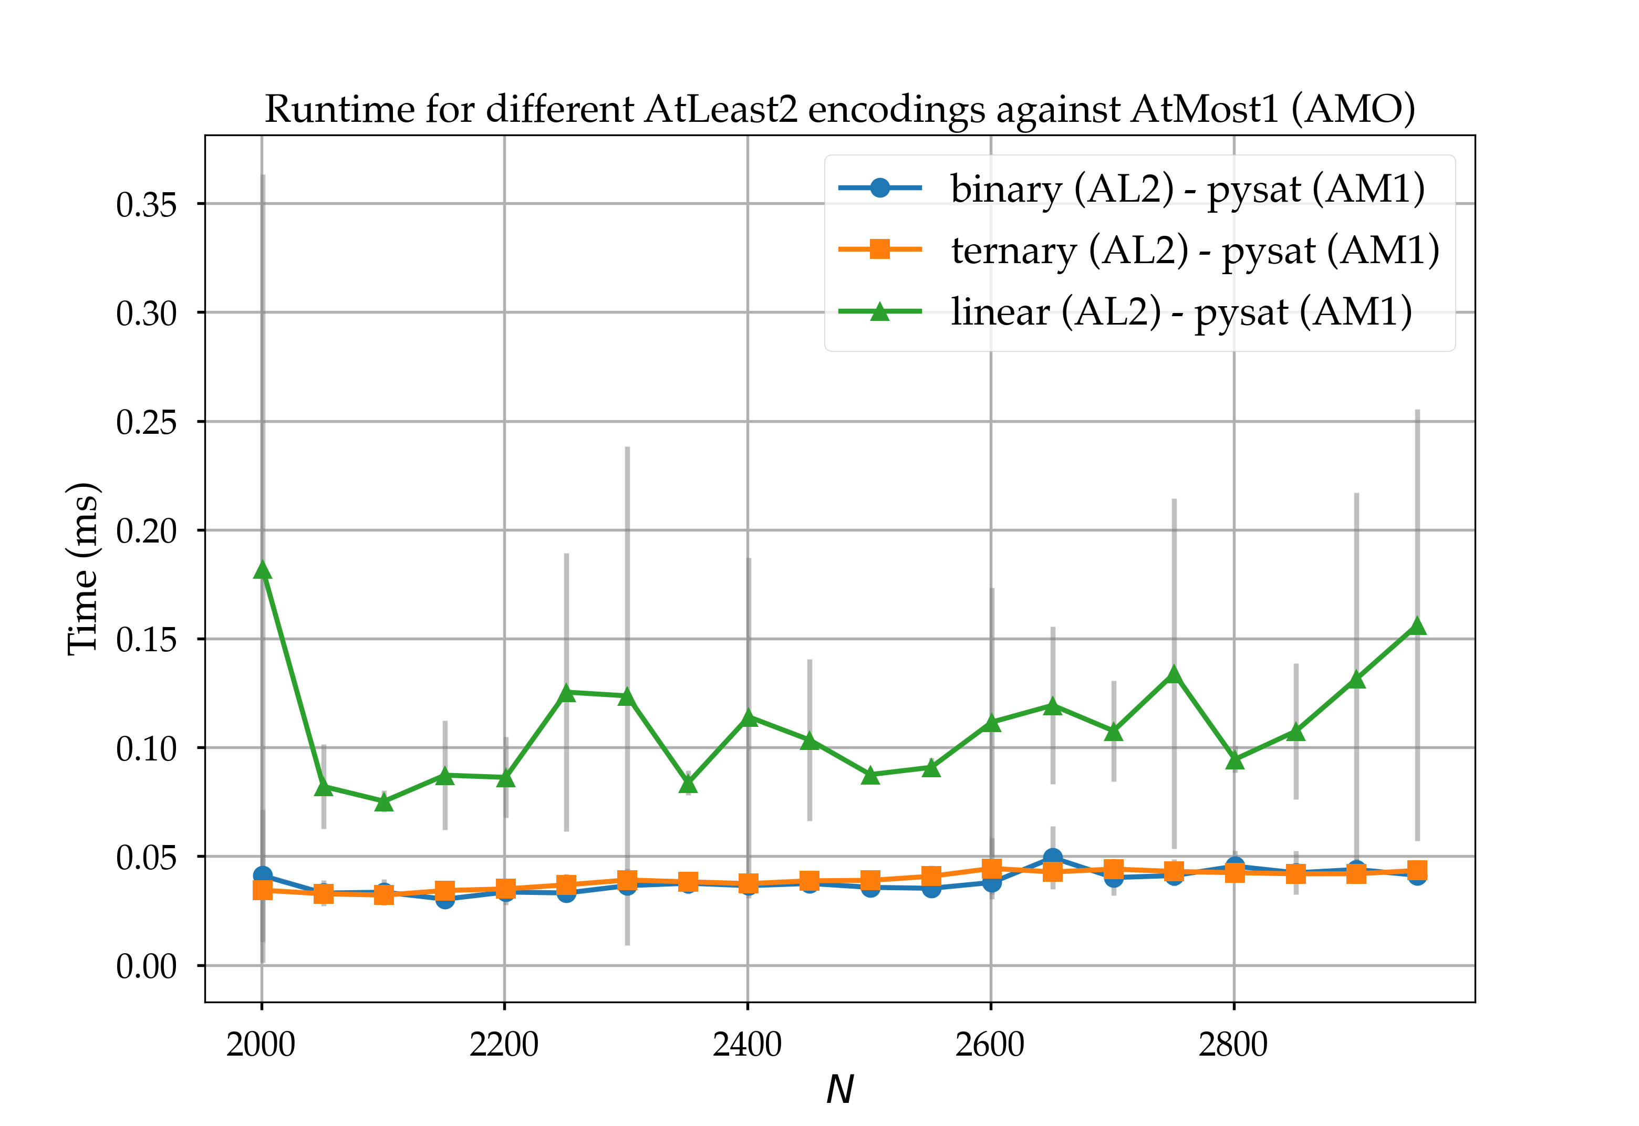

Slide 22
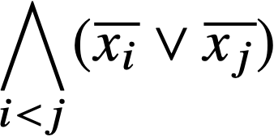

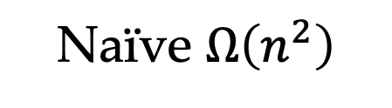
Naïve $Ω\left(n^{2}\right)$
The AtMostOne constraint
Suppose we have an auxiliary variable y that represents whether any of the variables x₁, x₂, x₃ is true.
Then we would say

Slide 23

The AtMostOne constraint
Suppose we have an auxiliary variable y that represents whether any of the variables x₁, x₂, x₃ is true.
Then we would enforce
Well, we can say

Slide 24
The AtMostOne constraint
Suppose we have an auxiliary variable y that represents whether any of the variables x₁, x₂, x₃ is true.
Then we would enforce
Well, we can say

Slide 25
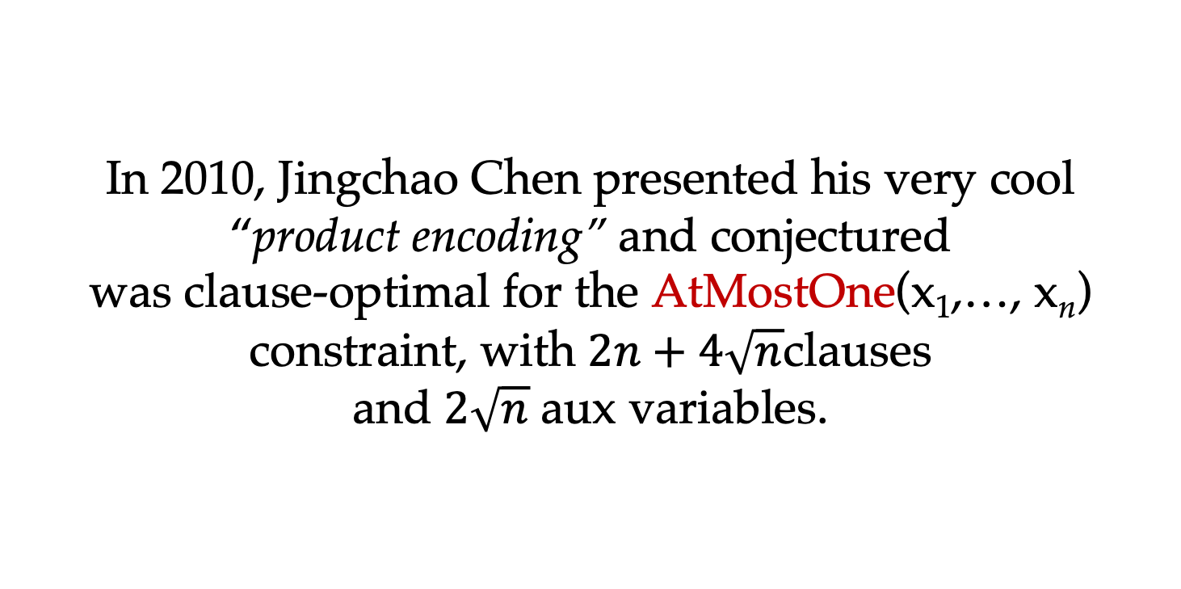
In 2010, Jingchao Chen presented his very cool
“product encoding” and conjectured was clause-optimal for the AtMostOne(x₁,…, x_{n}) constraint, with $2n+4\sqrt{n}$clauses and $2\sqrt{n}$ aux variables.
The AtMostOne constraint

Slide 26
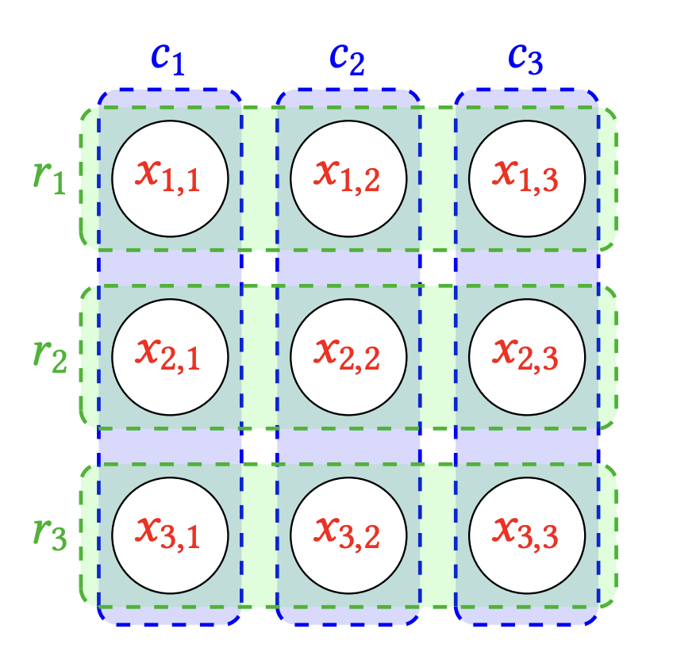
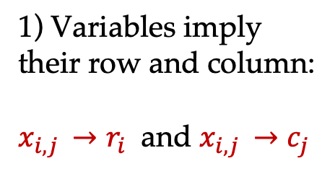
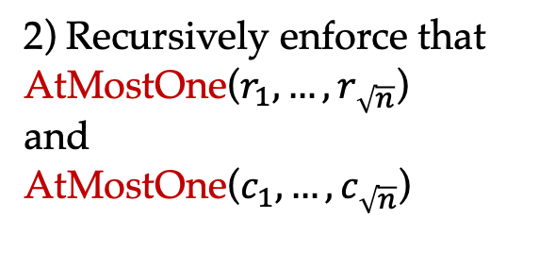
1) Variables imply their row and column:
$x_{i, j }→r_{i}$ and $x_{i,j }→c_{j}$
2) Recursively enforce that AtMostOne($r_{1}, …, r_{\sqrt{n}}$) and
AtMostOne($c_{1}, …, c_{\sqrt{n}}$)
Chen’s Product Encoding in the standard grid presentation

Slide 27
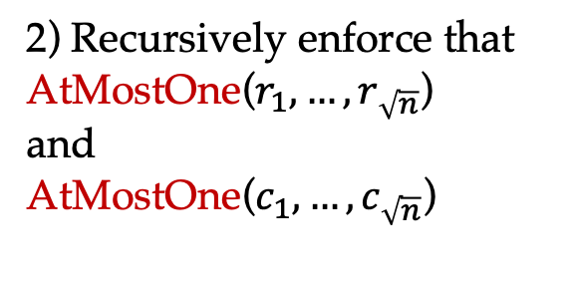

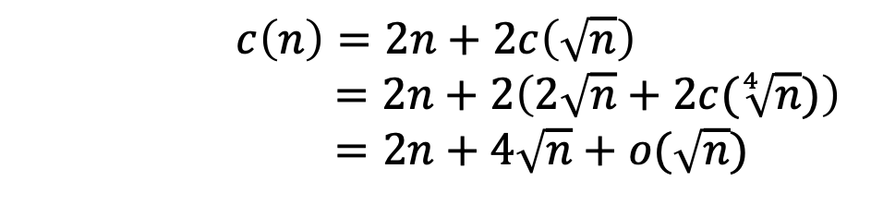
1) Variables imply their row and column:
$x_{i, j }→r_{i}$ and $x_{i,j }→c_{j}$
$$c\left(n\right)=2n+2c\left(\sqrt{n}\right)$$
$$=2n+2\left(2\sqrt{n}+2c(\sqrt[4]{n})\right)$$
$$=2n+4\sqrt{n}+o(\sqrt{n})$$
2) Recursively enforce that AtMostOne($r_{1}, …, r_{\sqrt{n}}$) and
AtMostOne($c_{1}, …, c_{\sqrt{n}}$)

Slide 28
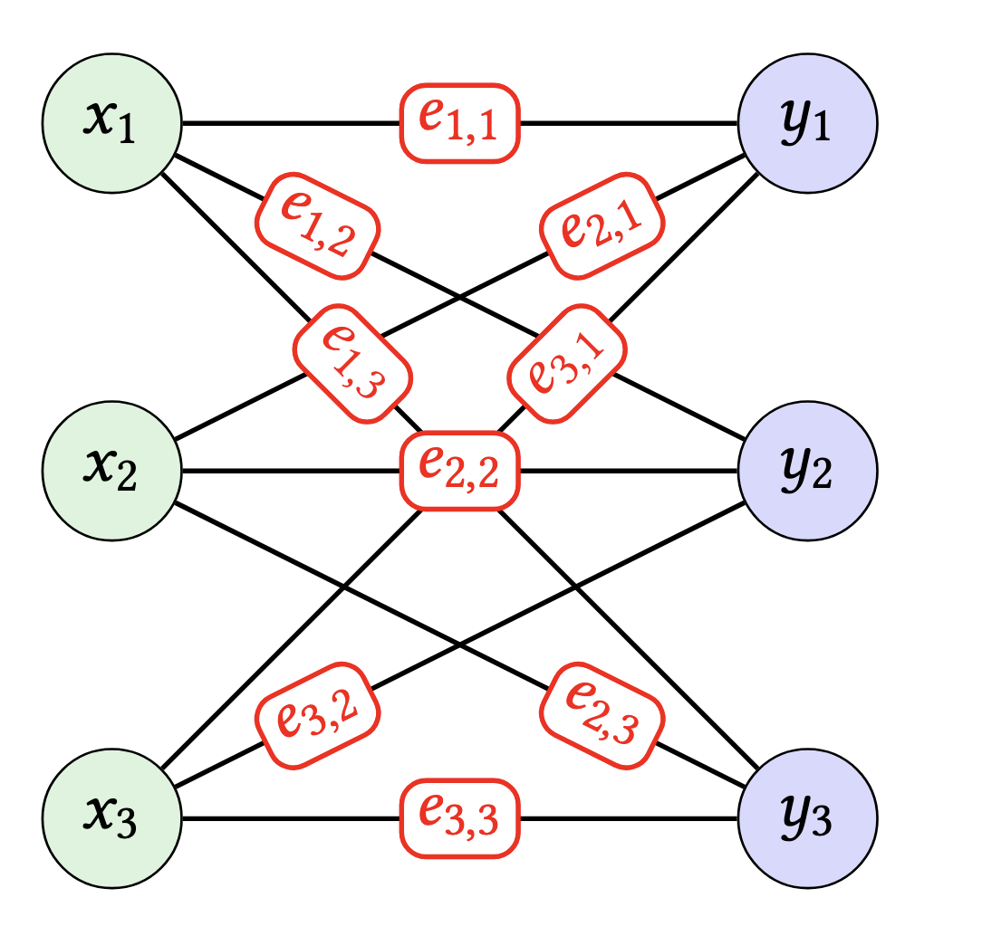
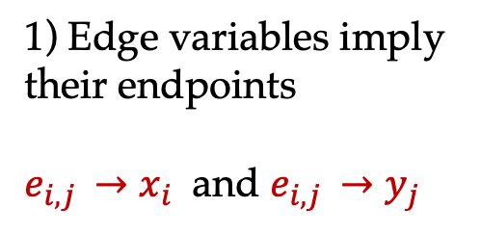
AtMostOne = AtMostOneEdge
1) Edge variables imply their endpoints
$e_{i, j }→x_{i}$ and $e_{i,j }→y_{j}$
2) AtMostOne(x) and
AtMostOne(y)
Chen’s Product Encoding as a complete bipartite graph!

Slide 29
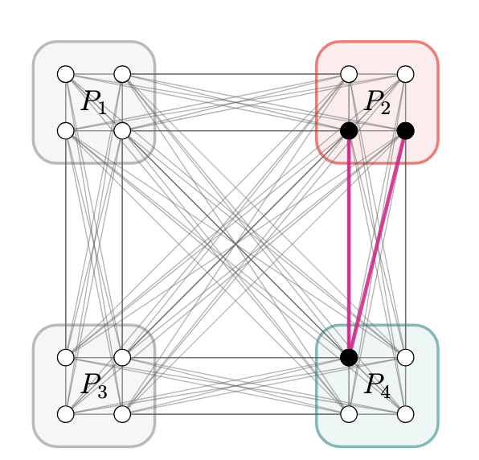
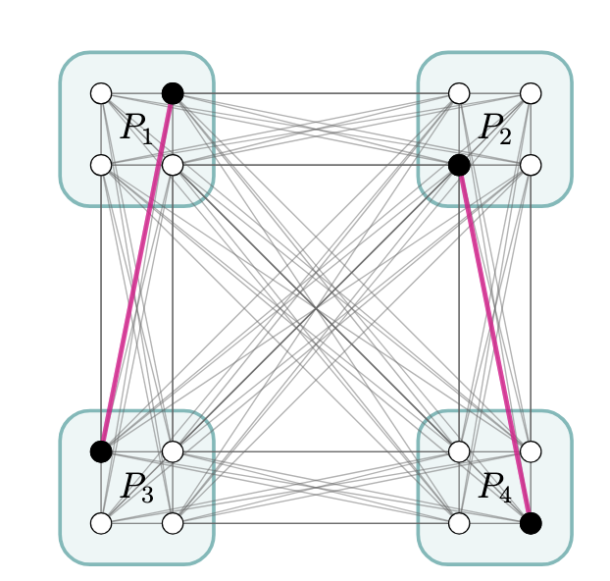
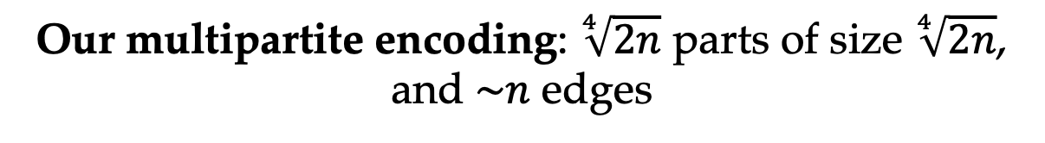
Our multipartite encoding: $\sqrt[4]{2n}$ parts of size $\sqrt[4]{2n}$, and $\sim n$ edges
AtMostOne_{z} per part
AtMostTwo active parts

Slide 30
Our multipartite encoding: $\sqrt[4]{2n}$ parts of size $\sqrt[4]{2n}$, and $\sim n$ edges
AtMostOne_{z} per part
AtMostTwo active parts
$2n+2\sqrt{2n}+O\left(\sqrt[4]{n}\right)$clauses and $\sqrt{2n}$ auxiliary variables

Slide 31
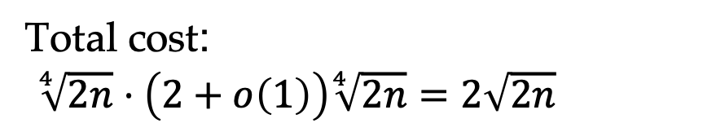
Our multipartite encoding, with $\sqrt[4]{2n}$ parts of size $\sqrt[4]{2n}$, and $\sim n$ edges
We introduce an auxiliary variable z_{i} for each part P_{i}
Within part P_{i} we do a slightly modified version of AtMostOne that also sets variable z_{i} to true if there is exactly one. This costs (2+o(1))|P_{i}|
Total cost:
$\sqrt[4]{2n}⋅\left(2+o\left(1\right)\right)\sqrt[4]{2n}=2\sqrt{2n}$
AtMostOne_{z} per part

Slide 32
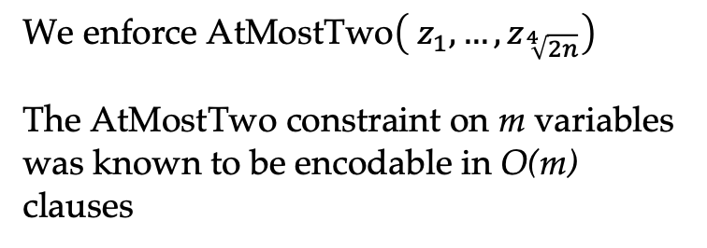
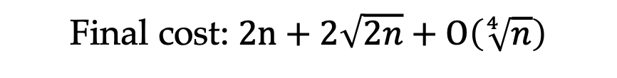
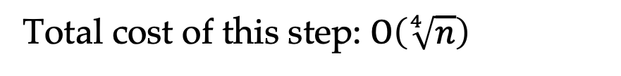
Our multipartite encoding, with $\sqrt[4]{2n}$ parts of size $\sqrt[4]{2n}$, and $\sim n$ edges
We enforce AtMostTwo$\left( z_{1}, …, z_{\sqrt[4]{2n}}\right)$
The AtMostTwo constraint on m variables was known to be encodable in O(m) clauses
Total cost of this step: $O\left(\sqrt[4]{n}\right)$
Final cost: $2n+2\sqrt{2n}+O\left(\sqrt[4]{n}\right)$
AtMostTwo active parts

Slide 33
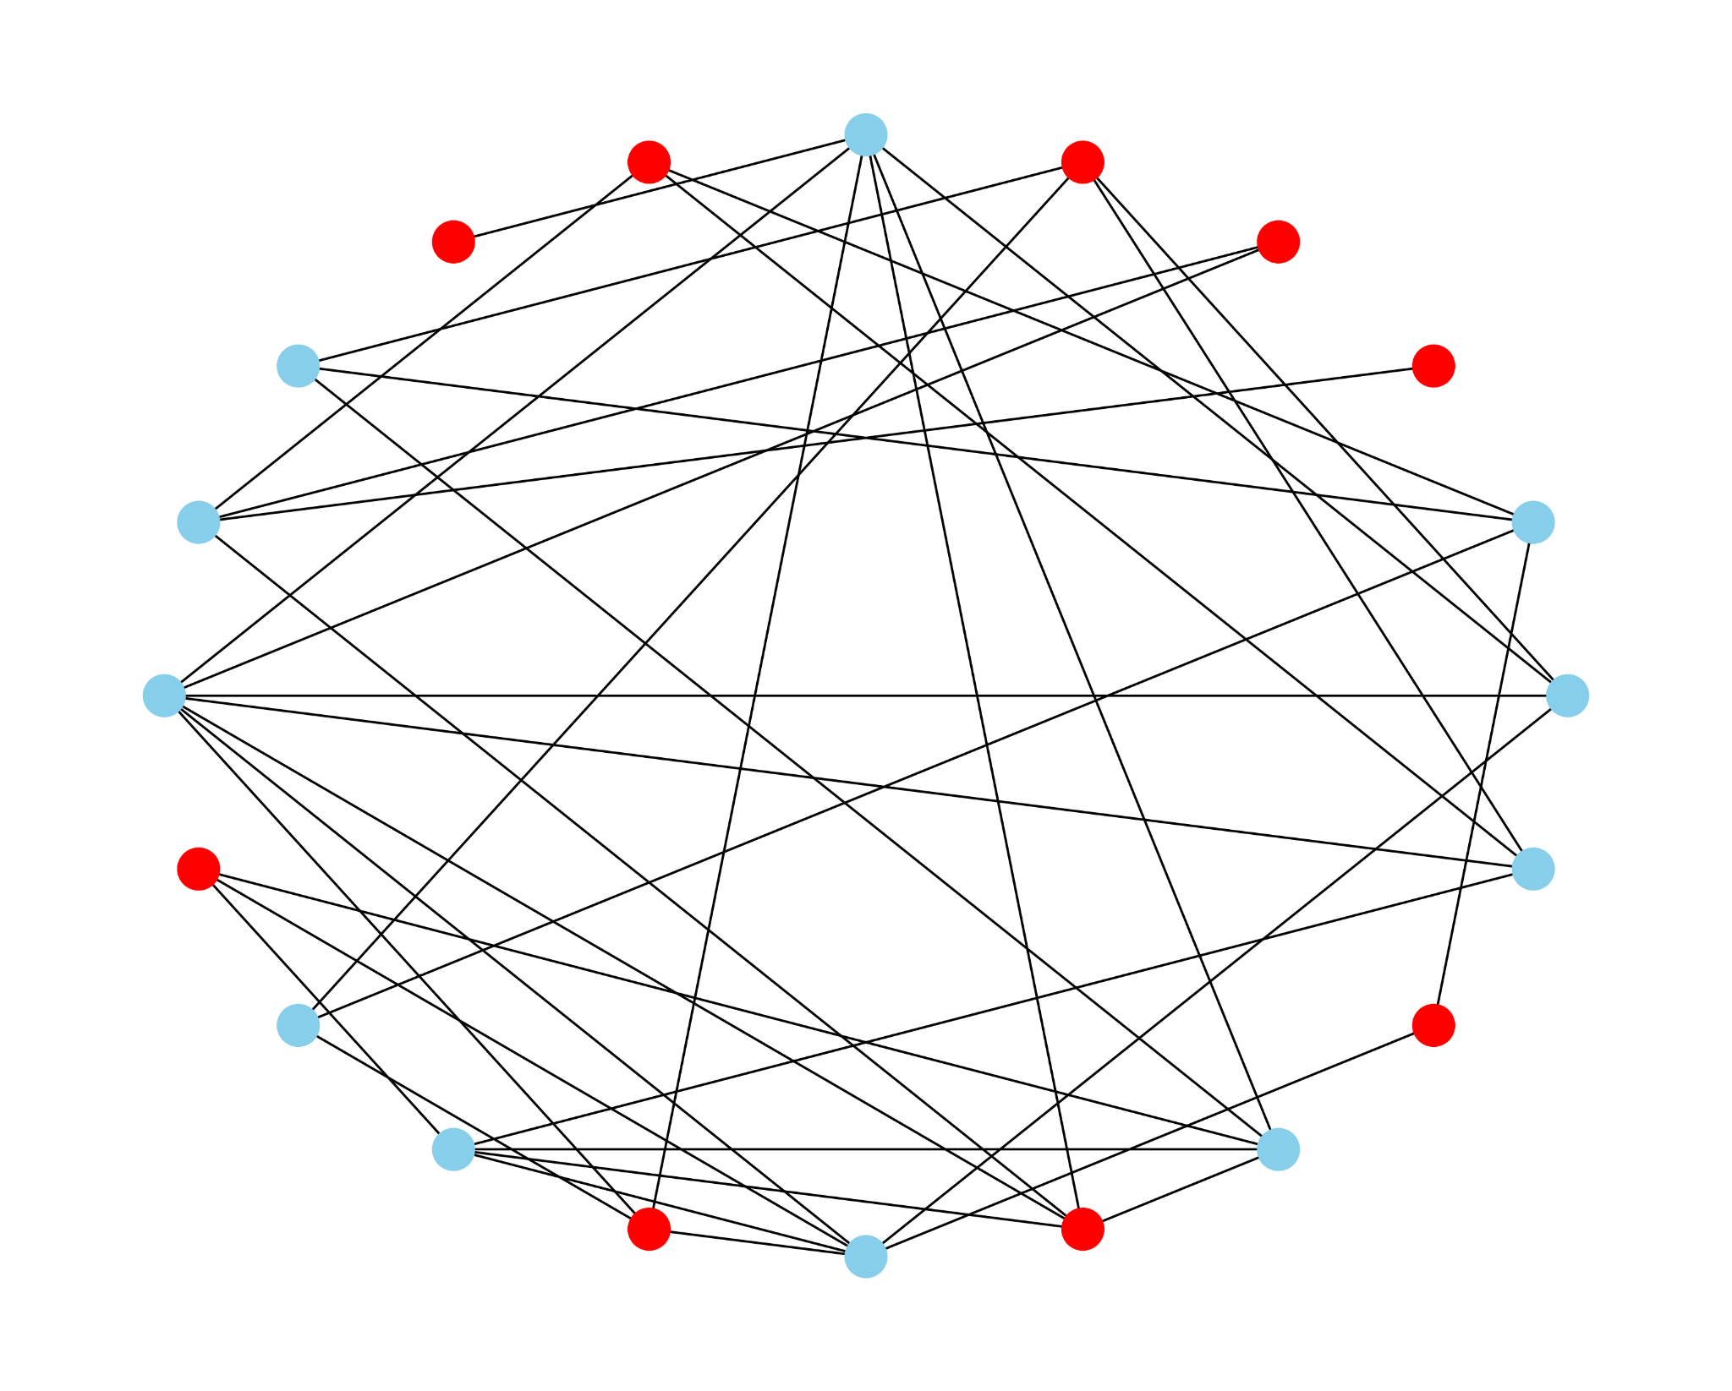
Independent Set
How many people here can we select such that no two of them have co-authored a paper?

Slide 34
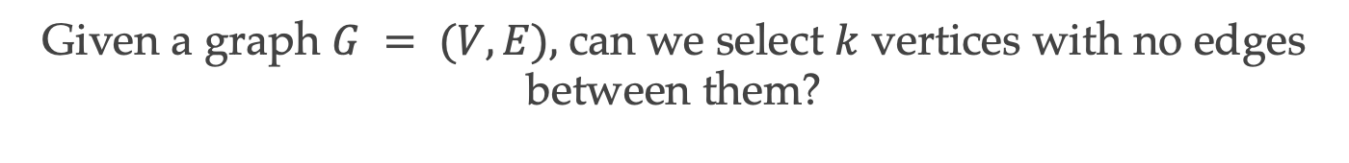
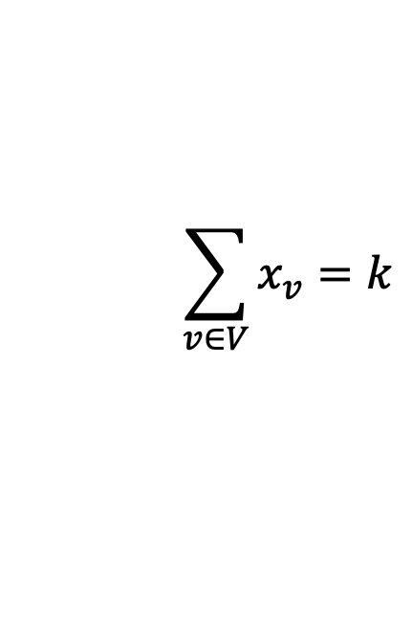

Independent Set
Given a graph $G = (V, E),$can we select $k$ vertices with no edges between them?
Direct encoding
Independence
Cardinality
$$\left(\overline{x_{u}}∨ \overline{x_{v}}\right), ∀\left\{u, v\right\}∈E$$
$$\sum_{v∈V}{x_{v}}=k$$

Slide 35

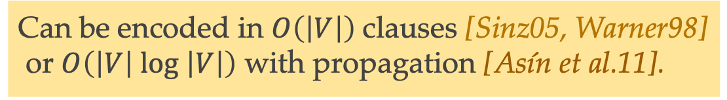
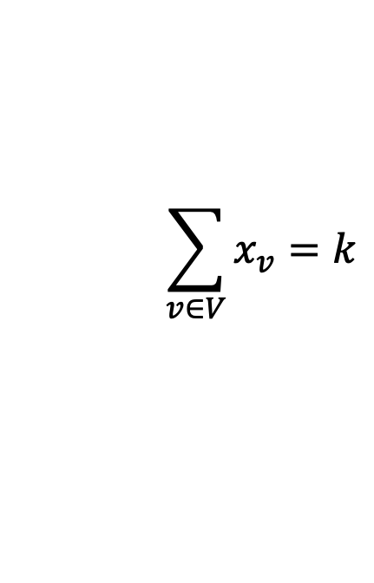
Independent Set
Direct encoding
Independence
Cardinality
$$\left(\overline{x_{u}}∨ \overline{x_{v}}\right), ∀\left\{u, v\right\}∈E$$
$$\sum_{v∈V}{x_{v}}=k$$
Can be encoded in $O\left(\left|V\right|\right)$clauses [Sinz05, Warner98]
or $O\left(\left|V\right| log \left|V\right|\right)$ with propagation [Asín et al.11].

Slide 36
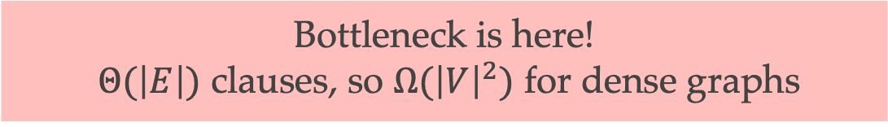
Independent Set
Direct encoding
Independence
Cardinality
$$\left(\overline{x_{u}}∨ \overline{x_{v}}\right), ∀\left\{u, v\right\}∈E$$
$$\sum_{v∈V}{x_{v}}=k$$
Bottleneck is here!
$Θ(\left|E\right|)$ clauses, so $Ω({\left|V\right|}^{2})$ for dense graphs

Slide 37
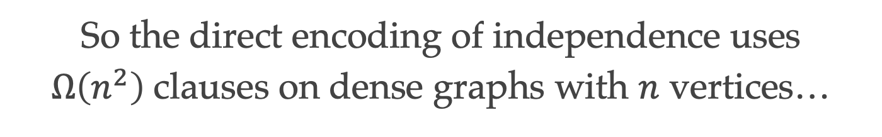
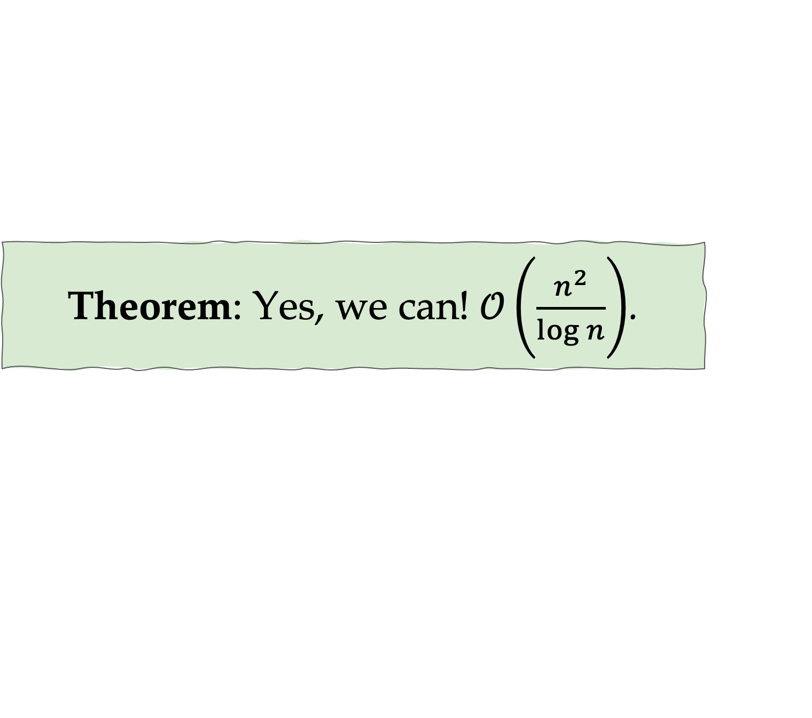
So the direct encoding of independence uses $Ω\left(n^{2}\right)$clauses on dense graphs with $n$ vertices…
Can we do better?
Theorem: Yes, we can!$\left. 𝒪\left(\frac{n^{2}}{\log{n}}\right.\right)$.

Slide 38



And it’s not only independent sets!
Vertex cover
Clique
$$\left(x_{u}∨x_{v}\right), ∀\{u, v\}∈E$$
$\left(\overline{x_{u}}∨\overline{x_{v}}\right), ∀\{u, v\}∉$ $E$
Graph coloring
$\left(\overline{x_{u, red}}∨\overline{x_{v, red}}\right), ∀\{u, v\}∈$ $E$

Slide 39
And it’s not only independent sets!
It’s any 2-CNF in which all occurrences of a variable have the same polarity!
But every 2-CNF has a large subformula of this form!
Proof. For every variable, flip a coin to decide its polarity, and then eliminate the clauses that don’t respect the chosen polarities. Each clause has probability ¼ of surviving, so in expectation ¼ of the clauses survive. At the very least some case matches the expectation!

Slide 40
One of the first things I learnt from my advisor Marijn
Q: What is the average width of a clause used in a SAT encoding?
A: less than 3

Slide 41
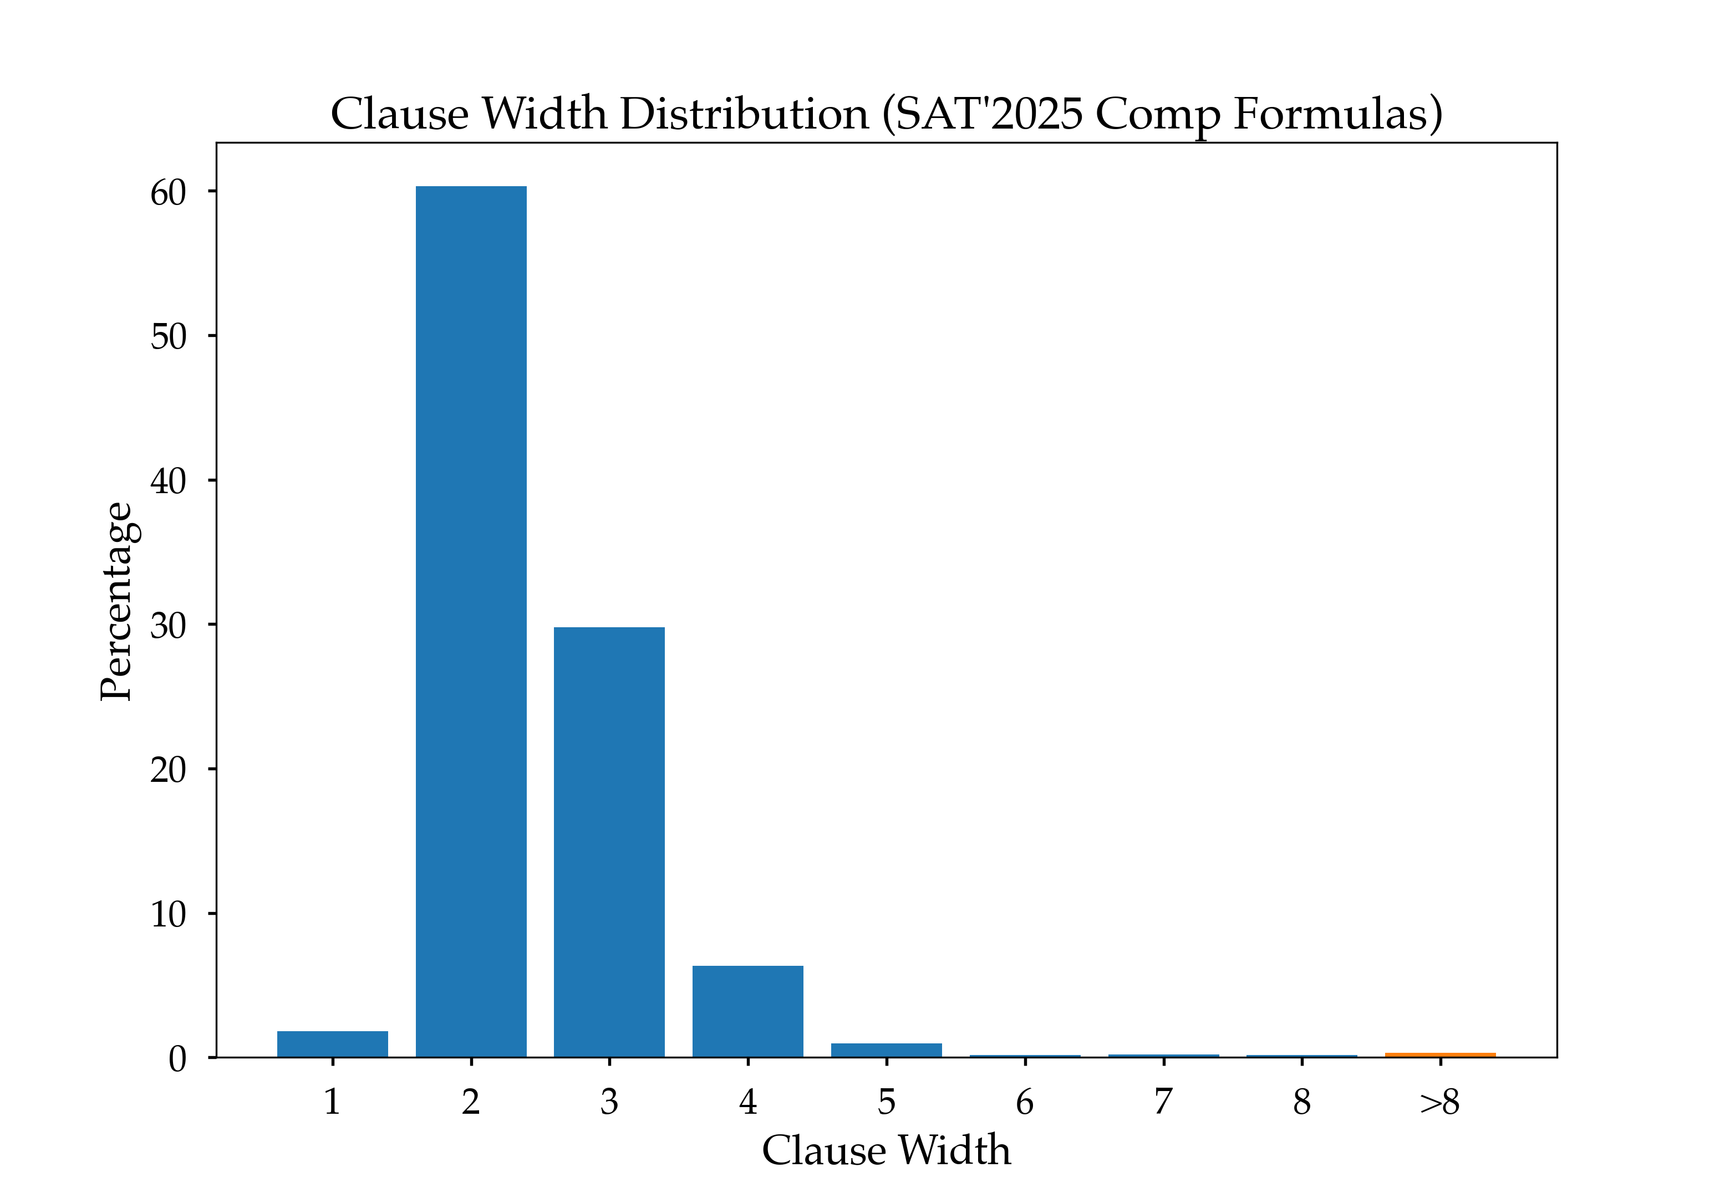
Avg = 2.67

Slide 42
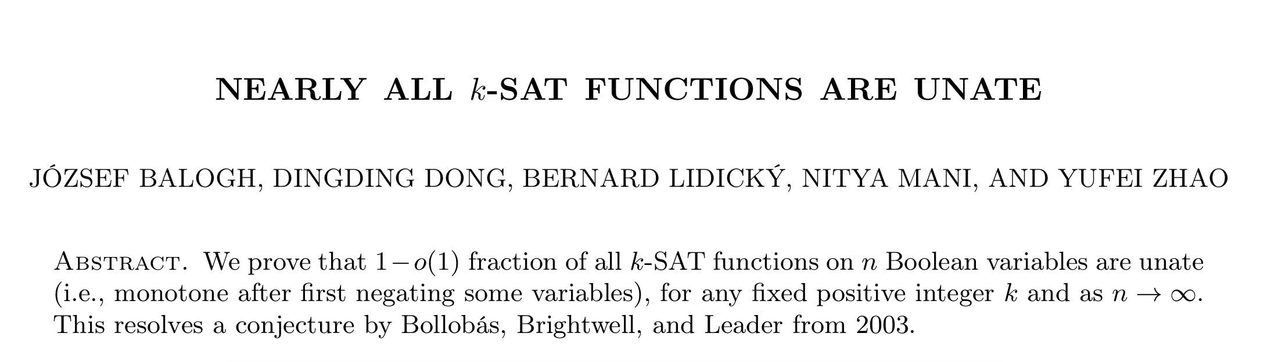
So I’m basically saying that we can
Provably reduce #clauses by a log-factor in most dense 2-CNF formulas
Including many natural graph problems, even on random instances
Get rid of a good fraction of clauses on almost k-CNFs !!
and all of this preserving propagation completeness

Slide 43
So are you saying this can really speed-up SAT solving?!
It already did!
It’s Bounded Variable Addition [Manthey, Heule, Biere 2012]
SBVA Winner of SAT Competition 2023

Slide 44
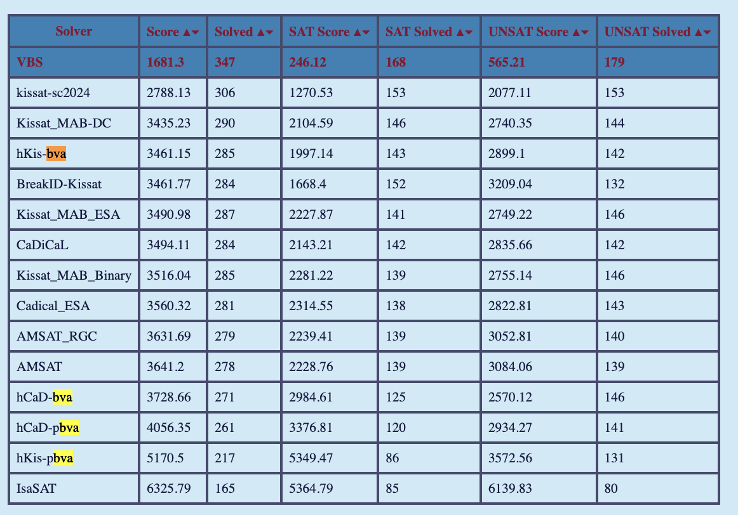
So are you saying this will really speed-up SAT solving?!
It already did!
It’s Bounded Variable Addition [Manthey, Heule, Biere 2012]
SBVA Winner of SAT Competition 2023

Slide 45
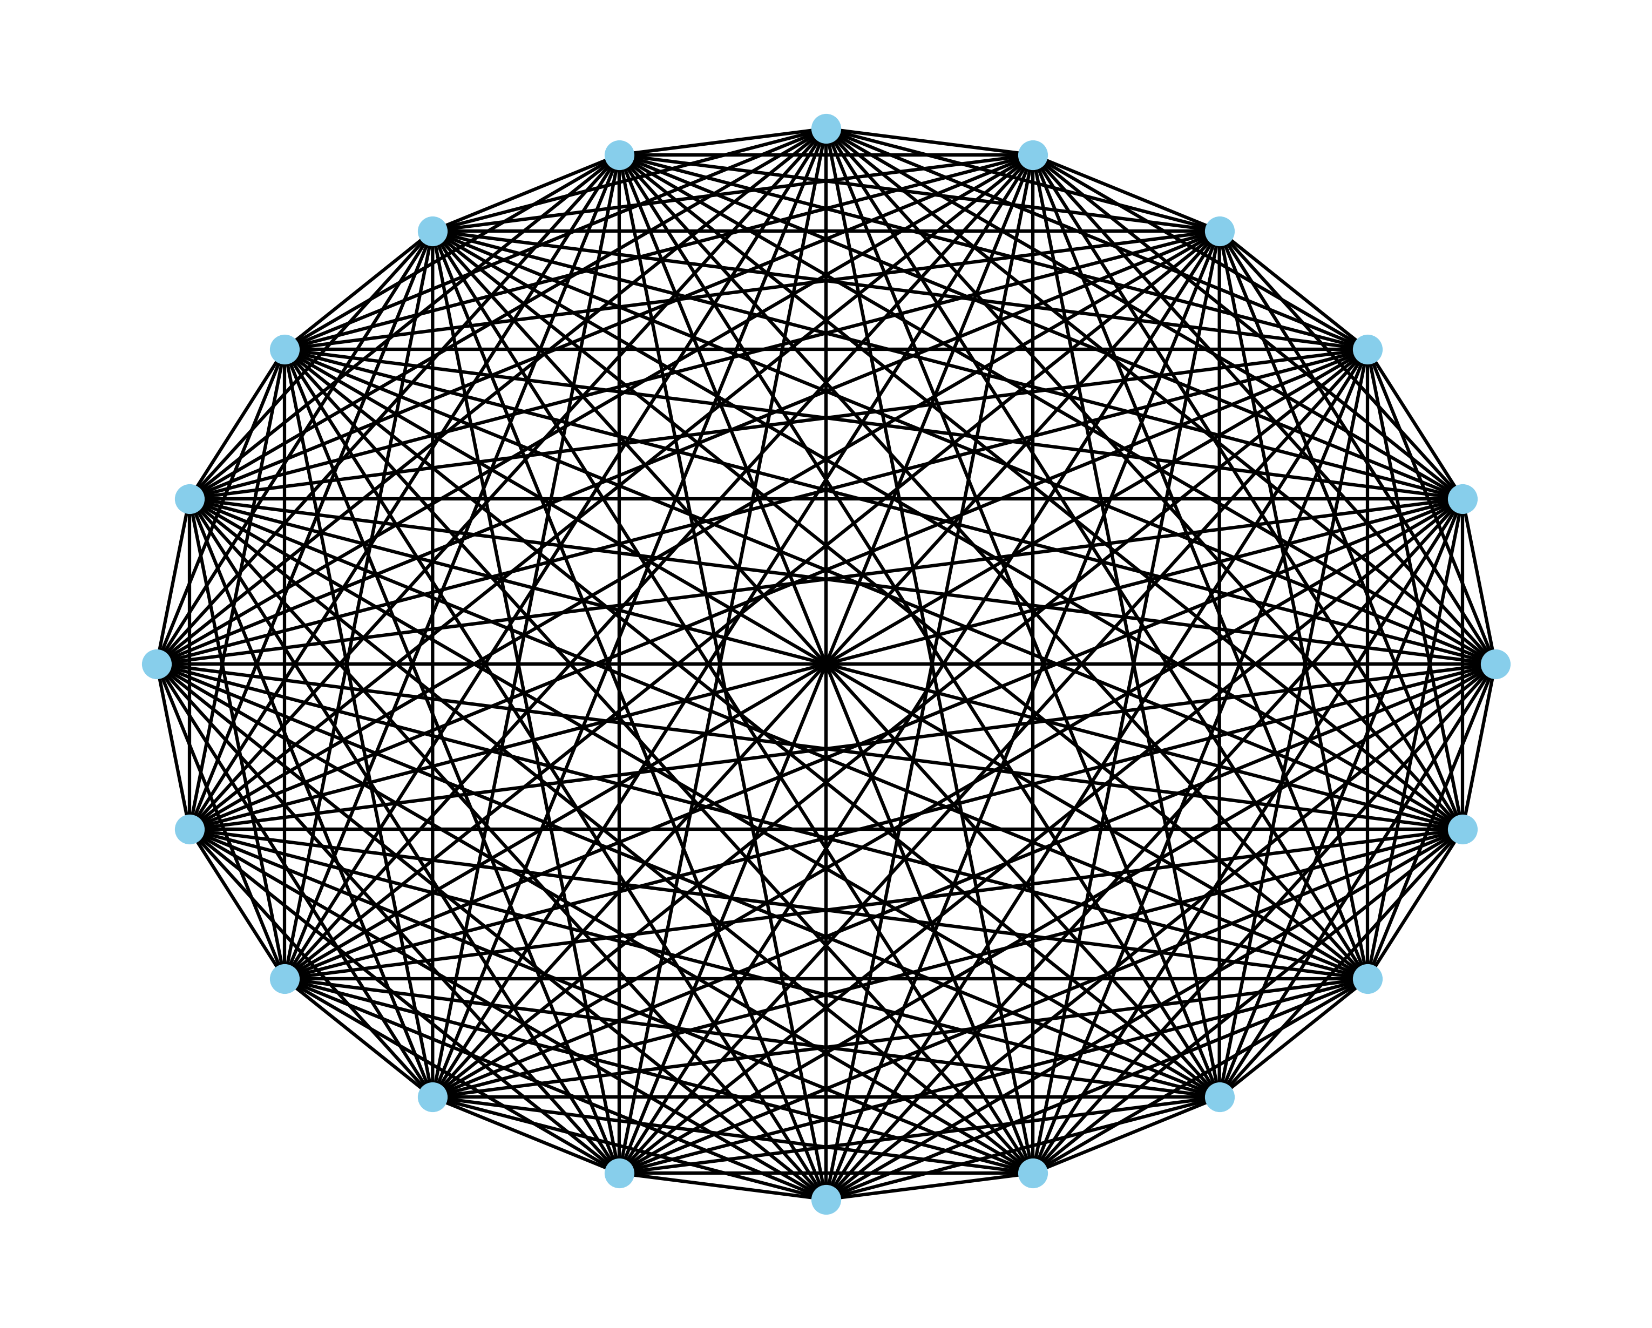
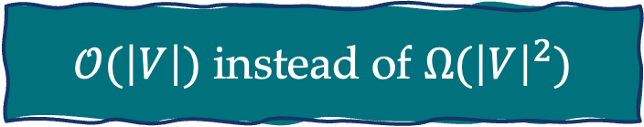
So how does it work?
Observation 1:
If your graph is a clique, then to encode independence just do AtMostOne vertex!
$𝒪(\left|V\right|)$ instead of $Ω({\left|V\right|}^{2})$

Slide 46


So how does it work?
Observation 2:
If your graph has a large clique $K_{t}$, then do AtMostOne vertex of the clique!
$𝒪\left(t\right)$ instead of $Ω(t^{2})$

Slide 47

This is almost the right idea!
Observed by [Ignatiev, Morgado, Marques-Silva, 2017], but they note that this doesn’t always help, since in a complete bipartite graph you don’t have cliques larger than 2

Slide 48

The right idea: bicliques

Slide 49

The right idea: bicliques

Slide 50


Why is this the right idea?
[Kővári, Sós, Turán, 1954] Any graph with $Ω\left(n^{2}\right)$ edges contains a $K_{t,t }$with $t=Θ(\log{n)}$
[Chung, Erdős, Spencer, 1983] Any graph on $n$ vertices can be written as a union of bicliques $B_{1}, …, B_{m}$ with
$$\sum_{i=1}^{m}{\left|V\left(B_{i}\right)\right|=𝒪\left(\frac{n^{2}}{\log{n}}\right)}$$

Slide 51

Theorem: The independence property of every n-vertex graph can be encoded as a 2-CNF with $𝒪\left(\frac{n^{2}}{\log{n}}\right)$ clauses.
Encoding can be computed in $𝒪\left(n^{2}\right)$.
Can we do better?

Slide 52

Relative power of BVA
Theorem: BVA is strictly more powerful than the biclique covering idea
It can do biclique coverings, but it can also reencode the complete graph into $O(n)$ clauses, while the best biclique covering of the complete graph uses $O(n\log{n)}$ clauses!
The secret: BVA can do recursive bicliques of bicliques

Slide 53
Theoretical understanding of BVA
We characterize the reencoding “power” of BVA in terms of rectifier networks, a generalization of biclique covers.

Slide 54
Theoretical understanding of BVA
We characterize the reencoding “power” of BVA in terms of rectifier networks, a generalization of biclique covers.
We can e.g., prove exactly how many clauses will result from BVA(NaiveAtMostOne(x₁, …, x_{n}))

Slide 55
Theoretical understanding of BVA
We characterize the reencoding “power” of BVA in terms of rectifier networks, a generalization of biclique covers.
We can e.g., prove exactly how many clauses will result from BVA(NaiveAtMostOne(x₁, …, x_{n}))
We have an implementation of an algorithm with provable guarantees and x10 faster

Slide 56
Remember the Plus Encoding?
It’s a biclique partition, with adjacent pluses reencoding bicliques!

Slide 57
Towards a Science of CNF Encodings
Based on work with Benjamin Przybocki and Andrew Krapivin
Bernardo Subercaseaux (CMU)

Slide 58

tinyurl.com/atMostOne

Slide 59


Slide 60


