Slide 1
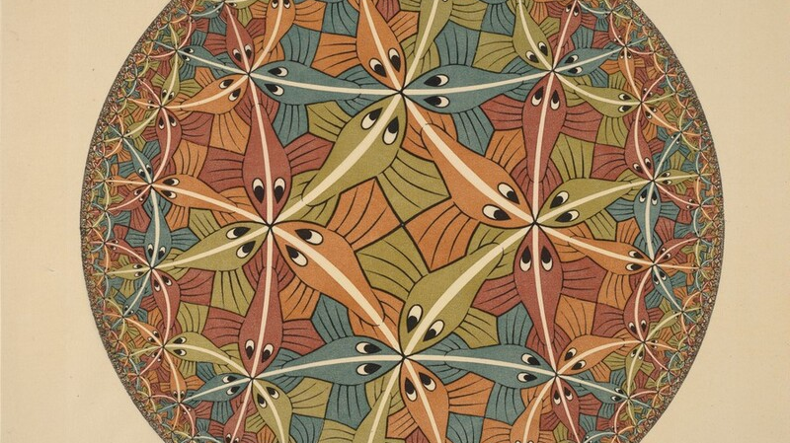
Near-Optimal Encodings of Cardinality Constraints
Bernardo Subercaseaux (bersub@cmu.edu)
Joint work with Andrew Krapivin and Benjamin Przybocki

Slide 2
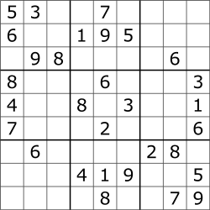
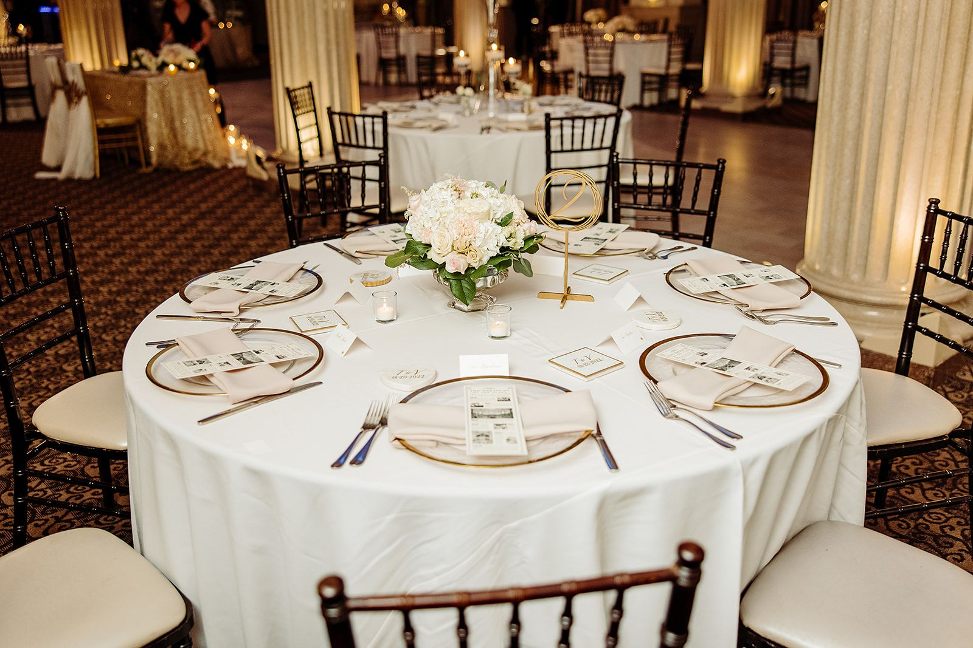


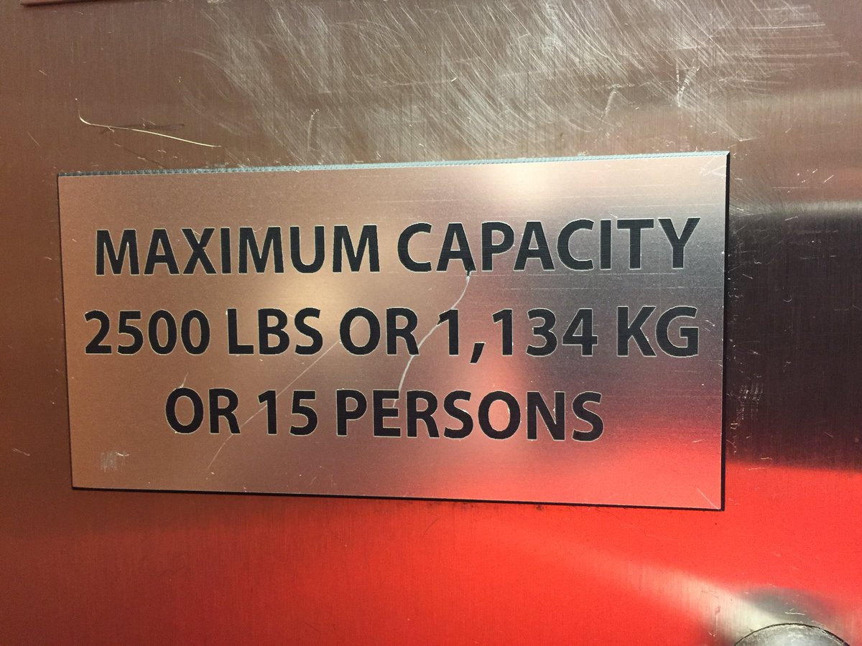
Cardinality constraints are everywhere!
exactly one 7 per row
at most 7 people per table
at least 3 reviewers per paper
exactly two edges per vertex
at most K as an approximation/redundant

Slide 3
Why encode these?

Slide 4
Summary

