Slide 1

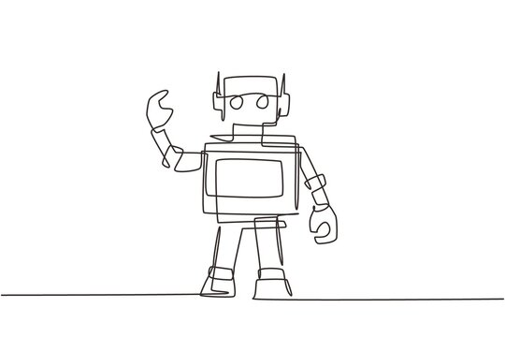
Computer-Assisted Intuition:
SAT Solvers in Mathematical Discovery
Bernardo Subercaseaux
Carnegie Mellon University
Notes:
Hi everyone! So I’ll be talking about SAT solvers can assist mathematical research. And I wanted to start by sharing a quote of Jordan Ellenberg that summarizes my point of view.

Slide 2
- Jordan Ellenberg
“What’s most exciting to me is modeling new modes of human-machine collaboration.
I don’t look to use these as a replacement for human mathematicians, but as a force multiplier.”
Notes:
(Mathematician that co-authored FunSearch with DeepMind,
using LLMs to improve bounds on the cap-set problem)

Slide 3
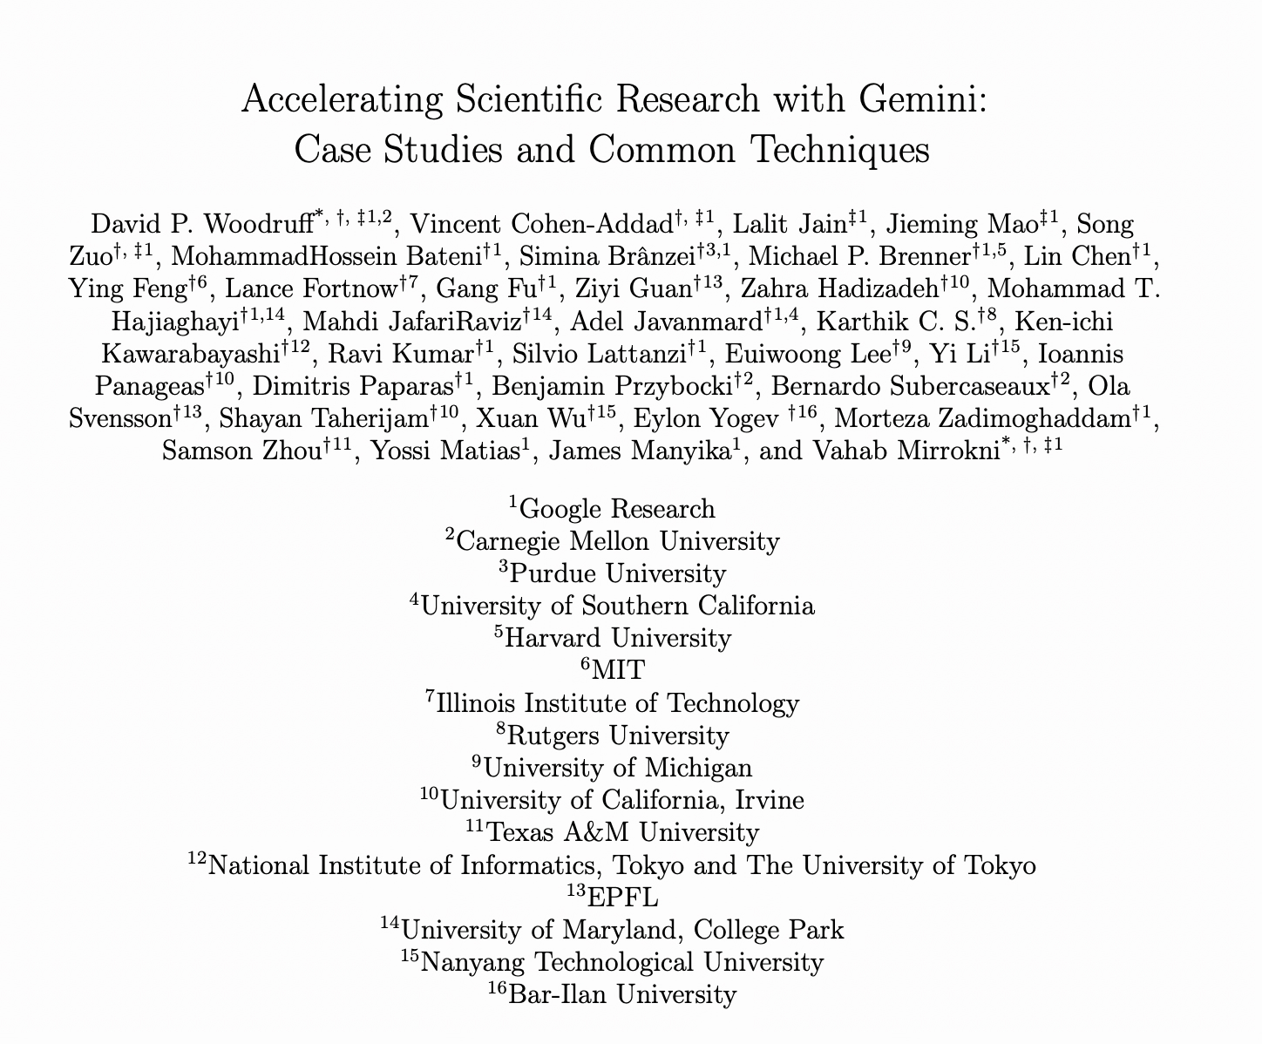
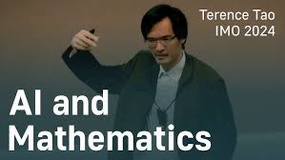
Computation has been assisting math since the beginning !
Abacus
Tables (Logarithm, Primes, OEIS, Elliptic curves, Groups)
Computer Algebra Systems (Maple, SAGE, Mathematica)
SAT solvers
Formal theorem provers (Lean)
LLMs?
Notes:
And for a bit of a broader context,

Slide 4
Computation has been assisting math since the beginning !
Abacus
Tables (Logarithm, Primes, OEIS, Elliptic curves, Groups)
Computer Algebra Systems (Maple, SAGE, Mathematica)
SAT solvers
Formal theorem provers (Lean)
LLMs?

Slide 5

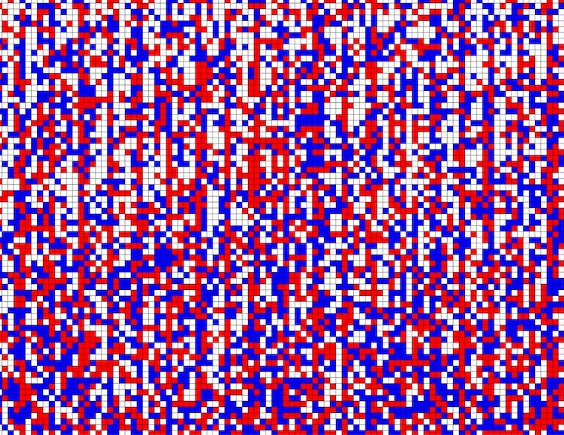
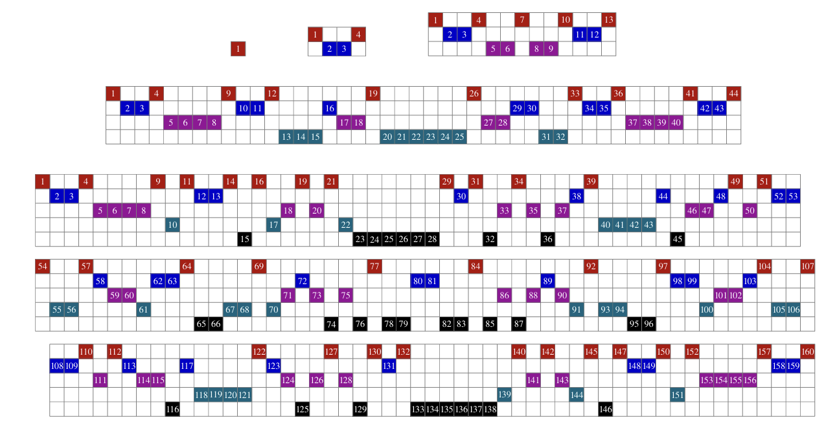
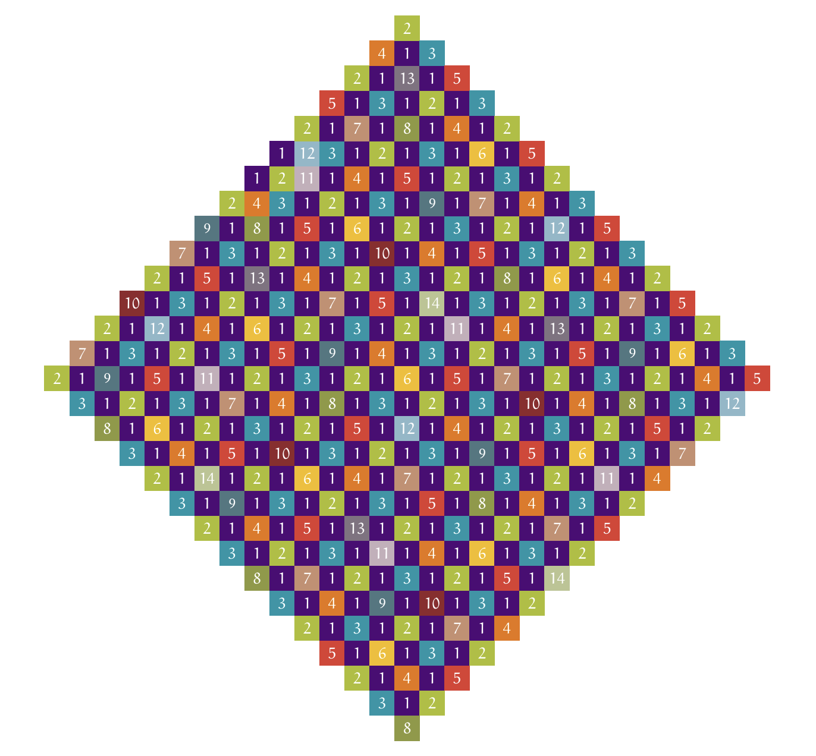
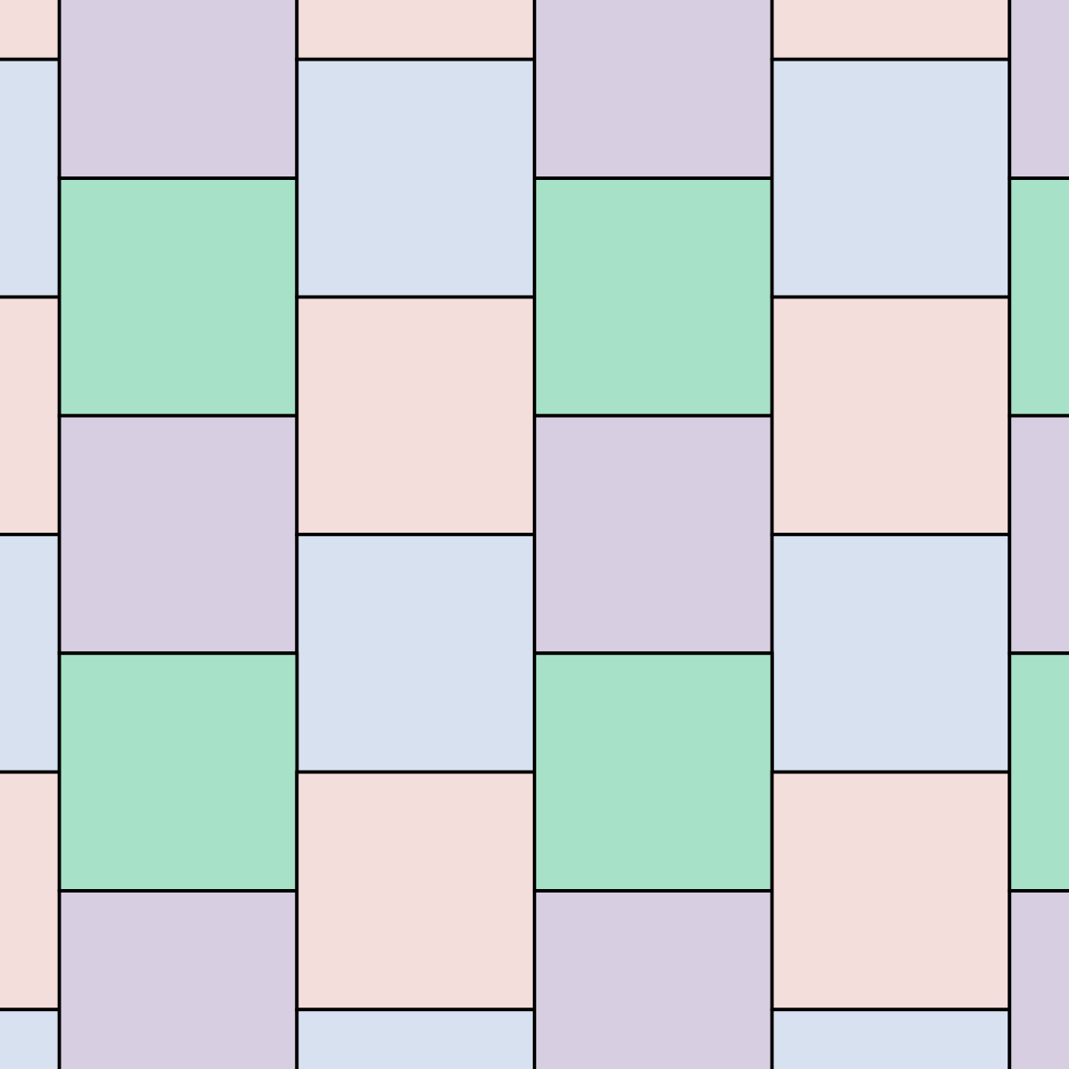
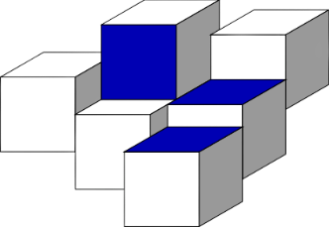
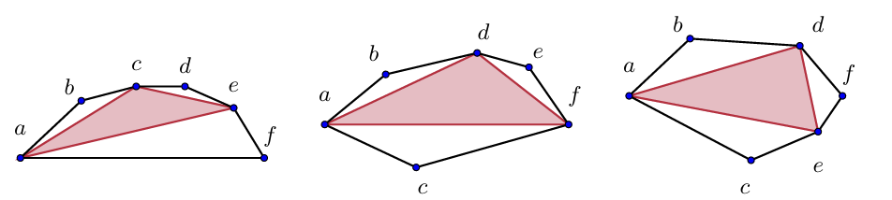
You’ve already heard about SAT for Math (?)
1 + 1 – 1 + 1 + 1
-1 + 1 – 1 + 1 – 1
+ 1 – 1 + 1 + 1 + 1
- 1 - 1 + 1 + 1 - 1
(2014) Boolean Erdős Discrepancy
(2016) Boolean Pythagorean Triples
(2018) Schur Number 5
(2019) Keller’s Conjecture
(2023) Packing Chromatic Number of Z²
(2024) Empty Hexagon every 30 Points

Slide 6
SAT solvers have been impactful in math!
These all follow a common pattern:
Using SAT solvers to put an end to a combinatorial problem where naïve brute force (i.e., backtracking) would take forever
1 + 1 – 1 + 1 + 1
-1 + 1 – 1 + 1 – 1
+ 1 – 1 + 1 + 1 + 1
- 1 - 1 + 1 + 1 - 1
What this talk is about:
SAT solvers can be used at different stages of mathematical research; to build examples, get ideas, and elicit conjectures.
(2014) Boolean Erdős Discrepancy
(2016) Boolean Pythagorean Triples
(2018) Schur Number 5
(2019) Keller’s Conjecture
(2023) Packing Chromatic Number of Z²
(2024) Empty Hexagon every 30 Points

Slide 7
Vision:
P1. (Counter)examples help drive mathematical progress
P2. Finding such (counter)examples can be (NP)-hard
P3. SAT solvers solve instances of NP-hard problems in practice
C. SAT solvers can help drive mathematical progress

Slide 8
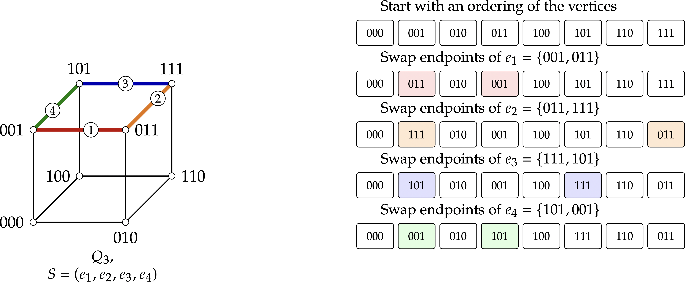
A problem from Symbolic Dynamics

Slide 9
A problem from Symbolic Dynamics

Slide 10
A problem from Symbolic Dynamics

Slide 11
A problem from Symbolic Dynamics

Slide 12
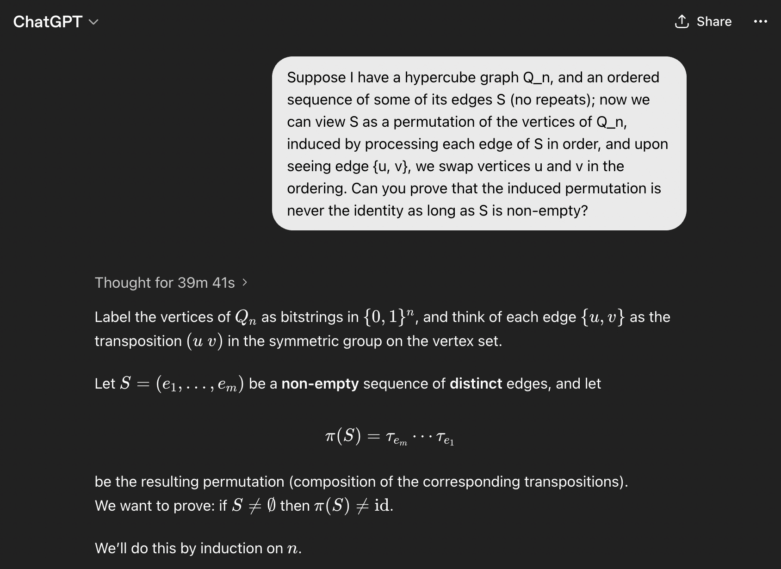
A problem from Symbolic Dynamics

Slide 13
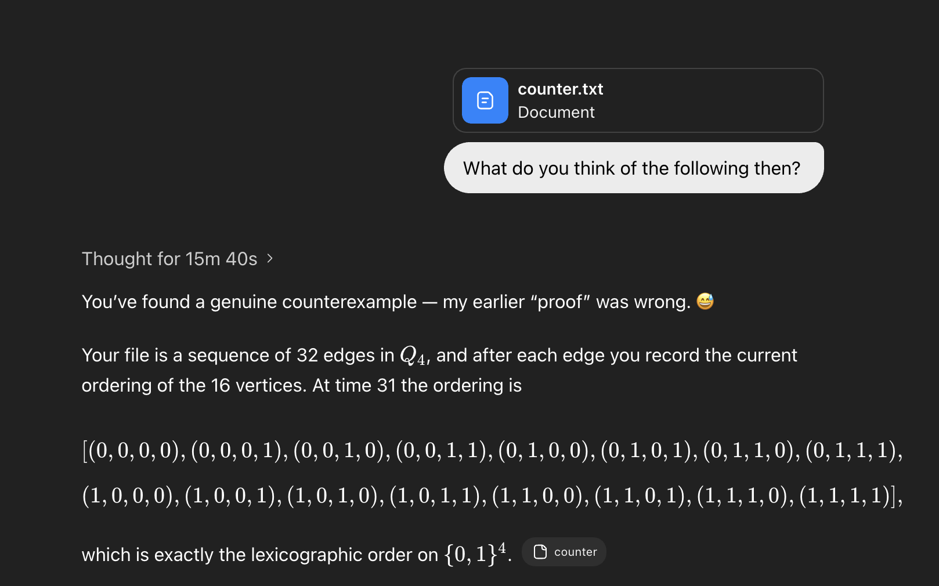

Slide 14
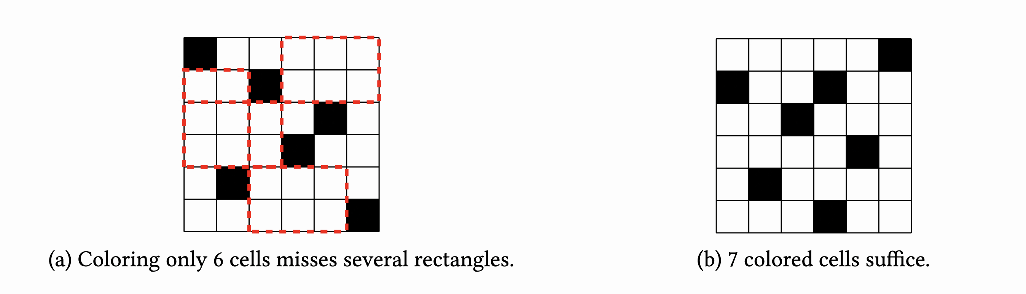

A grid covering problem
What is the minimum number of cells of an N x N grid that intersects all rectangles of area $≥$ N?

Slide 15
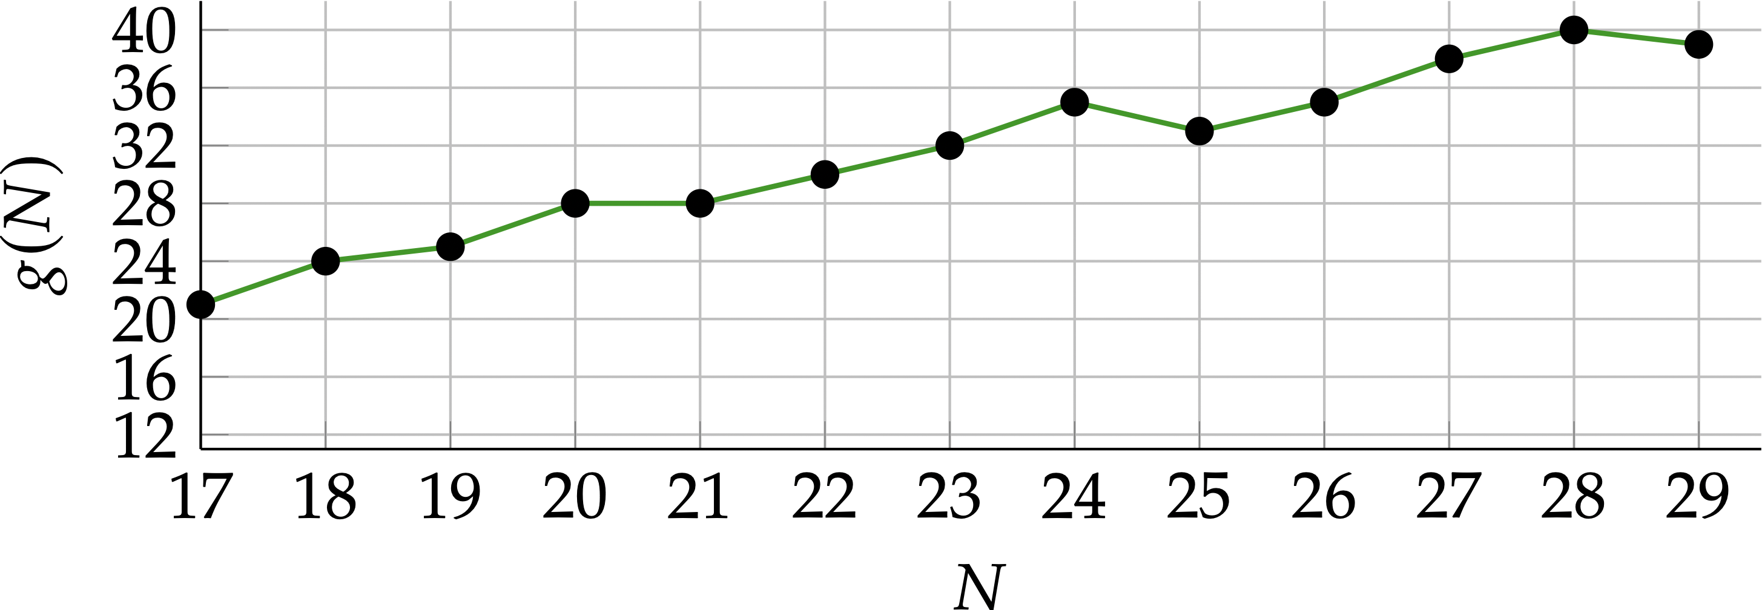
A grid covering problem
What is the minimum number of cells of an N x N grid that intersects all rectangles of area $≥$ N?

Slide 16
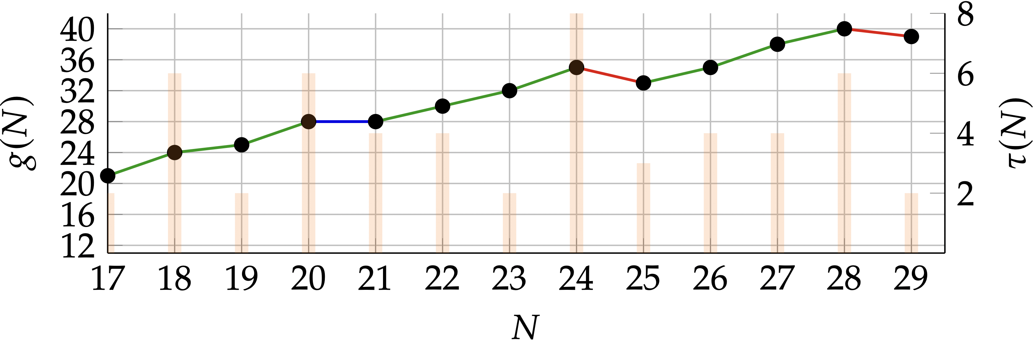
A grid covering problem
What is the minimum number of cells of an N x N grid that intersects all rectangles of area $≥$ N?

Slide 17
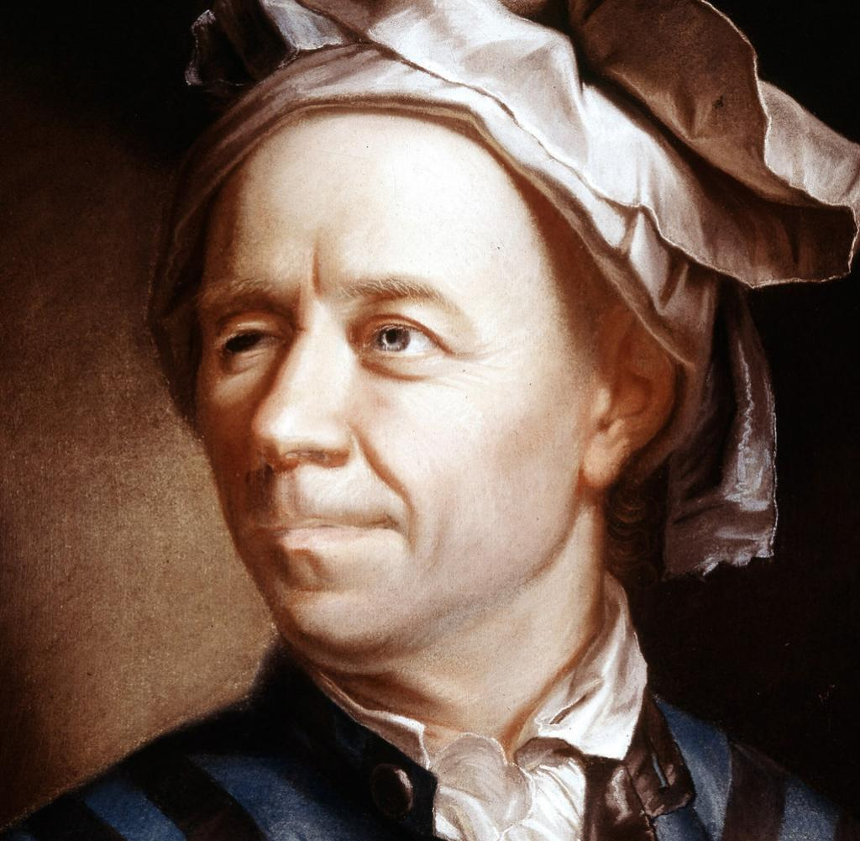
Leonhard Euler (1761)
Specimen de usu observationum in mathesi pura
(Example of the use of observation in pure mathematics)

Slide 18
(Part 1)
“It will seem not a little paradoxical to ascribe a great importance to observations even in that part of the mathematical sciences which is usually called Pure Mathematics, since the current opinion is that observations are restricted to physical objects that make impression on the senses. As we must refer the numbers to the pure intellect alone, we can hardly understand how observations and quasi-experiments can be of use in investigating the nature of the numbers”

Slide 19
(Part 1)
“It will seem not a little paradoxical to ascribe a great importance to observations even in that part of the mathematical sciences which is usually called Pure Mathematics, since the current opinion is that observations are restricted to physical objects that make impression on the senses. As we must refer the numbers to the pure intellect alone, we can hardly understand how observations and quasi-experiments can be of use in investigating the nature of the numbers”

Slide 20
(Part 1)
“Yet, in fact, as I shall show here with very good reasons, the properties of the numbers known today have been mostly discovered by observation, and discovered long before their truth has been confirmed by rigid demonstrations.”

Slide 21
(Part 2)
“There are even many properties of the numbers with which we are well acquainted, but which we are not yet able to prove; only observations have led us to their knowledge. Hence we see that in the theory of numbers, which is still very imperfect, we can place our highest hopes in observations; they will lead us continually to new properties which we shall endeavor to prove afterwards.”

Slide 22
(Part 2)
“The kind of knowledge which is supported only by observations and is not yet proved must be carefully distinguished from the truth; it is gained by induction, as we usually say. Yet we have seen cases in which mere induction led to error. Therefore, we should take great care not to accept as true such properties of the numbers which we have discovered by observation and which are supported by induction alone. Indeed, we should use such a discovery as an opportunity to investigate more exactly the properties discovered and to prove or disprove them; in both cases we may learn something useful.”

Slide 23
In the next ~50 minutes
I will try to convince you that SAT solvers are:
Easy to use
A powerful tool for assisting discrete math research
Free of hallucinations ;)

Slide 24
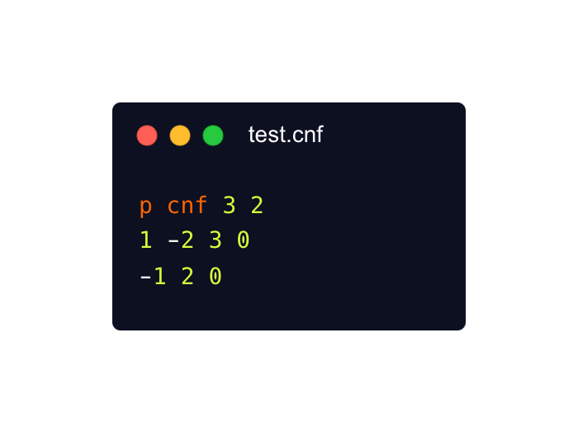

Quick Q&A
Q: What is a SAT solver?
A: A highly optimized program for deciding if a Boolean formula is satisfiable
Q: A Boolean formula?
A:
Q: Satisfiable?
A: Yes!
Q: And how do I write this on my computer ?
A:

Slide 25

Quick Q&A
Q: What is a SAT solver?
A: A highly optimized program for deciding if a Boolean formula is satisfiable
Q: A Boolean formula?
A:
Instead of writing this manually, you write high-level code that generates this!
Q: Satisfiable?
A: Yes!
Q: And how do I write this on my computer ?
A:

Slide 26
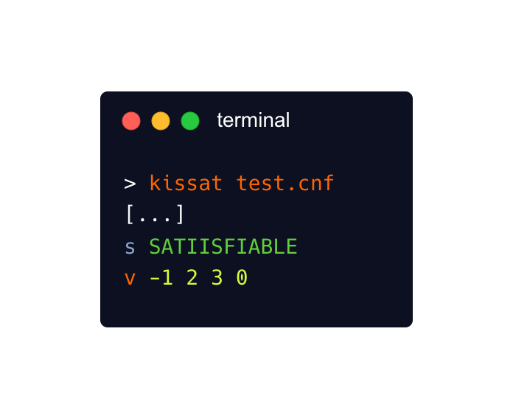
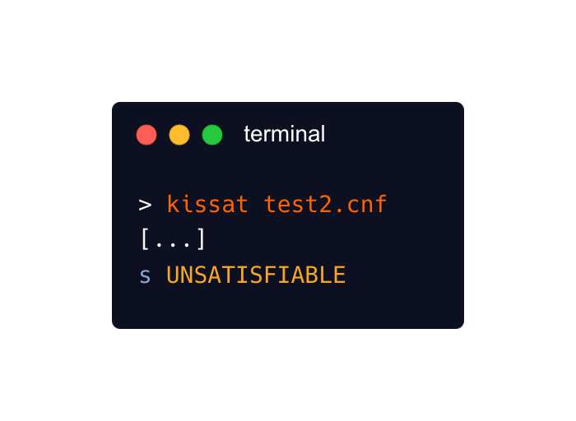

Quick Q&A
Q: And then what?
A:
or
or
You can also get a reproducible proof!

Slide 27
Quick Q&A
Q: Wait but isn’t SAT an NP-complete problem?!
A: Exactly!
It’s hard !
Writing your own efficient algorithm is a large engineering challenge
It’s universal !
Can represent a lot of different math problems
E.g., Graphs, matroids, groups, geometry

Slide 28
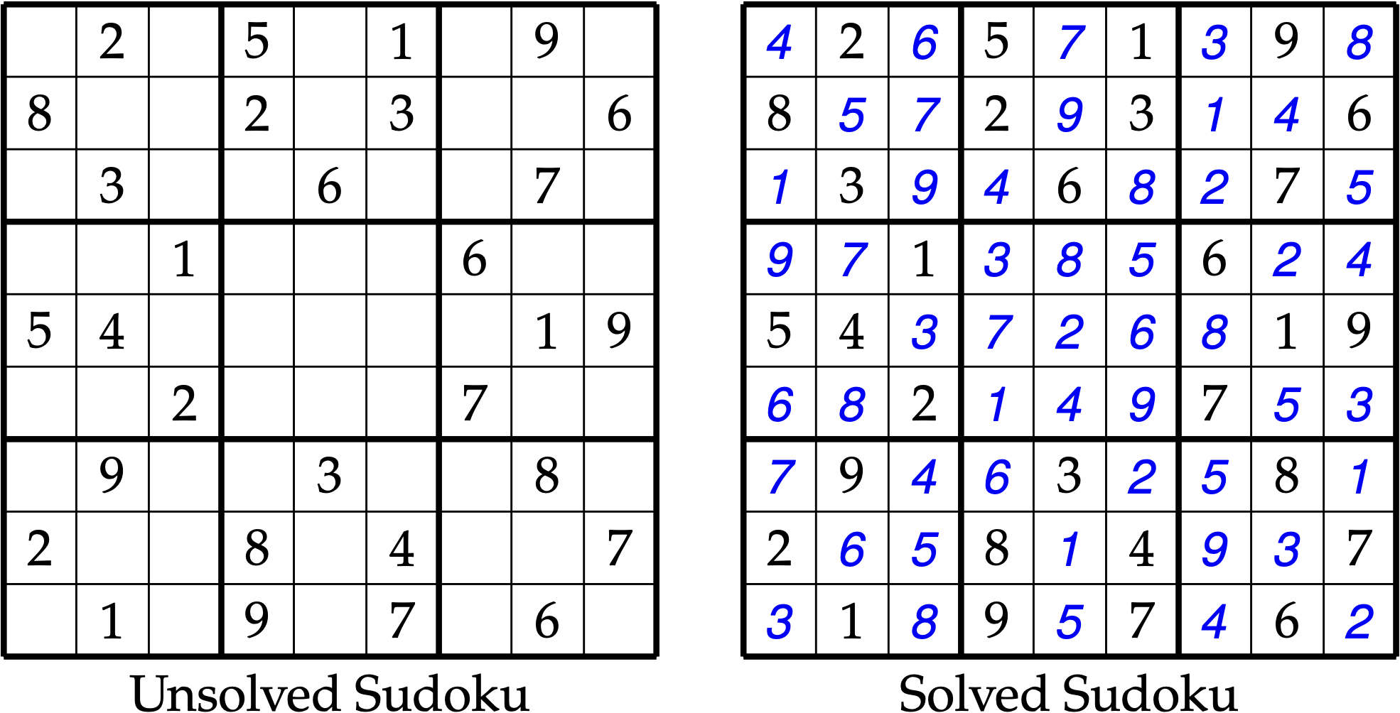
A toy example: Sudoku
Each cell must contain a number from {1, …, 9}
Each number from {1, …, 9} needs to appear exactly once per: - Row
- Column
- 3x3 major subgrid

Slide 29
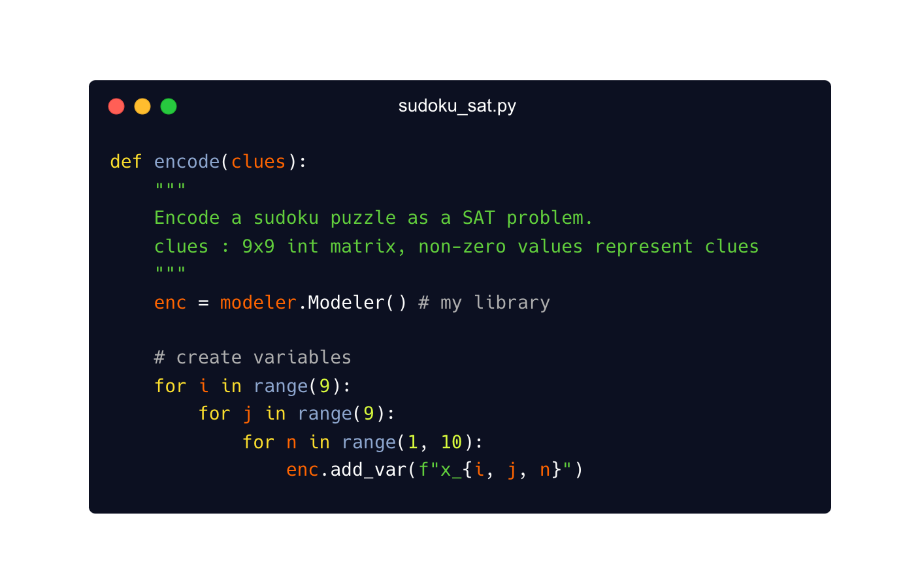

A toy example: Sudoku
Variables:
“cell (i, j) gets number n”

Slide 30
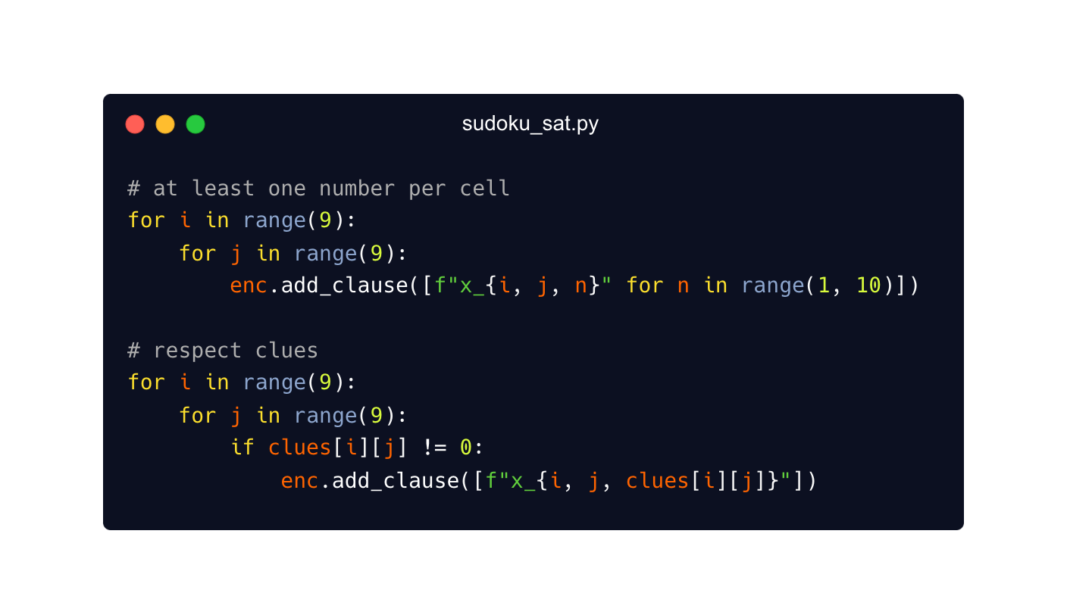
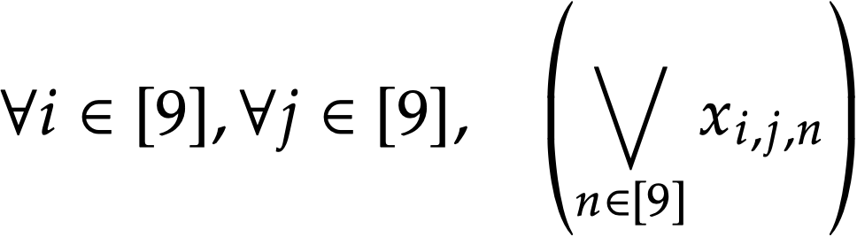

Sudoku Constraints
Each cell must contain a number from {1, …, 9}
  Respect clues!

Slide 31
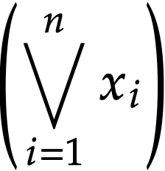
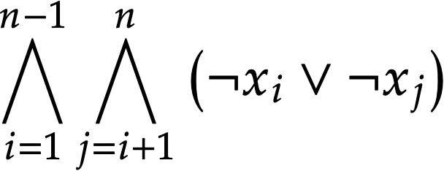
Sudoku Constraints
How to encode “Exactly one of the variables x₁, x₂, …, x_{n} is true”?
At least one
At most one
(naïve)

Slide 32



SAT encodings can be interesting ;)
If all we have are the variables x₁, x₂, …, x_{n}
then AMO(x₁, x₂, …, x_{n}) requires O(n²) clauses
Introduce “auxiliary” variable y that summarizes information
Suppose y summarizes whether a variable in {x₁, x₂, x₃} is true

Slide 33
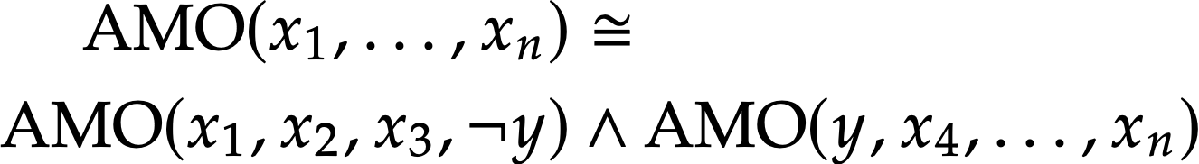
SAT encodings can be interesting ;)
Number of clauses f(n) satisfies f(n) = f(4) + f(n-2),
therefore, we have f(n) = O(n)
This is just the tip of the iceberg!
Good encodings are cool math on their own!

Slide 34
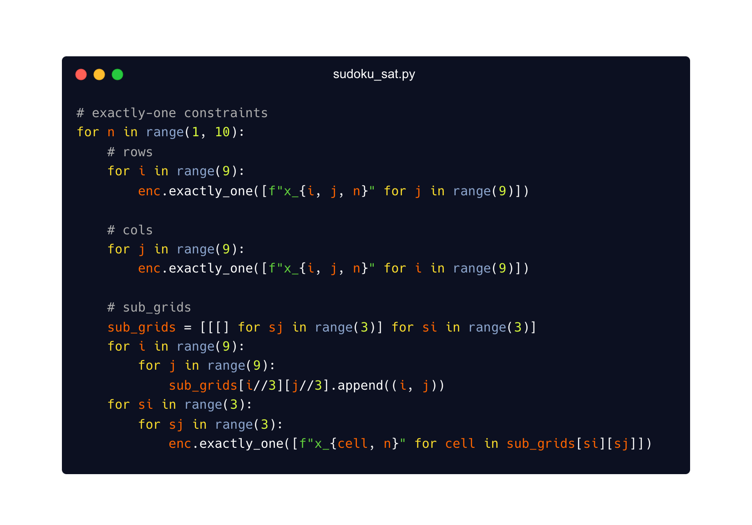
Cardinality constraints included in libraries

Slide 35
Okay, now on to some math examples!
Main idea: to gain insight on a problem, we will search for finite objects.
The (non-)existence of such objects will be encoded in a Boolean formula

Slide 36
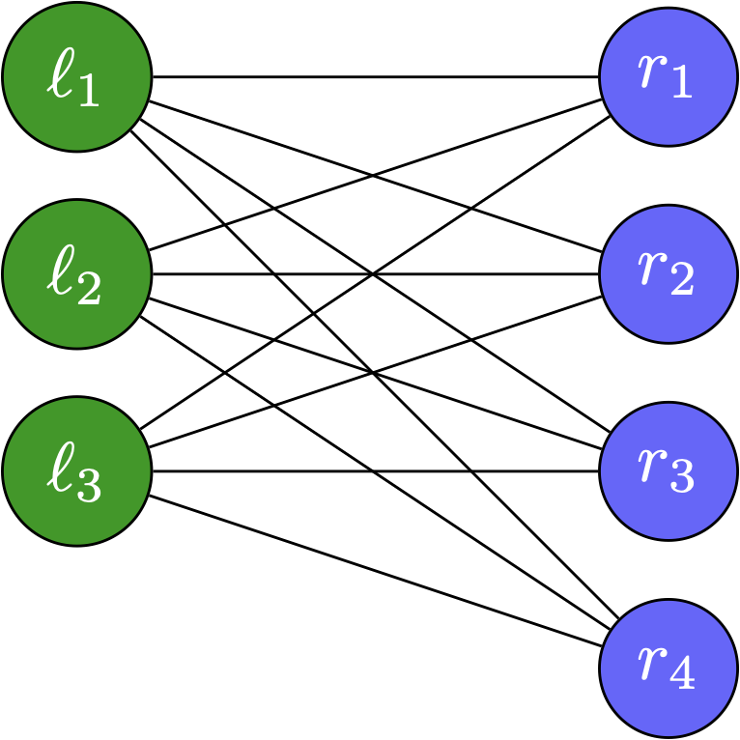
Mantel’s problem
What’s the maximum number of edges on
a triangle-free graph on n vertices?
Could we have more edges?
Is there a non-isomorphic graph that also achieves this?

Slide 37
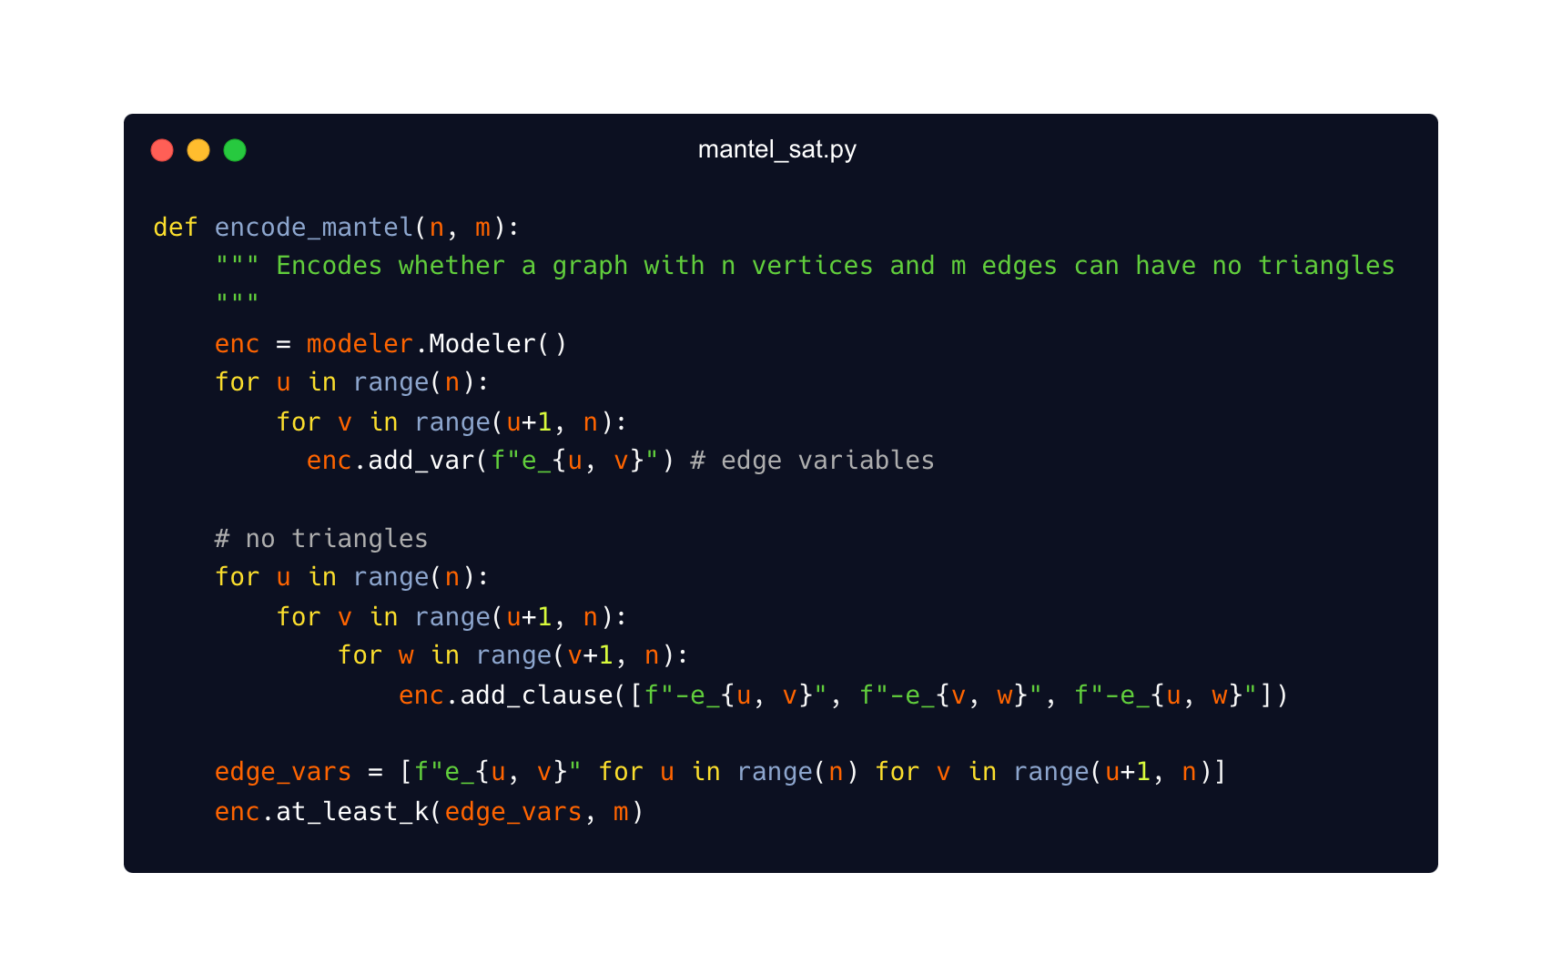
Mantel’s problem
What’s the maximum number of edges on
a triangle-free graph on n vertices?

Slide 38


Mantel’s problem
What’s the maximum number of edges on
a triangle-free graph on n vertices?
Could we have more edges?
Is there a non-isomorphic graph that also achieves this?

Slide 39
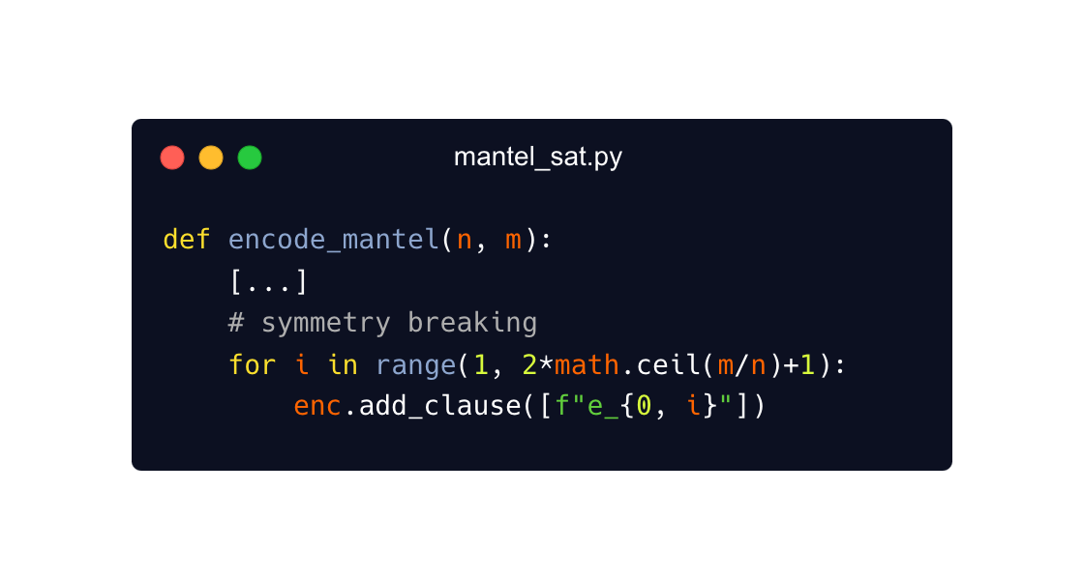
Mantel’s problem & Symmetry Breaking
If sum of degrees is 2m, some vertex has degree at least 2m/n
WLOG, that’s vertex 0, and that it’s connected to 1, 2, …, ceil(2m/n)
This is not enough to break all symmetries of the problem, but if we also force the edges of 0 to be sorted...
Then solution is unique!

Slide 40
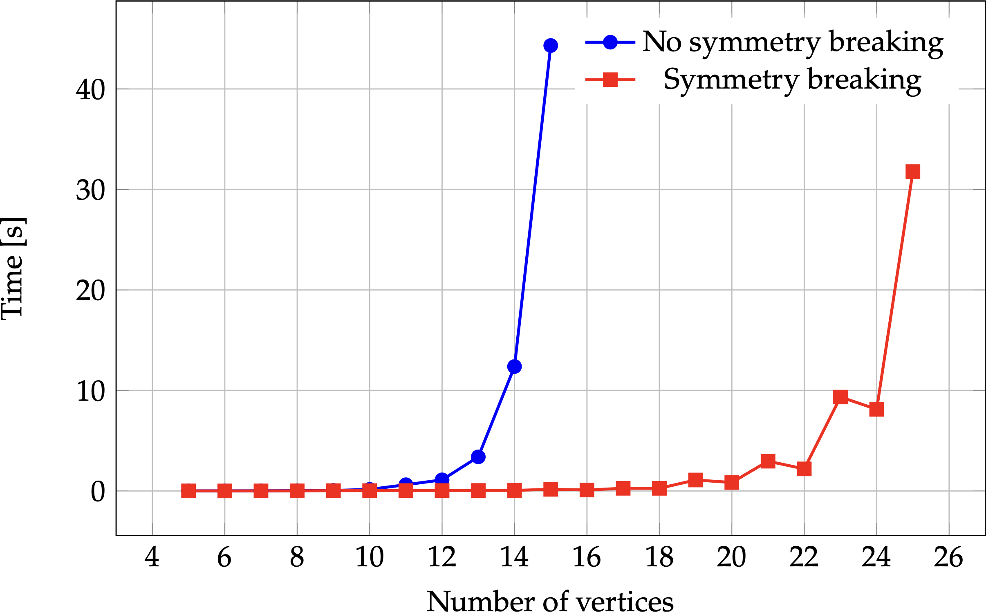
Mantel’s problem & Symmetry Breaking

Slide 41
Lagrange’s theorem
For every subgroup H of a finite group G, |H| divides |G|
We encode, given (n, k), the existence of a group of size n with a subgroup of size k.
E.g., (8, 1), (8, 2), (8, 4), and (8, 8) are SAT, the other (8, k) cases are UNSAT.

Slide 42
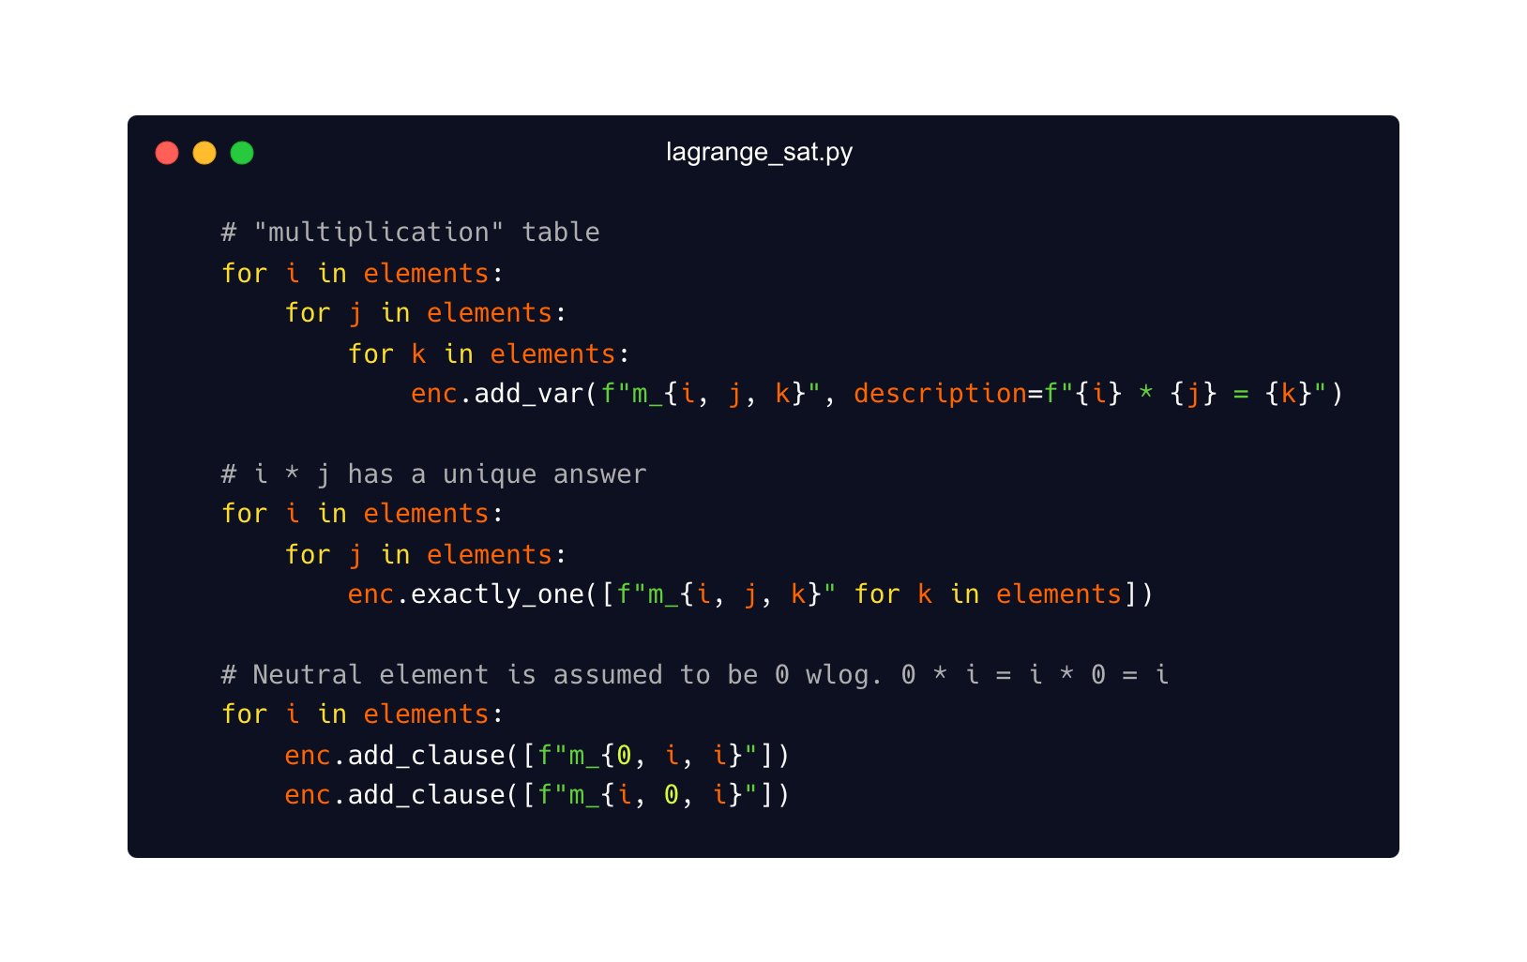
Lagrange’s theorem
For every subgroup H of a finite group G, |H| divides |G|

Slide 43
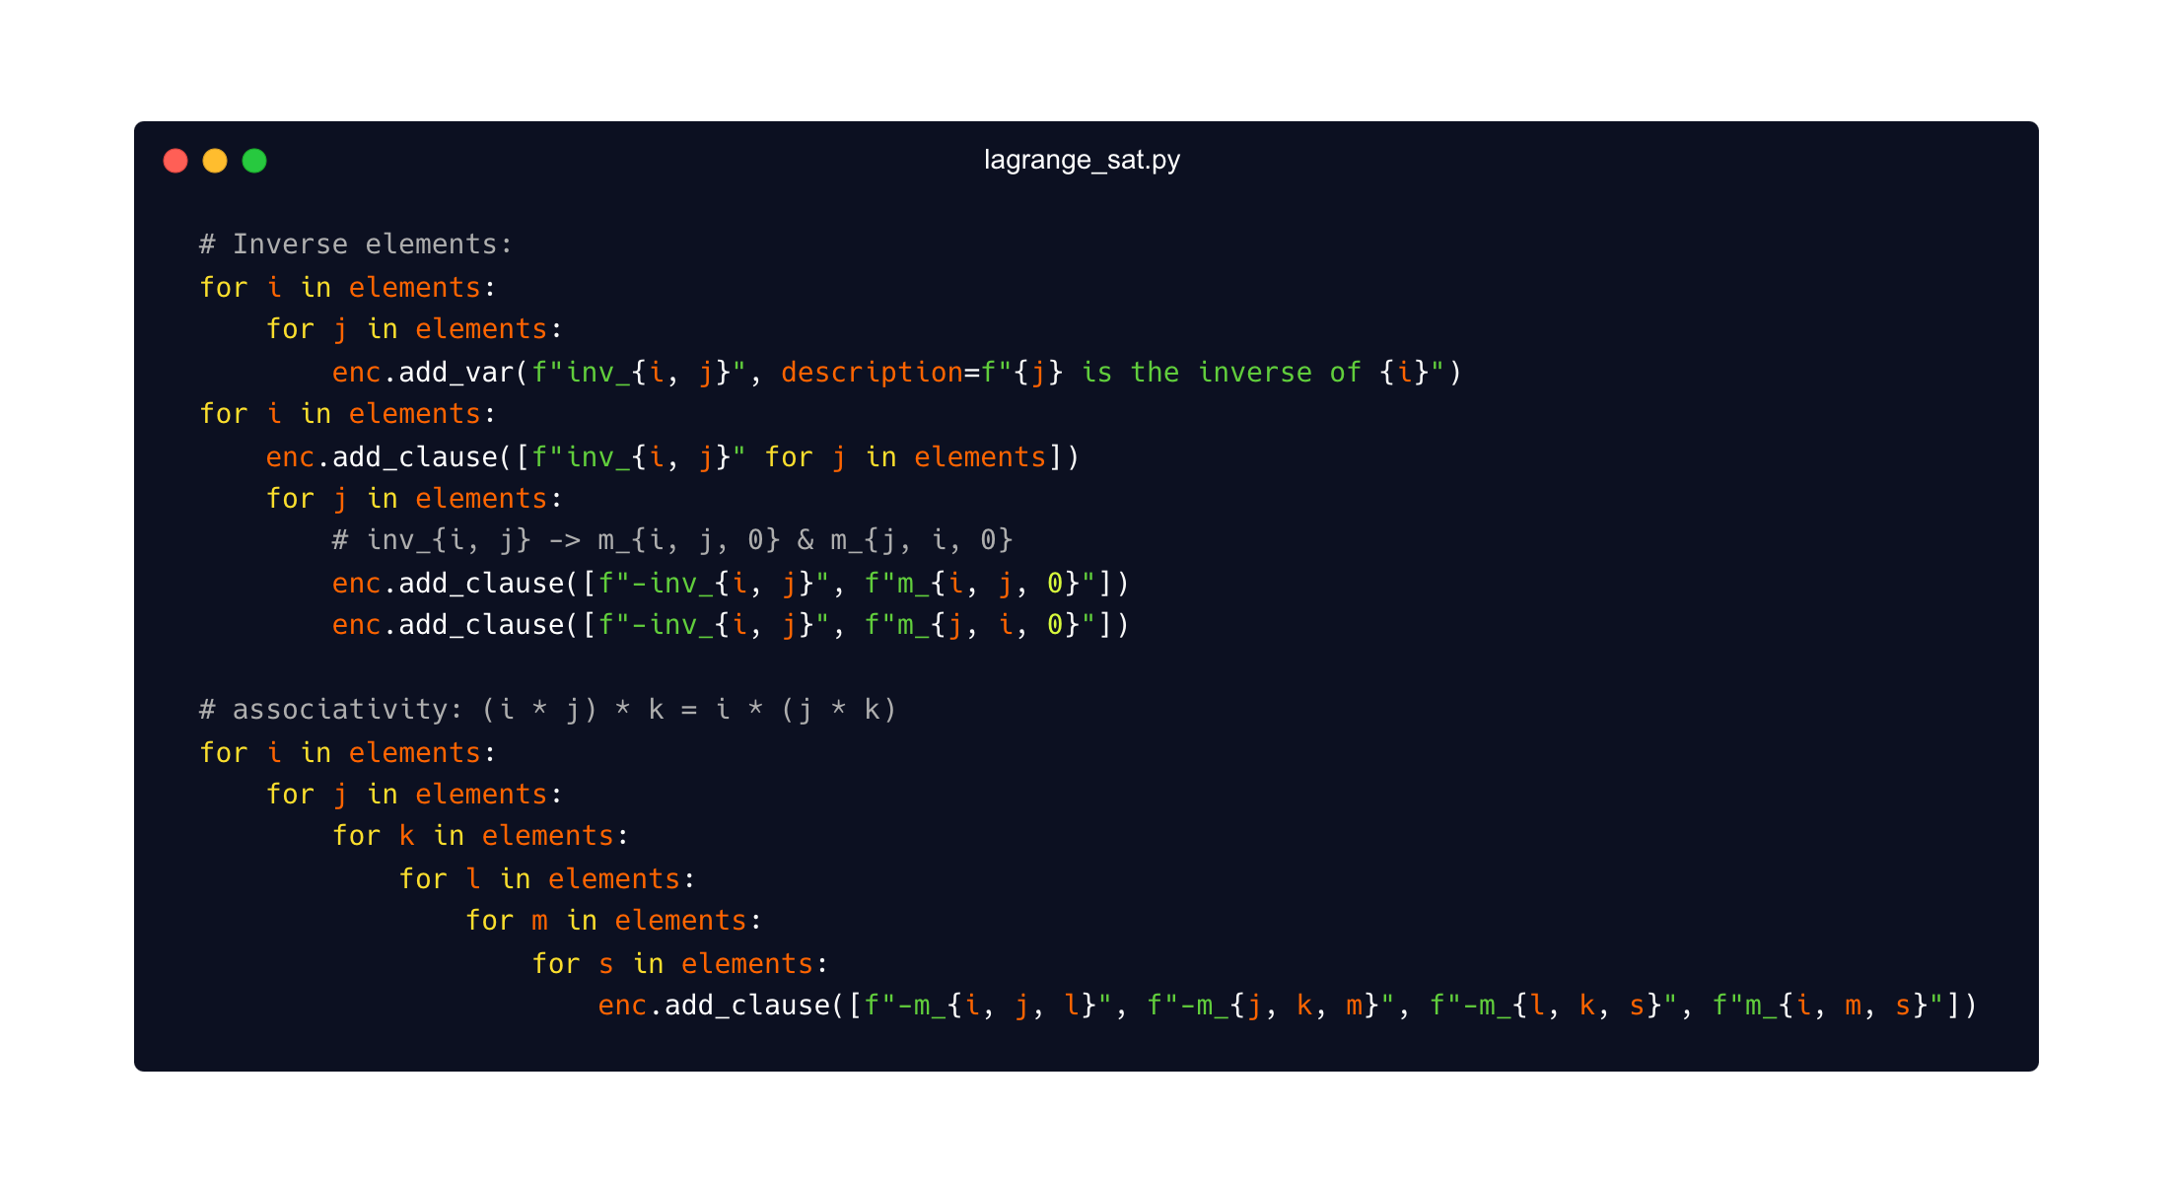
Lagrange’s theorem
For every subgroup H of a finite group G, |H| divides |G|

Slide 44
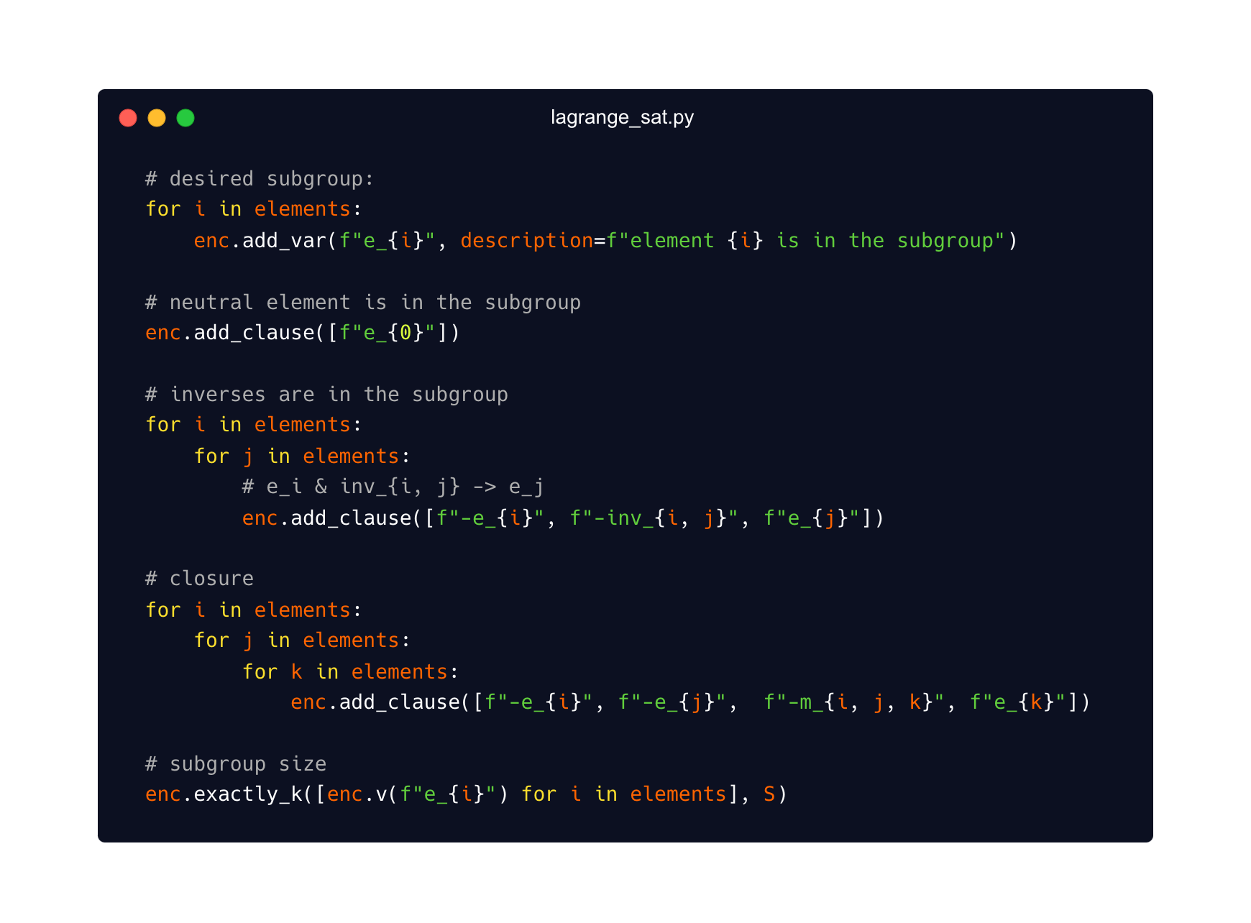
Lagrange’s theorem
For every subgroup H of a finite group G, |H| divides |G|

Slide 45
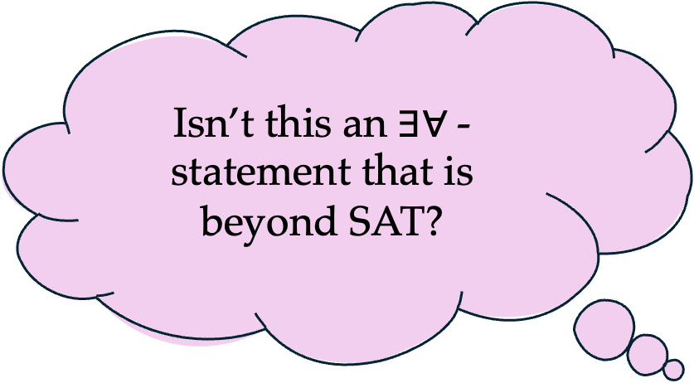
Lagrange’s theorem
Isn’t this an $∃∀$- statement that is beyond SAT?
For every subgroup H of a finite group G, |H| divides |G|
What about the “converse”?
Is there a group G on n elements, and some divisor d of n such that G has no subgroup of size d?
Yes! A group on 12 elements without subgroups of size 6

Slide 46
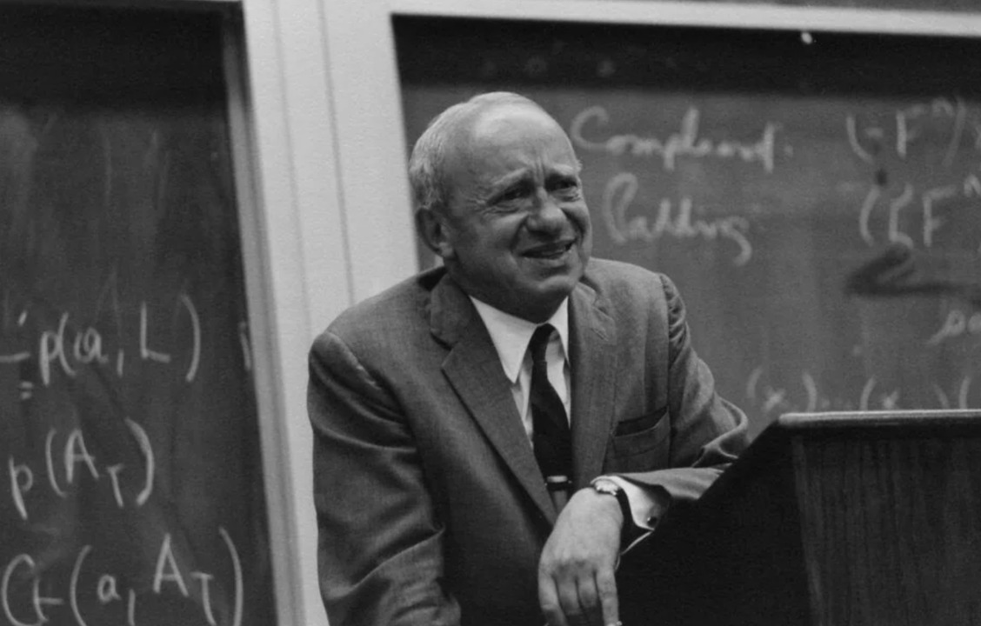
"However, the machine would permit us to test the hypothesis for any special value of n. We could carry out such tests for a sequence of consecutive values n=2,3,.. up to, say, n=100. If the result of at least one test were negative, the hypothesis would prove to be false;
Alfred Tarski (1948)
Otherwise, our confidence in the hypothesis would increase, and we should feel encouraged to attempt establishing the hypothesis (by means of a normal mathematical proof), instead of trying to construct a counterexample."

Slide 47
Discrete Geometry
How many points, without 3 on a line, guarantee a convex quadrilateral?
Answer: 5, Klein, “Happy Ending Theorem”
Notes:
Hopefully 40 minutes mark.

Slide 48

Discrete Geometry
How many points, without 3 on a line, guarantee a convex quadrilateral?
Answer: 5, Klein, “Happy Ending Theorem”
Case A: 5 points in convex hull
Case B: 4 points in convex hull
Case C: 3points in convex hull

Slide 49
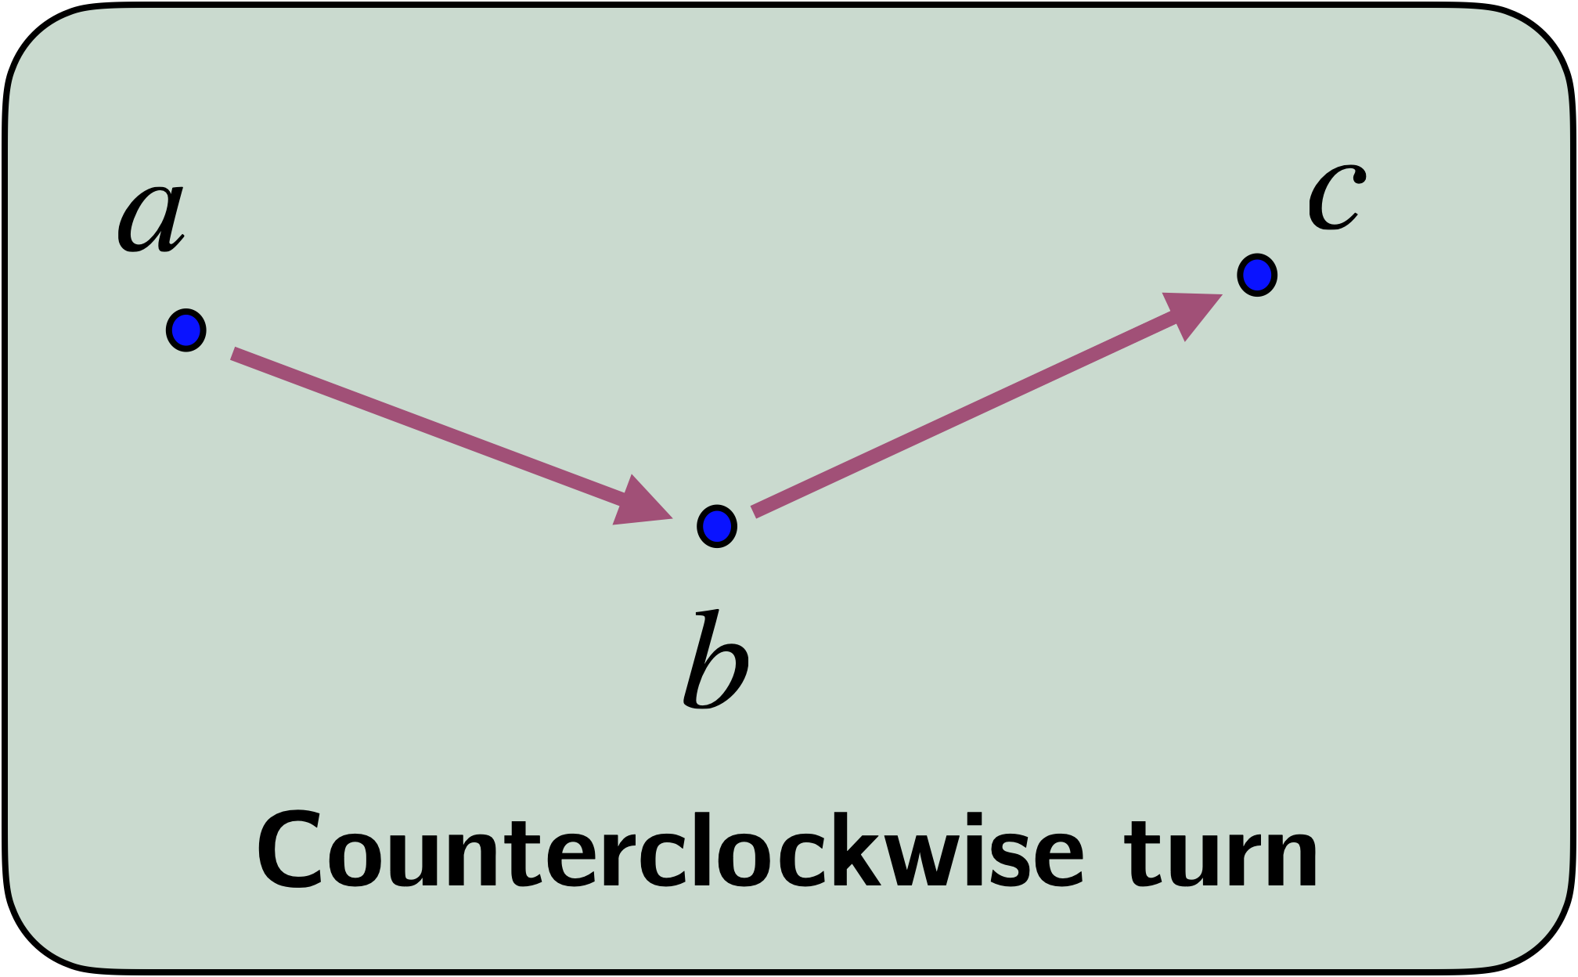
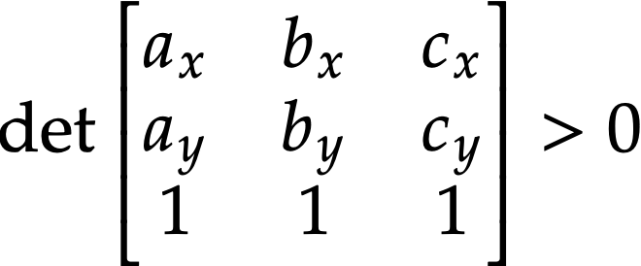
Discrete Geometry
We can define variables s_{(a, b, c)} that represent whether a,b,c is a CC-turn

Slide 50
Discrete Geometry
A polygon is convex if and only if the turns in “cyclic order”
are either all clockwise or all counterclockwise

Slide 51
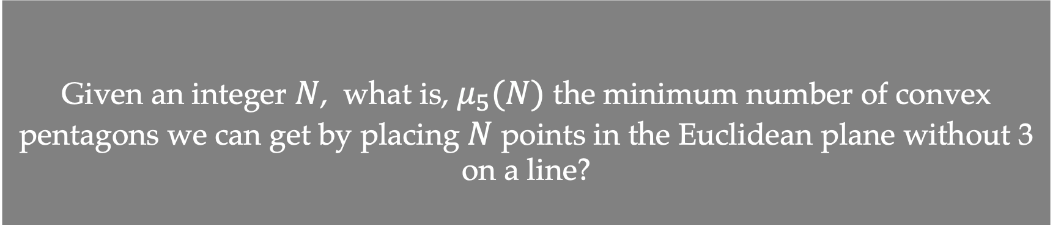
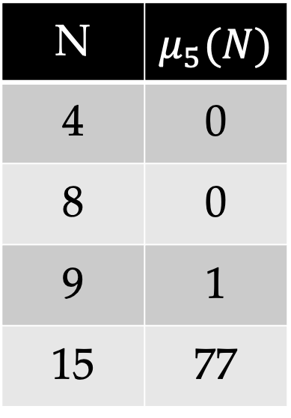
Problem: Minimizing Convex Pentagons
Given an integer $N$, what is, $μ_{5}(N)$ the minimum number of convex pentagons we can get by placing $N$ points in the Euclidean plane without 3 on a line?
N | $$μ_{5}(N)$$
4 | 0
8 | 0
9 | 1
15 | 77
N = 4
N = 8
Answer = 0
Answer = 0

Slide 52
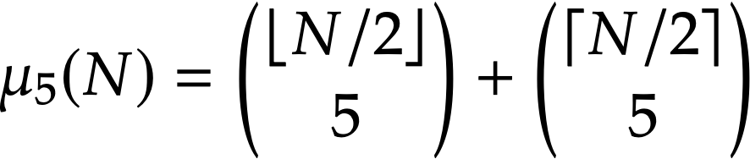
Minimum number of convex pentagons among N points?
N | Best | Time
9 | 1 | 0.00 s
10 | 2 | 0.00 s
11 | 7 | 0.00 s
12 | 12 | 0.00 s
13 | 27 | 0.01 s
14 | 42 | 0.01 s
15 | 77 | 0.01 s
16 | 112 | 0.02 s
N | Best | Time
23 | 1254 | 12 s
24 | 1584 | 472 s
25 | 2079 | 64 s
26 | 2574 | 5269 s
27 | 3289 | 1556 s
28 | 4004 | 1792 s
29 | 5005 | 467 s
30 | 6007 | 18244 s
…
…

Slide 53
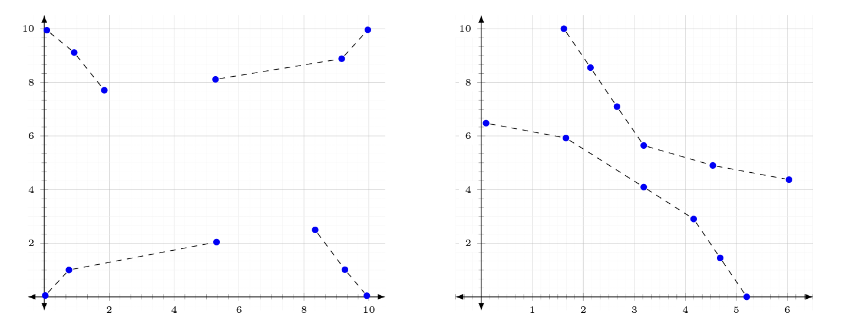
Realizability ($∃ℝ$-complete)
How to minimize # of convex pentagons among N points in general position?

Slide 54
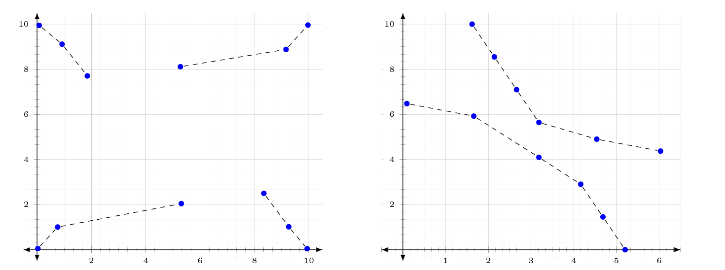
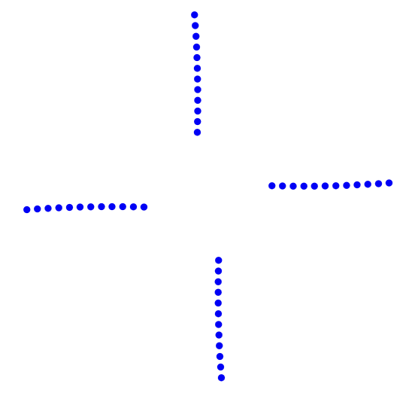
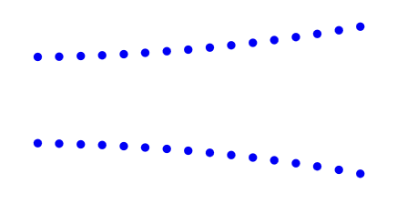
Generalize them as constructions!
Pinwheel
Parabolic

Slide 55
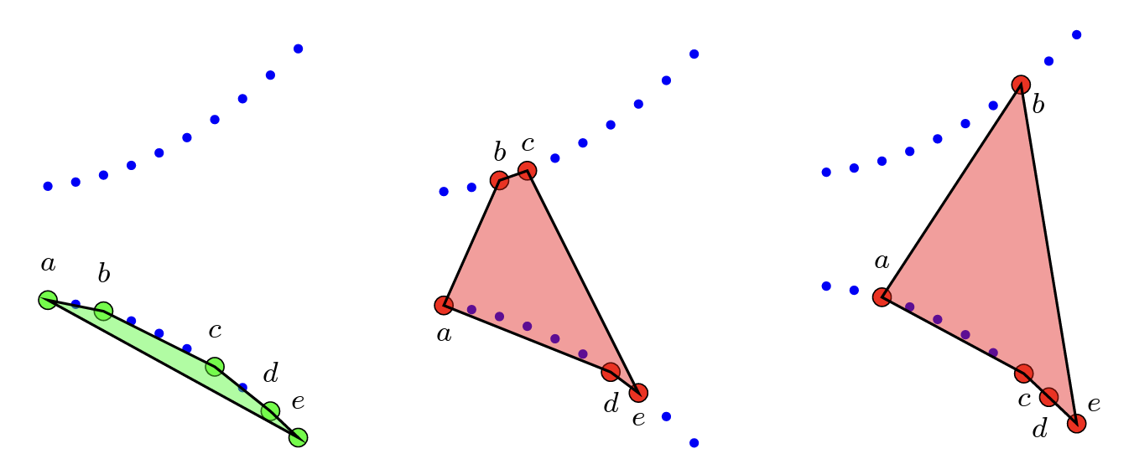
Parabolic Construction

Slide 56

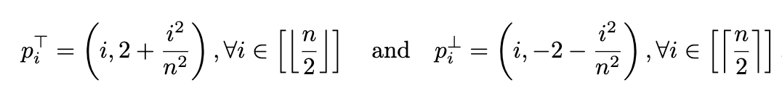
We need to be careful though!

Slide 57
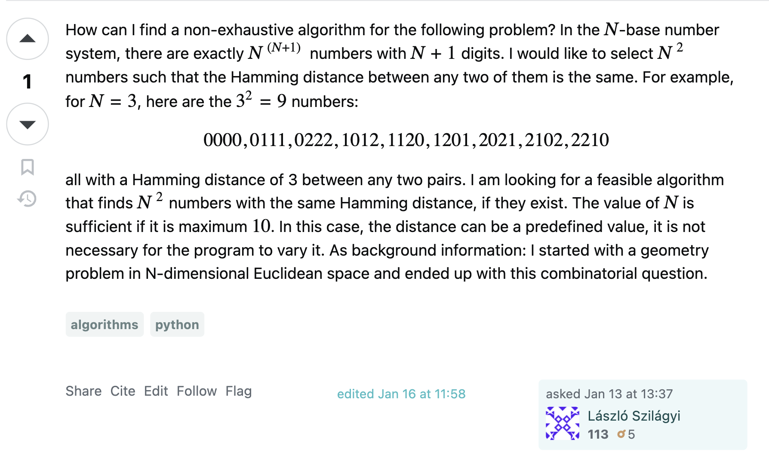
Distance Digits problem
Can we have N² many words over alphabet {0, …., N-1}, with length N+1,
that are all at same Hamming distance from each other?

Slide 58
Distance Digits problem
Can we have N² many words over alphabet {0, …., N-1}, with length N+1,
that are all at same Hamming distance from each other?
Encoded into SAT and found solutions for N = 4 and N = 5 right away.
Not able to find a solution for N = 6…
I started looking at solutions for N = 5 and see if I could enforce more patterns: e.g., that one string is just 00000.

Slide 59
Distance Digits problem
Can we have N² many words over alphabet {0, …., N-1}, with length N+1,
that are all at same Hamming distance from each other?
I started looking at solutions for N = 5 and see if I could enforce more patterns: e.g., that one string is just 000000.
000000
011111
022222
033333
044444
112340
123401
134012
140123
101234
224130
230241
241302
202413
213024
331420
342031
303142
314203
320314
443210
404321
410432
421043
432104

Slide 60
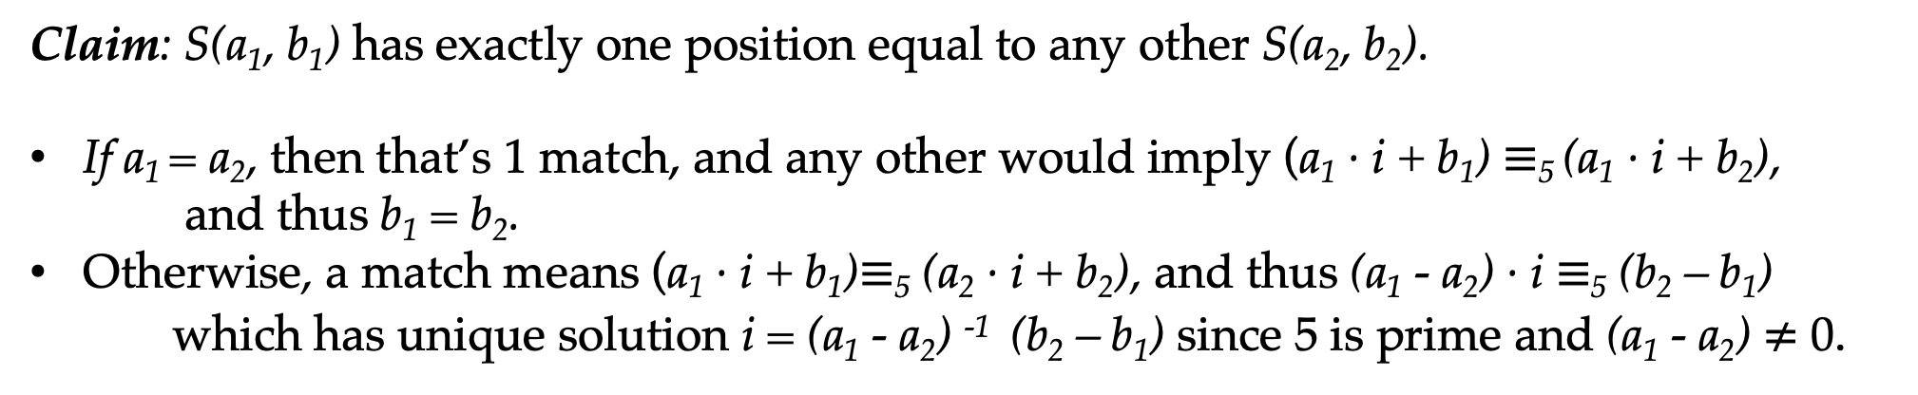
Distance Digits problem
000000
011111
022222
033333
044444
112340
123401
134012
140123
101234
224130
230241
241302
202413
213024
331420
342031
303142
314203
320314
443210
404321
410432
421043
432104
Let S(a, b) be string number b from block a (both indexed from 0).
Then S(a, b)[0] = a, and for i > 0, S(a, b)[i] = (a · i + b) mod 5
Claim: S(a₁, b₁) has exactly one position equal to any other S(a₂, b₂).
If a₁ = a₂, then that’s 1 match, and any other would imply (a₁ · i + b₁) $≡$₅ (a₁ · i + b₂),
and thus b₁ = b₂.
Otherwise, a match means (a₁ · i + b₁)$≡$₅ (a₂ · i + b₂), and thus (a₁ - a₂) · i $≡$₅ (b₂ – b₁)
which has unique solution i = (a₁ - a₂) ⁻¹ (b₂ – b₁) since 5 is prime and (a₁ - a₂) $≠$ 0.

Slide 61
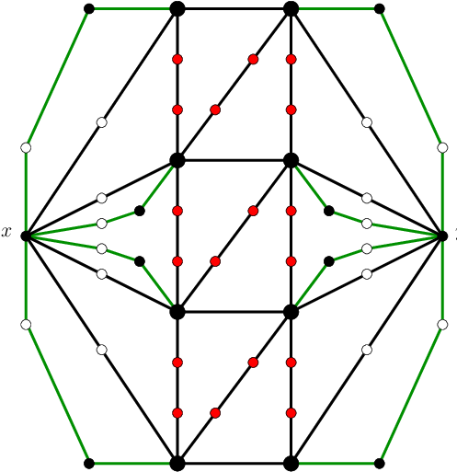
NP-hardness Gadgets
Vertex partitions of (C₃,C₄, C₆)-free planar graphs (Dross and Ochem 2017)

Slide 62

NP-hardness Gadgets
Collision Detection for Modular Robots -- it is easy to cause collisions and hard to avoid them
(Gupta, Kreveld, Michail, Padalkin 2013)

Slide 63

NP-hardness Gadgets

Slide 64
Feedback Vertex Set (NP-hard)
Remove minimum number of vertices so that the resulting graph has no directed cycles

Slide 65
Feedback Vertex Set (NP-hard)

Slide 66

Feedback Vertex Set (NP-hard)

Slide 67
Vertex Cover reduces to FVS

Slide 68
I needed to prove that FVS is NP-hard
On 3-out-regular graphs without C₂
Note: Vertex-cover is NP-hard on 3-regular graphs
Can we attach to the green vertex a 3-out-regular C₂-free graph (except that green vertex has outdegree 2)?

Slide 69

I needed to prove that FVS is NP-hard
On 3-out-regular graphs without C₂

Slide 70
The solutions I was getting were orientations of the complete graph…
General construction for k-out-regular C₂ –free:
Take complete graph on 2k+1 vertices.
As every vertex has degree 2k, there exists an Eulerian circuit w (visits each edge exactly once).
Now orient each edge according to the direction in which w takes it.

Slide 71
4-Packing Colorings
Color the vertices of a graph with {1, 2, 3, 4} so every pair of vertices receiving color i are at distance at least i+1
1
2
1
3
1
2
1
3
1
2
1
3
1
2
1
4
3
1
4
1
2
1
3
1

Slide 72

4-Packing Colorings
Color the vertices of a graph with {1, 2, 3, 4} so every pair of vertices receiving color i are at distance at least i+1
Reduction from Not-All-Equal-3SAT
A general issue with gadgets like these is creating “consistency” gadgets that guarantee that all occurrences of a variable get the same color

Slide 73

4-Packing Colorings
Color the vertices of a graph with {1, 2, 3, 4} so every pair of vertices receiving color i are at distance at least i+1
SAT-constructed Gadget
Reduction from Not-All-Equal-3SAT

Slide 74

How can we trust SAT solvers?
When the solver outputs a positive solution, we can just check in linear time that all constraints are satisfied
But what if there’s no solution?
Then the solvers can emit a proof in a standardized format (e.g., DRAT)
Each step of the proof is basically a transformation of the formula:
  $F→F_{1}→F_{2}…→\{\}$ (the empty clause)
There are verified checkers for these proof formats
A few math results using SAT have been proved in Lean!

Slide 75

Recent Formalization Experience

Slide 76
Lam’s problem:
  “is there a projective plane of order 10”?
Proven NO by custom computer programs in 1989
These custom algorithms are very hard to verify!
SAT refutation in 2020 with public certificates.
Not verified in Lean yet, but much easier than custom code

Slide 77






Conclusion: A mathematician’s toolbox
SAT Solvers?

Slide 78
Computer-Assisted Intuition:
SAT Solvers in Mathematical Discovery
Bernardo Subercaseaux
Carnegie Mellon University

